Slide 1
FIVETHON - WEBINAR ON PYTHON
DAY 3
Tuples, Dictionaries, Sorting

Slide 2
Tuples, Dictionaries, Sorting
Topics to be covered:
TUPLES:
Creating tuples
Accessing tuples
Tuple operations
Functions and mEthods in tuples
Nested tuples
DICTIONARIES:
What is a dictionary?
Accessing elements from a dictionary
Adding elements in a dictionary
Removing elements from a dictionary
SORTING:
Introduction
What is sorting?
Methods of sorting- insertion sort, bubble sort...

Slide 3
TUPLES
Sequences that are used to store values of different data types.
Eg.
>>> a = (1, ‘a’, 7, 6.5) # a is the tuple of mixed data type
>>> b = (2, 4, 6, 8, 10) # b is a tuple of only integers
>>> c = (“English”, “Hindi”, “Math”, “Science”) # c is a tuple of only string
>>> d = (2, 4, 7, [4, 5, 6]) # d is a tuple with list as an element

Slide 4
CREATING TUPLES
Tuples are written with round brackets.
Eg:
thistuple = ("apple", "banana", "cherry")
print(thistuple)
emptytuple=tuple()
Single element:
t=(1,)
t=1,
nestedtuple=(1,2,(3,4),3)

Slide 5
CREATING TUPLES
t=tuple(eval(input("Enter the tuple:")))
print(t)
Output:
Enter the tuple:1, 2, 3
(1, 2, 3)

Slide 6
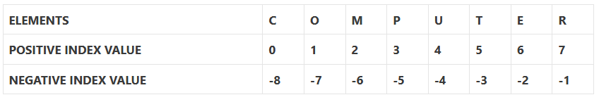
ACCESSING TUPLES
Elements of a tuple can be accessed in the same way as a list or string using indexing and slicing. for example
>>> a = (‘C’ , ‘ O’ , ‘M’ , ‘P’ , ‘U’ , ‘T’ , ‘E’ , ‘R’)
>>> a[9] # Output is IndexError: tuple index out of range
>>> a[4] # Output is U (fifth element of tuple)

Slide 7
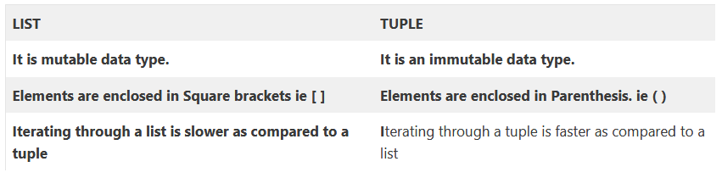
ACCESSING TUPLES
Tuple is an immutable data type. It means that the elements of a tuple cannot be changed after it has been
created. for example :
>>> a = (‘C’ , ‘ O’ , ‘M’ , ‘P’ , ‘U’ , ‘T’ , ‘E’ , ‘R’)
>>> a[2] = ‘S’
TypeError: ‘tuple’ object does not support item assignment.

Slide 8
TUPLE OPERATIONS
Concatenation (+)
Joining of two or more tuples is called Concatenation
Python allows us to join tuples using concatenation operator (+).
>>>t1 = (1, 2, 3)
>>>t2 = (8, 9, 11)
>>>t1+t2
OUTPUT :
(1, 2, 3, 8, 9, 11)
(#concatenates two tuples)
>>>t1 = (1, 2, 3)
>>>t2 = (8, 9, 11)
>>>t3 = t1+t2
(#Created new tuple)
OUTPUT :
(1, 2, 3, 8, 9, 11)
Concatenation operator can also be
used for extending an existing tuple.
>>>t1 = (1, 2, 3)
>>>t1 = t1 + (7,8,9)
>>>t1
OUTPUT :
(1, 2, 3, 7, 8, 9)

Slide 9
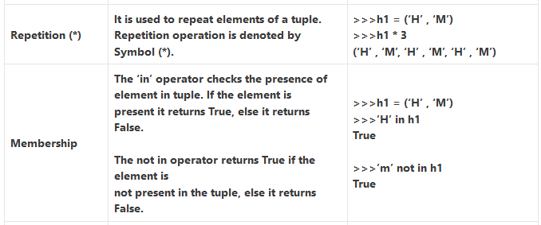
TUPLE OPERATIONS

Slide 10
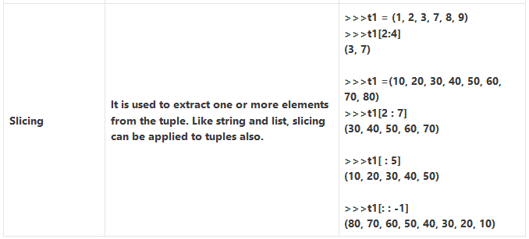
TUPLE OPERATIONS

Slide 11
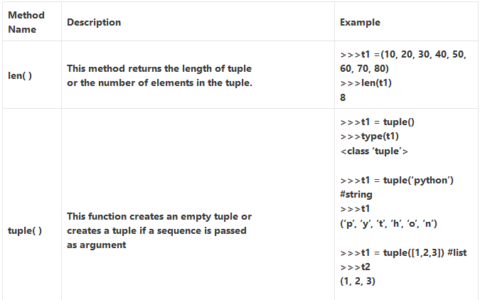
METHODS AND FUNCTIONS IN TUPLES

Slide 12
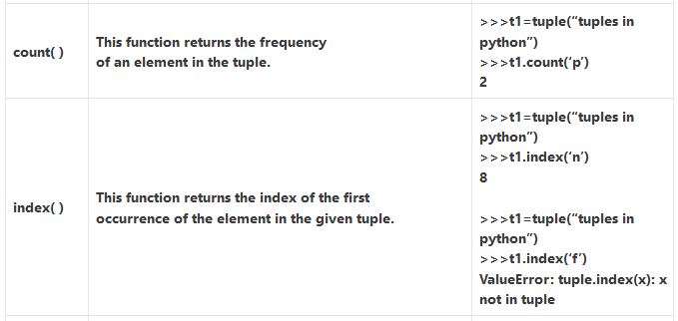
METHODS AND FUNCTIONS IN TUPLES

Slide 13
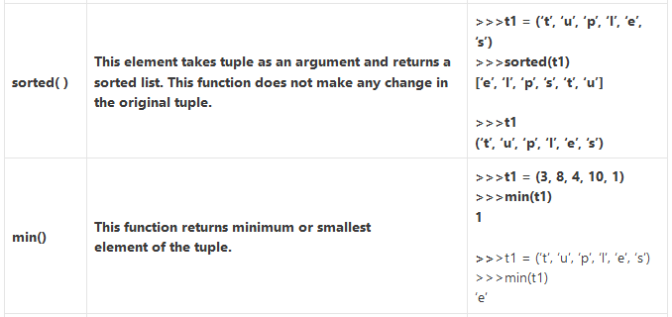
METHODS AND FUNCTIONS IN TUPLES

Slide 14
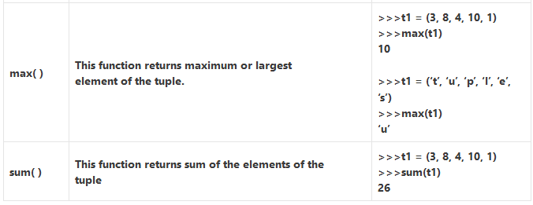
METHODS AND FUNCTIONS IN TUPLES

Slide 15
TUPLE ASSIGNMENT
It allows a tuple of variables on the left side of the assignment operator to be assigned respective values from a tuple on the right side. The number of variables on the left should be same as the number of elements in the tuple. for example
>>>(n1,n2) = (5,9)
>>>print(n1)
5
print(n2)
9
>>>(a,b,c,d) = (5,6,8) #values on left side and right side are not equal
ValueError: not enough values to unpack

Slide 16
NESTED TUPLE
A tuple inside another tuple is called a nested tuple. In nested tuples we can access the elements in the same way of nested list. for example
>>>t1 = ((“Amit”, 90), (“Sumit”, 75), (“Ravi”, 80))
>>>t1[0]
(‘Amit’, 90)
>>>t1[1]
(‘Sumit’, 75)
>>>t1[1][1]
75

Slide 17
DICTIONARIES
WHAT IS A DICTIONARY?
Python dictionary is a collection which is unordered, changeable and indexed.
Each item of a dictionary has a key:value pair and
are written within curly brackets separated by commas.
The values can repeat, but the keys must be unique and must be of immutable type(string, number or tuple).

Slide 18
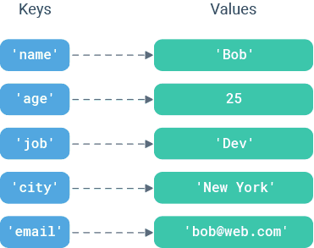
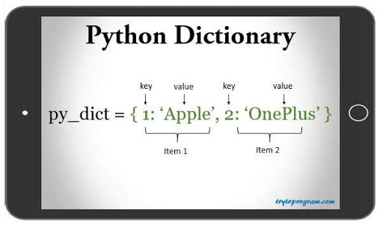
EXAMPLES:

Slide 19
ACCESSING ELEMENTS FROM A DICTIONARY:
You can access the elements of a dictionary by referring to its key name, inside square brackets.
my_dict = {‘name’: ‘Alexa’, ‘age’: 20, ‘place’: ‘Canada’}
print(my_dict[‘age’])
There is also a method called get() to access the elements.

Slide 20
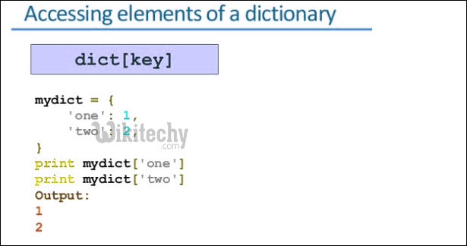
PROGRAM:

Slide 21
DICTIONARY LENGTH:
To determine how many elements (key-value pairs) a dictionary has, use the len() function.
my_dict = {‘name’: ‘Mariam’, ‘age’: 20, ‘place’: ‘London’}
print(len(my_dict))
which gives the output: 3

Slide 22
ADDING ELEMENTS TO A DICTIONARY:
Adding an element to the dictionary is done by using a new index key and assigning a value to it.
my_dict = {‘name’: ‘Mariam’, ‘age’: 20, ‘place’: ‘London’}
my_dict[‘phone’] = 688143
print(my_dict)
The output becomes:{‘age’: 20, ‘name’: ‘Mariam’, ‘phone’: 688143, ‘place’: ‘London’}

Slide 23
REMOVING ELEMENTS FROM A DICTIONARY:
There are various ways to remove elements from a dictionary:
(i) pop() — removes the element with the specified key name.
my_dict = {‘name’: ‘Mariam’, ‘age’: 20, ‘place’: ‘London’}
my_dict.pop(‘age’) //Removes the element with the key ‘age’
print(my_dict)
Output:{‘name’: ‘Mariam’, ‘place’: ‘London’}

Slide 24
(ii) del — removes the element with the specified key name.
my_dict = {‘name’: ‘Mariam’, ‘age’: 20, ‘place’: ‘London’}
del my_dict[‘age’]
print(my_dict)
Output:
{‘name’: ‘Mariam’, ‘place’: ‘London’}

Slide 25
(iii) clear() — empties the dictionary.
my_dict = {‘name’: ‘Mariam’, ‘age’: 20, ‘place’: ‘London’}
my_dict.clear()
print(my_dict)
This will produce an empty dictionary:{}

Slide 26
SORTING
WHAT IS SORTING?
The sort() method sorts the elements of a given list in a specific ascending or descending order.
The syntax of the sort() method is: list. sort(key=..., reverse=...)

Slide 27
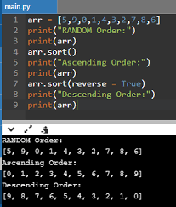
EXAMPLE

Slide 28
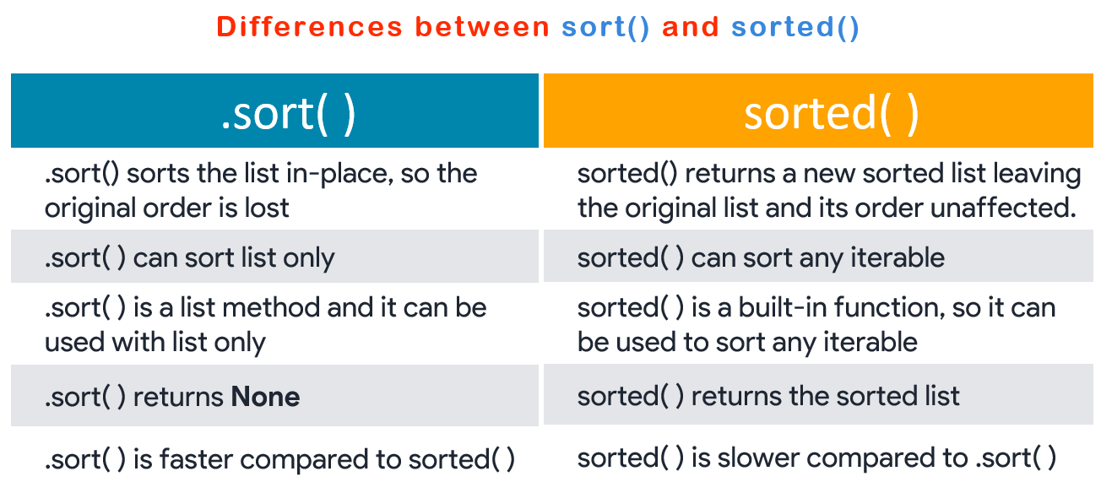
DIFFERENCES BETWEEN sort() AND sorted()

Slide 29
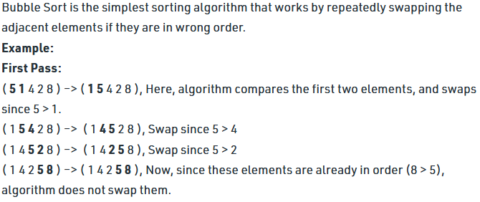
BUBBLE SORT

Slide 30
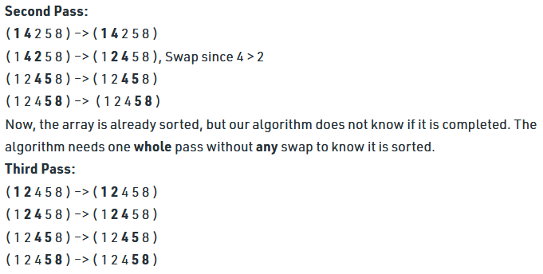

BUBBLE SORT
Largest no bubbles up

Slide 31
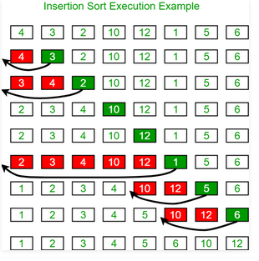
INSERTION SORT
Insertion sort is a simple sorting algorithm that works similar to the way you sort playing cards in your hands. The array is virtually split into a sorted and an unsorted part. Values from the unsorted part are picked and placed at the correct position in the sorted part.

Slide 32
THANK YOU

