Slide 1
FIVETHON - WEBINAR ON PYTHON
DAY 5
Data structures

Slide 2
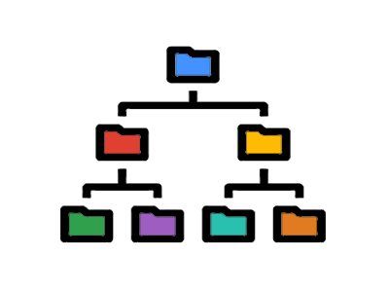
DATA STRUCTURES
A Data Structure is a named group of data of different data types which is stored in a specific way and can be processed as a single unit.
A data structure has well-defined operations, behaviour and properties.

Slide 3
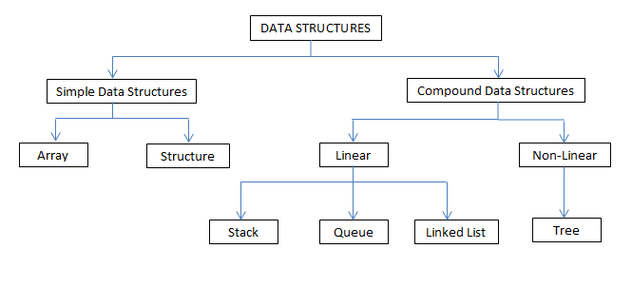
TYPES OF DATA STRUCTURES

Slide 4
TYPES OF DATA STRUCTURES
Simple Data Structures
These are normally built from primitive data types like integer, string,
reals, Boolean. These data can be called as Arrays or linear list.
Compound Data Structures
▶ Simple data structures can be combined in various ways to form more complex structures called compound data structures.
▶ Compound data structures are classified into following two types:
➥ Linear data structure
➥ Non Linear data structure

Slide 5
TYPES OF DATA STRUCTURES
Linear Data Structure
These data structures are single level data structures. A data structure is said to be linear if its elements form a sequence. Following are the examples of linear data structures:
➥ Stack
➥ Queue
➥ Linked List
Non-linear Data Structures
These are multilevel data structures. Example of non-linear data structure is Tree.

Slide 6
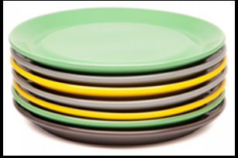
STACKS
Stacks data structures refer to the lists stored and accessed in a special way, where LIFO (Last In First Out) technique is allowed.
In Stacks, insertions and deletions take place only at one end, called the top.
EXAMPLE OF STACKS
Here, you can:
▪ Put a new plate on top
▪ Remove the top plate
▪ And, if you want the plate at the bottom, you must first remove all the plates on top. This is exactly how the stack data structure works

Slide 7
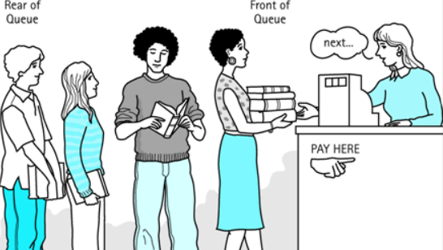
QUEUES
Queues data structures are FIFO (First In First Out) lists, where insertions take place at the "rear" end of the queues and deletions take place at the "front" end of the queues.
EXAMPLE OF QUEUES
First person will be the first to pay and
a new person can join the queue, at the
rear end of it.

Slide 8
LINKED LIST
Linked lists are special lists of some data elements linked to one another.
The logical ordering is represented by having each element pointing to the next element.
Each element is called a node, which has two parts.
The INFO part which stores the information and the reference-pointer part, which points to i.e., stores the reference of the next element.
Types of Linked List:
★ Singly Linked List
★ Doubly Linked List

Slide 9
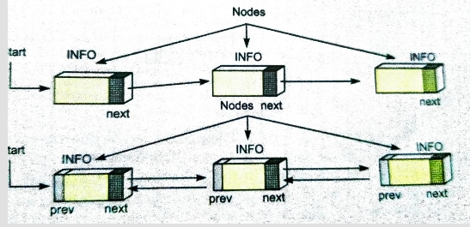
SINGLY & DOUBLY LINKED LIST
In singly linked lists, nodes have one reference pointer (next) pointing to the next node.
In double linked lists, nodes have two reference pointers (prev and next). Prev points to the previous node and next points to the next node in the list.

Slide 10
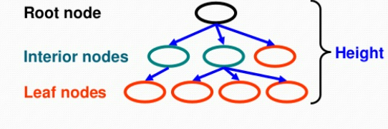
TREES
Trees are multilevel data structures having a hierarchical relationship among its elements called nodes.
Topmost node is called the root of the tree and bottommost nodes are called leaves of the tree. Each of the nodes has some reference-pointers, pointing to (i.e., storing the reference of) the nodes below it.

Slide 11
OPERATIONS ON DATA STRUCTURE
The basic operations that are performed on data structures are as follows!
Insertion means addition of a new data element in a data structure.
Deletion means removal of a data element from a data structure. The data element is searched for before its removal.
Searching involves searching for the specified data element in a data structure.
Traversal of a data structure means processing all the data elements of it, one by one.
Arranging data elements of a data structure in a specified order is called Sorting.
Combining elements of two similar data structures to form a new data structure of same type, is called Merging.

Slide 12
LINEAR SEARCH
Linear search is a very simple search algorithm.
In this type of search, a sequential search is made over all items one by one. Every item is checked and if a match is found then that particular item is returned, otherwise the search continues till the end of the data collection.

Slide 13
LINEAR SEARCH - ALGORITHM
Step 1: Start.
Step 2: Read n elements into the list.
Step 3: Read the search element from the user.
Step 4: Compare the search element with the first element in the list.
Step 5: If both are equal, then display position of the element and go to step 9.
Step 6: If both are not equal, then compare the search element with the next element in the list.
Step 7: Repeat steps 5 and 6 until the search element is compared with the last element in the list.
Step 8: If the last element in the list doesn’t match, display "Element not found" and go to step 9.
Step 9: Stop.

Slide 14
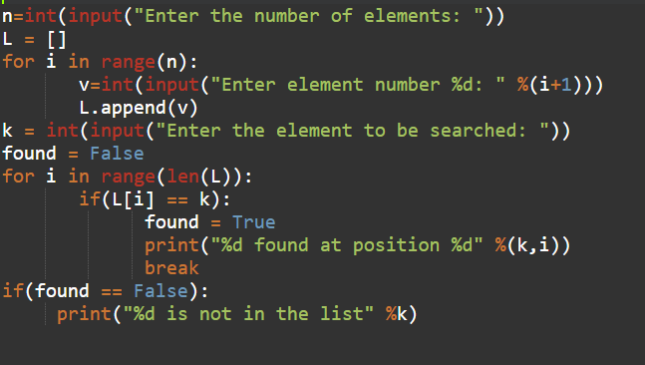
LINEAR SEARCH-CODE

Slide 15
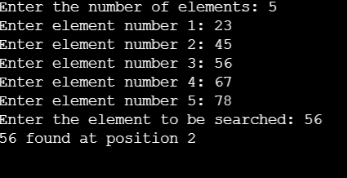
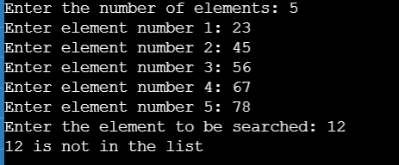
OUTPUT
If element is present
If element is not present

Slide 16
BINARY SEARCH
Binary search looks for a particular item by comparing the middle most item of the collection. If a match occurs, then the index of item is returned.
If the middle item is greater than the item, then the item is searched in the sub-array to the left of the middle item.
Otherwise, the item is searched for in the sub-array to the right of the middle item. This process continues on the sub-array as well until the size of the subarray reduces to zero.

Slide 17
BINARY SEARCH-ALGORITHM
Step 1: Start.
Step 2: Read the search element from the user.
Step 3: Find the middle element in the sorted list.
Step 4: Compare the search element with the middle element.
Step 5: If both are equal, then return the position of the element and go to step 11.
Step 6: If both are not equal, then check whether the search element is smaller or larger than the middle element.
Step 7: If the search element is smaller than the middle element, then repeat steps 3, 4, 5 and 6 for the left sub-list of the middle element.
Step 8: If the search element is larger than the middle element, then repeat steps 3, 4, 5 and 6 for the right sub-list of the middle element.
Step 9: Repeat the same process until we find the search element in the list or until the sub-list contains only one element.
Step 10: If the search element is not found in the list, then display "Element not found".
Step 11: Stop.

Slide 18
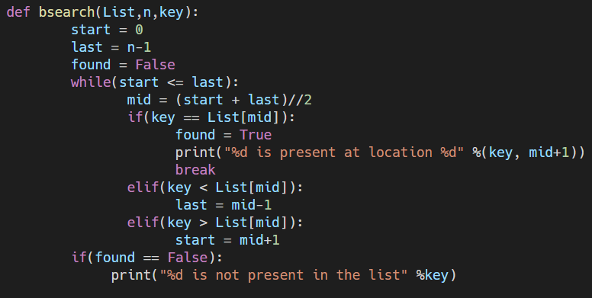
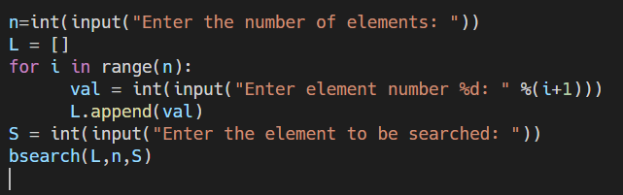
BINARY SEARCH-CODE

Slide 19
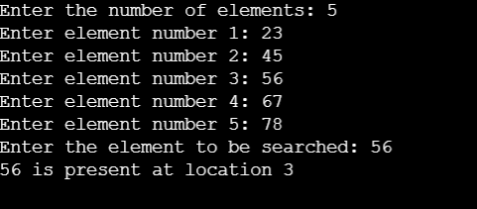
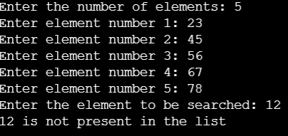
OUTPUT
If element is present
If element not present

Slide 20
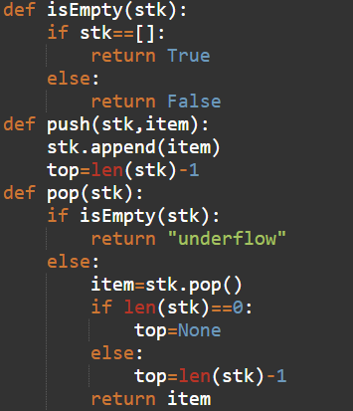
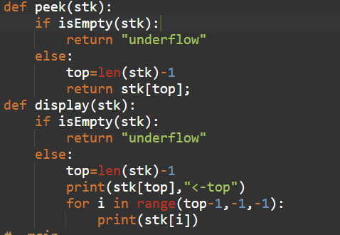
STACKS CODE

Slide 21
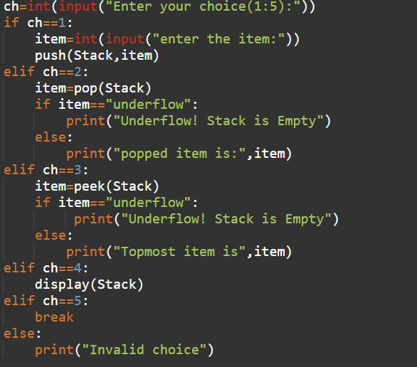
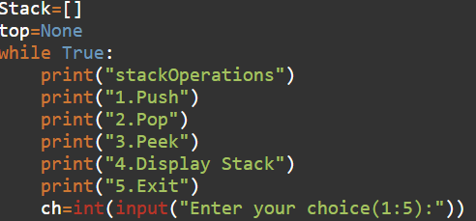
STACKS CODE

Slide 22
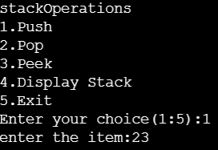
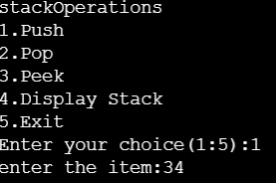

OUTPUT
Push operations

Slide 23
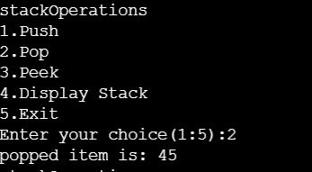
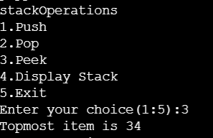
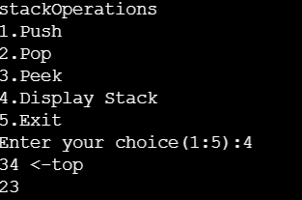
OUTPUT
Pop, peak and display operations

Slide 24
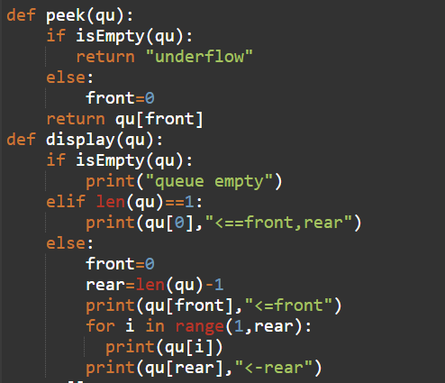
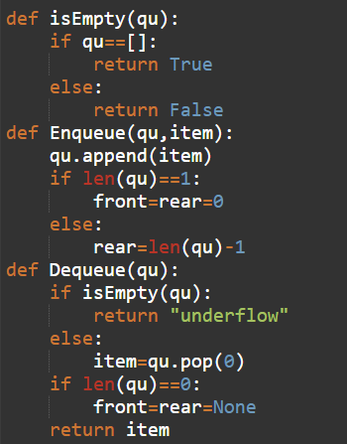
QUEUES CODE

Slide 25
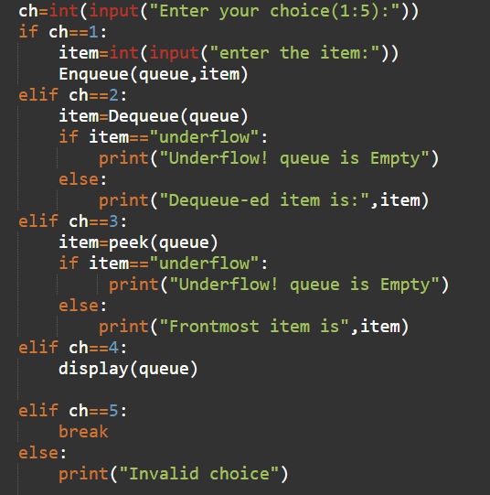
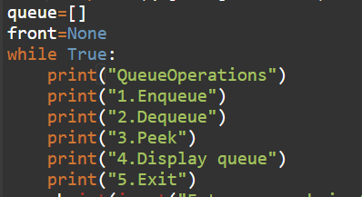
QUEUES CODE

Slide 26
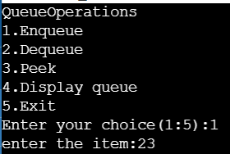
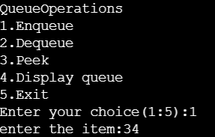
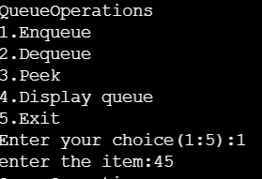
OUTPUT
Enqueue Operations

Slide 27
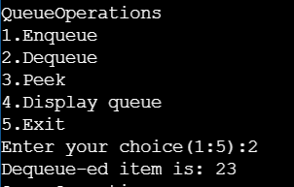
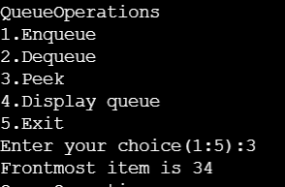
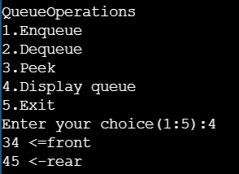
OUTPUT
Dequeue , Peek and Display Operations

Slide 28
INFIX,PREFIX,POSTFIX
1. Infix Notation:
Operators are written between the operands they operate on.
Eg. 3 + 4 .
2. Prefix Notation:
Operators are written before the operands
Eg. + 3 4
3. Postfix Notation:
Operators are written after operands.
Eg. 3 4 +

Slide 29
STEPS TO FOLLOWED TO CONVERT INFIX TO POSTFIX
We start by going through the characters of the infix expression one by one.
If we come across an operand we simply copy it to the Postfix output string.
If we come across any opening parenthesis we push it on the stack.
If we come across any closing parenthesis we pop the stack till we find the corresponding opening parenthesis.
If we come across an operator then we have 2 cases based on the precedence of the operators
If the current operator has higher precedence than the stack top then we push the current operator on the stack.
If the current operator has precedence less than or equal to the stack top then we pop the operator at the top and put it to the output string and then check the above condition again with the new stack top.

Slide 30
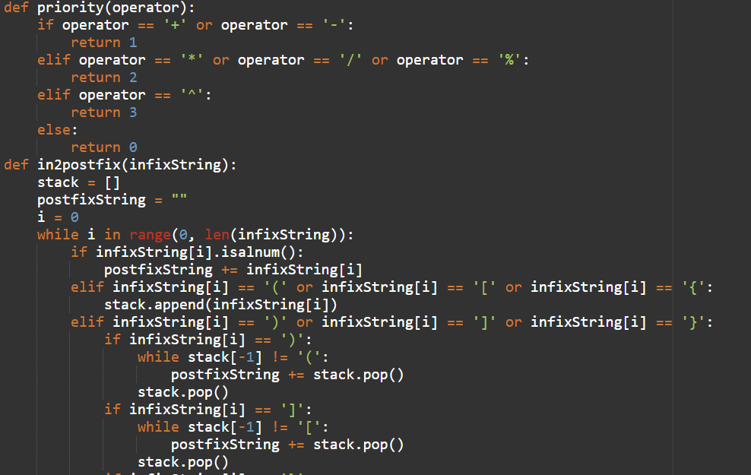
INFIX TO POSTFIX CODE

Slide 31
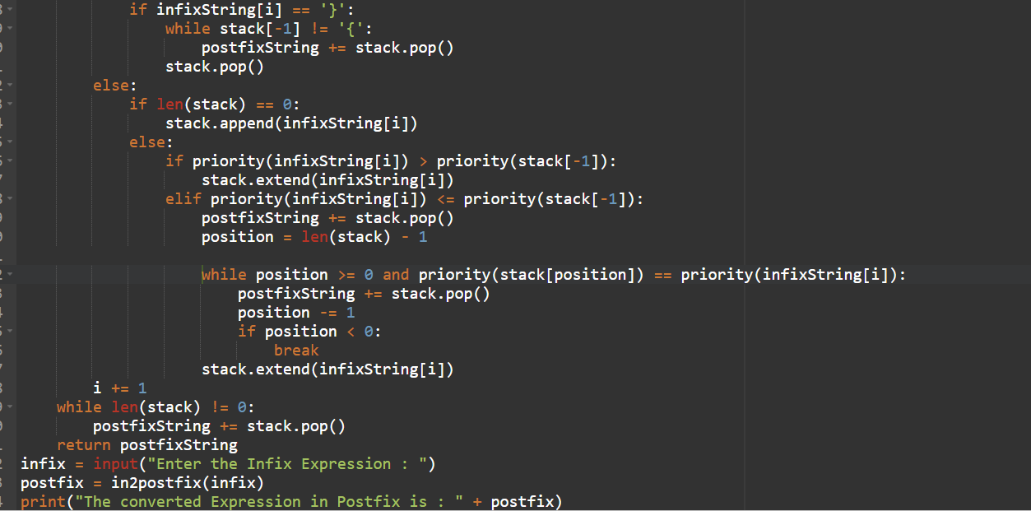

Slide 32
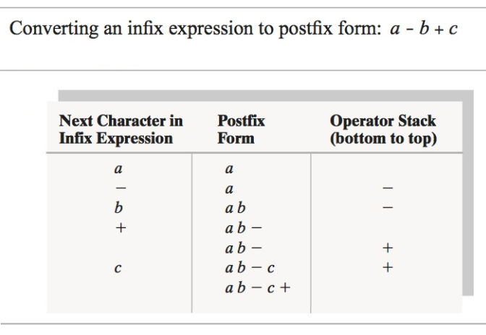
OUTPUT AND EXAMPLE
Enter the Infix Expression : a-b+c
The converted Expression in Postfix is : ab-c+

Slide 33
STEPS TO FOLLOWED TO CONVERT INFIX TO PREFIX
We first reverse the input infix expression.
We then start by going through the characters of the infix expression one by one.
If we come across an operand we simply copy it to the Prefix output string.
If we come across any closing parenthesis we push it on the stack.
If we come across any opening parenthesis we pop the stack till we find the corresponding closing parenthesis.
If we come across an operator then we have 2 cases based on the precedence of the operators
If the current operator has precedence higher than or equal to the stack top then we push the current operator on the stack.
If the current operator has precedence less than the stack top then we pop the operator at the top and put it to the output string and then check the above condition again with the new stack top.
Finally, we reverse the prefix output string.

Slide 34
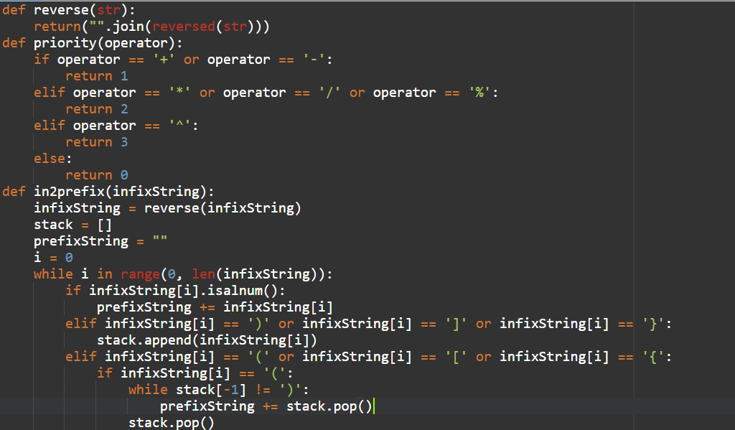
INFIX TO PREFIX CODE

Slide 35
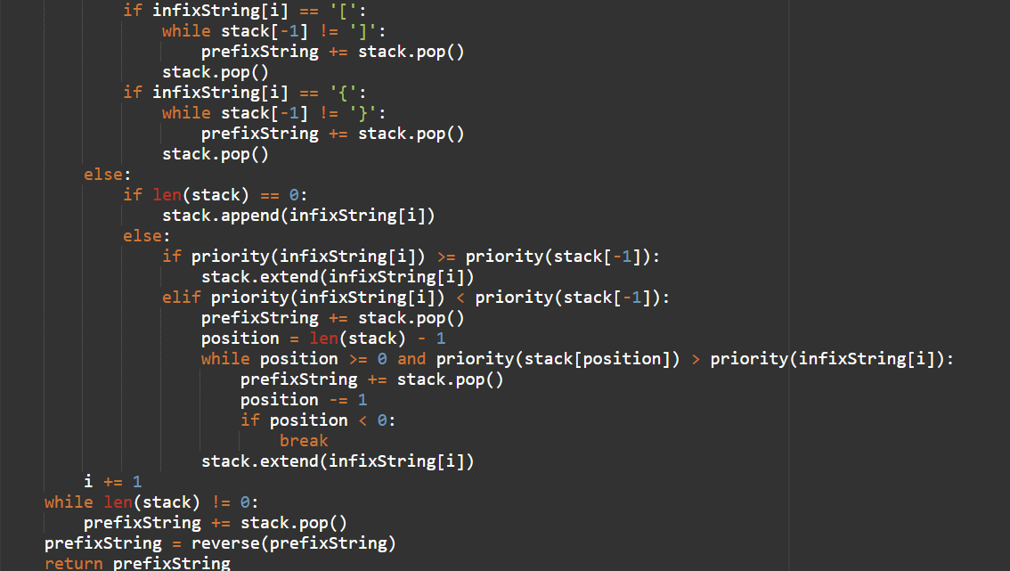

Slide 36


Slide 37
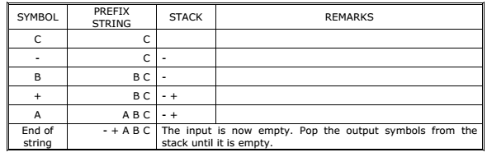
OUTPUT AND EXAMPLE
Enter the Infix Expression : a+b-c
The converted Expression in Prefix is : -+abc

