Slide 1


IMAGE GENERATION AND UPSCALING USING GENERATIVE ADVERSIAL NETWORK
Team Members: (BATCH N0:22)
Sakthi Murugan V (211520205122)
Saran Nithish NA (211520205131)
Shyam Ganesh J (211520205138)
Guide Name:
Mrs.M.Ramya.ME.,
Assistant Professor,Dept of IT
Panimalar Institute Of Technology

Slide 2
ABSTRACT
Generative Adversarial Network (GAN) is a deep learning framework comprising two neural networks, a generator, and a discriminator, engaged in a minimax game.
The generator aims to produce realistic data samples, while the discriminator endeavours to distinguish between real and generated samples.
Through adversarial training, the networks iteratively improve, leading to the generation of high-fidelity synthetic data across various domains, including images, text, and audio.
GANs have revolutionized tasks such as image generation, style transfer, and data augmentation, demonstrating remarkable potential in generating novel content and advancing machine learning capabilities.

Slide 3
INTRODUCTION
Our project harnesses the power of Generative Adversarial Networks (GANs) for image generation and up scaling.
By employing GANs, we aim to generate visually compelling images and enhance low-resolution images to higher quality.
Leveraging advanced deep learning techniques, our approach promises to deliver remarkable results in creating lifelike images, preserving cherished memories, and enhancing visual content.
Through this endeavour, we strive to contribute to the advancement of image processing technology, offering accessible solutions for diverse applications in photography, art, and digital media.

Slide 4
LITERATURE SURVEY
S.NO | YEAR | TITLE | AUTHOR | MERITS | DEMERITS
1. | 2024 | Model-Guided Generative Adversarial Networks for Unsupervised Fine-Grained Image Generation | Jian Xiao, Xiaojun Bi | Structured approach Real data training Guided generation Attention mechanism. | Complexity Potential overfitting Training overhead Hyper parameter tuning Performance variability.

Slide 5
S.NO | YEAR | TITLE | AUTHOR | MERITS | DEMERITS
2. | 2022 | ProfileSR-GAN: A GAN Based Super-Resolution Method for Generating High-Resolution Load Profiles | Lidong Song Yiyan Li Ning Lu | Improved Accuracy Enhanced Downstream Tasks | Potential complexity in implementation and dependency on weather data for accurate load profile generation.
3. | 2022 | A Review: Generative Adversarial Networks | Liang Gonog Yimin Zhou | Sampling or generating is direct. Training excludes Maximum Likelihood estimation. | Probability Distribution is Implicit . Training is Hard and Non-Convergent.

Slide 6
EXISTING SYSTEM
Traditional Image Processing Methods: While traditional methods like interpolation techniques can upscale images, they often result in loss of detail and produce unrealistic outputs.
Conventional GAN Implementations: Many existing GAN implementations lack user-friendly interfaces and robust training mechanisms, making them challenging to use effectively.
Manual Image Enhancement Techniques: Manual image enhancement techniques require expertise and are often time-consuming, limiting their practicality in real-world applications.

Slide 7
PROPOSED SYSTEM
Our proposed system taps into the potential of Generative Adversarial Networks (GANs) to transform image generation and up scaling.
By diving into deep learning, our method allows for creating top-notch images automatically, enhancing low-res images with precision, and reviving old or battered photos accurately.
Through user-friendly interfaces and clever algorithms, we aim to offer a simple yet powerful toolset that surpasses traditional methods, bringing advanced image processing and restoration within reach for everyone.

Slide 8
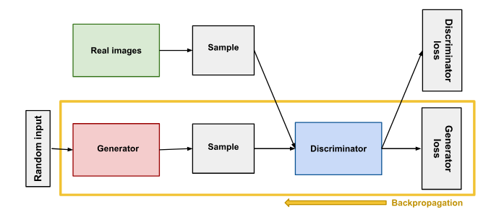
ARCHITECTURE DIAGRAM

Slide 9
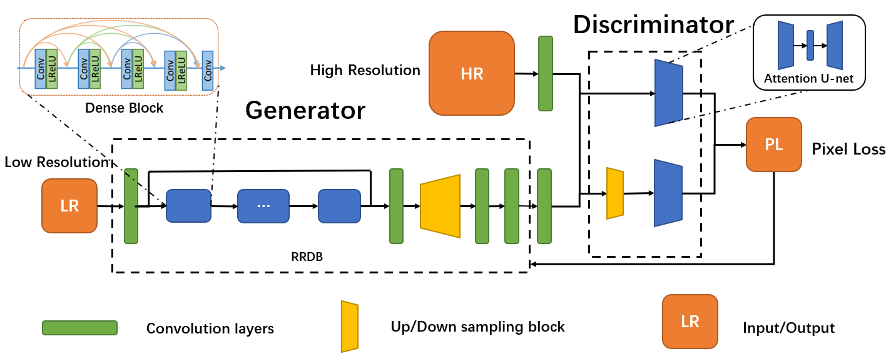

Slide 10
HARDWARE REQUIREMENTS
Processor: Minimum 3.8GHz
Memory (RAM): 16 GB
6gb Graphics Card
Hard Drive: 200GB

Slide 11
SOFTWARE REQUIREMENTS
Python --3.11.7
PyTorch --2.2.1
Tensorboard --2.16.2
CUDA and cuDNN --10.1
Conda --24.1.2
Jupyter Notebook

Slide 12
CONCLUSION
In conclusion, our project demonstrates the effectiveness of utilizing advanced deep learning techniques, particularly Generative Adversarial Networks (GANs), for image generation and upscaling tasks. By leveraging the capabilities of PyTorch and TensorBoard, we have developed a userfriendly system that streamlines the training process and enhances the quality of generated images. Our automated image enhancement pipeline offers scalable solutions across various industries, reducing manual intervention and improving efficiency. Through extensive testing and validation, we have shown that our system outperforms traditional methods and offers superior results in terms of image quality and realism. Moving forward, the insights gained from this project can be applied to further advancements in image processing and deep learning research, paving the way for innovative solutions in fields such as computer vision, healthcare, and entertainment.

Slide 13
FUTURE ENHANCEMENT
Looking ahead, several avenues for future enhancements in our project can be explored. Firstly, we can investigate techniques to further improve the efficiency and performance of our image generation and upscaling models, such as exploring novel architectures or incorporating additional loss functions for better image fidelity. Additionally, enhancing the scalability of our system to handle even larger datasets and more complex models will be beneficial. Furthermore, integrating techniques for domain-specific image enhancement, such as medical imaging or satellite imagery, can extend the applicability of our system to various specialized fields. Moreover, refining the user interface to provide more intuitive controls and visualization tools can enhance user experience and facilitate broader adoption of our system. Lastly, continuous monitoring and adaptation of our system to emerging advancements in deep learning and image processing will ensure that it remains at the forefront of technology and continues to deliver state-of-the-art results.

Slide 14
REFERENCE
1.Xiao, J., & B, X. (2024). "Model-Guided Generative Adversarial Networks for Unsupervised Fine-Grained Image Generation." [IEEE], [Volume(I26)], pp. [12]
2.Cheng, W., Zhang, S., & Lin, Y. (2023). "Study on the Adversarial Sample Generation Algorithm Based on Adversarial Quantum Generation Adversarial Network." [3rd International Symposium on Computer Technology and Information Science], pp. [6].
3.Wang, M., Zhou, Y., & Xu, K. (2023). "MoE-ESRGAN: A Super-Resolution Network for Multi-degraded Chinese Painting Images." In Proceedings of the 2023 3rd International Conference on Electronic Information Engineering and Computer (EIECT).
4.Hostin, M.-A., Sivtsov, V., Attarian, S., Bendahan, D., & Bellemare, M.-E. (2023). "CONTEXT-GAN: Controllable Context Image Generation Using GANs." In 2023 IEEE 20th International Symposium on Biomedical Imaging (ISBI).

