Slide 1



Title :- Deal-O-City
Presented By :- Shyam Patidar
Enrolment No :- 22100BTCSAII11053
Institution :- Shri Vaishnav Vidyapeeth Vishwavidyalaya, Indore
Guide Name :- Mr. Deepanshu Kumar

Slide 2

Build a fashion e-commerce platform for local retailers
Help users discover nearby fashion deals
Promote local fashion businesses digitally
Offer an easy-to-use shopping experience

Slide 3








Technologies Used

Slide 4



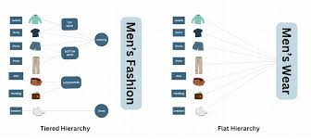
Features
Location-based fashion product discovery
Add to Cart and secure Checkout system
Daily/weekly fashion deal highlights
Shopkeeper dashboard for inventory & offers
Admin panel for monitoring users & products
Responsive UI for mobile and desktop
Category-wise product browsing

Slide 5





Limitations
Limited to local fashion retailers
Requires internet & accurate location services
No return/exchange process integrated
No wishlist or save-for-later functionality
Limited analytics/reporting for sellers
No mobile app version yet (web-only)

Slide 6
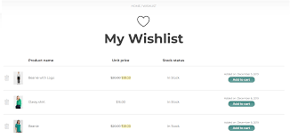


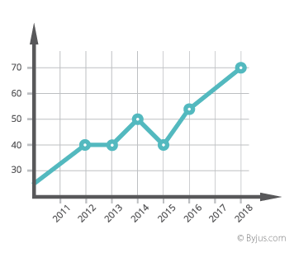
Future Updates
Mobile App Launch
Returns & Exchanges
Invoice & Billing System
Advanced Seller Analytics
Wishlist & Save-for-Later
.

Slide 7
Thank You
- Shyam Patidar

