Slide 1

SMART INDIA HACKATHON 2026
TITLE PAGE
Problem Statement Title-Design/Development of an Efficient Energy Storage System (ESS) to integrate intermittent renewable energy sources and stabilize the grid.
Theme-Renewable / Sustainable Energy
PS Category- Software
Team Name :Gypsies

Slide 2
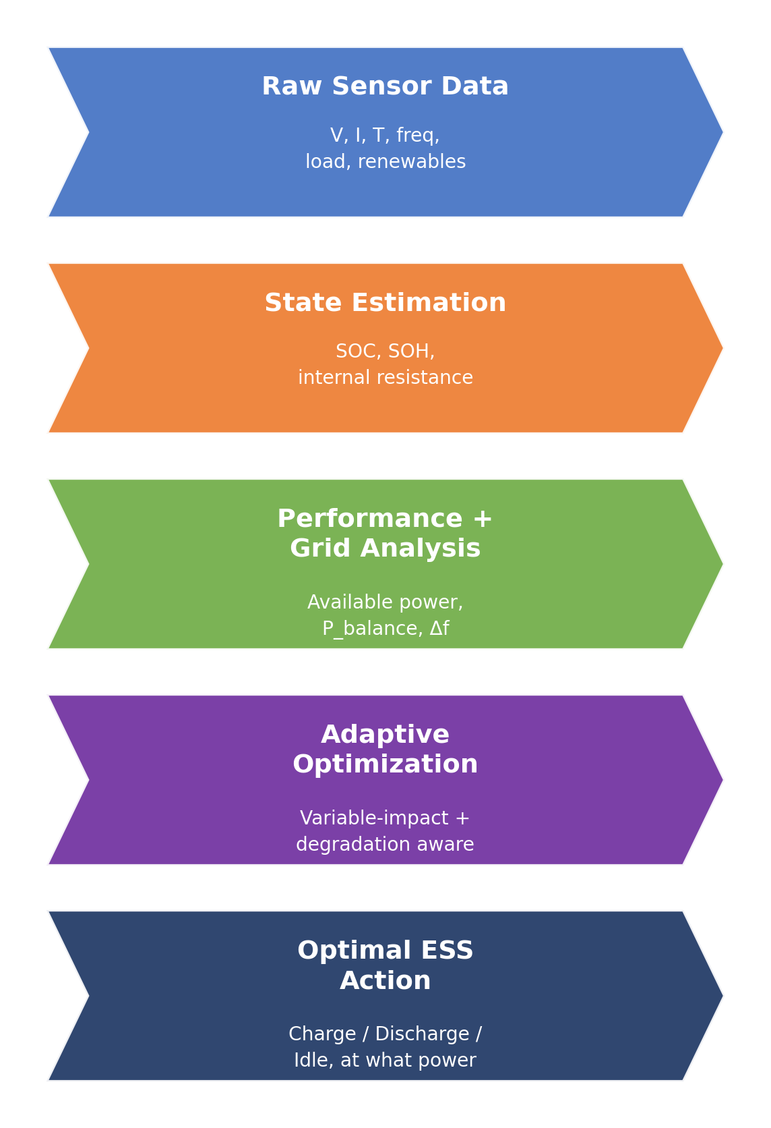
Adaptive Mathematical Optimization Framework for Grid-Stable ESS Operation
Gypsies
Proposed Solution
1. Real-Time ESS Monitoring IoT continuously collects renewable generation, load, grid conditions and ESS parameters such as SOC, SOH, DOD, voltage and temperature.
2. Multi-Layer Mathematical Analysis State Estimation derives SOC (coulomb counting), SOH/EFC and R_int from raw V/I/T; Performance Estimation gives available charge/discharge power; Grid Analysis tracks renewable-load balance and frequency deviation (Δf).
3. Optimal & Adaptive ESS Operation A constrained linear-programming engine takes current SOC, available power, energy balance, frequency deviation and forecasted load/renewables, and maximizes Profit = Revenue − Energy Cost − Degradation Cost subject to SOC, power and thermal limits — outputting Charge, Discharge, Hold, Frequency Support or Market Participation.
4. What Makes Our Approach Different Instead of relying only on fixed thresholds or a single optimization objective, our framework focuses on variable-impact analysis + ESS state + grid stability + degradation, allowing the optimal operating strategy to evolve with the system.

Slide 3
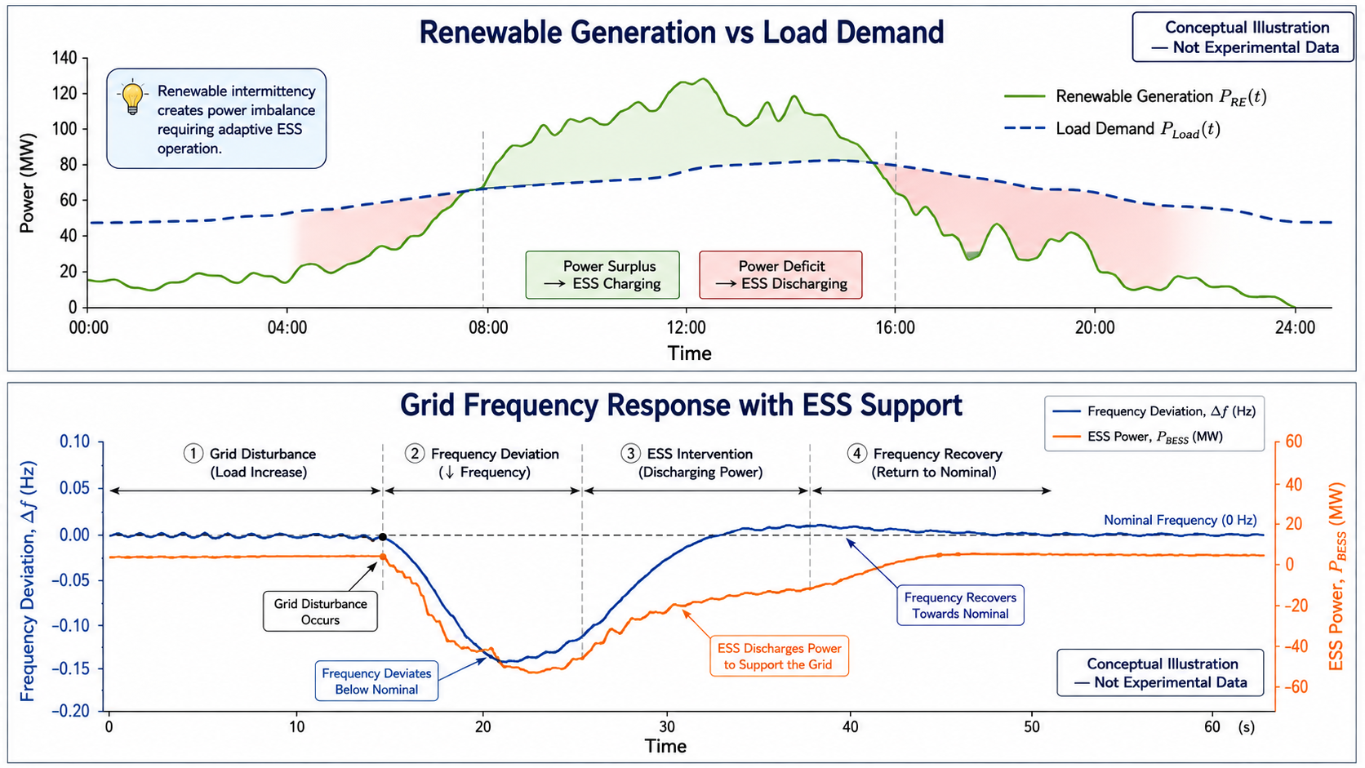
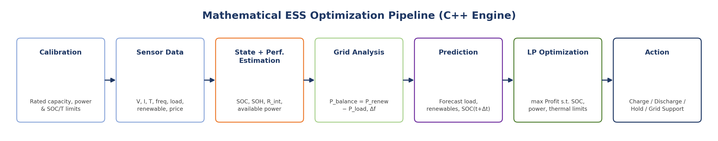
TECHNICAL APPROACH
Gypsies
Technology Stack:
C++ — Core mathematical model, numerical computation & optimization engine
Supabase — Storage of real-time and historical ESS/grid data
IoT / Sensors — Collection of BESS, renewable and grid parameters
Backend API — Node.js layer connecting the C++ engine, MongoDB and dashboard
Web Dashboard — Real-time visualization, monitoring and recommended ESS operation
BESS/PCS Interface — Communication of optimized charge/discharge setpoints

Slide 4
FEASIBILITY AND VIABILITY
Gypsies
Challenge | Mitigation
Limited live BESS data | Simulation + historical datasets
Noisy/incomplete sensor data | Data filtering & validation
Model uncertainty | Literature + simulation-based validation
Optimization time | Bounded & efficient optimization
BMS/PCS compatibility | Standard interfaces + simulator
Unsafe operating decisions | Hard SOC, power & temperature constraints
Technical Feasibility:
Real-time data: Grid, renewable, load and ESS parameters can be obtained through IoT/BESS telemetry.
Computationally feasible: C++ performs the mathematical analysis and optimization efficiently.
Prototype-ready: Initial validation can be performed using simulation + historical data before real BESS integration.
Modular architecture: C++ engine, backend, database and dashboard can be developed and tested independently.

Slide 5
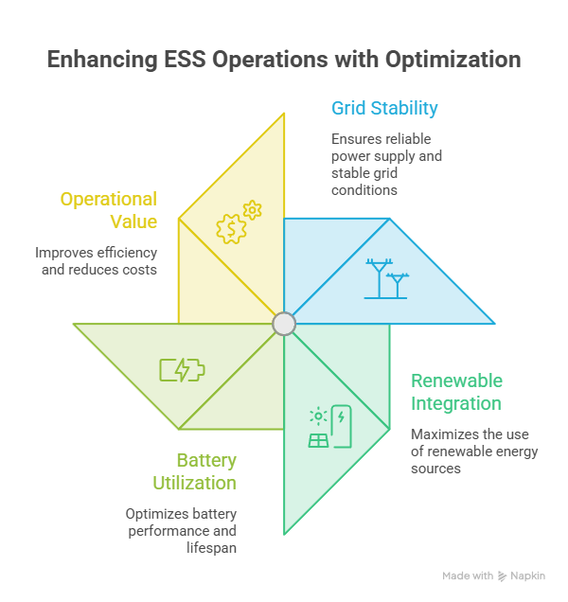
IMPACT AND BENEFITS
Gypsies
Impact:
Moves beyond fixed BMS/EMS operating rules by analyzing grid balance (P_balance), frequency deviation (Δf), ESS state (SOC/SOH), and control variables before selecting Charge, Discharge or Hold.
Adapts the ESS decision in real time using forecasted load, renewables and frequency deviation, while a degradation-cost-aware LP objective protects battery health alongside profit.
Improves decision quality and extends usable battery life over time by using real-time + historical data to refine variable-impact analysis and future ESS operating decisions.

Slide 6
RESEARCH AND REFERENCES
Gypsies
Key Research References
[1] Collath et al. (2022) — Aging-aware BESS operation [2] RSER (2022) — BESS modelling & optimal energy management [3] Rana et al. (2023) — ESS applications in power grids [4] JPS (2023) — Variable renewable integration & BESS [5] Energy Reports (2025) — Grid-connected ESS management [6] JES (2026) — ESS optimization & microgrid stability

