Slide 1
CSE7000 - INTERNSHIP A Presentation on AI & GPU Summer Internship Program
Student Details
Name | M Shyam
Roll No | 20241CSG0089
Section | 5CSG01
Under the Supervision of,
Dr.Robin Rohit Vincent
Head, AI Center of Excellence (NVIDIA)
Presidency University
Name of the Program: AI & GPU Summer Internship
Name of the HoD: Dr Pallavi R
Name of the Program Internship Coordinator: Mr Gyanesh Verma
Name of the School Internship Coordinators: Dr. Bhuvaneshwari Patil

Slide 2
Content
About the Organization
Working domain or the Technology
Objectives of the work
Methodology Used
System Architecture
Implementation
Results
Conclusion
Future Scope

Slide 3
About Company or Organization
Presidency University – AI Centre of Excellence
The internship was conducted by the Presidency School of AI and Advanced Computing.
The program focused on Artificial Intelligence and GPU Computing.
Students received practical exposure to AI model development and modern software engineering.
The internship included hands-on labs, mentoring, and an independent capstone project.
Industry-grade AI tools and frameworks were used throughout the program.

Slide 4
Working domain or the technology
Domain:
Artificial Intelligence
Code Analysis
Software Engineering
Large Language Models (LLMs)
Developer Productivity
Cloud Memory Systems

Slide 5
Technologies Used
FastAPI
React
Tailwind CSS
Monaco Editor
Groq API
Qwen3-32B
Hindsight Memory
Python
JavaScript / TypeScript

Slide 6
Objectives of the Work
Objectives
Build an intelligent AI-powered code review system.
Automatically analyze source code and identify coding issues.
Generate meaningful suggestions for improving code quality.
Maintain persistent memory of previous code reviews.
Adapt review feedback based on the developer's coding history.
Improve consistency and efficiency in software code reviews.

Slide 7
Methodology Used
System Workflow
User enters source code.
Code is sent to the FastAPI backend.
Previous review history is retrieved using Hindsight Memory.
The memory context is combined with the current code.
The Groq LLM analyzes the code.
Review suggestions are generated.
Review results are stored back into Hindsight Memory.

Slide 8
Methodology Used
Backend Implementation
FastAPI REST APIs
Request validation using Pydantic
Asynchronous API calls
Hindsight Memory integration
Groq API integration
Review history management
Memory-based reasoning

Slide 9
Methodology Used
Frontend Implementation
React-based user interface
Monaco Code Editor
Dashboard for review history
Memory analytics page
Responsive UI using Tailwind CSS
API communication using Axios

Slide 10
Key Features
AI-powered code review
Persistent developer memory
Context-aware review suggestions
Multi-language code support
Intelligent review history
Adaptive feedback generation
Fast asynchronous processing
Modern web interface

Slide 11
Results
Successfully developed a complete AI code review platform.
Integrated Hindsight Memory for persistent developer context.
Generated intelligent code review suggestions using Groq Qwen3-32B.
Built an interactive React frontend with Monaco Editor.
Implemented review history and adaptive AI feedback.
Supported multiple programming languages.

Slide 12
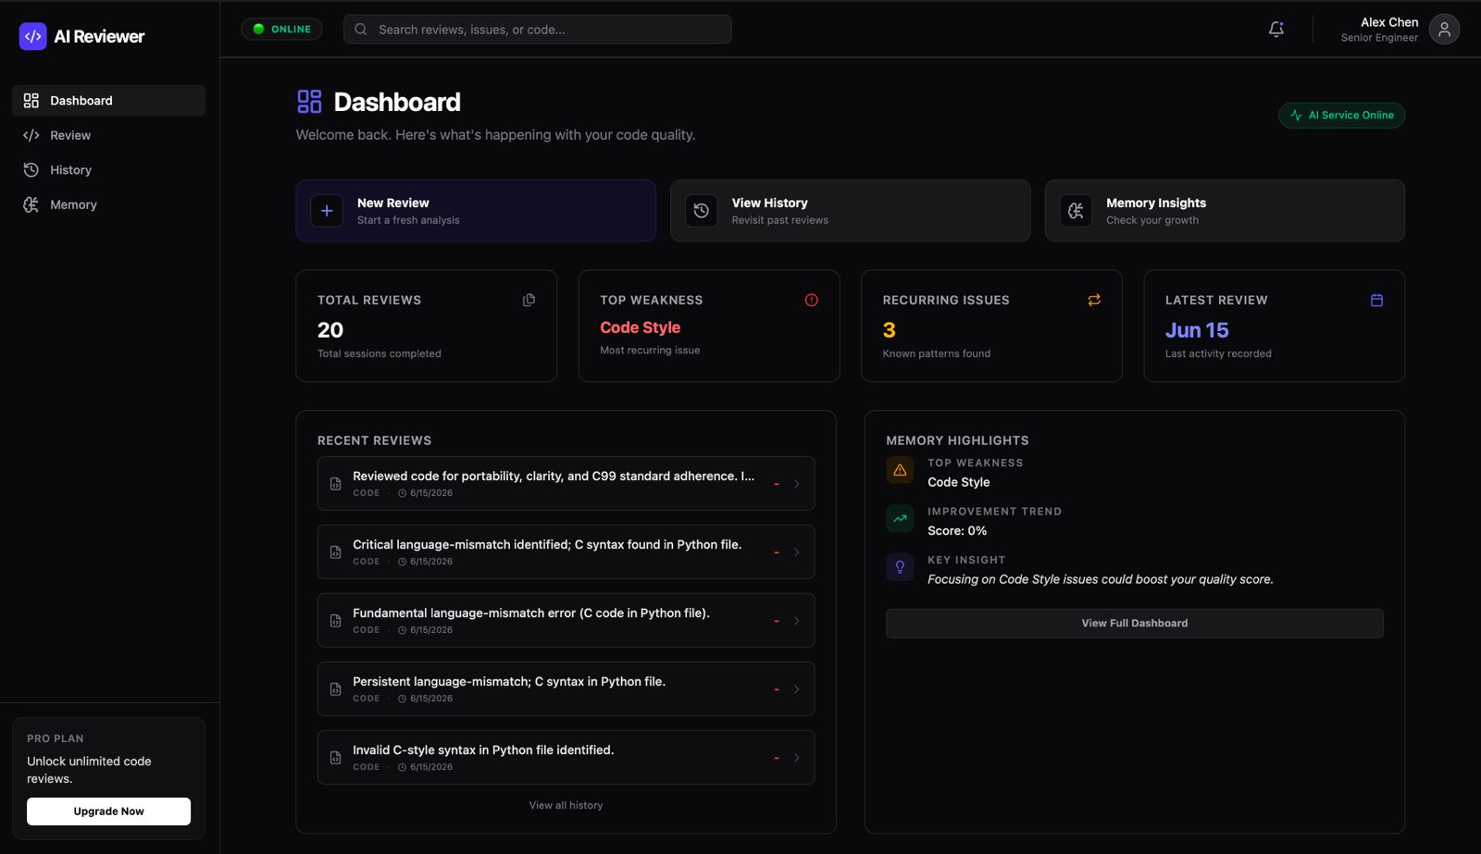
Results

Slide 13
Conclusion
Successfully designed and implemented an AI-powered Code Review Agent.
Combined Large Language Models with persistent memory to improve review quality.
Reduced repetitive feedback by learning from previous reviews.
Demonstrated practical use of AI in modern software development workflows.
Gained hands-on experience with FastAPI, React, Groq, and Hindsight Memory.

Slide 14
Future Scope
Support additional programming languages.
Integrate GitHub Pull Request reviews.
Add real-time collaborative code review.
Improve security vulnerability detection.
Deploy the application on cloud infrastructure.
Add team-wide analytics and dashboards.
Fine-tune custom AI models for organization-specific coding standards.

Slide 15
Q&A

Slide 16
Thank you !!

