Slide 1
METRICMIND
SIGNATURE • FINAL PROJECT
THE ANALYTICS LOOP
MetricMind
QUESTION
Agentic Semantic BI Engine
↓
AGENT
A premium conversational analytics workflow that connects business questions, semantic meaning, governed data and evidence.
↓
SEMANTIC
↓
DATA
FRONTEND
BACKEND
DATABASE
↓
React
FastAPI
MySQL
ANSWER + CHART
Shyam • Chetan • Mansi • Himesh • Yoshita • Prashant
AXLERO SOLUTIONS • FINAL PROJECT • AUGUST 2026
01

Slide 2
METRICMIND
EXECUTIVE STORY
The final story in one screen.
Problem → architecture → semantic layer → agentic reasoning → evidence.
01
02
03
04
Problem
Architecture
Workflow
Evidence
→
→
→
Incorrect joins + metric drift
Agent + semantic boundary
Multi-step root cause
UI + API + testing
CORE PRINCIPLE
The LLM interacts with the semantic layer rather than directly generating unrestricted raw SQL.
AXLERO SOLUTIONS • FINAL PROJECT • AUGUST 2026

Slide 3
METRICMIND
PROBLEM
Why traditional text-to-SQL breaks trust.
The problem is not that SQL exists. The problem is who controls meaning and scope.
TRADITIONAL
METRICMIND
Question
Natural language
Meaning is governed before data is returned.
LLM
Raw SQL
Shared metric definitions
Warehouse
Direct access
Bounded query scope
Result
Metric / join risk
Traceable answer path
AXLERO SOLUTIONS • FINAL PROJECT • AUGUST 2026
03

Slide 4
METRICMIND
ARCHITECTURE
A clean architecture with one critical boundary.
Implemented stack + target semantic design are both documented.
FRONTEND
React + Vite
Dashboard • Reports • Chat • Profile
SPECIFICATION
↓
Next.js / Cube.dev / PostgreSQL appear in the target architecture.
BACKEND
FastAPI + Python
REST • Auth • Orchestration
↓
Repository implementation uses React + Vite / FastAPI / MySQL.
SEMANTIC
Governed metrics
Revenue • Margin • Cost • Time • Geography
↓
NON-NEGOTIABLE
DATA
MySQL
Application / analytics data
NO RAW SQL
Semantic-layer-only access
AXLERO SOLUTIONS • FINAL PROJECT • AUGUST 2026
04

Slide 5
METRICMIND
SEMANTIC LAYER
Semantic layer: the business contract.
A shared catalog reduces ambiguity across questions, formulas and dimensions.
METRIC CATALOG
AGENT
DATA
Revenue
Margin
Selects relevant business meaning from the question.
Returns governed results without free-form SQL.
→
→
Cost
Time
Geography
Product / Customer
AXLERO SOLUTIONS • FINAL PROJECT • AUGUST 2026

Slide 6
METRICMIND
AGENTIC WORKFLOW
European margin root-cause analysis.
The agent can turn one “why?” into multiple governed analytic steps.
“Why did our European margins drop last quarter?”
MARGIN QUERY
→
DETECT DROP
→
COST BREAKDOWN
→
SHIPPING / MATERIAL / OTHER
→
ROOT CAUSE
FINAL ANSWER
Business-friendly explanation supported by the reasoning path.
AXLERO SOLUTIONS • FINAL PROJECT • AUGUST 2026
06

Slide 7
METRICMIND
GOVERNANCE
Hard limits. Clear trace. Controlled access.
MAX QUERIES / TURN
MAX ROWS / QUERY
UNRESTRICTED SQL
5
1,000
NO
Per conversational turn
Per query result
Semantic-layer-only
API TRACE
Question
→
Intent
→
Query
→
Result
→
Answer
AXLERO SOLUTIONS • FINAL PROJECT • AUGUST 2026
07

Slide 8
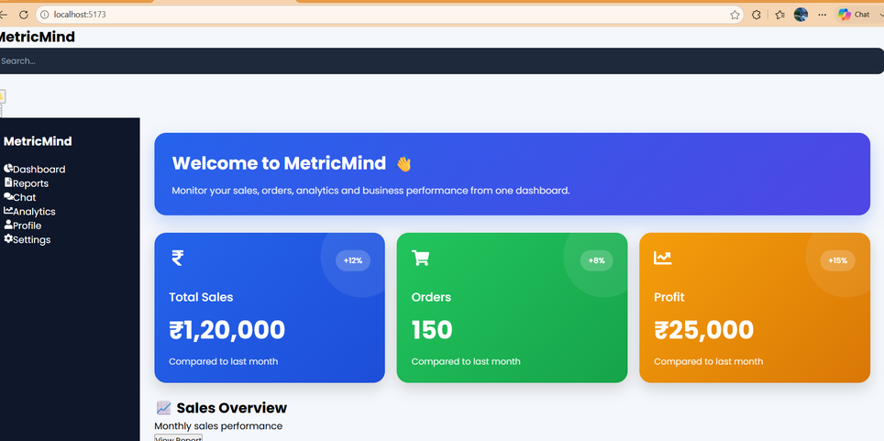
METRICMIND
DASHBOARD
Dashboard — full visual evidence.
KPI cards, sales graph and recent transactions are shown from the captured UI.
VISIBLE KPI DETAILS
TOTAL SALES
₹1,20,000
ORDERS
150
PROFIT
₹25,000
Transcribed from the captured dashboard evidence.
ACTUAL DASHBOARD SCREENSHOT
AXLERO SOLUTIONS • FINAL PROJECT • AUGUST 2026

Slide 9
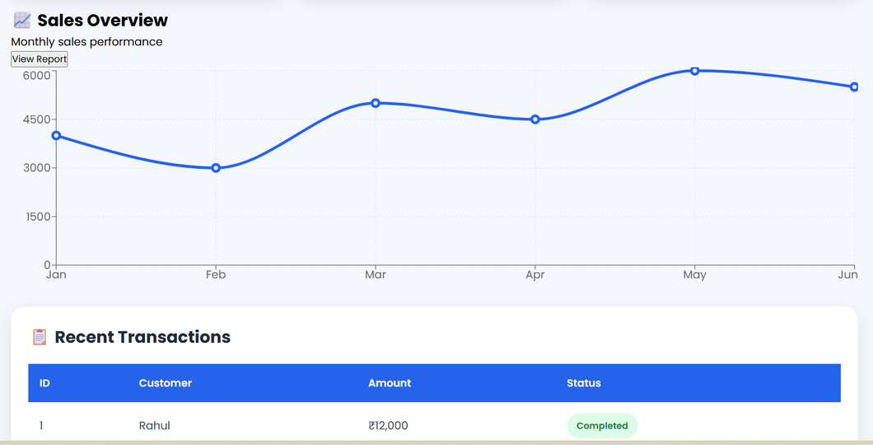
METRICMIND
GRAPH DETAIL
Sales overview — graph-first presentation.
The chart receives its own slide so the visual evidence is easy to inspect.
GRAPH NOTES
View
Sales Overview
Period
Jan → Jul
Type
Monthly trend
Source
Dashboard
No values are invented beyond the visible evidence.
SALES OVERVIEW • ACTUAL UI
AXLERO SOLUTIONS • FINAL PROJECT • AUGUST 2026
09

Slide 10
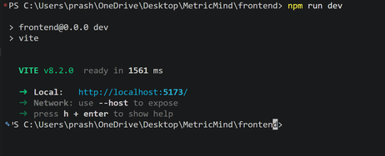
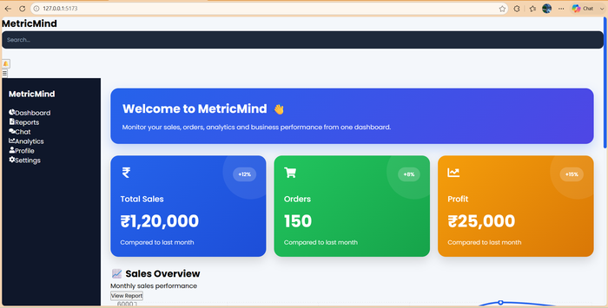
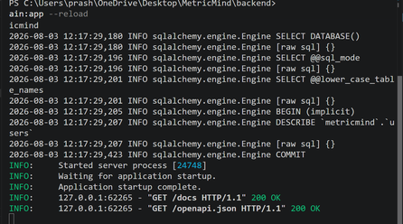
METRICMIND
UI EVIDENCE
Screenshots with context — not just decoration.
Frontend, dashboard and runtime evidence are shown together.
FRONTEND • VITE
DASHBOARD CAPTURE
BACKEND • FASTAPI
AXLERO SOLUTIONS • FINAL PROJECT • AUGUST 2026
10

Slide 11
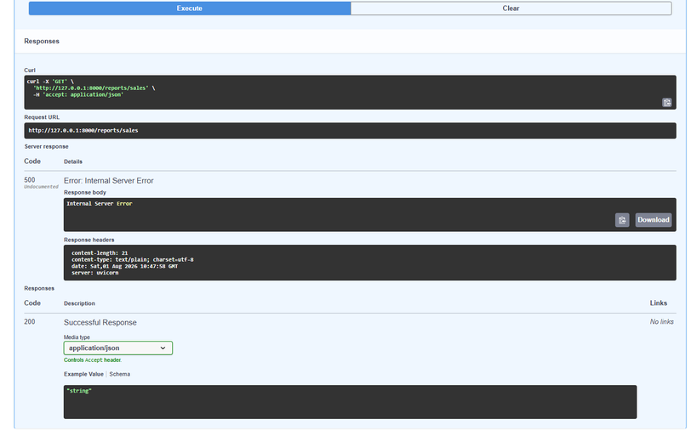
METRICMIND
AUTHENTICATION
Register → Login → Protected Profile.
Authentication evidence is presented as a complete user journey.
REGISTER
201 Created
LOGIN
200 OK
PROFILE
200 OK
PROTECTED PROFILE • API EVIDENCE
AXLERO SOLUTIONS • FINAL PROJECT • AUGUST 2026

Slide 12
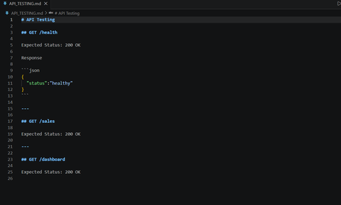
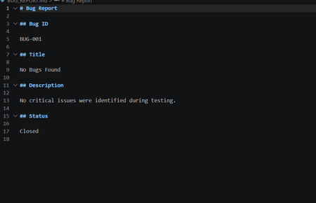
METRICMIND
TESTING
Testing is honest — passes and failures are both visible.
APIs TESTED
PASSED
FAILED
OVERALL
14
8
6
PARTIALLY PASSED
TESTING REPORT
BUG REPORT • 3 OPEN BUGS
AXLERO SOLUTIONS • FINAL PROJECT • AUGUST 2026
12

Slide 13
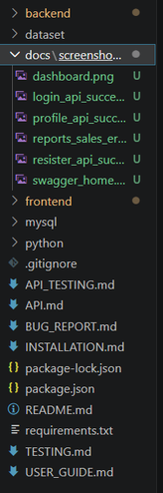
METRICMIND
DOCUMENTATION
A premium presentation needs premium evidence.
Repository structure, documentation and testing records complete the engineering story.
DOCUMENTATION SET
README.md
BUG_REPORT.md
Project overview + setup
Known defects
API.md
INSTALLATION.md
Endpoint documentation
Environment setup
TESTING.md
USER_GUIDE.md
Manual test evidence
Usage instructions
REPOSITORY STRUCTURE
AXLERO SOLUTIONS • FINAL PROJECT • AUGUST 2026
13

Slide 14
METRICMIND
TEAM
Six people. One delivery.
SHYAM
Team lead • DevOps • Integration
CHETAN
Backend • Agent orchestration
MANSI
Data • Semantic validation
YOSHITA
UI / Frontend
HIMESH
Frontend • Reassigned work
PRASHANT
QA • Documentation
AXLERO SOLUTIONS • FINAL PROJECT • AUGUST 2026
14

Slide 15
METRICMIND
RESULTS & NEXT
What is proven — and what must happen next.
A strong final presentation is transparent about project maturity.
PROVEN
PROVEN
OPEN
NEXT
UI + Auth
Dashboard + charts
6 API failures
Regression
NEXT MILESTONE
Fix the Home Dashboard, Reports and Analytics 500 errors → rerun the complete test suite → freeze final screenshots.
No invented numbers. No hidden failures. Evidence first.
AXLERO SOLUTIONS • FINAL PROJECT • AUGUST 2026
15

Slide 16
METRICMIND
FINAL
MetricMind
Agentic Semantic BI Engine
CONVERSATIONAL • GOVERNED • TRACEABLE
Question → Agent → Semantic Layer → Data → Answer + Chart + API Trace
Thank you
AXLERO SOLUTIONS • AUGUST 2026
AXLERO SOLUTIONS • FINAL PROJECT • AUGUST 2026

