Slide 1
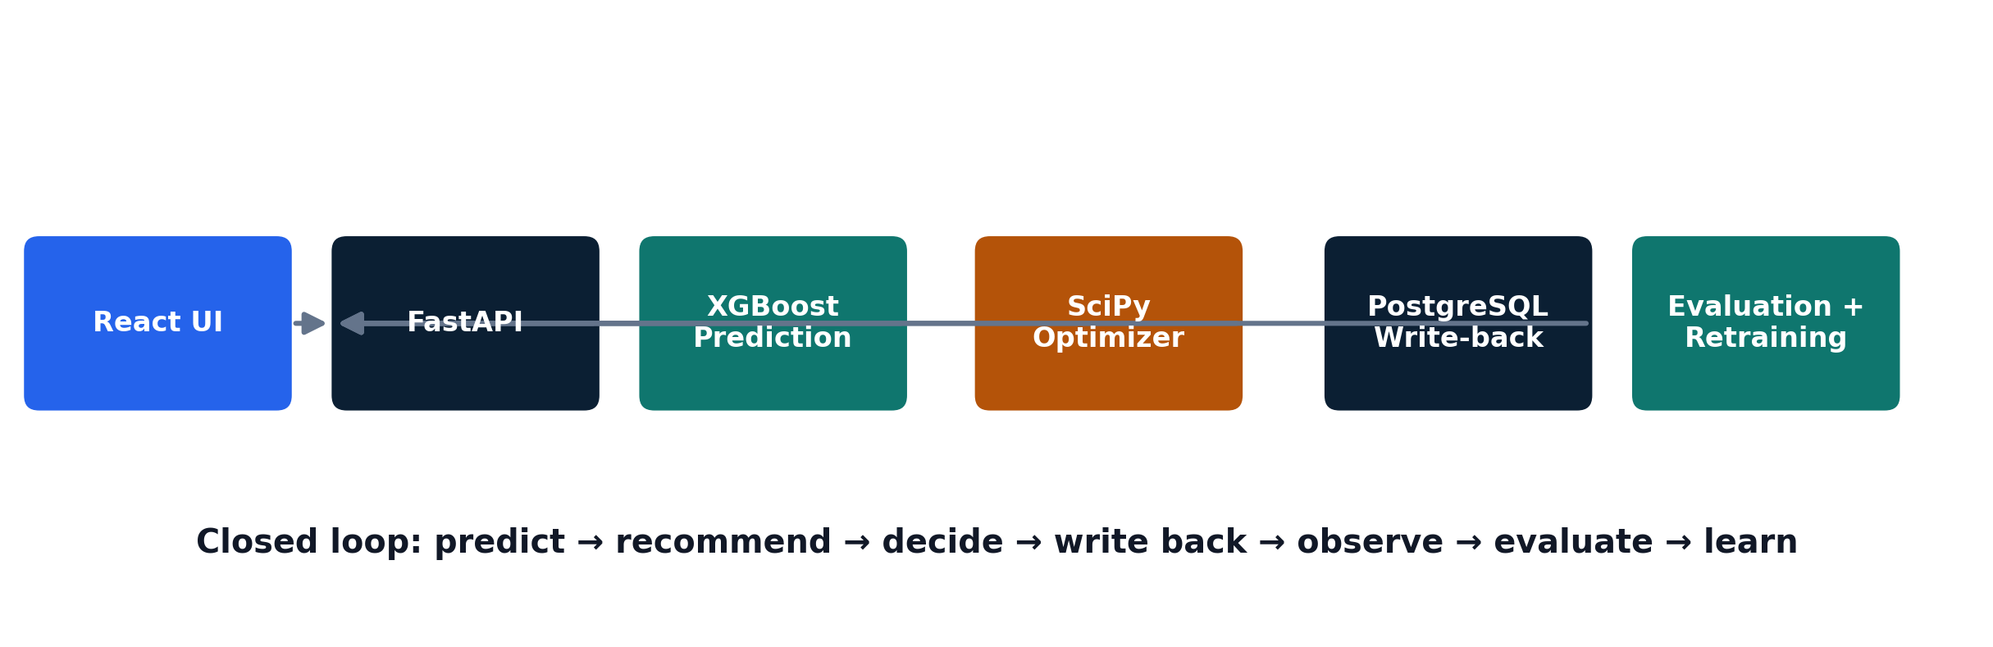
SUPPLY PRESCRIPT
Closed-Loop Prescriptive Analytics for Supply Chain Operations
Project Presentation

Slide 2
Executive Summary
What the final release delivers and what is verified.
Backend CI tests
Real PostgreSQL tests
Skipped / failed
Frontend lint + build
15 / 15
2 / 2
0
PASS
Predict shipment-delay risk from a real PostgreSQL record.
Generate three constrained recommendations with cost/time trade-offs.
Execute a feasible decision and persist it to the operational database.
Capture actual outcomes, evaluate the decision and report ROI.
Detect meaningful discrepancies and trigger XGBoost retraining.
FINAL RELEASE
POSTGRESQL
XGBOOST + SCIPY
CLOSED LOOP

Slide 3
Problem and Objectives
Prediction is useful only when it leads to an operational decision.
Business problem
Release objectives
A delay prediction tells the operator what may happen. It does not, by itself, decide what to do next.
XGBoost shipment-delay prediction.
SciPy optimization with Budget / Time / Capacity constraints.
Three alternatives with cost and time trade-offs.
Real decision write-back to PostgreSQL.
Actual outcome, evaluation and ROI.
Discrepancy-driven retraining.
Supply Prescript closes the gap by joining prediction, optimization, execution and feedback in one workflow.
PREDICT
OPTIMIZE
LEARN

Slide 4
Project 3 Requirements
The release was built around the four weekly implementation phases and the Mid Review gate.
Week 1
XGBoost • historical data • React • PostgreSQL
PASS
Week 2
SciPy • Budget/Time/Capacity • 3 alternatives • Cost vs Speed
PASS
Mid Review
Hard budget • Execute Decision → DB INSERT
PASS
Week 3
Actual vs predicted • Evaluation • Decision ROI
PASS
Week 4
Discrepancy detection • XGBoost retraining
PASS
The source brief allows PostgreSQL or Snowflake for application scaffolding. The final release uses PostgreSQL.

Slide 5
Solution Architecture
A compact operational stack with a clear path from prediction to learning.
Frontend
React + Vite
Backend
FastAPI / Python
Prediction
XGBoost
Optimization
SciPy
Database
PostgreSQL
CI
GitHub Actions

Slide 6
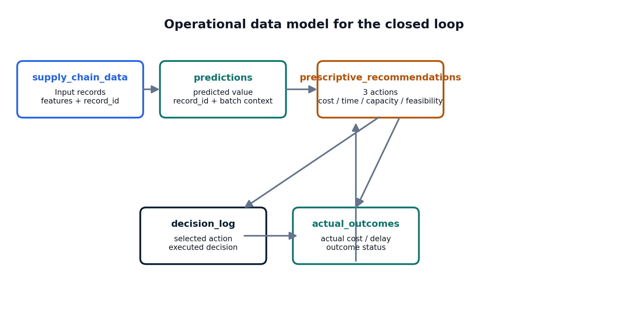
Data and Database Design
PostgreSQL is the operational store for the closed loop.
Core tables
supply_chain_data
predictions
prescriptive_recommendations
decision_log
actual_outcomes
POSTGRESQL
REAL DB TESTS
CI creates PostgreSQL 16.4, loads the schema and fixtures, then runs the real integration tests.

Slide 7
Predictive Model — XGBoost
Prediction is generated from real shipment records and persisted for the downstream workflow.
Dataset rows
Training samples
Testing samples
113,097
90,477
22,620
Load a real supply-chain record from PostgreSQL.
Build the approved feature set.
Run XGBoost and return delivery-time deviation.
Persist the prediction for recommendation and evaluation.
Representative live evidence
12 Sep 2026
Predicted delay: 5.67630672454834

Slide 8
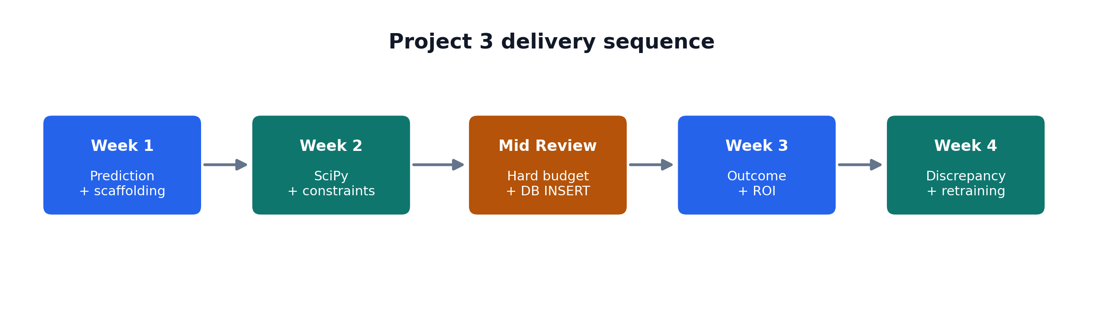
Prescriptive Optimization
SciPy turns a prediction into three constrained actions.
OPTION 1
OPTION 2
OPTION 3
Air Freight
Secondary Supplier
Delay Launch
Higher cost / faster
Alternative supplier route
Lower direct cost / slower
Constraint rule: infeasible alternatives remain visible for auditability but cannot be selected or executed.

Slide 9
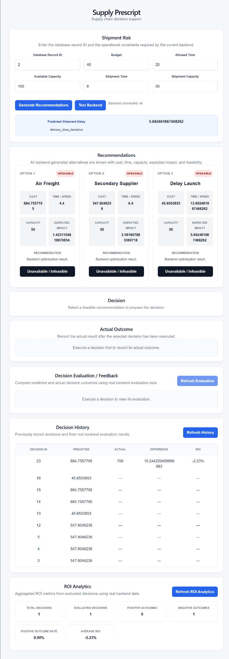
Operational UI and UX
The frontend follows the operator workflow and keeps model output visible.
What the operator sees
Six operational inputs: record, budget, time and capacity constraints.
Three live backend-generated recommendation cards.
Feasible / infeasible state and selected recommendation.
Execute Decision and returned Decision ID.
Actual Outcome, Evaluation, History and ROI Analytics sections.
Loading, error and empty states plus responsive layout.
FEASIBLE
INFEASIBLE
EXECUTE
EVALUATE

Slide 10
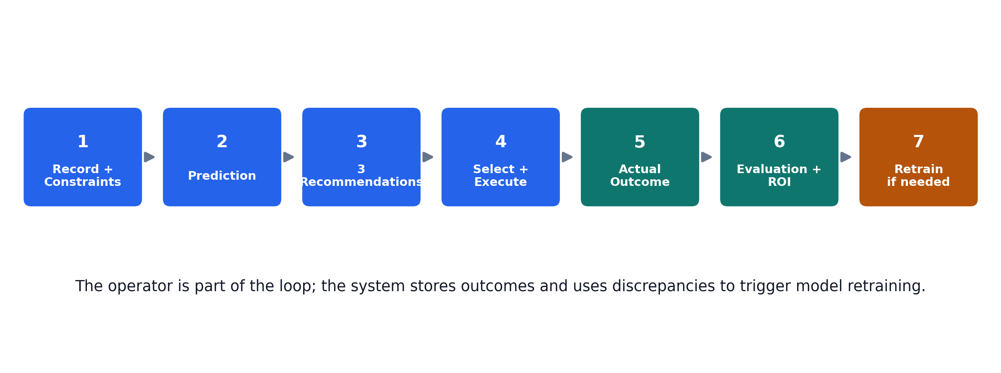
Closed-Loop Workflow
The decision is stored, evaluated and fed back into the learning cycle.
Execute
Observe
Evaluate
Learn
decision_log
actual_outcomes
difference + ROI
retrain on discrepancy

Slide 11
API Surface
The release exposes a small set of focused REST endpoints.
/health
/predict/shipment-delay
health check
direct prediction
/recommend
/decisions
prediction + optimization
decision write-back
/decisions/history
/decisions/{id}/outcome
decision history
actual outcome
/decisions/{id}/evaluation
/decisions/analytics/roi
decision evaluation
aggregate ROI
REAL API CALLS — NO PLACEHOLDERS

Slide 12
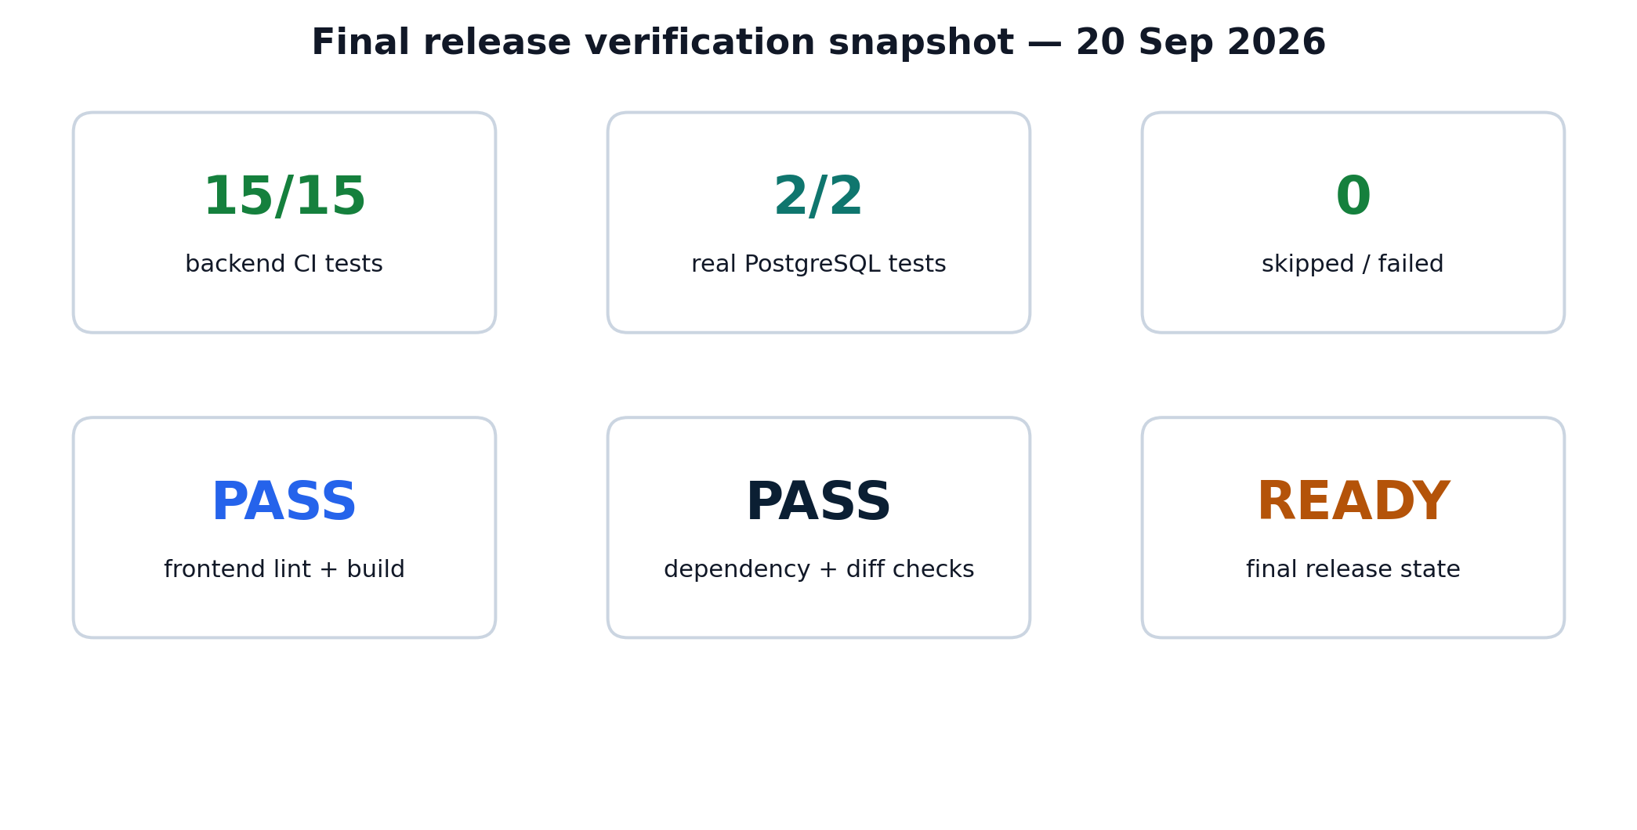
Testing and Quality Assurance
Final release verification uses automated tests, real PostgreSQL integration and browser evidence.
Final CI gate
PostgreSQL 16.4 container + schema + CI fixtures.
RUN_REAL_DB=1 enabled in CI.
15 tests collected / 15 passed / 0 failed.
No skipped real-DB tests and no Python test warnings.
Frontend npm ci, lint and build pass.
Latest release commit: 93be9fb

Slide 13
Observed Results
A representative browser run makes the workflow concrete.
Integrated browser run
Prediction target
delivery_time_deviation
Predicted delay
5.67630672454834
Alternatives
Air Freight / Secondary Supplier / Delay Launch
Hard-budget case
Budget = 40 → all options infeasible
Evaluation status
discrepancy_detected
Representative ROI
-1433.39%

Slide 14
Team and Release Delivery
The final release closes the engineering loop and the documentation loop.
Shyam
Team lead / DevOps / Integration
COMPLETE
Chetan
Backend / orchestration / write-back
COMPLETE
Yoshita
UI / frontend / decision workflow
COMPLETE
Prashant
QA / traceability / documentation
COMPLETE
Release sequence
6e972e5 → 918ec4a → 02c2369 → a5693cf → 05e01aa → 93be9fb

Slide 15
FINAL STATUS
Submission-ready release
The software is stable, the PostgreSQL gate is green, and the final QA/documentation state is synchronized.
No open pull requests
15/15 backend tests
2/2 real PostgreSQL tests
0 skipped / 0 failed
Frontend lint + build PASS
XGBoost + SciPy + write-back + ROI + retraining

