Slide 1
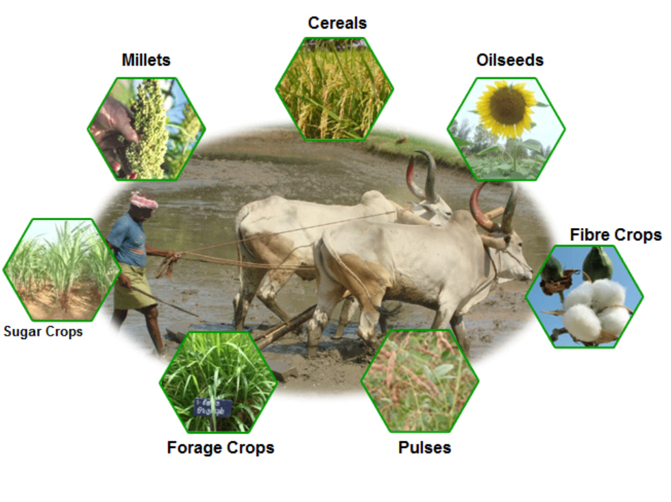
TOPIC : CROP RECOMMENDATION SYSTEM
TEAM NAME : CodeBitz
TEAM MEMBERS :
SHYAMAL KACHA
DARPAN RANA
DHAIRYA PATEL
KRISH PARIKH

Slide 2

INTRODUCTION
There are numberous problems which are faced by our farmers daily. One of the them is grow the correct crop according to the climate, type of soil and various other factors. Thus this Crop recommendation project involves advising farmers on the most suitable crops. It helps farmer to grow crops based on various factors such as soil quality, climate conditions, and market demand. This project ensures to help the farmer by recommending the right crop at right time.This project offer tailored solutions to enhance crop productivity, ensure efficient use of resources, and maximize economic returns.

Slide 3
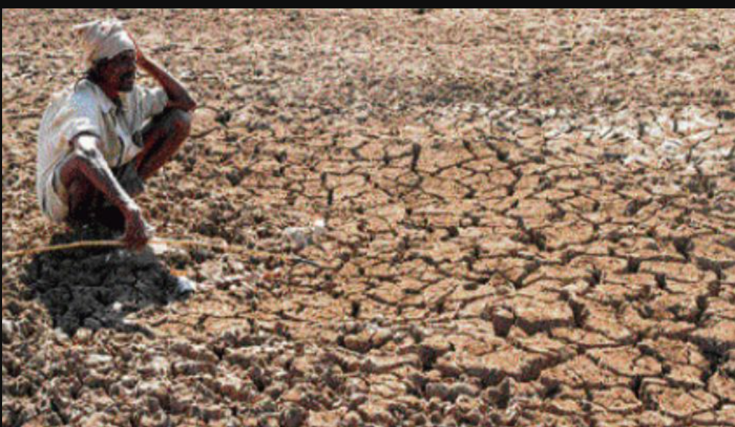
WHAT HAPPENS IF CROP RECOMMENDATION SYSYEM IN NOT IMPLEMENTED
Reduced Crop Yields: Without proper recommendations, farmers may plant crops that are not suited to their soil or climate, resulting in lower yields and wasted resources.
Environmental Degradation: Poor crop choices can lead to soil depletion, increased erosion, and higher pesticide and fertilizer runoff, contributing to environmental pollution and degradation.
Inefficient Resource Use: Misalignment between crops and environmental conditions can lead to excessive use of water, fertilizers, and pesticides, increasing costs and harming the environment.
Decreased Crop Diversity: Failing to diversify crops can make farming systems more vulnerable to pests, diseases, and market fluctuations. Reduced crop diversity can also limit ecological benefits and resilience.

Slide 4
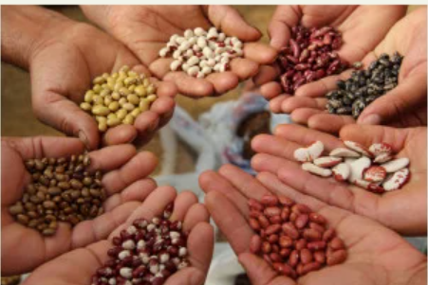
WHY CROP RECOMMENDATON IS NEEDED?
Maximizes Yield: By recommending the best-suited crops for specific soil types, climates, and conditions, crop recommendations help farmers achieve higher yields.
Enhances Soil Health: Recommending crops that fit into a rotation plan can help prevent soil degradation, nutrient depletion, and erosion, promoting long-term soil fertility.
Adaptation to Climate Change: As climate patterns shift, crop recommendations can help farmers adapt to new conditions by suggesting crops that are more likely to succeed under changing circumstances.

Slide 5
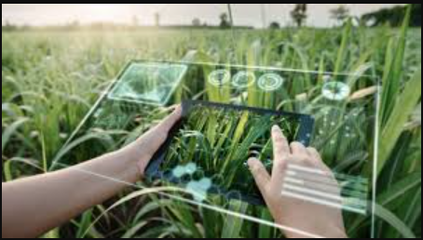
HOW ML IS USED?
In crop recommendation projects, machine learning leverages data from soil sensors, weather stations, and historical crop performance to provide tailored planting advice. By analyzing factors such as soil conditions, climate patterns, and market trends, ML models predict which crops
will thrive in specific environments and offer insights into potential yields and profitability. This data-driven approach helps farmers make informed decisions, optimize resource use, and improve crop outcomes, ultimately enhancing productivity and sustainability. This leads to more efficient farming practices and better alignment with both environmental and economic goals.

Slide 6
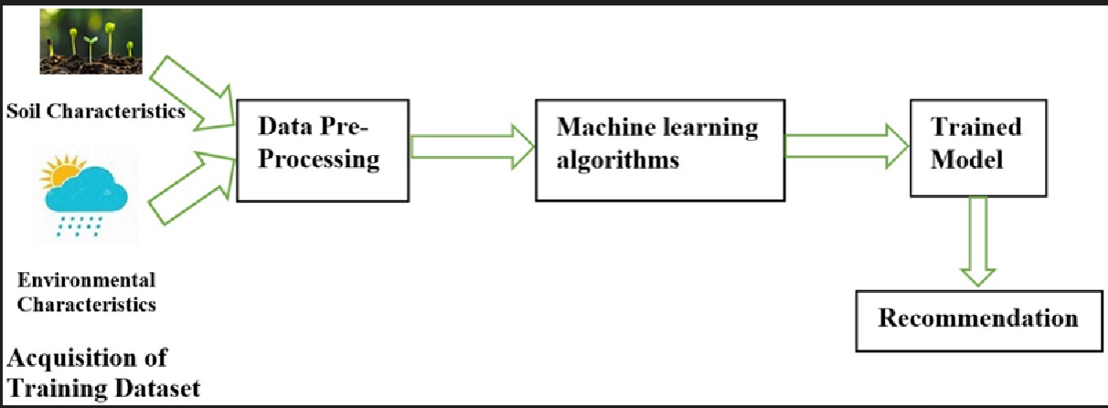
PROCESS FOLLOWED
In Crop Recommendation we have used supervised learning model of machine learning. We use labeled data from past crop performance, soil conditions, and weather patterns to train models that predict the best crops for given environments. This approach helps tailor recommendations based on historical outcomes and specific agricultural variables.

Slide 7

DATA COLLECTION AND INPUT
Data Source: https://www.kaggle.com/datasets/atharvaingle/crop-recommendation-dataset
Input features :
N (Nitrogen):The nitrogen content in the soil, measured in parts per million (ppm).Nitrogen is a crucial nutrient for plant growth, influencing the development of leaves and stems.
P (Phosphorus):The phosphorus content in the soil, also measured in ppm.Phosphorus plays a key role in root development and energy transfer within the plant.
K (Potassium):The potassium content in the soil, measured in ppm. Potassium is essential for the overall health of the plant, aiding in water regulation and disease resistance.
Temperature: The ambient temperature of the environment where the crop is grown, measured in degrees Celsius (°C).Temperature affects the rate of photosynthesis and growth; different crops have optimal temperature ranges
.
Humidity:The relative humidity of the air, expressed as a percentage (%).Humidity influences water loss through transpiration and can affect the health and yield of the crop.
pH: The pH level of the soil, indicating its acidity or alkalinity on a scale from 0 to 14.Soil pH affects nutrient availability; different crops require different pH levels for optimal growth.
Rainfall: The amount of rainfall the area receives, measured in millimeters (mm). Adequate rainfall is essential for crop growth, influencing water availability and soil moisture.

Slide 8
TECHNOLOGY STACK
TensorFlow: Used for building and training the machine learning model for crop recommendation.
Gradio: Implemented to create a user-friendly web interface for inputting data and receiving crop recommendations.
Pandas: Utilized for data preprocessing, cleaning, and analysis.
scikit-learn: Employed for data transformation and scaling.

Slide 9
CONCLUSION
The Crop Recommendation System effectively utilizes machine learning to predict the most suitable crops based on soil characteristics, climate conditions, and environmental factors. By analyzing key inputs such as nitrogen, phosphorus, potassium, temperature, humidity, pH, and rainfall, the model provides accurate and actionable recommendations, helping farmers make informed decisions to optimize yield and resource use. The system demonstrates the potential of data-driven agriculture to enhance productivity, sustainability, and food security. Future improvements could involve incorporating more diverse datasets and real-time data to further refine the recommendations.

Slide 10
Thank You

