Slide 1
Prediction of heart disease

Slide 2
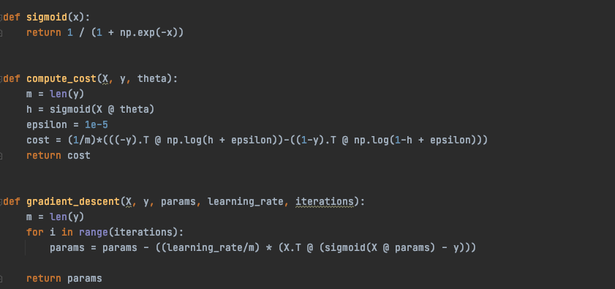
Logistic Regression w/ Gradient Descent

Slide 3
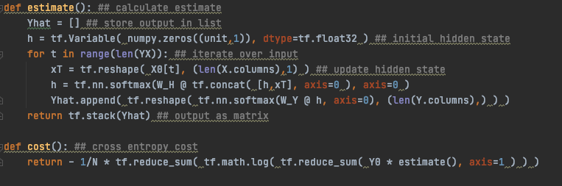
MaxNet w/ softmax
Best accuracy achieved at 150+ epochs and 60+ tensor size

Slide 4
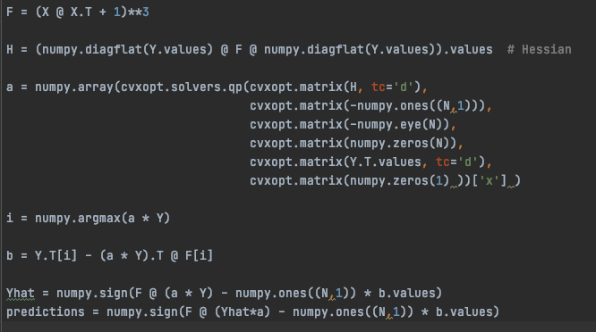
SVM w/ cubic normalization
Best accuracy achieved with normalization above cubic
Best accuracy results of the 3 methods used

