Slide 1

INDIAN AGRICULTURE
Production • Weather • NPK Fertilizer • Crop Mix • Climate Impact
By
V.ShyamalaDevi

Slide 2
Introduction & Objectives
Using dashboard visuals to understand production and resource patterns
Project objectives
• Summarize agricultural production across the major seasons.
• Compare crop-level requirements for potassium (K), nitrogen (N) and phosphorus (P).
• Examine the distribution of crop-related measures across selected crop types.
• Relate seasonal conditions and weather patterns to agricultural performance.
• Provide a concise evidence base for planning farm inputs and monitoring trends.
What the dashboard helps answer
• Production view: whole-year output is substantially higher than individual seasonal segments.
• Resource view: fertilizer requirements vary materially by crop.
• Seasonal view: the dashboard separates whole-year, kharif, rabi and summer periods.
• Impact view: percentage and distribution charts support comparison across observations.
Agricultural Production & Resource Analysis
2

Slide 3
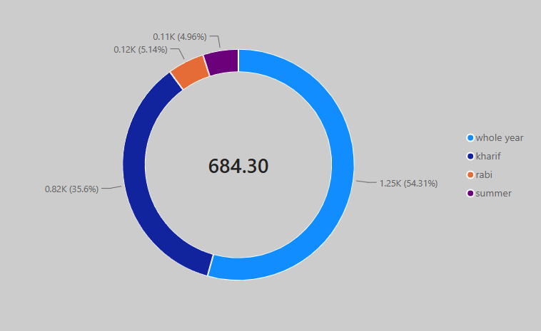
KPI Overview
Key values visible in the supplied dashboard visuals
0.55M
Whole-year production
0.145M
Kharif production
0.108M
Rabi production
0.022M
Summer production
Approx. dashboard value
Approx. dashboard value
Approx. dashboard value
Approx. dashboard value
KPI interpretation
• The seasonal bar chart shows the largest displayed production measure for the whole-year category.
• Kharif and rabi are the next two displayed categories, while summer is much smaller.
• The donut chart also shows a four-part seasonal distribution, with the largest slice labeled 1.25K (54.31%).
Seasonal distribution shown in the dashboard
Agricultural Production & Resource Analysis
3

Slide 4
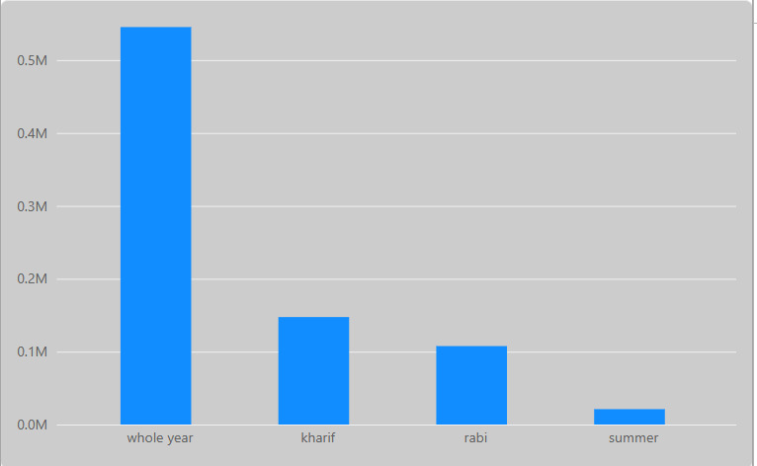
Production Analysis
Seasonal production profile from the dashboard
Key observations
• Whole-year production is approximately 0.55M in the displayed chart.
• Kharif is around 0.145M, followed by rabi at about 0.108M.
• Summer is the smallest displayed category at roughly 0.022M.
• The chart indicates strong seasonality in the observed production measures.
• These values should be treated as dashboard readings rather than raw-data totals.
Production by season
Agricultural Production & Resource Analysis
4

Slide 5
Weather Analysis
Seasonal distribution represented in the dashboard
Weather-related takeaways
• The largest donut segment is whole year: 1.25K (54.31%).
• Kharif contributes 0.82K (35.6%).
• Rabi is 0.12K (5.14%), while summer is 0.11K (4.96%).
• The visual highlights a concentration of the displayed measure in whole-year and kharif categories.
• Seasonal weather interpretation should be paired with rainfall and temperature records.
Seasonal share / distribution
Agricultural Production & Resource Analysis
5

Slide 6
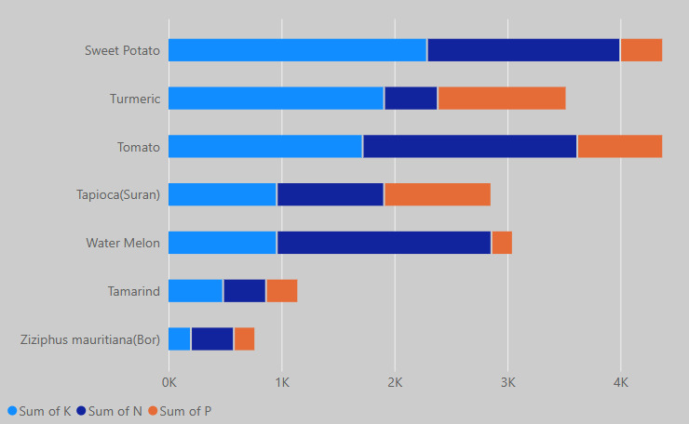
NPK Fertilizer Requirements
Crop-wise comparison of potassium, nitrogen and phosphorus
Interpretation
• Sweet potato shows the largest combined displayed requirement.
• Tomato also has a high combined requirement, with a large N component.
• Turmeric and tapioca (suran) show substantial multi-nutrient requirements.
• Tamarind and Ziziphus mauritiana (Bor) have smaller totals in the chart.
• The stacked format supports both total-input and nutrient-mix comparisons.
Stacked comparison of K, N and P requirements
Agricultural Production & Resource Analysis
6

Slide 7
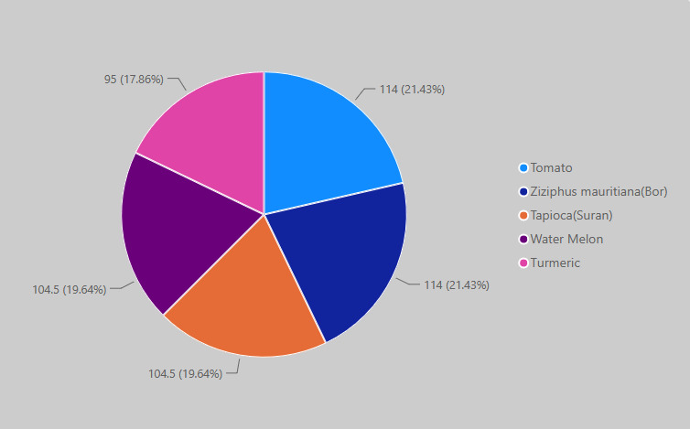
Crop Type, Area & Yield
Distribution of the selected crop categories
Crop-mix observations
• Tomato and Ziziphus mauritiana (Bor) are each labeled 114 (21.43%).
• Tapioca (Suran) and Water Melon are each labeled 104.5 (19.64%).
• Turmeric is labeled 95 (17.86%).
• The displayed categories are relatively balanced, with only modest differences between slices.
• The chart can be used as a starting point for comparing crop mix with area and yield measures.
Crop-type distribution
Agricultural Production & Resource Analysis
7

Slide 8
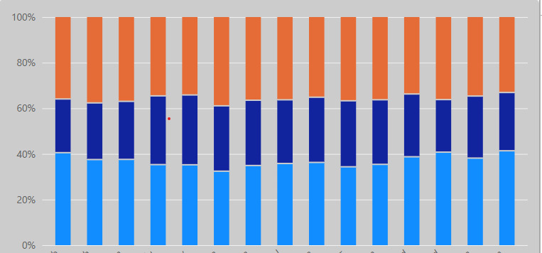
Rainfall / Temperature Impact
Relative composition across the displayed observations
How to read the chart
• The chart normalizes each observation to 100%, making composition easier to compare.
• The blue segment generally ranges around the mid-30% to low-40% band.
• The dark-blue segment generally occupies about one-quarter of the bar.
• The orange segment makes up the remaining share and varies across observations.
• This visual is useful for spotting changing proportions; direct causal impact requires the underlying rainfall and temperature values.
100% stacked comparison
Agricultural Production & Resource Analysis
8

Slide 9
Conclusion
Summary of the dashboard-based analysis
Main findings
• Production is strongly differentiated by season, with the whole-year category dominating the displayed production measure.
• NPK requirements differ substantially across crops, supporting crop-specific input planning.
• The crop distribution is comparatively balanced across the five highlighted crop types.
• Seasonal composition charts provide a useful way to monitor shifts across agricultural periods.
Suggested next steps
• Use rainfall and temperature records alongside production data to test relationships rather than assuming causation.
• Track fertilizer requirements by crop and season to support resource planning.
• Combine area, yield and production measures for a fuller productivity assessment.
• Use the dashboard as a monitoring tool and refresh it with current farm or field-level data.
Thank you
Agricultural Production & Resource Analysis
9

