Slide 1

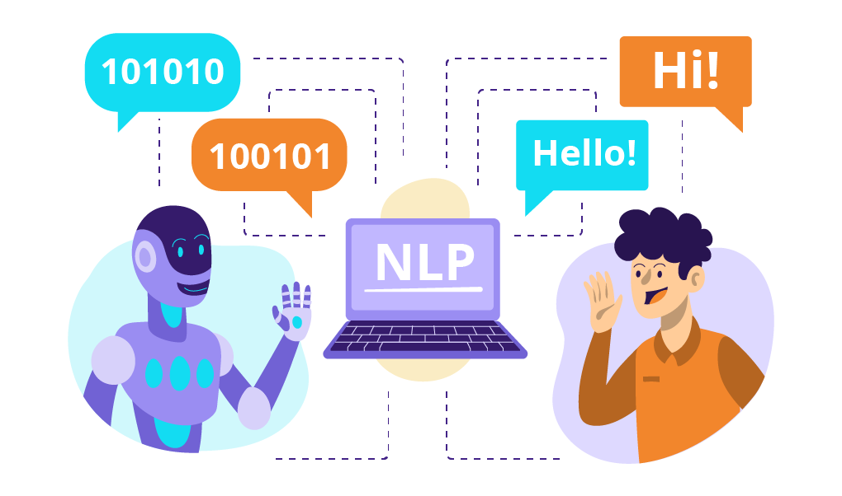
Scifor Technologies
Natural Language Processing
Presented by
Shyamashree Ghorai (STB03-T0007)
M.Sc. in Data Science, MAKAUT
B.Sc. in Mathematics, Calcutta University

Slide 2
Content
Introduction
Main parts of the field
Technologies related to NLP
Use case – Semantic Analysis
Future Scope
Natural Language Processing
2

Slide 3
1. Introduction
Natural Language Processing(NLP) is a field of artificial intelligence and computer science that is concerned with the interactions between humans and computers in natural language. The main purpose of NLP is to develop an algorithm that enables computers to understand, interpret, generate and manipulate human languages.
Natural Language Processing
3

Slide 4
2. Different parts of the field
The field is mainly divided into three different parts: -
Speech Recognition - Ability of computer that translates the spoken language into text (machine readable language). Nowadays majority of the system use Hidden Markov Models (HMMs) that use mathematical calculation to determine the natural language in order to convert into text.
Natural Language Understanding(NLU) - It enables computer to understand the spoken languages. First, computer tries to figure out whether the word is a noun or a verb or in the present or past tense and so on. This is called parts-of-speech tagging (POS). Then generate some grammatical rule to build NLP systems.
Natural Language Generation(NLG) – It enables computer to generate natural language.
Natural Language Processing
4

Slide 5
3. Technologies related to NLP
Machine Learning: NLP relies on heavily on machine learning techniques, supervised, unsupervised, deep learning and reinforcement learning.
Natural Language Toolkits (NLTK): NLTK is a open source python library that provides tools for NLP tasks such as tokenization, stemming and parts-of-speech tagging. There are other libraries also spaCy, OpenNLP and CoreNLP.
Text-to-Speech (TTS) and Speech-to-Text (STT) systems: TTS system converts written text into spoken words and STT system converts spoken words into written text.
Name Entity Recognition Systems: It identifies named entities such as peoples, places and organizations from the text.
Sentiment Analysis: It is a techniques to understand the emotions expressed in a piece of text.
Natural Language Processing
5

Slide 6
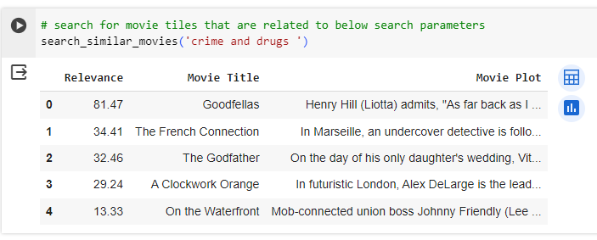
4. Use case – Semantic Analysis
Latent Semantic Analysis is a natural language processing method that uses the statistical approach to identify the association among the words in a document.
Latent Semantic Analysis is a concept that search engines use to discover how a keyword and content work together to mean the same thing.
retrieve relevant movie titles using semantic search based on the concept of Natural Language processing (NLP)
Natural Language Processing
6

Slide 7
5. Future scope
Bots: Chatbots assist clients to get to the point quickly by answering inquiries. If we want effective chatbots, it must be fast, smart and easy to use. To accomplish this, chatbots employ NLP to understand language, usually over text or voice-
recognition interactions.
Smarter Search: NLP’s future also includes improved search. Smarter search allows a chatbot to understand a customer’s request. Google recently announced that NLP capabilities have been added to Google Drive, allowing users to search for documents and content using natural language.
Natural Language Processing
7

Slide 8


