Slide 1
Digital Healthcare
Management System
HEALTHCARE
A role-based platform unifying hospitals, doctors and patients around the digital prescription
[ Shyamcharan Bharathi | Vellore Institute of Technology Chennai ]

Slide 2
01
Abstract
Healthcare is a role-based web application designed to streamline interactions between patients, doctors, and hospitals through a centralized digital platform. Administrators manage hospitals and accounts; doctors issue digital prescriptions and manage consultations; patients upload externally received prescriptions and track their treatment history.
The system applies Optical Character Recognition (OCR) to extract medicine names, dosages, frequencies and durations from uploaded prescription images or PDFs, matches them against a medicine reference dataset, and performs basic drug-interaction checks. A doctor-patient relationship is established automatically the first time a doctor issues a patient's first digital prescription — never through manual administrator assignment.
Medication reminders, adherence tracking, and role-specific analytics dashboards complete the platform, giving each user — Administrator, Doctor or Patient — a structured, searchable digital record built entirely on standard relational database technology, with no dependency on advanced AI or medical-domain models.
Healthcare – Digital Healthcare Management System
2

Slide 3
02
Introduction
Fragmented records
Manual, error-prone workflows
A patient's prescriptions, consultations and medication history are scattered across paper records and separate hospital systems.
Reading handwritten prescriptions, tracking doses, and checking for drug interactions are still done manually by patients and caregivers.
No unified directory
Adherence goes untracked
There is no single place to browse hospitals, departments and doctors, or to see a structured history of who treated a patient and when.
Once a prescription is issued, there is typically no system-level way to remind a patient or measure whether they actually took their medication.
Healthcare – Digital Healthcare Management System
3

Slide 4
03
Existing System — Drawbacks
×
Paper-based or scanned prescriptions with no structured, searchable digital record
×
No centralized hospital/doctor directory — patients cannot browse or compare providers
×
Doctor-patient relationships tracked informally, or not tracked at all
×
No automated drug-interaction checking across a patient's active medicines
×
No reminder or adherence-tracking mechanism once a prescription is issued
×
Consultation notes and follow-ups kept outside any queryable system
Healthcare – Digital Healthcare Management System
4

Slide 5
04
Proposed System — Research Gap
✓
OCR-based digitization: upload a prescription image/PDF; the system extracts and structures medicine, dosage, frequency and duration
✓
Centralized, role-open Hospital Directory covering every registered hospital, department and doctor
✓
Automatic doctor-patient linking the moment a doctor issues a first digital prescription — no manual assignment
✓
Built-in drug-interaction checking against a shared medicine reference dataset
✓
Medication reminders with mark-as-taken tracking and a computed adherence percentage
✓
Fully implementable on a standard relational database — no advanced AI or medical-domain model required
Healthcare – Digital Healthcare Management System
5

Slide 6
05
System Architecture
PRESENTATION TIER
Admin | Doctor | Patient Dashboards
Web UI (Django Templates + Bootstrap)
APPLICATION TIER (Django)
Authentication &
Role Routing
Hospital &
Account Mgmt
Doctor & Patient
Mgmt
Prescription Mgmt
(OCR Service)
Medication Mgmt
(Interactions, Reminders)
Dashboard &
Analytics
Scheduler
(Celery + Redis)
DATA TIER
PostgreSQL
(11 relational tables)
Media Storage
(Rx Images / PDFs)
OCR Engine
(Tesseract)
Three-tier architecture: Presentation (web UI) → Application (Django services) → Data (PostgreSQL, media storage, OCR engine).
Healthcare – Digital Healthcare Management System
6

Slide 7
06
Module Decomposition
Healthcare Management System
Authentication
Hospital Mgmt
Doctor Mgmt
Patient Mgmt
Prescription Mgmt
Medication Mgmt
Dashboard & Analytics
Authentication
Hospital Mgmt
Doctor Mgmt
Patient Mgmt
Prescription Mgmt
Medication Mgmt
Dashboard & Analytics
Login + role-based
routing
Directory + hospital/dept
records
Profile, consultations,
prescriptions
Profile, prescription
history
OCR upload, verification,
storage
Lookup, interactions,
reminders
Role-specific
metrics
Healthcare – Digital Healthcare Management System
7

Slide 8
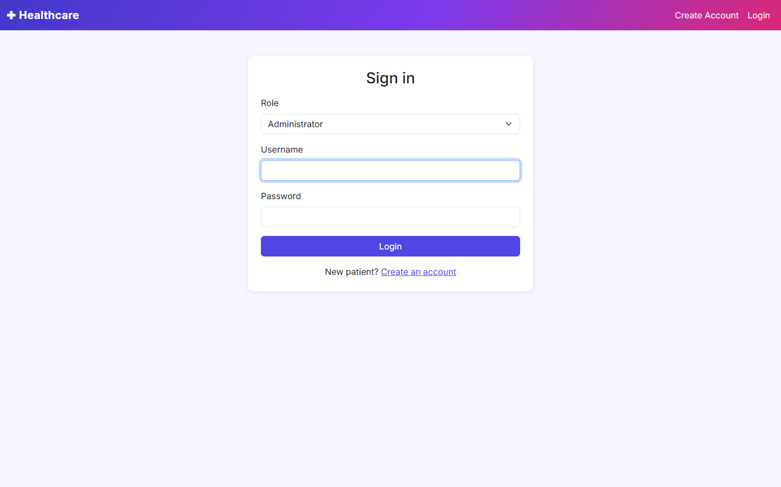
07
Role-Based Authentication
Every session begins with a single login screen. The user submits credentials and their role (Administrator, Doctor or Patient); the system verifies the account and routes them to a dashboard built for that role's responsibilities.
INPUT
Username, password,
selected role
↓
OUTPUT
Authenticated session,
role-specific dashboard
ROLE-BASED AUTHENTICATION — SCREEN
Healthcare – Digital Healthcare Management System
8

Slide 9
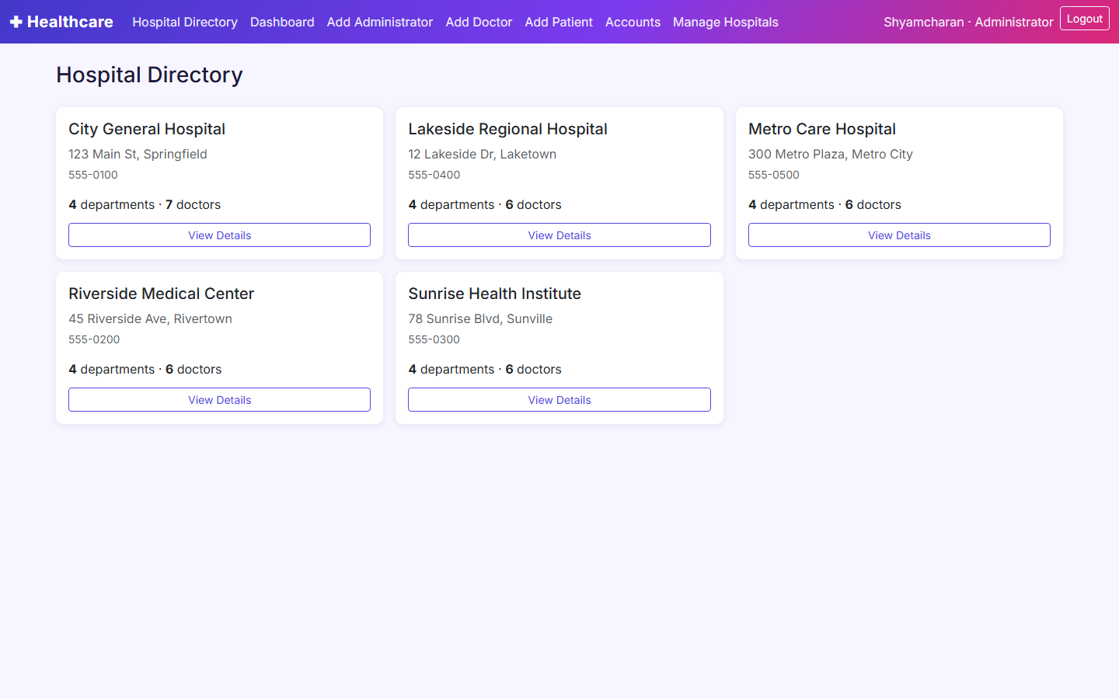
08
Hospital Management & Directory
Administrators register and maintain hospitals, departments and staff. Every authenticated role — not just Administrators — can browse the resulting directory to find a hospital, department or doctor.
INPUT
Hospital/department data (Admin) or
a directory browse request (any role)
↓
OUTPUT
Updated hospital records, or a hospital
/ department / doctor directory listing
HOSPITAL MANAGEMENT & DIRECTORY — SCREEN
Healthcare – Digital Healthcare Management System
9

Slide 10
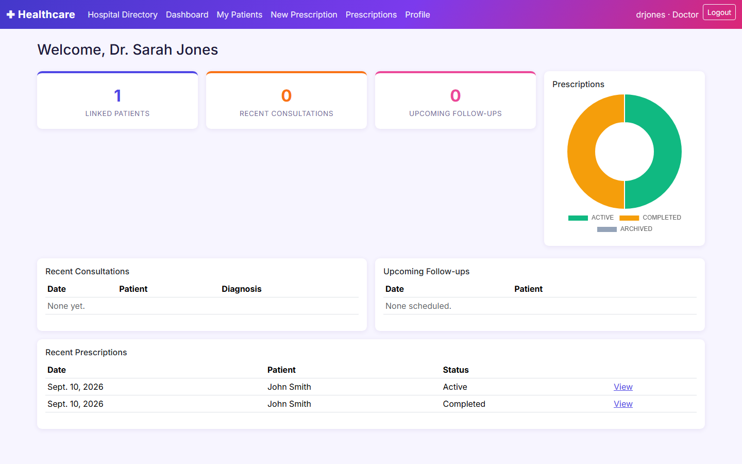
09
Doctor Management
Doctors view their linked patients, author consultation notes, and issue digital prescriptions. Issuing a patient's first prescription is also what silently creates the doctor-patient link — there is no separate admin step for it.
INPUT
Consultation details, prescription
data (medicines, dosage, dates)
↓
OUTPUT
Saved consultation note, issued
prescription, auto-created doctor link
DOCTOR MANAGEMENT — SCREEN
Healthcare – Digital Healthcare Management System
10

Slide 11
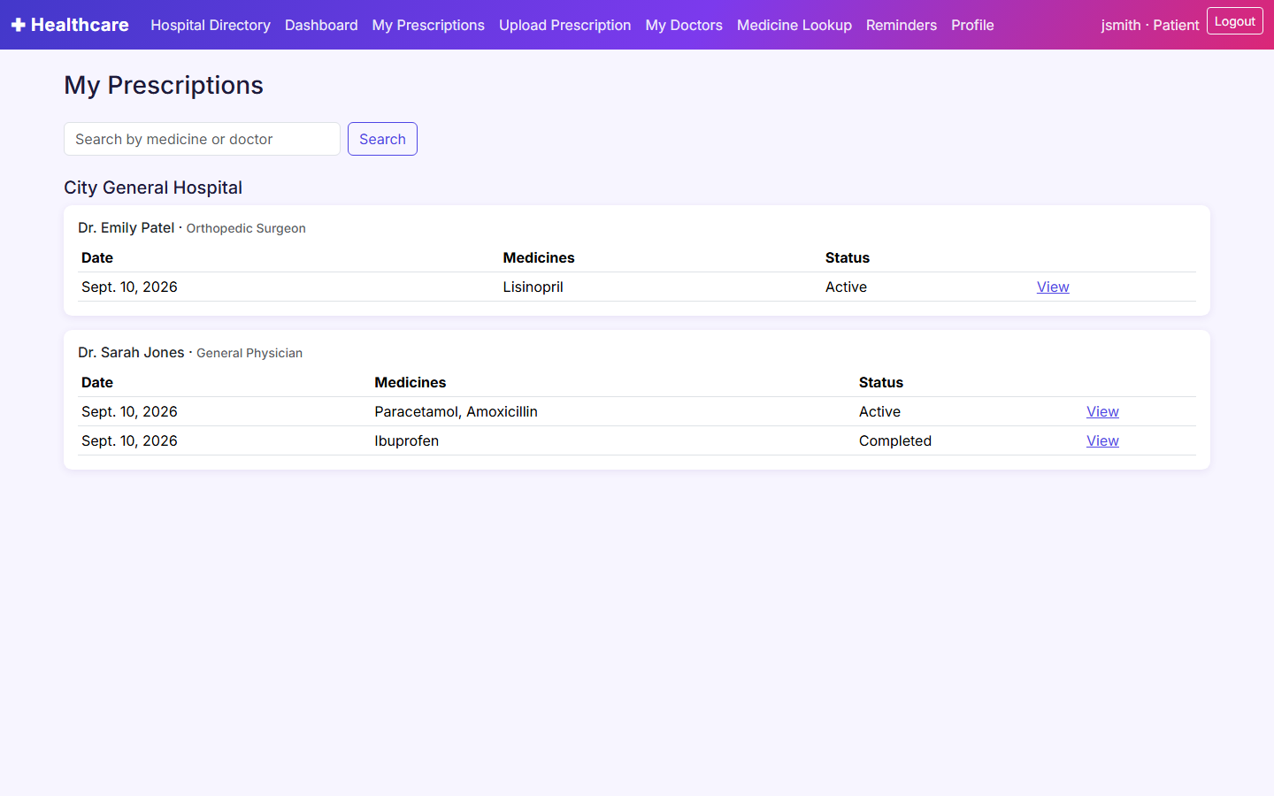
10
Patient Management
Patients maintain their profile and see every prescription they've received, organized by hospital and doctor. They can also upload a prescription they received outside the system for the same structured tracking.
INPUT
Profile edits, uploaded
prescription image/PDF
↓
OUTPUT
Updated profile, prescription history
grouped by hospital and doctor
PATIENT MANAGEMENT — SCREEN
Healthcare – Digital Healthcare Management System
11

Slide 12
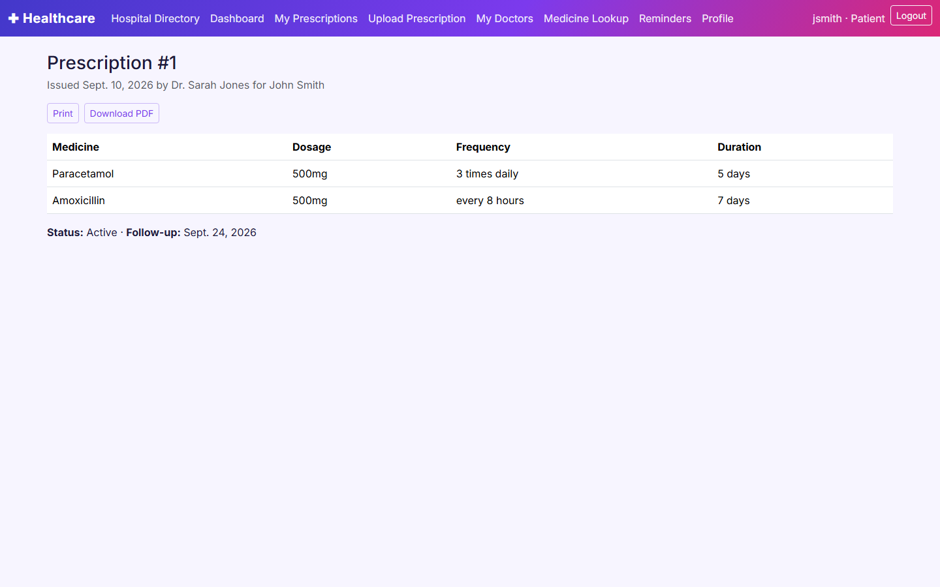
11
Prescription Management
The core OCR pipeline: an uploaded prescription image or PDF is scanned for medicine names, dosages, frequencies and durations, shown back to the patient for verification, and only the confirmed data is saved.
INPUT
Prescription image/PDF, or
doctor-entered prescription data
↓
OUTPUT
Structured digital prescription
(medicines, dosage, status)
PRESCRIPTION MANAGEMENT — SCREEN
Healthcare – Digital Healthcare Management System
12

Slide 13
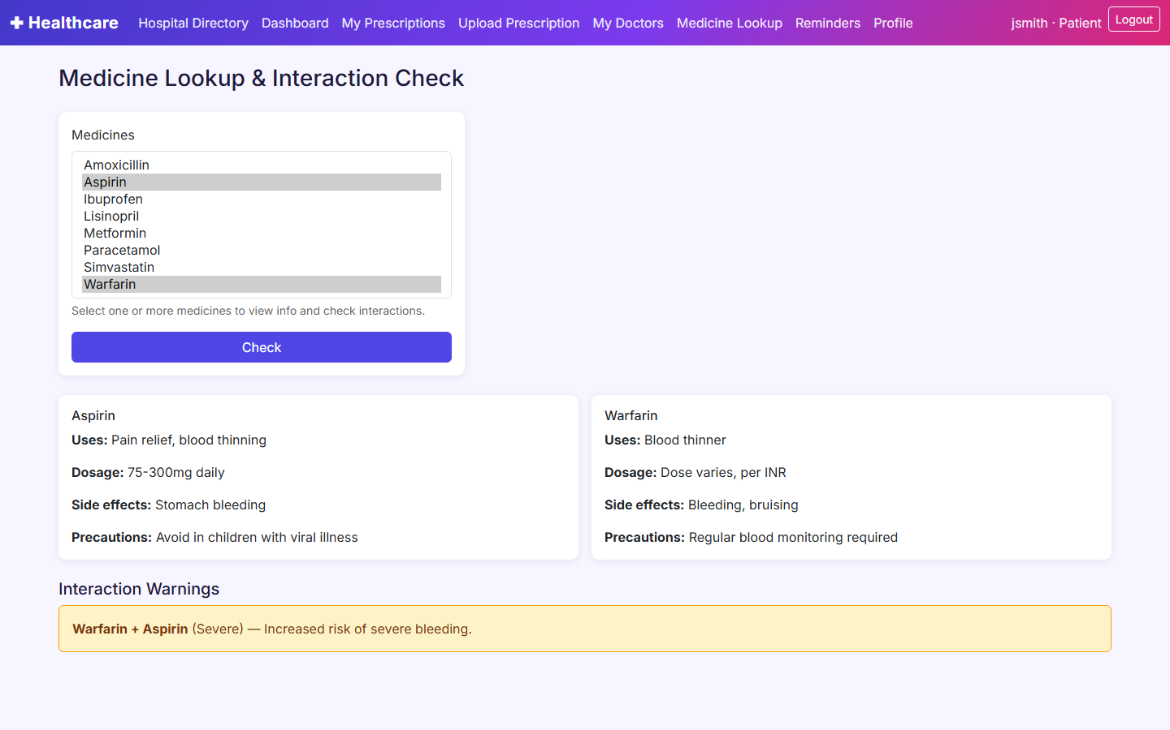
12
Medication Management
Patients look up medicine information and check for interactions across their active prescriptions, then schedule reminders for each dose and mark them as taken to build an adherence record.
INPUT
Medicine name/ID query, reminder
schedule, “mark as taken” action
↓
OUTPUT
Medicine info / interaction warning,
scheduled reminders, adherence %
MEDICATION MANAGEMENT — SCREEN
Healthcare – Digital Healthcare Management System
13

Slide 14
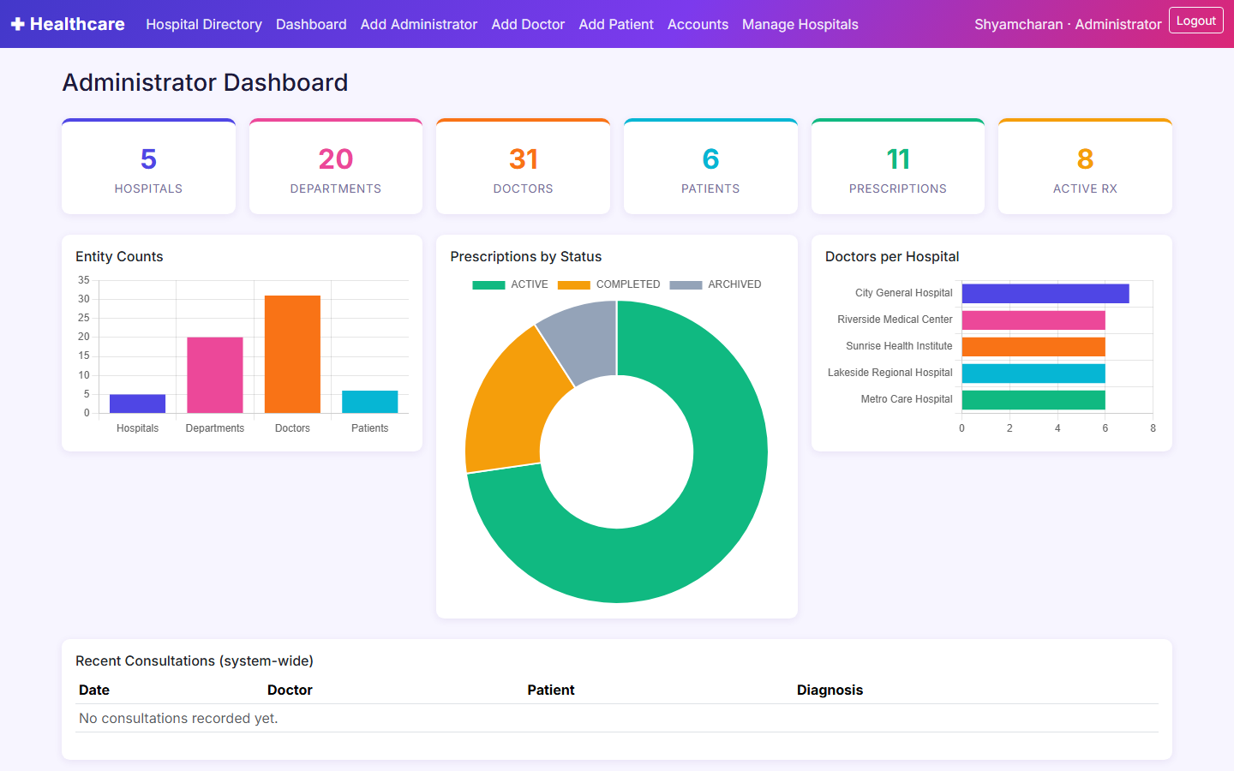
13
Dashboard & Analytics
Each role gets a tailored analytics view: Administrators see system-wide counts, Doctors see their patients and upcoming follow-ups, and Patients see active prescriptions, today's medications and adherence.
INPUT
Aggregated queries across hospitals,
prescriptions, reminders (role-scoped)
↓
OUTPUT
Role-specific dashboard: counts,
charts, recent activity, upcoming items
DASHBOARD & ANALYTICS — SCREEN
Healthcare – Digital Healthcare Management System
14

