Slide 1
Duration: 17/03/2025 To 17/04/2025 Tools Used: Excel, Python, MySQL
Title: Data Analysis Internship Project
Subtitle: Cognifyz Technologies – Internship Report
SHYAM DHUDIYA

Slide 2
•Introduction
Content::
Objective of the project
Tools used for analysis
Dataset summary

Slide 3
•Dataset Overview
Content::
Total Records: 130+ City
Columns: Restaurant Name, Cuisine, Location, Rating, Cost, Online Delivery, Online Booking
Source: Internship-provided dataset

Slide 4
•Excel Analysis
Tool Used: Excel Filters, Pivot Table, Charts
Pivot Table : 1. Average Rating by City
2. Votes by City
3. Total Restaurant per cuisines
4. Average Rating by Price Range
Charts : 1. Column Chart Average Rating by City
2. Bar Chart Votes by City
3. Pie Chart Cuisines Distributions
4. Line Chart Average Rating by Price Range

Slide 5
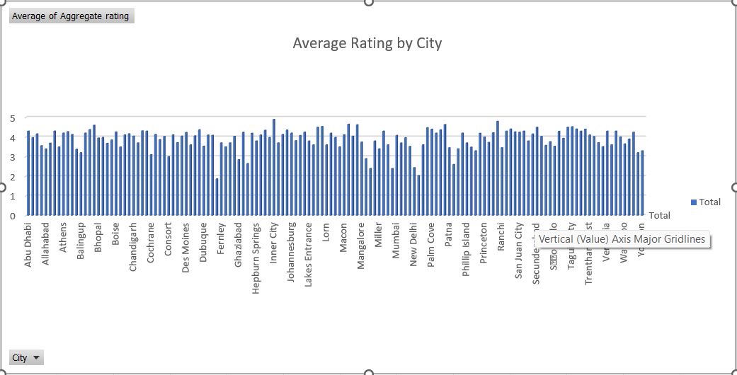
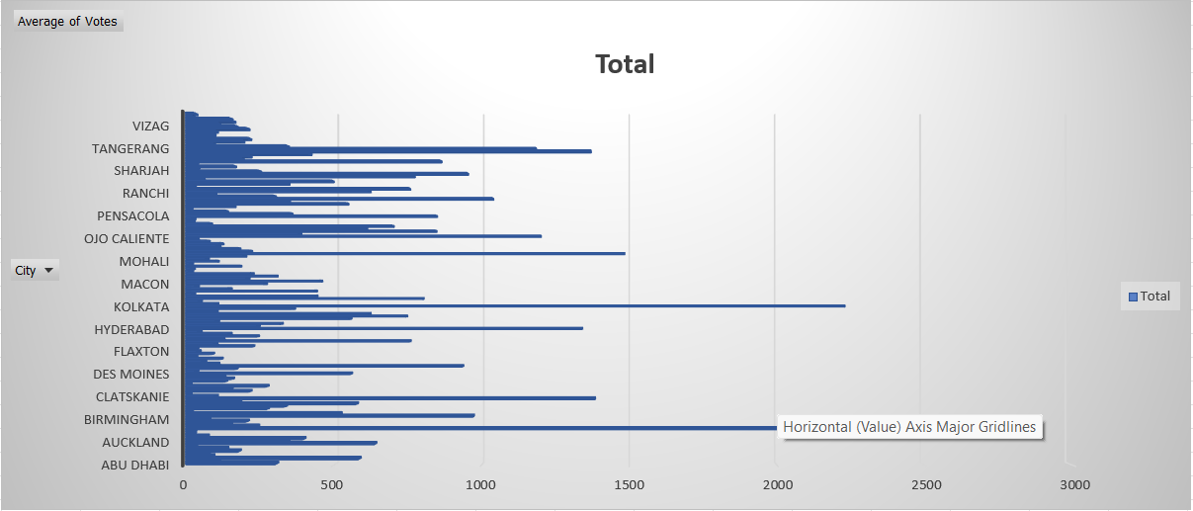

Slide 6
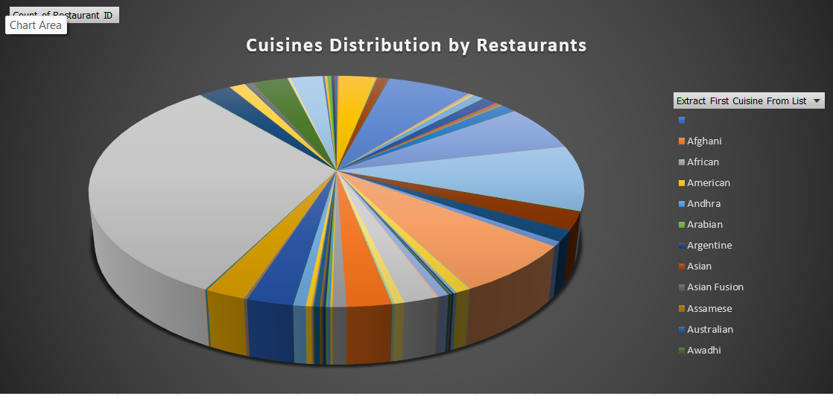
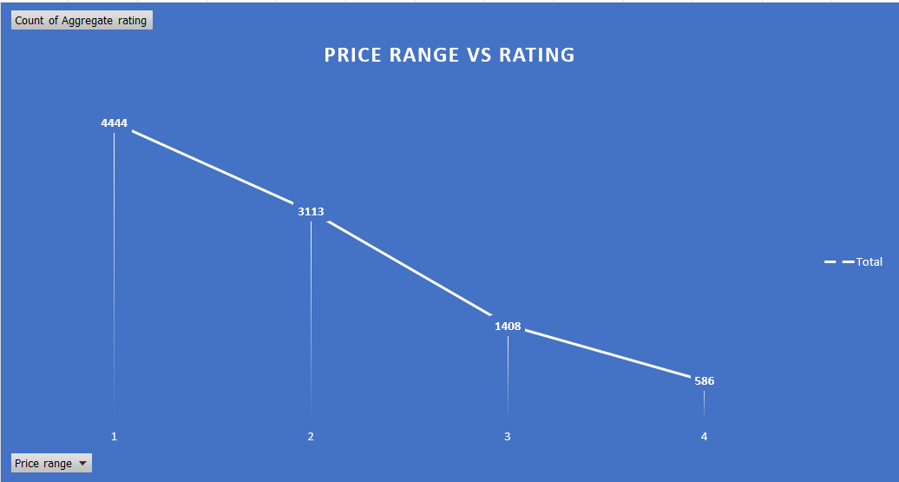

Slide 7
•MYSQL Analysis

Slide 8
navigating q&a sessions
Know your material in advance
Anticipate common questions
Rehearse your responses
Maintaining composure during the Q&A session is essential for projecting confidence and authority. Consider the following tips for staying composed:
Stay calm
Actively listen
Pause and reflect
Maintain eye contact

Slide 9

speaking impact
Your ability to communicate effectively will leave a lasting impact on your audience
Effectively communicating involves not only delivering a message but also resonating with the experiences, values, and emotions of those listening

Slide 10
speaking impact
Learn to infuse energy into your delivery to leave a lasting impression
One of the goals of effective communication is to motivate your audience
METRIC | MEASUREMENT | TARGET | ACTUAL
Audience attendance | # of attendees | 150 | 120
Engagement duration | Minutes | 60 | 75
Q&A interaction | # of questions | 10 | 15
Positive feedback | Percentage (%) | 90 | 95
Rate of information retention | Percentage (%) | 80 | 85

Slide 11
final tips & takeaways
CONSISTENT REHEARSAL
Strengthen your familiarity
REFINE DELIVERY STYLE
Pacing, tone, and emphasis
TIMING AND TRANSITIONS
Aim for seamless, professional delivery
PRACTICE AUDIENCE
Enlist colleagues to listen & provide feedback
Seek feedback
Reflect on performance
Explore new techniques
Set personal goals
Iterate and adapt

Slide 12
speaking engagement metrics
IMPACT FACTOR | MEASUREMENT | TARGET | ACHIEVED
Audience interaction | Percentage (%) | 85 | 88
Knowledge retention | Percentage (%) | 75 | 80
Post-presentation surveys | Average rating | 4.2 | 4.5
Referral rate | Percentage (%) | 10 | 12
Collaboration opportunities | # of opportunities | 8 | 10

Slide 13
thank you
BRITA TAMM
502-555-0152
brita@firstupconsultants.com
www.firstupconsultants.com

