Slide 1

NExUS : Networked Exchange using IPFS and P2P in a decentralized, universal system leveraging the Blockchain Technology
SHIVANI SURESH, 2021503050
SWATHY K S, 2021503052
SHYAMALA R B, 2021503558

Slide 2
INTRODUCTION
Data Share aims at creating a decentralized system where files can be shared securely.
By integrating blockchain technology, we make sure that the files shared on the network cannot be tampered or corrupted and the complete history of all the files shared will be stored giving users a sense of security.
Technologies used:
Blockchain
IPFS
AES Encryption

Slide 3
PROBLEM STATEMENT
In today's digital landscape, traditional centralized file sharing systems suffer from security vulnerabilities, data privacy concerns, and scalability issues. Users and organizations demand a more secure and efficient way to exchange files while maintaining data integrity and privacy. To address these challenges, we aim to develop a Blockchain-based Decentralized File Sharing System using IPFS. This system will provide a robust solution for secure, transparent, and efficient file sharing, ensuring the confidentiality and reliability of shared data in an increasingly interconnected world.

Slide 4
OBJECTIVES
Enhanced Security: Develop a system that prioritizes security through blockchain technology, safeguarding files from unauthorized access and alterations.
Data Privacy Assurance: Implement measures to preserve user data privacy during file transfers, bolstering confidence in the system's privacy features.
Decentralization with IPFS: Establish a resilient, decentralized network using IPFS to ensure system reliability and fault tolerance.
Data Integrity: Utilize blockchain's immutability to guarantee the unaltered state of shared files, mitigating data corruption risks.
User-Friendly Experience: Create an intuitive and user-friendly interface to facilitate effortless navigation and seamless file sharing for users.

Slide 5
LITERATURE SURVEY
S.NO | Title of the paper | Name of the Journal and published year | Proposed work | Methodology | Limitations
1 | Blockchain-Based Decentralized File Sharing System for Secure Data Sharing in the Cloud | IEEE Access, 2021 | Blockchain and IPFS for secure data sharing in the cloud | Scalability, regulatory compliance, and privacy | 1
2 | Decentralized File Sharing using Blockchain Empowering Peer-to-Peer Collaboration | International Journal of Engineering Research & Technology, 2023 | Blockchain-based decentralized file sharing system with incentives | Scalability, security, and privacy | 2
3 | A Decentralized File Sharing System Based on IPFS and Blockchain Using Reputation Mechanism | IEEE International Conference on Blockchain and Cryptocurrency (ICBC), 2022 | Blockchain-based decentralized file sharing system with reputation mechanism | Scalability and security | 3
4 | A Blockchain-Based Decentralized File Sharing System for Secure Data Sharing in the Internet of Things | IEEE Transactions on Industrial Informatics, 2022 | Blockchain and IPFS for secure data sharing in the IoT | Scalability and security | 4

Slide 6
LITERATURE SURVEY
S.NO | Title of the paper | Name of the Journal and published year | Proposed work | Methodology | Limitations
5 | A Blockchain-Based Decentralized File Sharing System with Fine-Grained Access Control | IEEE Transactions on Network and Service Management, 2023 | Blockchain and IPFS for decentralized file sharing with fine-grained access control | Scalability and security | 5
6 | A Blockchain-Based Decentralized File Sharing System with Attribute-Based Encryption | IEEE Transactions on Cloud Computing, 2022 | Blockchain and IPFS for decentralized file sharing with attribute-based encryption | Scalability and security | 6
7 | A Blockchain-Based Decentralized File Sharing System with Proof-of-Storage and Proof-of-Retrieval | IEEE Transactions on Information Forensics and Security, 2021 | Blockchain and IPFS for decentralized file sharing with proof-of-storage and proof-of-retrieval | Scalability and security | 7
8 | A Blockchain-Based Decentralized File Sharing System with Reputation System and Incentive Mechanism | IEEE Transactions on Parallel and Distributed Systems, 2020 | Blockchain and IPFS for decentralized file sharing with reputation system and incentive mechanism | Scalability and security | 8

Slide 7
PROPOSED WORK
It is a decentralized distributed database existing on multiple computers at the same time. It is constantly growing as new sets of recordings, or ‘blocks’, are added to it.
Each block contains a timestamp and a link to the previous block, so they actually form a chain.
Everyone in the network gets a copy of the whole database. Old blocks are preserved forever and new blocks are added to the ledger irreversibly, making it impossible to manipulate by faking documents, transactions and other information.
The blocks are cryptographically linked together.

Slide 8
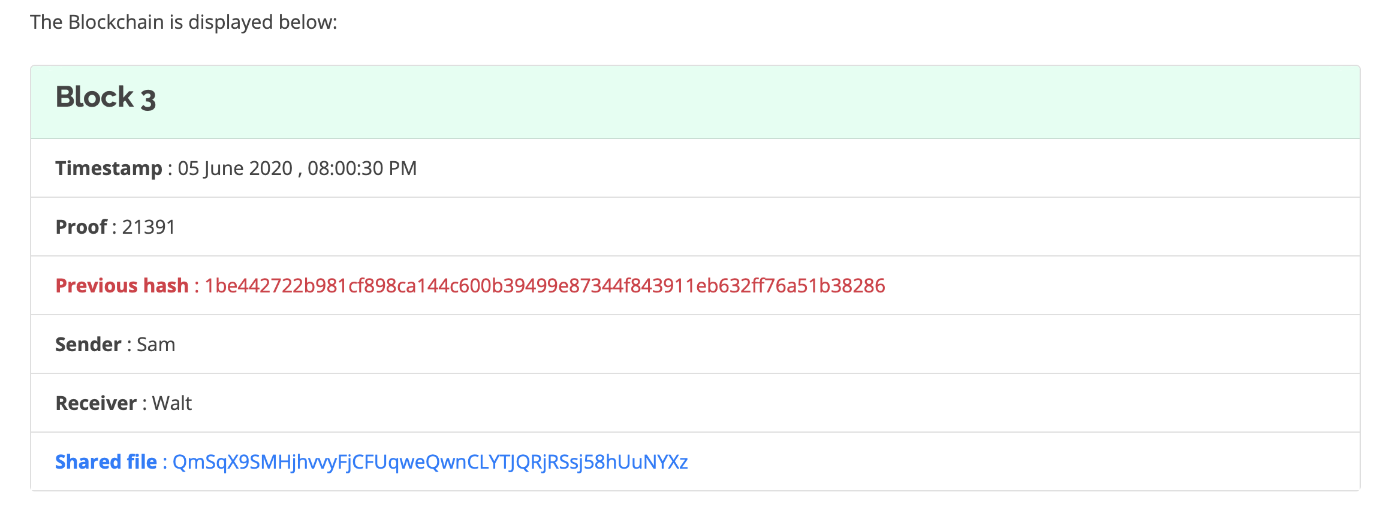
PROPOSED ARCHITECTURE
Block Structure
Nonce to uniquely represent a block
SHA-256 hash of the Block 2
Data stored in the blockchain
Hash of the shared file generated by IPFS using AES Encryption and SHA256 hashing algorithm

Slide 9
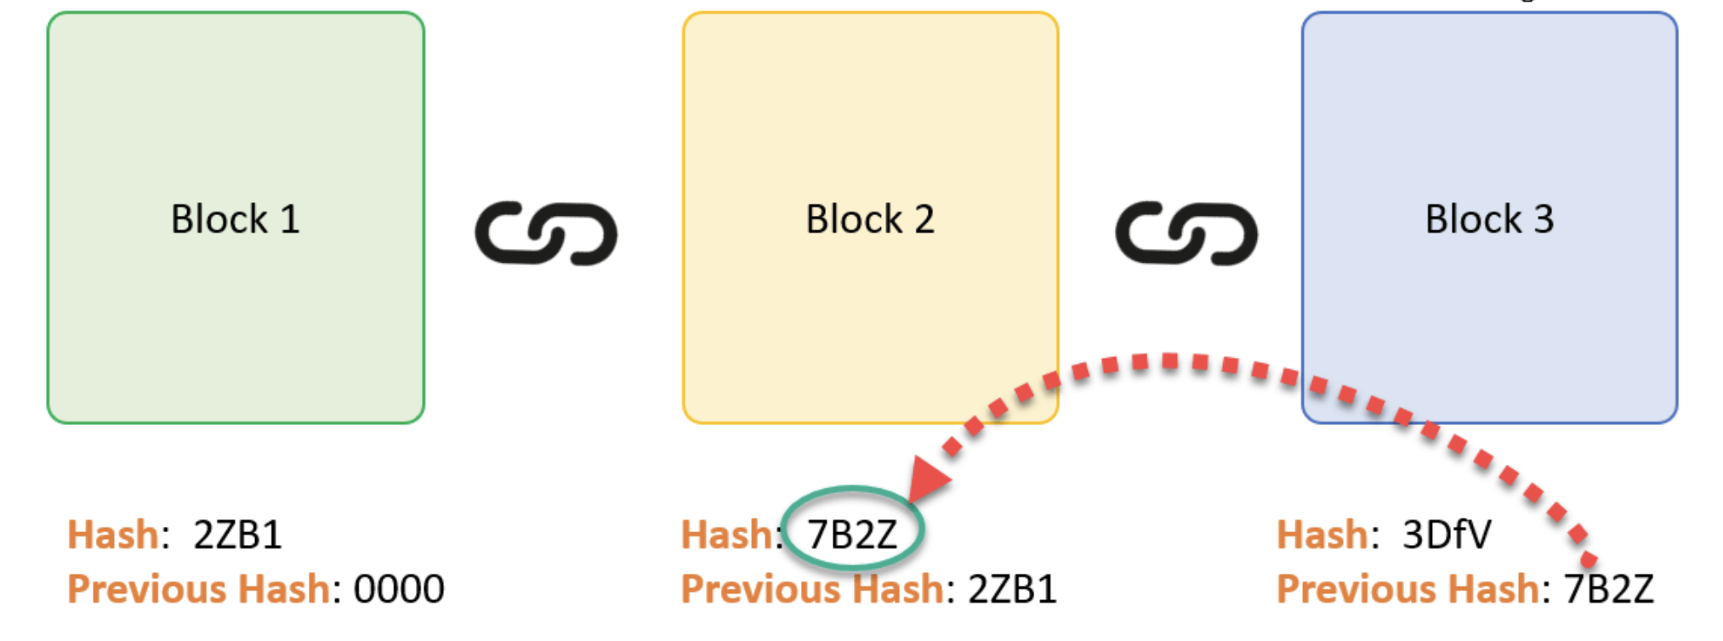
PROPOSED ARCHITECTURE

Slide 10
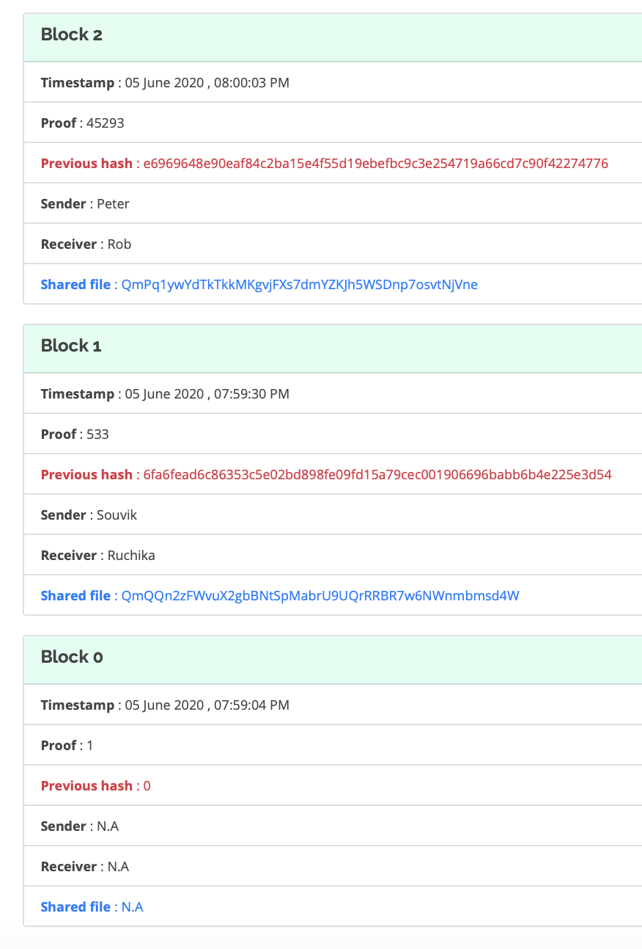
PROPOSED ARCHITECTURE
Blockchain with three blocks cryptographically linked together
Blocks are linked together cryptographically using the SHA-256 hashes of the previous blocks
Genesis Block

Slide 11
MECHANISM/MODULE
1. User Authentication and Registration Module:
Mechanism: Implement user registration and authentication using cryptographic techniques (e.g., public-private key pairs) to ensure secure access to the system.
2. File Upload and Storage Module:
Mechanism: Utilize IPFS for decentralized file storage, allowing users to upload and store files securely across the IPFS network.
3. File Sharing Module:
Mechanism: Enable users to share files securely by generating and sharing access keys or links. Implement encryption and access control to protect shared files.
4. Blockchain Ledger Module:
Mechanism: Maintain a blockchain ledger to record file sharing activities, user interactions, and access control permissions for audit and transparency.

Slide 12
MECHANISM/MODULE
5. Data Privacy Module:
Mechanism: Implement privacy-enhancing techniques such as zero-knowledge proofs or data anonymization to protect user data during file transfers.
6. Access Control and Permissions Module:
Mechanism: Develop a module to define and manage access controls, allowing file owners to specify who can view, edit, or share their files.
7. File Retrieval Module:
Mechanism: Enable users to retrieve shared files by securely accessing the IPFS network and decrypting files using appropriate access keys.
8. User Interface Module:
Mechanism: Design an intuitive user interface that provides a user-friendly experience for file upload, sharing, and access control management.

Slide 13
ALGORITHM
# Step 1: User Registration and Authentication
user_info = register() # Register the user and collect their personal information
private_key = generate_private_key() # Generate a private key for the user
user_authenticated = authenticate(user_info, private_key) # Authenticate the user
# Step 2: File Upload and Storage
file_to_share = select_file() # User selects a file for upload
file_id = generate_unique_identifier() # Generate a unique identifier for the file
encrypted_file = encrypt(file_to_share, private_key) # Encrypt the file
ipfs_hash = store_on_ipfs(encrypted_file) # Store the encrypted file on IPFS
record_on_blockchain(ipfs_hash) # Record the IPFS hash on the blockchain

Slide 14
ALGORITHM
# Step 3: File Sharing
authorized_users = select_authorized_users() # User specifies authorized users
permissions = define_permissions() # Define access control settings
access_keys = generate_access_keys(authorized_users, permissions) # Generate access keys or links
# Step 4: File Retrieval
user_input = provide_access_key() # User provides an access key or link
retrieved_ipfs_hash = retrieve_ipfs_hash(user_input) # Retrieve the IPFS hash from the blockchain
encrypted_file = fetch_from_ipfs(retrieved_ipfs_hash) # Fetch the encrypted file from IPFS
decrypted_file = decrypt(encrypted_file, private_key) # Decrypt the file

Slide 15
ALGORITHM
# Step 5: Blockchain Ledger
blockchain_transaction = record_transaction(file_id, user, activity) # Record file-related activities on the blockchain
# Step 6: Data Privacy
encrypted_data = encrypt(data, public_key) # Encrypt data for privacy
# Step 7: Access Control and Permissions
access_control_list = manage_access_control(file_id, authorized_users, permissions) # Manage access control lists
# Step 8: User Interface
user_interface = create_user_interface() # Create a user-friendly interface for user interactions

Slide 16
IMPLEMENTATION DETAILS
User Registration and Authentication:
User Registration:
Users provide their personal information (e.g., username, email, name).
A unique user identity is generated, typically in the form of a public-private key pair.
Registration data is stored securely on the system.
User Authentication:
During login, users present their private keys for authentication.
The system verifies the private key against the user's registered public key.
Successful authentication grants access to the user's account.

Slide 17
IMPLEMENTATION DETAILS
File Upload and Storage:
File Selection:
Users initiate file uploads by selecting the files they wish to share.
File Encryption and Identifier Generation:
Uploaded files are encrypted to protect their content.
A unique identifier (e.g., a hash) is generated for each uploaded file to distinguish it from others.
IPFS Storage:
The encrypted file is stored on the IPFS network, which provides decentralized and distributed file storage.
The IPFS hash generated for the file's location is recorded for future retrieval.

Slide 18
IMPLEMENTATION DETAILS
File Sharing:
User Selection:
Users specify who they want to share files with by selecting authorized users.
Access Control Settings:
Users define access control settings, including permissions (e.g., view, edit, share) for the authorized users.
Access Key Generation:
The system generates access keys or links, which grant authorized users access to the shared files.

Slide 19
IMPLEMENTATION DETAILS
File Retrieval:
User Access Request:
Authorized users present access keys or links to access shared files.
IPFS Hash Retrieval:
The system retrieves the IPFS hash associated with the requested file from the blockchain.
IPFS File Fetching:
Using the retrieved IPFS hash, the system fetches the corresponding encrypted file from the IPFS network.
Decryption:
The encrypted file is decrypted using the appropriate access keys, enabling authorized users to view or edit the file.

Slide 20
IMPLEMENTATION DETAILS
Blockchain Ledger:
Transaction Recording:
The system maintains a blockchain ledger to record all file-related activities, including uploads, sharing, and access control changes.
Transparency and Auditability:
Blockchain transactions ensure transparency and provide a reliable audit trail of file transactions, making the system tamper-proof and trustworthy.
Data Privacy:
Data Encryption:
Sensitive data, including file content, user information, and access keys, is encrypted using cryptographic algorithms to protect it from unauthorized access.
Anonymization:
Anonymization techniques may be applied to data to further protect user privacy.

Slide 21
KEY FEATURES
Security and Privacy:
Robust encryption mechanisms to ensure the confidentiality and integrity of shared files.
User-controlled access permissions and access keys to protect sensitive data.
Decentralization:
Utilizes IPFS for decentralized file storage, reducing single points of failure and enhancing fault tolerance.
Transparency and Auditability:
Blockchain ledger for recording and tracking all file sharing activities, ensuring transparency and auditability.
Data Integrity:
Leveraging blockchain's immutability to guarantee the integrity of shared files, preventing unauthorized alterations.
User-Friendly Interface:
An intuitive and user-friendly interface for easy navigation and seamless file sharing.

Slide 22
KEY FEATURES
Access Control:
Granular access control settings, allowing file owners to specify who can view, edit, and share their files.
Data Privacy:
Implementation of data privacy measures, such as encryption and anonymization, to protect user data during file transfers.
Scalability:
Designed to handle increasing user loads and growing data volumes without compromising performance.
Blockchain Integration:
Compatibility with popular blockchain platforms for efficient recording and management of file transactions.
Cross-Platform Compatibility:
Support for file sharing across various devices and operating systems, promoting interoperability.

Slide 23
REFERENCES
C. Vaidya, K. Takalkar, A. Ghosekar, S. Nimgade and V. Ghode, "Decentralized File Sharing," 2023 IEEE International Students' Conference on Electrical, Electronics and Computer Science (SCEECS), Bhopal, India, 2023, pp. 1-6, doi: 10.1109/SCEECS57921.2023.10062977.
M. N. Uddin, A. H. M. A. Hasnat, S. Nasrin, M. S. Alam and M. A. Yousuf, "Secure File Sharing System Using Blockchain, IPFS and PKI Technologies," 2021 5th International Conference on Electrical Information and Communication Technology (EICT), Khulna, Bangladesh, 2021, pp. 1-5, doi: 10.1109/EICT54103.2021.9733608.
J. Anthal, S. Choudhary and R. Shettiyar, "Decentralizing File Sharing: The Potential of Blockchain and IPFS," 2023 International Conference on Advancement in Computation & Computer Technologies (InCACCT), Gharuan, India, 2023, pp. 773-777, doi: 10.1109/InCACCT57535.2023.10141817.
W. -C. Huang, L. -Y. Yeh and J. -L. Huang, "A Monitorable Peer-to-Peer File Sharing Mechanism," 2019 20th Asia-Pacific Network Operations and Management Symposium (APNOMS), Matsue, Japan, 2019, pp. 1-4, doi: 10.23919/APNOMS.2019.8892963.
H. Shen, "EAD: An Efficient and Adaptive Decentralized File Replication Algorithm in P2P File Sharing Systems," 2008 Eighth International Conference on Peer-to-Peer Computing, Aachen, Germany, 2008, pp. 99-108, doi: 10.1109/P2P.2008.37.

Slide 24
REFERENCES
Y. Lin and C. Zhang, "A Method for Protecting Private Data in IPFS," 2021 IEEE 24th International Conference on Computer Supported Cooperative Work in Design (CSCWD), Dalian, China, 2021, pp. 404-409, doi: 10.1109/CSCWD49262.2021.9437830.
M. Jain and M. Jailia, "Proposed model to decentralized storage of educational data for privacy preservation using Blockchain," 2022 International Conference on Computer Communication and Informatics (ICCCI), Coimbatore, India, 2022, pp. 1-5, doi: 10.1109/ICCCI54379.2022.9740654.
V. -D. Pham et al., "B-Box - A Decentralized Storage System Using IPFS, Attributed-based Encryption, and Blockchain," 2020 RIVF International Conference on Computing and Communication Technologies (RIVF), Ho Chi Minh City, Vietnam, 2020, pp. 1-6, doi: 10.1109/RIVF48685.2020.9140747.
G. S. Reen, M. Mohandas and S. Venkatesan, "Decentralized Patient Centric e- Health Record Management System using Blockchain and IPFS," 2019 IEEE Conference on Information and Communication Technology, Allahabad, India, 2019, pp. 1-7, doi: 10.1109/CICT48419.2019.9066212.
L. Sari and M. Sipos, "FileTribe: Blockchain-based Secure File Sharing on IPFS," European Wireless 2019; 25th European Wireless Conference, Aarhus, Denmark, 2019, pp. 1-6.

