Slide 1
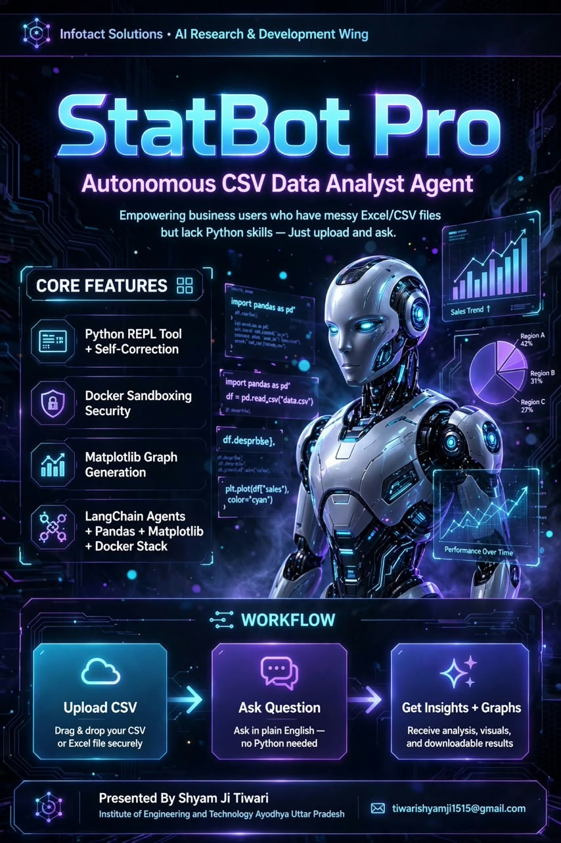

Slide 2

Title

Slide 3
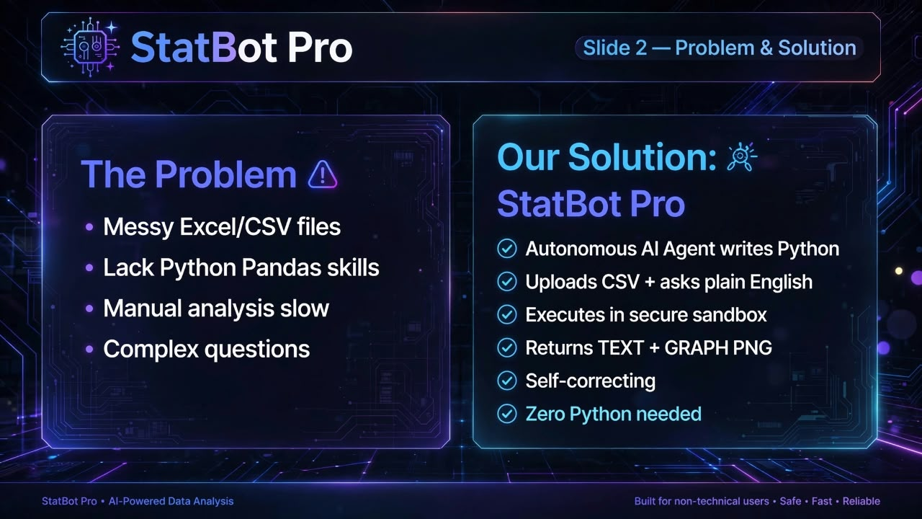
Problem & Solution

Slide 4
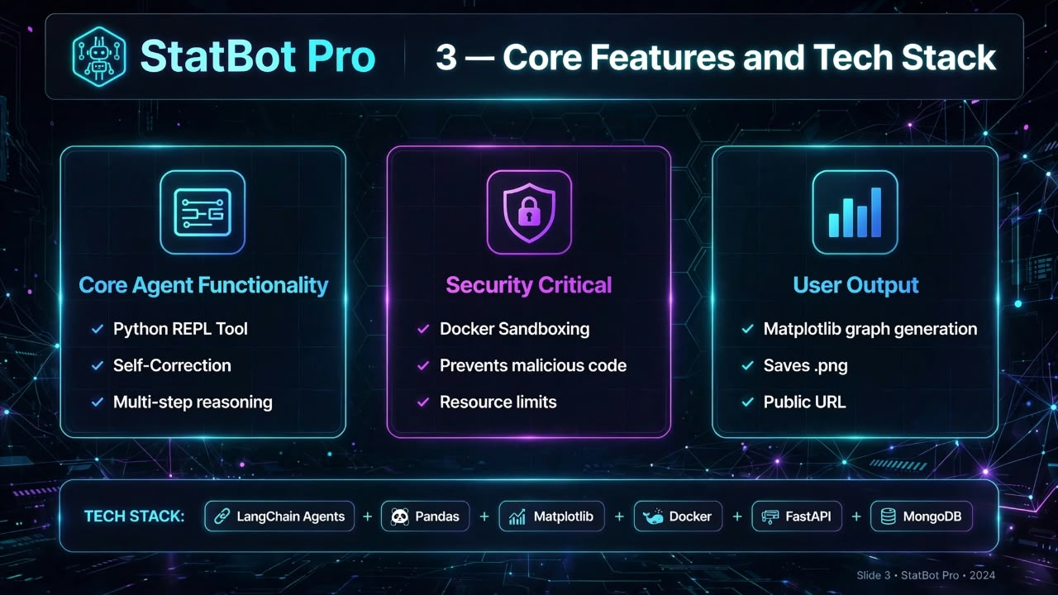
Core Features & Tech Stack

Slide 5
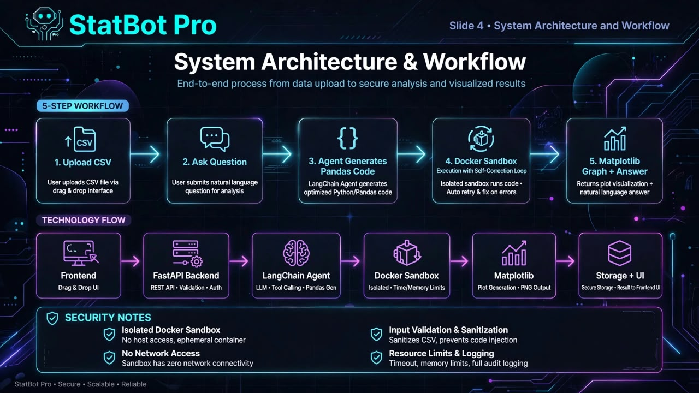
Architecture & Workflow

Slide 6
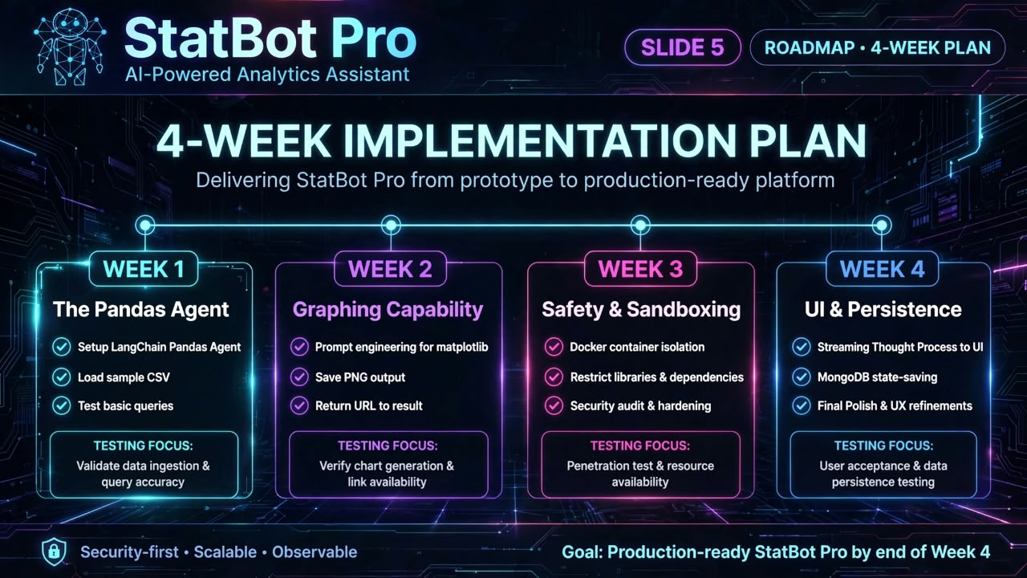
Week Implementation Plan

Slide 7

Conclusion

