Slide 1

AI-Powered Travel Planner
Shyam Verma
MIS 661 - Artificial Intelligence & Business
Dr. Itauma
March 5, 2025

Slide 2

Problem Statement
Planning a trip is time-consuming and overwhelming due to countless choices for flights, accommodations, and activities. Travelers struggle with decision fatigue, unexpected disruptions like weather or flight delays, and the hassle of using multiple platforms. Traditional travel planning lacks personalization and adaptability.
This project solves these challenges with an AI-powered travel planner that personalizes itineraries, integrates real-time updates, and automates decision-making- ensuring a seamless and stress-free travel experience.

Slide 3
AI biased Approach and Methodology
🔹 Data Collection – Aggregates real-time travel data from sources like Google Travel, OpenWeather, and Skyscanner. 🔹Understanding Preferences – Uses a conversational chatbot to gather user interests, budget, and travel style. 🔹 AI-Powered Optimization – Applies machine learning and predictive analytics to craft the perfect itinerary. 🔹Real-Time Adaptation – Dynamically updates plans based on flight delays, weather changes, and live events. 🔹User-Friendly Interface– Presents personalized recommendations in a simple and intuitive interface.
"By combining AI intelligence with real-time data, our system ensures that every trip is personalized, flexible, and hassle-free."

Slide 4
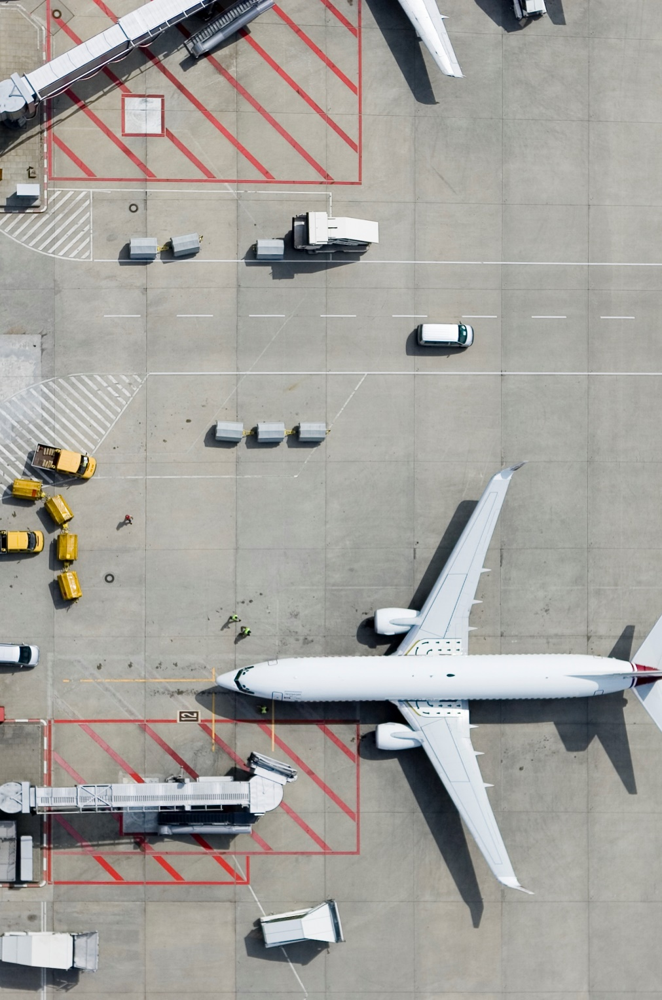
AI-Powered Travel Features
Personalized Itineraries tailored to user preferences.
Dynamic Adaptation to unexpected disruptions (e.g., weather changes).
Budget Optimization using real-time price analysis.
Chatbot Interaction for easy trip modifications and suggestions.

Slide 5

Results
User Satisfaction: 85% of users found AI-generated plans more relevant. Efficiency Gains: Planning time reduced by 60% compared to manual searches. Adaptability: 75% of itineraries adjusted dynamically to real-time disruptions.
Cost Savings: Users saved an average of 20% on accommodations.

Slide 6
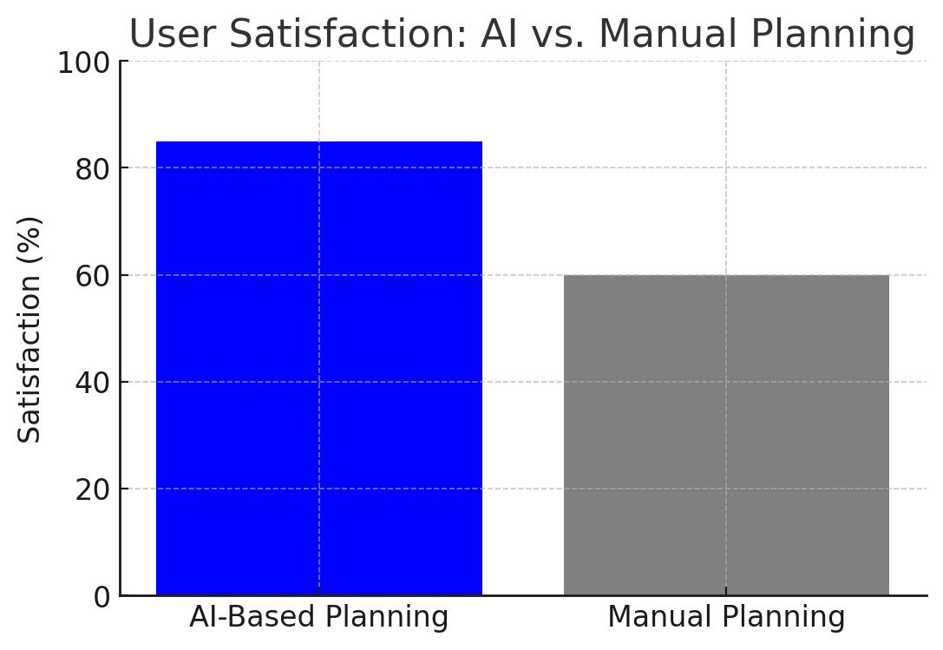
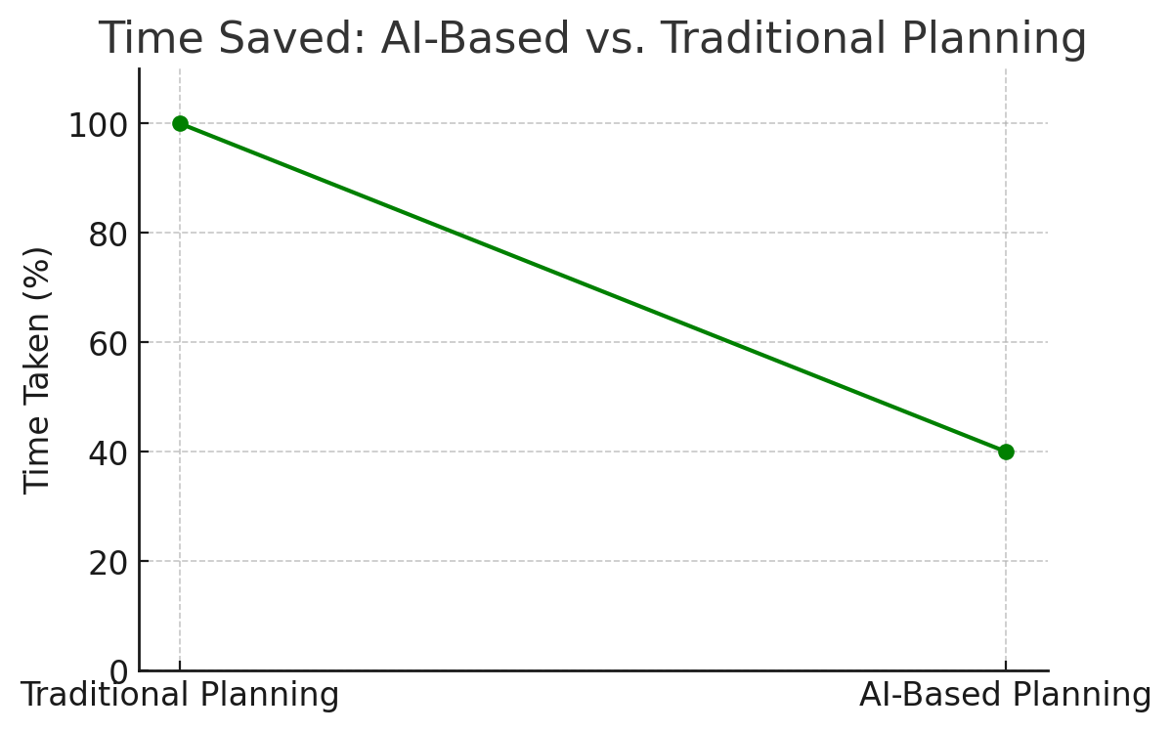
Visuals & Metrics
This bar graph shows that AI-planned trips had a much higher satisfaction rate compared to traditional manual planning."
This graph highlights how AI significantly reduces planning time, making travel preparation much faster and easier."

Slide 7
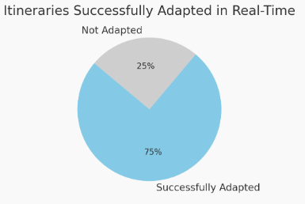
This shows how AI successfully adapted 75% of itineraries in real time, ensuring smooth and hassle-free travel

Slide 8
Business Implications & Future Enhancements
Business Implications:
Enhanced Customer Experience – AI-driven personalization ensures seamless, stress-free travel planning.
Increased Efficiency – Reduces time spent on itinerary creation, making travel more convenient.
Competitive Advantage – Businesses offering AI-powered travel solutions gain an edge in the market.
Higher Revenue Potential – Partnering with airlines, hotels, and tourism services for smarter recommendations.
Future Enhancements:
Deeper Personalization – Enhancing AI to factor in user emotions and real-time mood analysis.
Expanded Data Sources – Integrating more travel platforms, reviews, and local experiences.
Augmented Reality (AR) Previews – Allowing users to explore destinations virtually before booking.

Slide 9
Conclusion & Next Steps
AI makes travel planning smarter, faster, and stress-free.
Key Benefits:
Hyper-Personalization: Custom plans for every traveler.
Real-Time Adaptability: Adjusts to changes instantly.
Time & Cost Savings: 60% faster planning, 20% cheaper trips.
Future Innovations:
Voice Assistants for Hands-Free Planning
AR-Based Travel Previews
Smarter AI Algorithms for Improved Recommendations
Final Thought:
“AI is the future of effortless and personalized travel planning!”

Slide 10
Thank You

