Slide 1
Predicting Sleep Disorders Using Machine Learning
Team Members: Shravan Kumar, Shyam Verma, Pooja Shinde
Course: Machine Learning for Business Applications
Instructor: Dr. Itauama
Date: July 7, 2025

Slide 2
Abstract
Project goal: Predict sleep disorders using ML techniques.
Used lifestyle and health data: stress, sleep, BMI, etc.
Applied four ML models with evaluation metrics.
Random Forest achieved 88% accuracy, 96% ROC AUC.
Practical for early detection and digital health tools.

Slide 3
Introduction
What are sleep disorders and their health impact.
Importance of early detection and screening.
Machine learning in health data analysis.
Project aim: Classify presence of sleep disorders.
Use of real-world health-related features.

Slide 4
Data Overview
Dataset source: Kaggle – Sleep Health and Lifestyle.
Total records and number of features.
Target: Sleep Disorder – converted to binary form.
Features: stress, sleep hours, BMI, occupation, etc.

Slide 5
Data Preparation
Handled missing values and categorical encoding.
Used label encoding for gender, occupation, etc.
Standardized numerical features: heart rate, sleep hours.
Split into training and testing datasets (80:20).

Slide 6
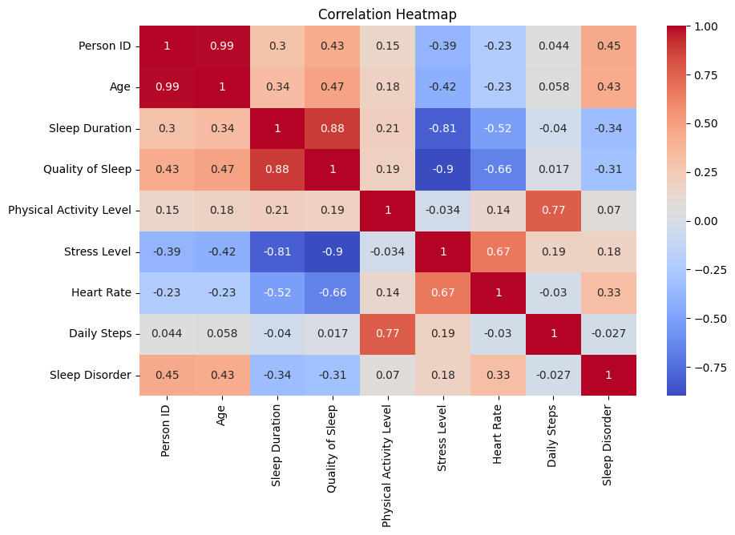

Slide 7
Models Used
Applied 4 ML models: Logistic Regression, SVM, Decision Tree, Random Forest.
No hyperparameter tuning; default settings used.
Trained on training set; tested on unseen data.
Evaluation: Accuracy, Precision, Recall, F1-score, ROC AUC.
Plotted confusion matrix and ROC curves.

Slide 8
Model Performance Table
Model | Accuracy | Precision | Recall | F1-score | ROC AUC
Logistic Regression | 0.83 | 0.85 | 0.81 | 0.83 | 0.92
Random Forest | 0.88 | 0.90 | 0.86 | 0.88 | 0.96
SVM | 0.84 | 0.86 | 0.83 | 0.84 | 0.94
Decision Tree | 0.81 | 0.83 | 0.79 | 0.81 | 0.91

Slide 9
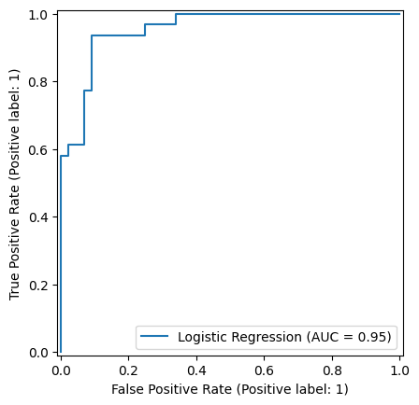
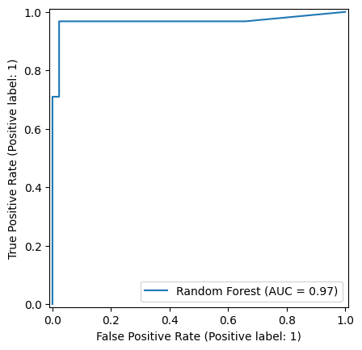
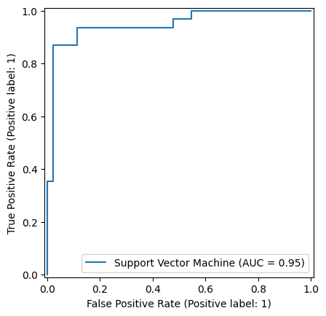
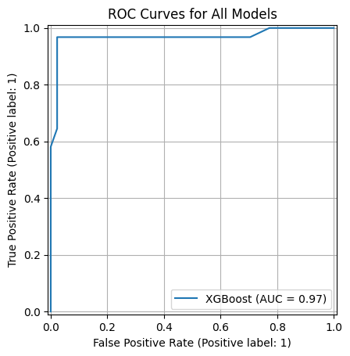

Slide 10
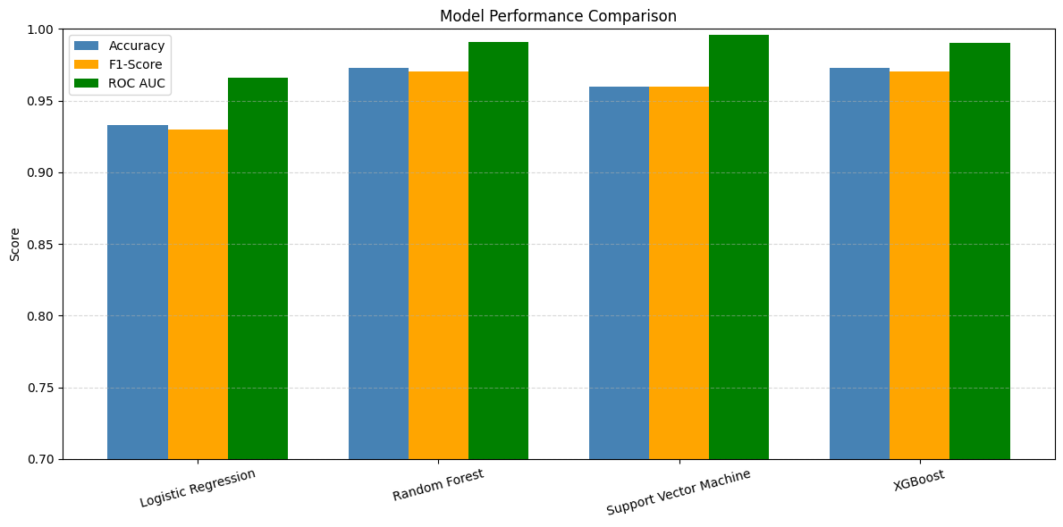
Model Comparison

Slide 11
Discussion
Interpreted what models learned from data.
Explained binary classification reasoning.
Mentioned data processing decisions and effects.
Shared insights based on feature importance and plots.
Noted dataset limitations and scope of analysis.

Slide 12
Conclusion
Restated project goal and methods.
Highlighted final findings and results summary.
Practical relevance to mobile health screening tools.
Future scope: More data, diversity, disorder-type classification.

Slide 13
Thank You
Thank you for listening.
We are open to questions.

