Slide 1

Unsupervised learning
Submitted by
Shyam Mohan
M4c-14
CASP

Slide 2
Learning
Learning is a phenomena through which a system gets trained and becomes adaptable to give result in an accurate manner.
Learning is the most important phase as how well the system performs on the data provided to the system depends on which algorithms used on the data.
Entire dataset is divided into two categories, one which is used in training the model i.e. Training set and the other that is used in testing the model after training, i.e. Testing set.

Slide 3
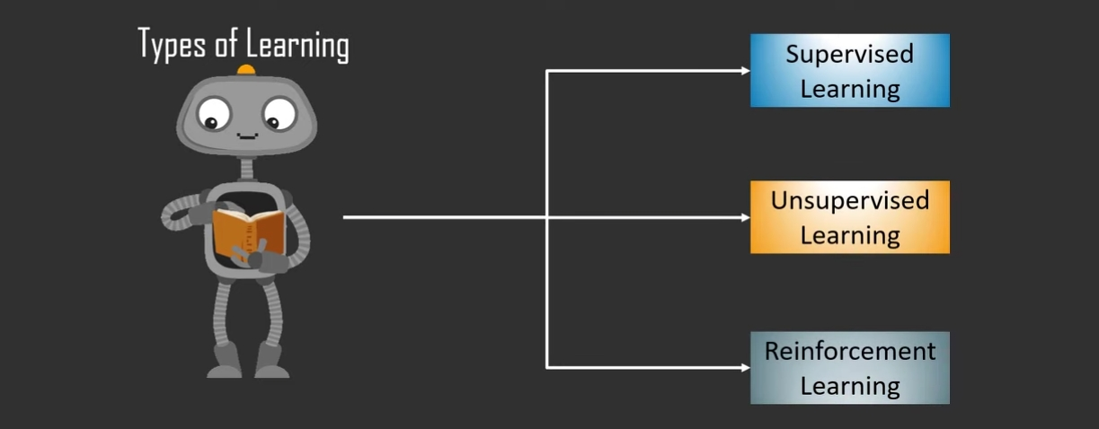

Slide 4
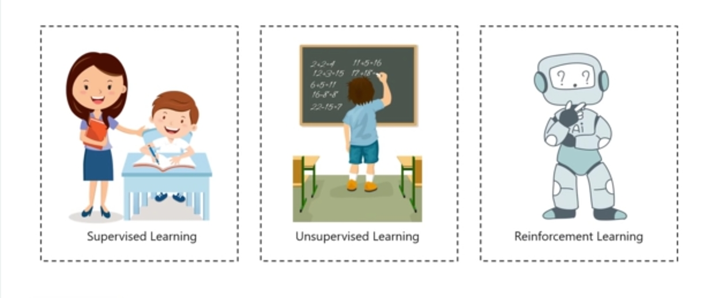

Slide 5
Supervised Learning :
The system is presented with example inputs and desired outputs, given by a teacher and the goal is to learn a general rule that maps to outputs.
That is, Supervised learning process means that, data you have collected here is labelled and so you know what input needs to be mapped to what output.
This helps you correct your algorithm if it makes a mistake in giving you the answer.
Unsupervised Learning :
No labels are given to the learning algorithm, leaving it on its own to find structure in its input.
That is, data collected here has no labels and you are unsure about the outputs.
So you model your algorithm such that it can understand patterns from the data and output the required answer.
Unsupervised learning can be a goal in itself (discovering hidden patterns in data).
You do not interfere when the algorithm learns.

Slide 6
Reinforcement Learning :
A system interact with dynamic environment in which it perform certain goal (such as driving a vehicle or playing a game against an opponent).
The system is provided feedback in terms of rewards and punishment as it navigates its problem space.
With continuous interactions and learning, it goes from being bad to being the best that it can for the problem assigned to it
[ Between Supervised and Unsupervised learning is Semi-supervised learning, where the teacher gives an incomplete training signal: a training set with some (often many) of the target outputs missing. ]

Slide 7
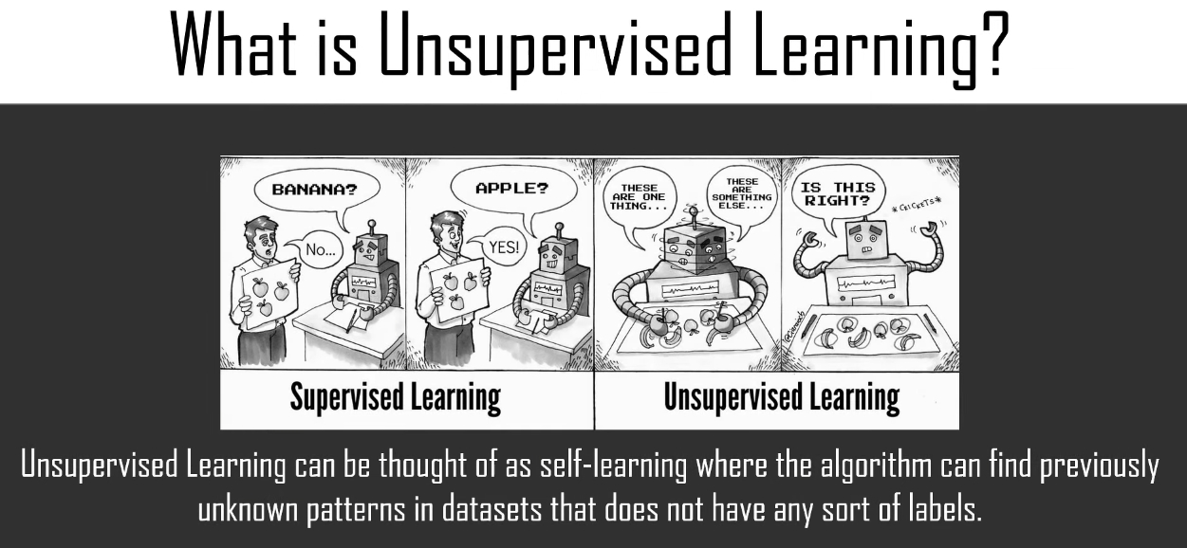

Slide 8
Supervised Learning vs. Unsupervised Learning
Parameter | Supervised Learning | Unsupervised Learning
Dataset | Labelled Dataset | Unlabelled Dataset
Method of Learning | Guided learning | The algorithm learns by itself using dataset
Complexity | Simpler method | Computationally complex
Accuracy | More Accurate | Less Accurate

Slide 9
Unsupervised learning
In some pattern recognition problems, the training data consists of a set of input vectors X without any corresponding target values.
Unsupervised Learning algorithms work on datasets that are unlabeled and find patterns which would previously not be known to us.
The goal in such unsupervised learning problems may be to discover groups of similar patterns.
These patterns obtained are helpful if we need to categorize the elements or find an association between them.
They can also help detect anomalies and defects in the data which can be taken care of by us.

Slide 10
In unsupervised learning, input vectors of similar type are grouped with out the use of training data to specify how a member of each group look or to which group a number belongs.
In the training process, every network receive the input patterns and organize these pattern to form clusters.
When a new pattern is applied, the neural network gives an output response indicating the class to which the input pattern belongs.
For an input ,if a pattern class cannot be found,it create a new class or cluster.
The network must itself discover patters, similarities, features and categories from the input data and relation for the input data or the outputs.

Slide 11
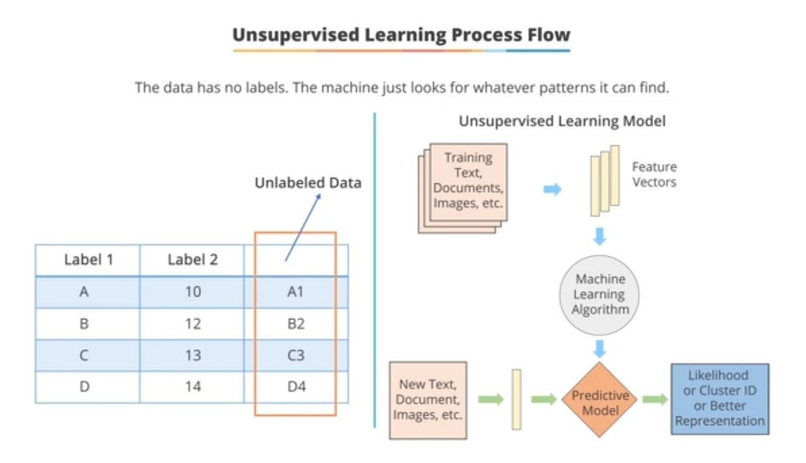

Slide 12
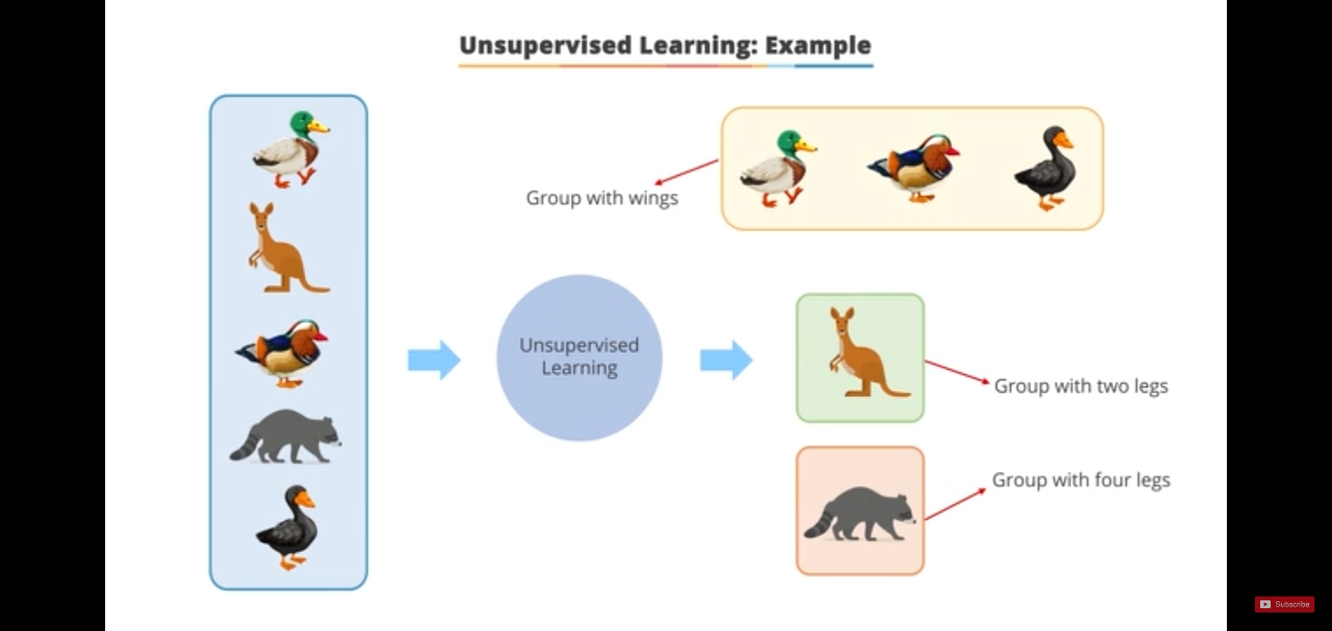

Slide 13
Here, are primary reasons for using Unsupervised Learning:
Unsupervised machine learning finds all kind of unknown patterns in data.
Unsupervised methods help you to find features which can be useful for categorization.
It is taken place in real time, so all the input data to be analyzed and labeled in the presence of learners.
It is easier to get unlabeled data from a computer than labeled data, which needs manual intervention.
Types of Unsupervised Learning
Unsupervised Learning has been split up majorly into 2 types:
Association
Clustering

Slide 14
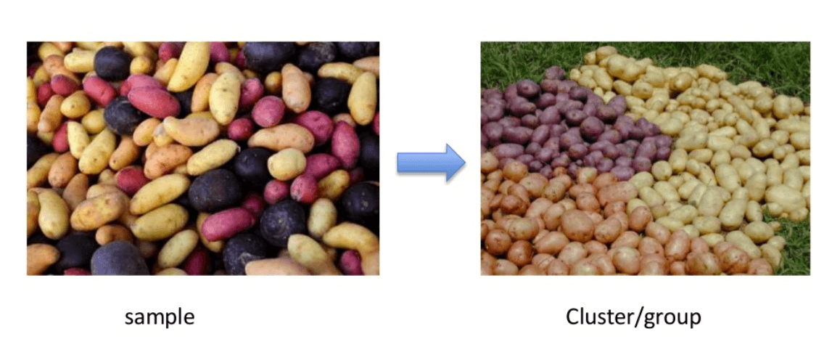
Clustering
Clustering can be considered as most important unsupervised learning problem Or Clustering is an important concept when it comes to unsupervised learning.
It mainly deals with finding a structure or pattern in a collection of uncategorized data.
Clustering algorithms will process your data and find natural clusters(groups) if they exist in the data. You can also modify how many clusters your algorithms should identify. It allows you to adjust the granularity of these groups.

Slide 15
There are different types of clustering type we can utilize:
Exclusive (partitioning)
In this clustering method, Data are grouped in such a way that one data can belong to one cluster only.
Example: K-means
Agglomerative
In this clustering technique, every data is a cluster. The iterative unions between the two nearest clusters reduce the number of clusters.
Example: Hierarchical clustering
Overlapping
In this technique, fuzzy sets is used to cluster data. Each point may belong to two or more clusters with separate degrees of membership.
Here, data will be associated with an appropriate membership value. Example: Fuzzy C-Means
Probabilistic
This technique uses probability distribution to create the clusters
[example:”man’s shoe”,”women’s shoe ”,”women’s glove”,”man’s glove”]
These can be clustered into 2 category “shoe” and “glove” or “man” and “women”.

Slide 16
Clustering Algorithms
These are the most used clustering algorithms.
Hierarchical clustering
K-means clustering
K-NN (k nearest neighbors)
Principal Component Analysis
Singular Value Decomposition
Independent Component Analysis
Mixture of gaussians

Slide 17
Association
Association rules allow you to establish associations amongst data objects inside large databases.
This unsupervised technique is about discovering interesting relationships between variables in large databases.
Association mining identifies sets of items which often occur together in your datasets.
For example, people that buy a new home most likely to buy new furniture.

Slide 18
Advantages of Unsupervised Learning
Labelling of data demands a lots of manual work and expenses. Unsupervised learning solves the problem by learning the data and classifying it without any label
Clustering automatically split the dataset into groups base on their similarities.
Anomaly detection can discover unusual data points in your dataset. It is useful for finding fraudulent transactions.
Association mining identifies sets of items which often occur together in your dataset.
This is the perfect tool for data scientist, as unsupervised learning can help to understand the raw data.
This type of learning similar to human intelligence in some way as the model learns slowly and then calculate the result.

Slide 19
Disadvantages of Unsupervised Learning
You cannot get precise information regarding data sorting, and the output as data used in unsupervised learning is labeled and not known
Less accuracy of the results is because the input data is not known and not labeled by people in advance. This means that the machine requires to do this itself.
The modal is learning from raw data without any prior knowledge.
It is also a time-consuming process. The learning phases of the algorithm might take a lot of time, as it analyses and calculates all possibilities.

Slide 20
Applications of unsupervised learning
Amazon – Amazon also uses unsupervised learning to learn the customer’s purchase and recommend the products which are most frequently bought together which is an example of association rule mining.
Credit-Card Fraud Detection – Unsupervised Learning algorithms learn about various patterns of the user and their usage of the credit card. If the card is used in parts that do not match the behavior, an alarm is generated which could possibly be marked fraud and calls are given to you to confirm whether it was you using the card or not.
AirBnB – This is a great application which helps host stays and experiences connecting people all over the world. This application uses Unsupervised Learning where the user queries his or her requirements and Airbnb learns these patterns and recommends stays and experiences which fall under the same group or cluster.

Slide 21
Thank You...

