Slide 1

Belief Measure

Slide 2
Fuzzy Measures
A fuzzy measure explains the imprecision or ambiguity in the assignment of an element a to two or more crisp set
We assign a value in the unit interval [0, 1] to each possible crisp set to which the element in problem might belong.
The value assigned represents the degree of evidence or uncertainty or belief of the element's membership in the set.
The representation of uncertainty of this manner is called fuzzy measure.
g: P(X) -> [0, 1]
g: B -> [0, 1]

Slide 3
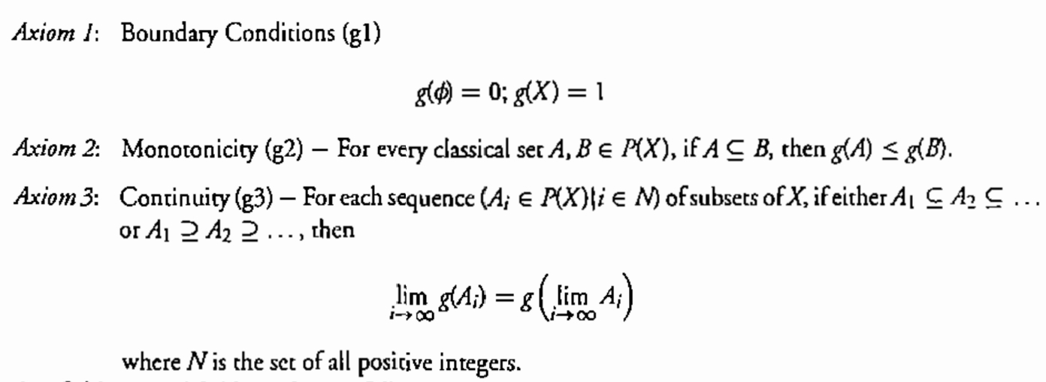
Axioms of Fuzzy Measure

Slide 4
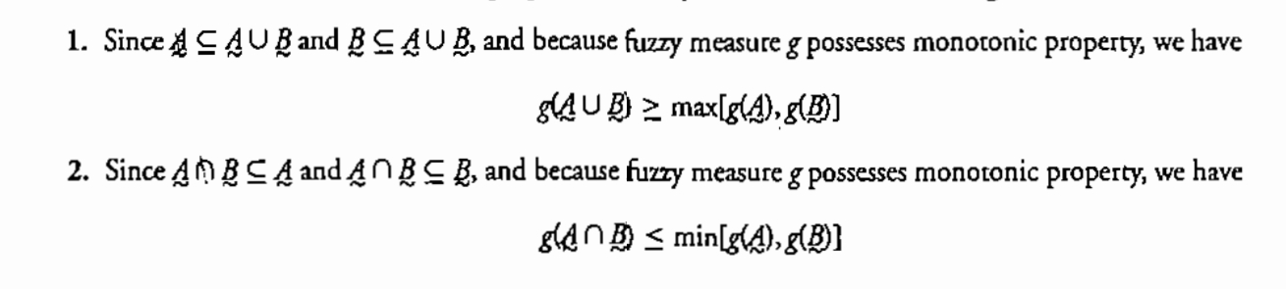
Addictive property
h(A U B) = h(A) + h(B)
Subadditivity

Slide 5
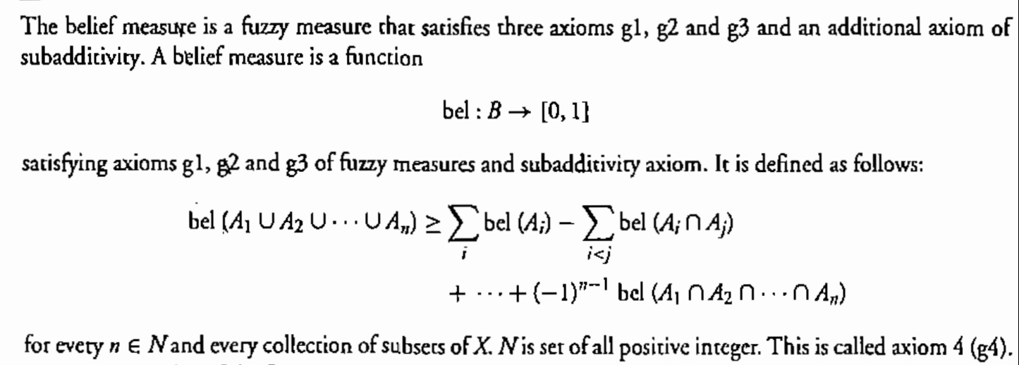
Belief Measure

Slide 6
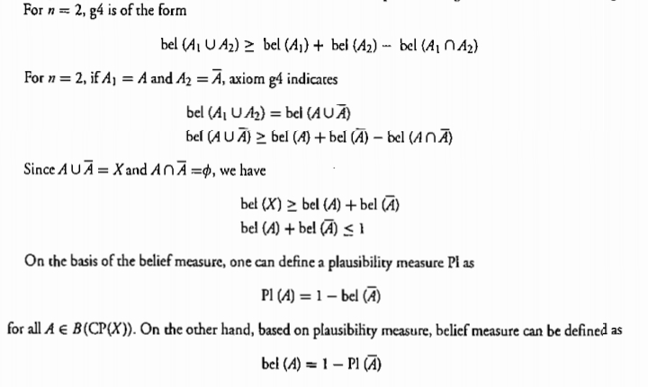

Slide 7
Thank You...

