Slide 1
Noise-Resilient Seismic Analysis for Planetary Landers
STARFIELD

Slide 2
Objective
Planetary seismology missions face significant challenges in efficiently transmitting seismic data back to Earth due to power constraints and the overwhelming volume of data collected. Continuous data collection generates vast amounts of information; however, only a small fraction of this data is scientifically valuable. This project aims to develop a computer program capable of analyzing seismic data from the Apollo missions and the Mars InSight Lander to accurately identify and distinguish genuine seismic quakes from background noise.
By programming a lander to distinguish signals from noise, this project seeks to enhance the scientific utility of planetary seismic data. Effective identification of seismic events not only optimizes data transmission but also contributes to our understanding of seismic activity on celestial bodies, which is crucial for future exploration missions.

Slide 3
Team Members
Shyam Mohan
Alan Sebastian
Abin Sabu
Miriam Samson
Gadha Sajimon
Aleena George

Slide 4
Ways Explored
IDE Used
R Studio
Algorithm Used
STA/LTA
Language Used
R Programming
Output
Visualization Of Data

Slide 5
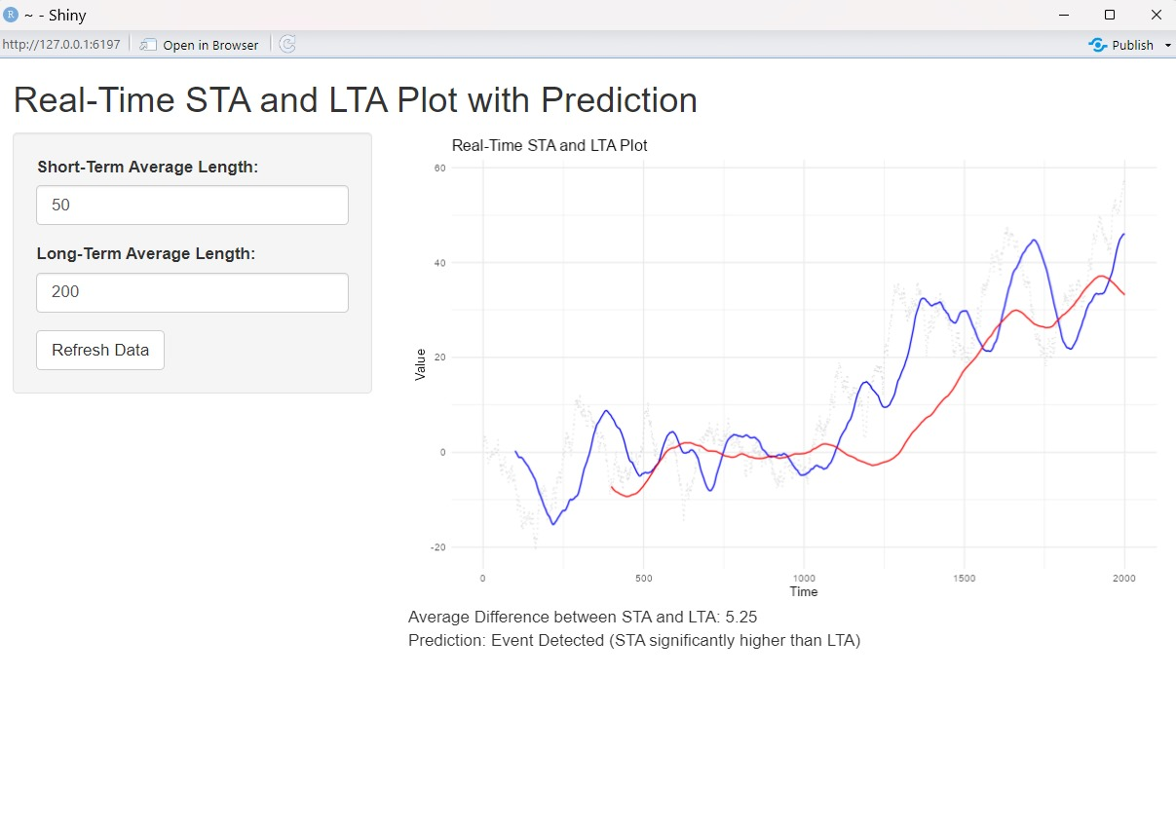
Visualized Data

Slide 6
Seismic Detection Across the Solar System
The Challenge

Slide 7
References
Nasa Resources
https://wufs.wustl.edu/SpaceApps/data/space_apps_2024_seismic_detection.zip
Space Agency Partner Resources
https://psa.esa.int/psa/#/pages/home
Canadian Space Agency(CSA)
https://www.earthquakescanada.nrcan.gc.ca/stndon/wf-fo/index-en.php

