Slide 1
AWS
QuickLoan – Scalable Web Application on AWS
Secure VPC · Auto Scaling · Load Balancing · CloudWatch & SNS Monitoring — Verified Live
Prepared by
Shyam Nair

Slide 2
OVERVIEW
Agenda
01
Project Overview
02
Workflow & Architecture
03
AWS Services Used
04
Implementation Steps
05
Scaling: AMI, ASG, ALB
06
Monitoring: SNS + CloudWatch
07
Live Load Test Results
08
Security & Cleanup
QuickLoan on AWS
2

Slide 3
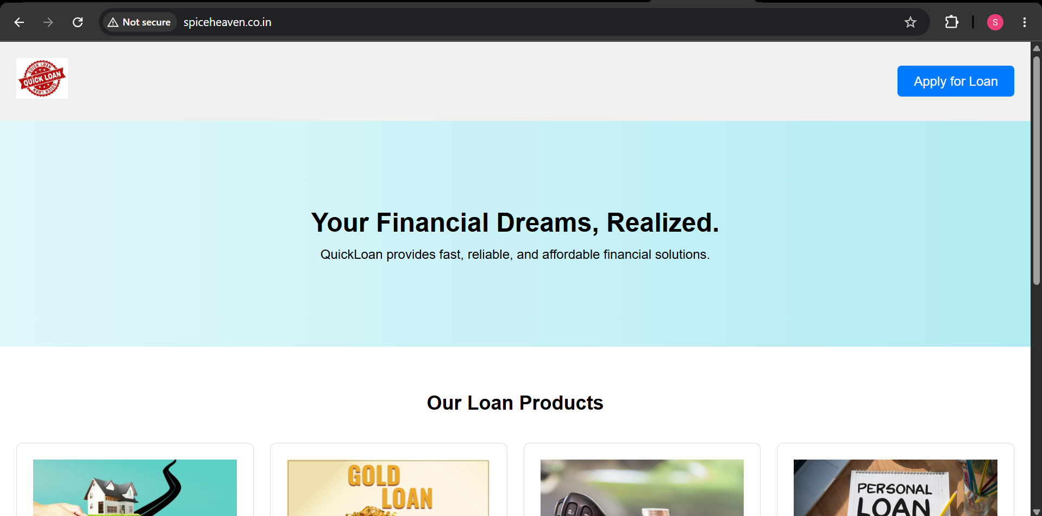
INTRODUCTION
Project Overview
QuickLoan is a cloud-hosted loan application platform. This deployment goes beyond a basic setup — it includes a fully verified Auto Scaling loop with real CloudWatch alarms and SNS email alerts, tested under live synthetic load.
1
Secure Networking
Custom VPC, public/private subnets, NAT Gateway
2
Managed Database
Amazon RDS (MySQL) in a private subnet
3
Elastic & Available
Live QuickLoan homepage
Auto Scaling Group behind an Application Load Balancer
4
Actively Monitored
CloudWatch alarms + SNS email alerts, load-tested live
QuickLoan on AWS
3

Slide 4
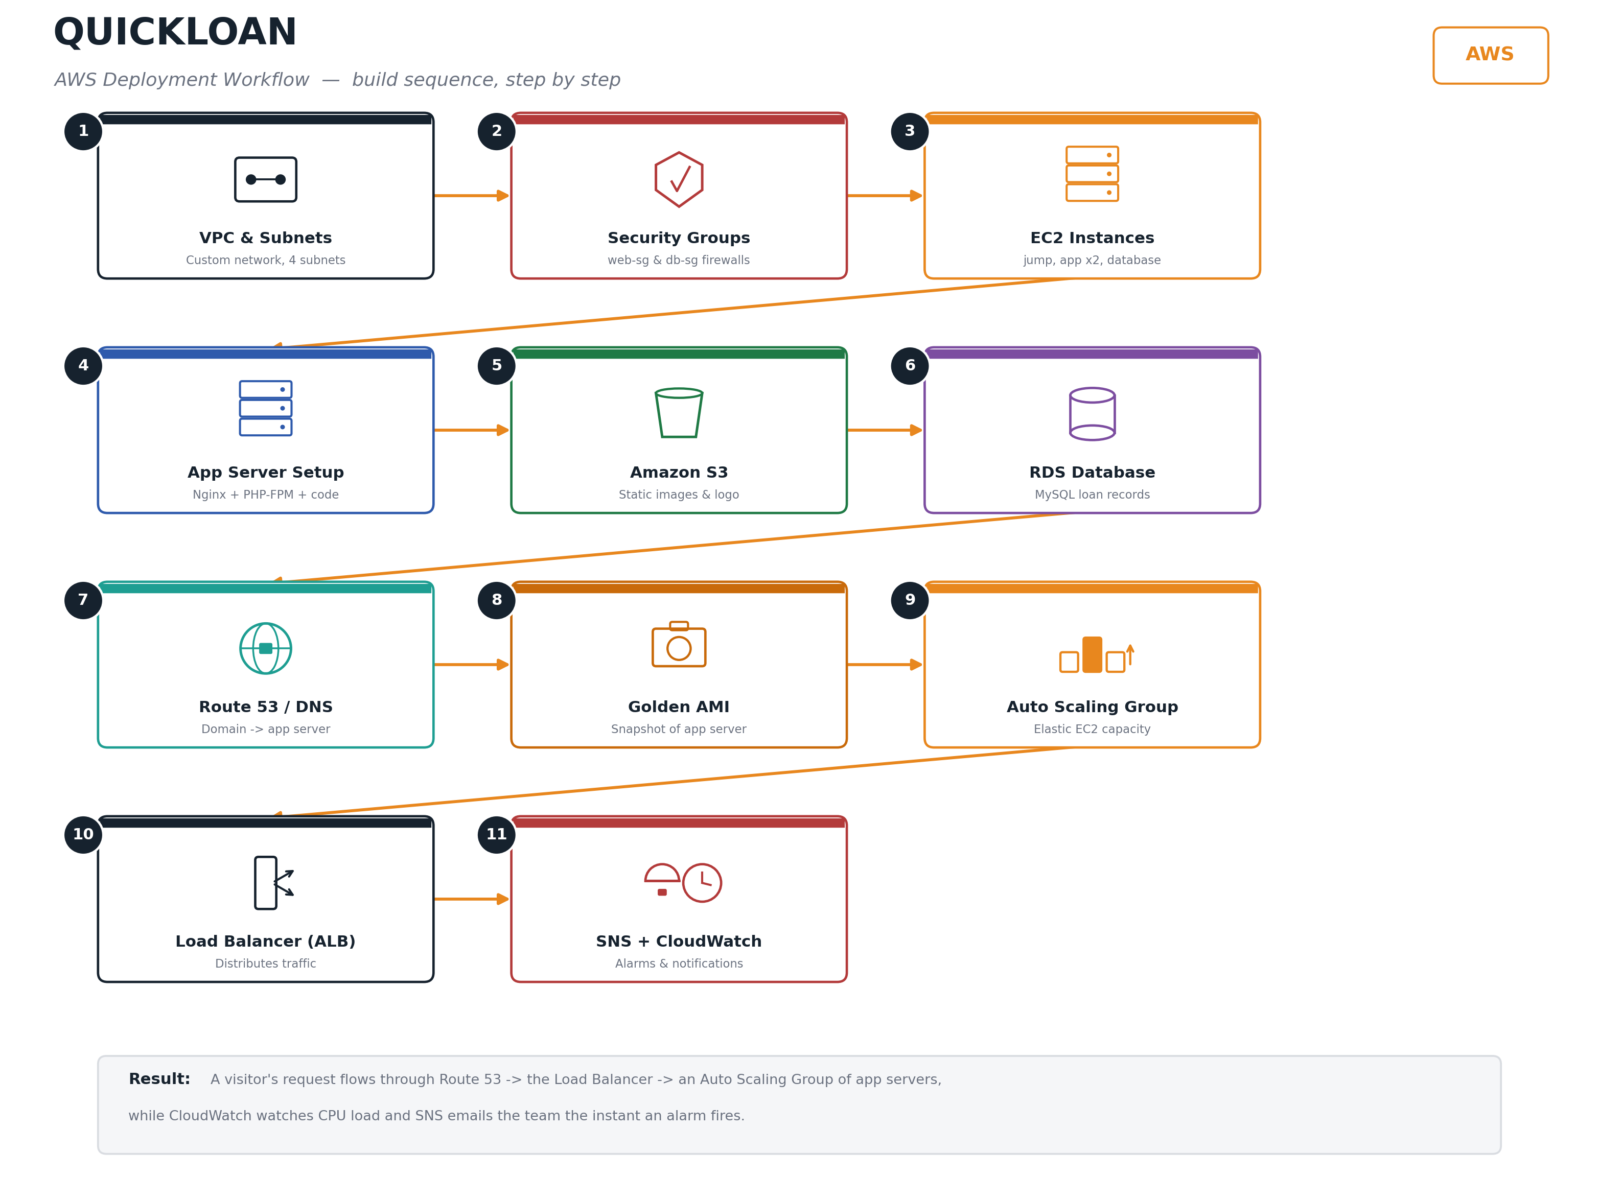
WORKFLOW
Deployment Workflow, Step by Step
QuickLoan on AWS
4

Slide 5
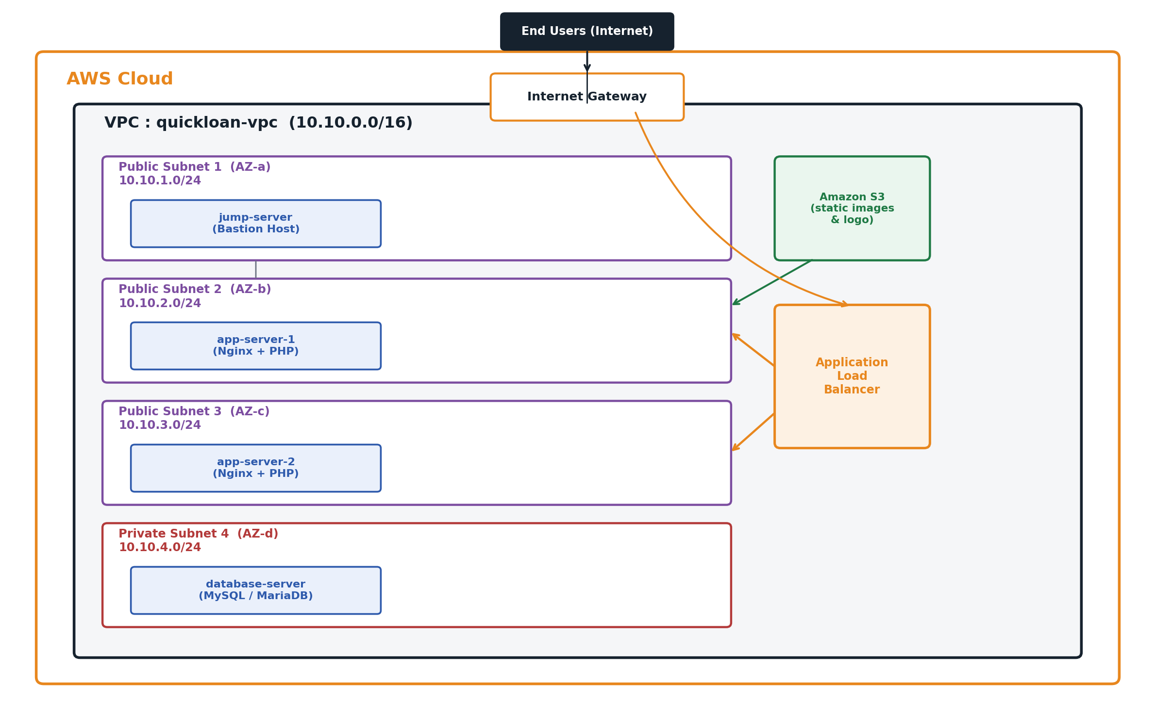
ARCHITECTURE
Network Architecture
QuickLoan on AWS
5

Slide 6
SERVICES
AWS Services Used
Amazon VPC
Amazon EC2
Amazon S3
Amazon RDS
Isolated custom network
Compute for all server roles
Static asset storage
Managed MySQL database
Auto Scaling Group
Load Balancer (ALB)
CloudWatch
SNS
Elastic capacity management
Traffic distribution & health checks
Monitors CPU & drives scaling
Email alerts on every alarm
QuickLoan on AWS
6

Slide 7
IMPLEMENTATION
Base Deployment Steps
1
2
3
4
Build VPC, subnets, IGW, NAT & route tables
Create web-sg & db-sg security groups
Launch jump & app server EC2 instances
Install & configure Nginx + PHP-FPM
5
6
7
8
Deploy application code to app server
Upload static assets to Amazon S3
Provision RDS & connect app to DB
Map custom domain & test end-to-end
QuickLoan on AWS
7

Slide 8
PRODUCTION-READY
Scaling: AMI, ASG & Load Balancer
1
2
3
Golden AMI
Auto Scaling Group
Application Load Balancer
Capture a ready-to-run image of the fully configured app server.
Automatically add or remove app servers based on CPU demand.
Distribute traffic across all healthy instances with health checks.
QuickLoan on AWS
8

Slide 9
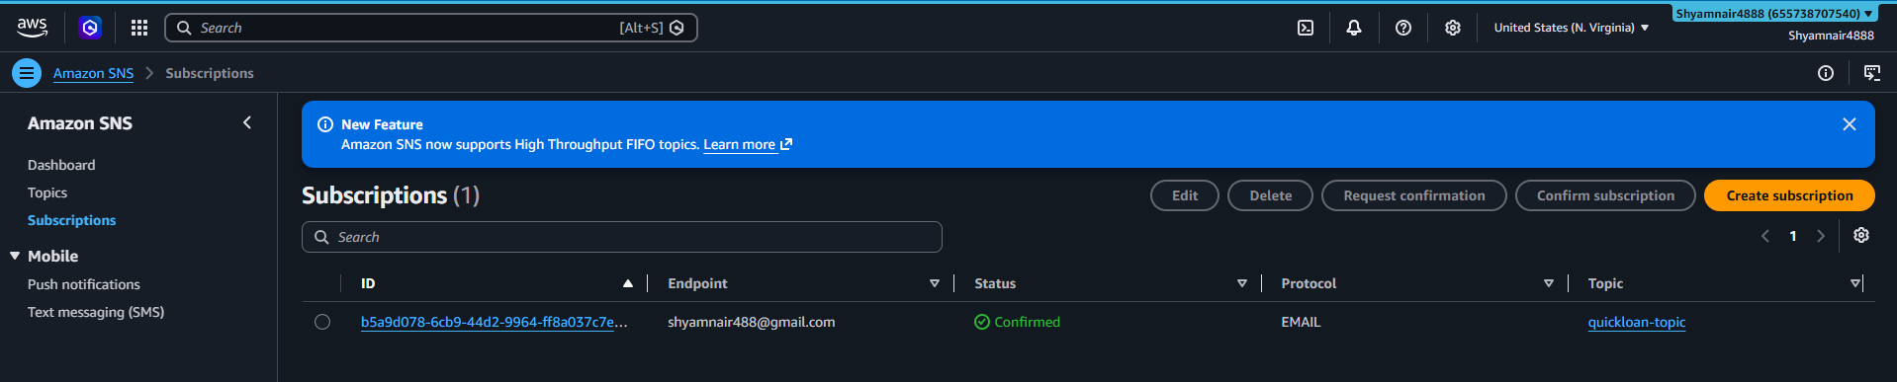
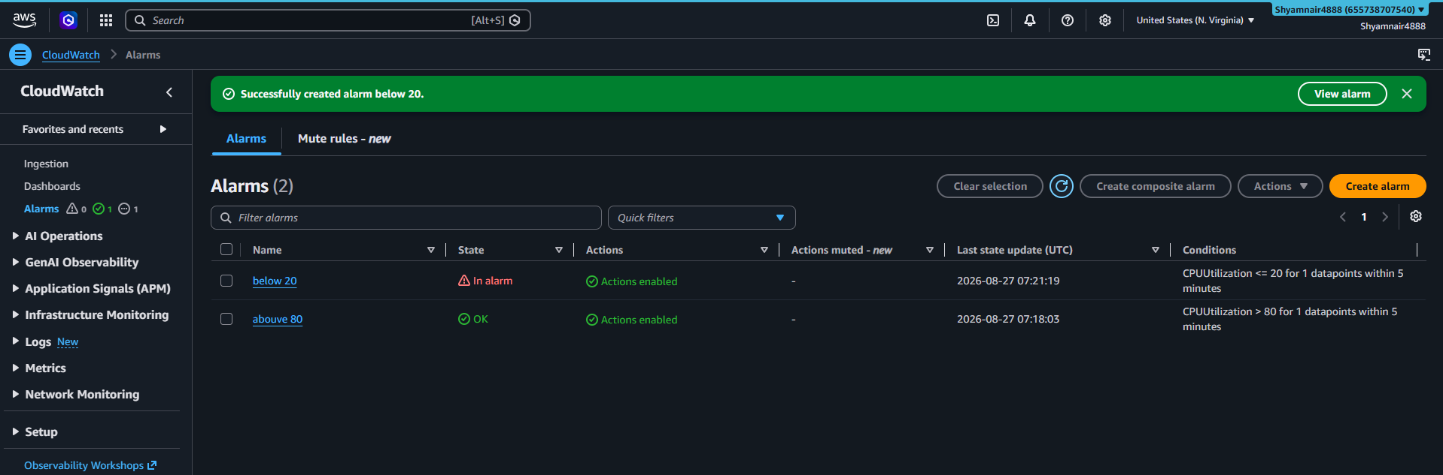
MONITORING
SNS Notifications + CloudWatch Alarms
SNS topic with confirmed email subscription
CloudWatch alarm firing during the load test
QuickLoan on AWS
9

Slide 10
VERIFIED LIVE
Auto Scaling — Load Test Results
stress-ng loads all CPU cores on an app server
CloudWatch alarm moves OK -> In alarm
1
2
SNS emails the team instantly
ASG launches a new instance from the AMI
3
4
New instance registers healthy in the ALB
Load stops -> alarm clears -> ASG scales back in
5
6
QuickLoan on AWS
10

Slide 11
SECURITY
Security Best Practices
Database in a private subnet / RDS, no public access
Role-scoped Security Groups — least privilege
✓
✓
Single jump host for all administrative SSH access
Separate key pairs per server role
✓
✓
Web root file permissions locked to what Nginx requires
Credentials isolated, ready for AWS Secrets Manager
✓
✓
QuickLoan on AWS
11

Slide 12
TEARDOWN
Cleanup Guide — Delete In Order
1
CloudWatch Alarms
2
SNS topic & subscription
3
Auto Scaling Group (scale to 0 first)
4
Load Balancer & Target Group
5
Launch Template
6
AMI + snapshot
7
EC2 instances
8
RDS database
9
S3 bucket (empty first)
10
Elastic IPs
11
Security Groups (db-sg, then web-sg)
12
NAT Gateway, Route Tables, IGW, Subnets, VPC
Full narrated 21-step guide with exact console navigation: Documentation, Section 11
QuickLoan on AWS
12

Slide 13
CONCLUSION
A secure, scalable, actively-monitored
AWS deployment.
QuickLoan combines a segmented VPC, role-based EC2 instances, decoupled S3 storage, a managed RDS tier, and Auto Scaling with a Load Balancer — all verified live with CloudWatch alarms and SNS alerts under real load, plus a complete, ordered teardown procedure.
Prepared by Shyam Nair
Thank You

