Slide 1

Project Review Presentation
March 2024
Dayananda Sagar College of Engineering, Bangalore, Karnataka
Department of Electronics & Communication Engineering
Project Batch No. : B8
Subject code :19EC8ICPR2
Compressor Based 8-bit Vedic multiplier using FinFET
USN : 1DS20EC039 (Sec-A) Name : Basava Keerthana U
USN : 1DS20EC044 (Sec-A) Name : C R Surya Dev
USN : 1DS20EC046 (Sec-A) Name : Charan Kumar M
USN : 1DS20EC188 (Sec-D) Name : Shyam S
Dr. Dinesha P
Professor, Dept ECE

Slide 2
Overview of The Project Selection Phase Presentation
Introduction
Literature Survey
Problem Statement
Objectives
Proposed Methodology
Implementation
Block Diagram
Results
Applications
References.

Slide 3
Introduction
Area optimization, less power consumption and performance of multiplier is the main domain of concern in the field of VLSI design .The speed of processor depends on the performance of multiplier.
In past decade several new architecture of multiplier has been design like Booth’s multiplier , Modified Booth multiplier, Wallace Multiplier etc. In these algorithms various partial products are generated and also runs through various steps to attain the final resultant.
The various steps comprises of addition , subtraction, and many comparisons which as a result consume much time therefore reduce the speed of multiplier. Since speed is major concern for Multiplier Design, therefore these architectures are not feasible.
With a view to mitigating the aforesaid problems, we put forward a new technique to design multiplier with concept of Vedic Mathematics.

Slide 4
FinFET (Fin Field-Effect Transistor) technology is a type of transistor design that offers several advantages over traditional CMOS (Complementary Metal-Oxide-Semiconductor) technology, making it a preferred choice for advanced semiconductor manufacturing processes.
There are many advantages of FinFET. These are some of them to name a few: Improved Performance, Better Scaling, Reduced Leakage Current, Improved On/Off Switching, Lower Variability, Enhanced Drive Current, Better Analog Performance, Improved Thermal Management.
A compressor, in the context of digital logic circuits, is a specialized circuit that's used to reduce the number of inputs and outputs in multi-bit addition operations.
It has many advantages over the conventional full adder and hall adder circuits. These are some to note: Improved Speed, Reduced Gate Count, Reduced Wiring Complexity, Lower Power Consumption, Space Efficiency.

Slide 5
Literature Survey
Author | Year | Sample | Title | Findings
Radheshyam Gupta, Rajdeep Dhar | 2020 | 8 bit Vedic multiplier | Design of high performance 8 bit Vedic multiplier using Compressor | In this paper a new architecture of Vedic multiplier by using 4:2 compressors and 7:2 compressors for addition that increase the speed of Multiplier.
Malti Bansal, Jasmeet Singh | 2020 | FinFET Technology | Comparative Analysis of 4-bit CMOS Vedic Multiplier and GDI Vedic Multiplier using 18nm FinFET Technology | In this paper the Vedic multiplier circuit is implemented by using GDI technique and also 18nm FinFET is deployed for analyzing simulation results.

Slide 6
Author | Year | Sample | Title | Findings
Medhi Ghasemzadeh, Amin Akbari | 2019 | 7:2 Compressor | A New Ultra High Speed 7:2 Compressor with a New Structure | This paper devotes to a new 7:2 compressor designed according to a new architecture with a pure Glitchless output. The number of transistors used in this architecture is less than the recent 7:2 compressors. The proposed structure’s simulations applied to Hspice software using standard TSMC 0.18μm CMOS technology is about 285ps.
M Jurczak, N Collaert, T Hoffmann | 2020 | Review | Review of FinFET Technology | In this paper they have discussed integration challenges, VT tuning, Junction formation, Strain engineering.

Slide 7
Problem Statement
To Design 8*8 compressor based Vedic multiplier using FinFET technology.
Designing of 4:2 & 5:2, compressor.
Designing of 7:2 compressor using 5:2 compressor and full adders.

Slide 8
Objectives
Our main objective is to design a efficient 8-bit Vedic multiplier. This design procedure involves various methods. We have adopted a compressor based Urdhva-Tiryakbhyam architecture.

Slide 9
Proposed Methodology
In this project we incorporate a compressor based technique to increase the speed of Vedic mathematics based Multiplier by changing Full adder and Half adder and using Compressor.
Compressor can add more than three bits at a time and computes this operation with fewer numbers of gates and has higher speed as compared to full adder. Since the compressor requires few gates so area of compressor reduces in comparison to equivalent full.
In this project we introduce a new architecture of Vedic multiplier by using 4:2 compressors and 7:2 compressors for addition that increase the speed of Multiplier. The 7:2 compressors are made of 5:2 compressors and two full adders.

Slide 10
In this project, a compressor based Urdhva-Tiryakbhyam architecture in is proposed which is based on the Urdhva-Tiryakbhyam Sutra of Vedic mathematics so as to enhance the speed of the binary multiplication.
The idea of designing the multiplier from Vedic mathematics has emerged as in this technique the partial products and the sums are generated in only a single step.
These partial products are then added based on the Vedic math’s algorithm to obtain the final product. This in turn leads to a very high speed approach to perform multiplication.

Slide 11
Proposed Methodology
Required Design Component
Design of basic gates (AND, OR, XOR)
Design of adders
Design of Compressors
Design 8-bit Vedic multiplier

Slide 12
Implementation
Software:
We are using Cadence Virtuoso software for design and simulation purpose. FinFET used is of 22nm technology.

Slide 13
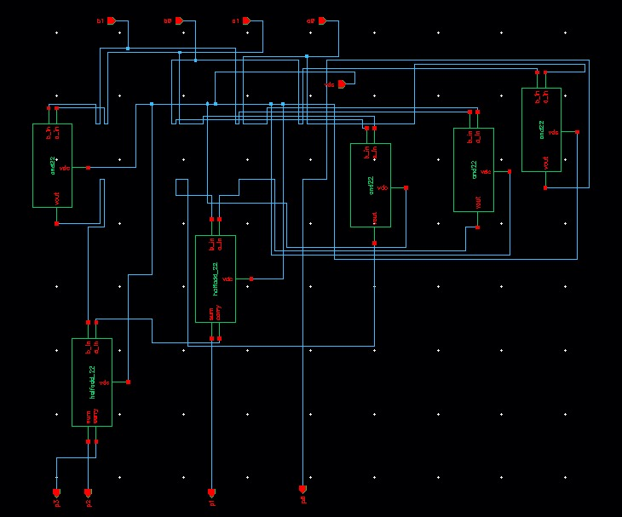
2x2 Vedic Multiplier

Slide 14
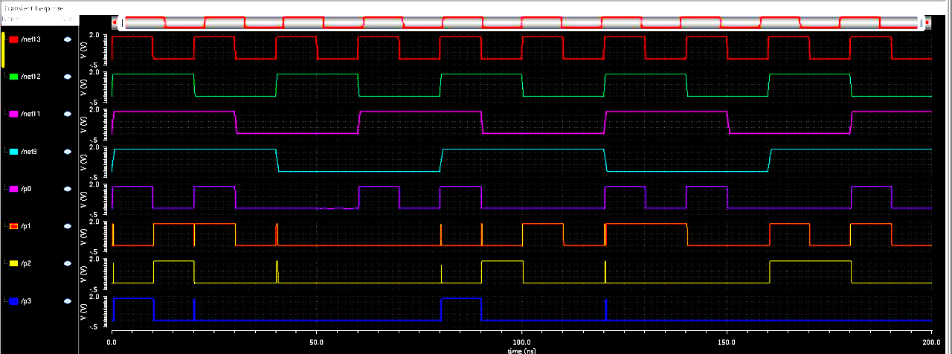
2-bit Vedic Multiplier Output Waveform
2-bit Vedic multiplier

Slide 15
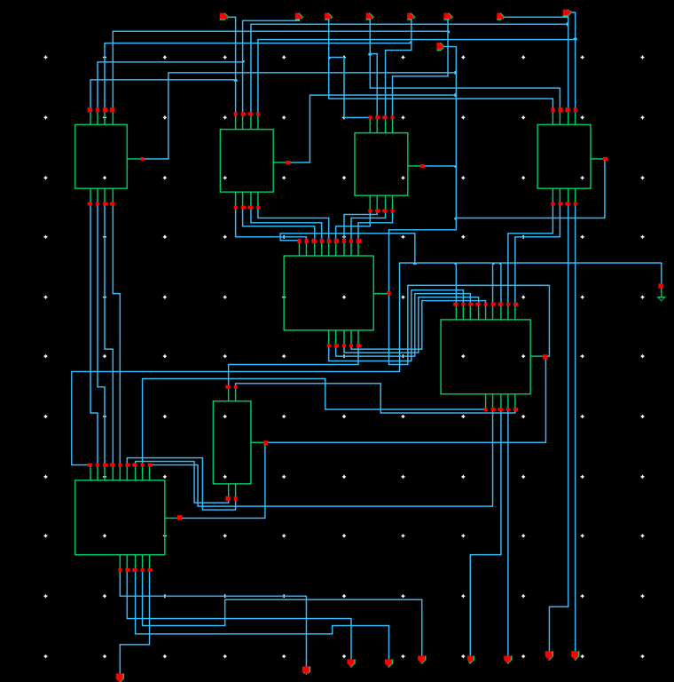
4x4 Vedic Multiplier
2x2
4-RCA
2x2
4-RCA
2x2
Half adder
4-RCA
2x2

Slide 16
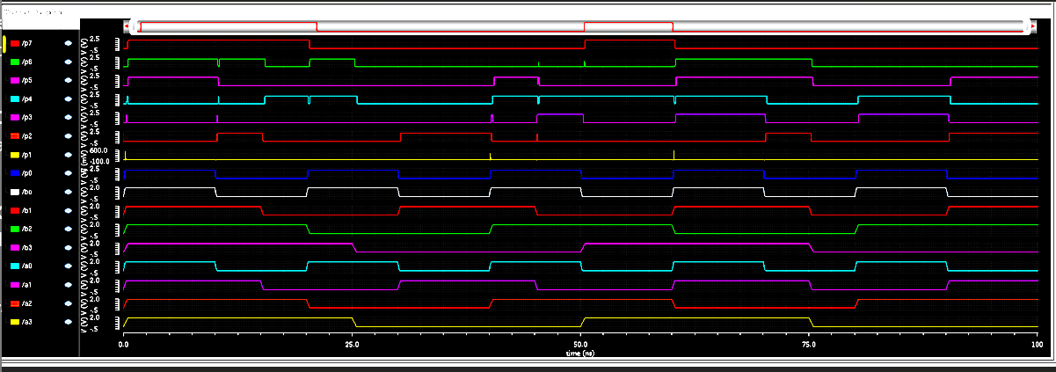
4-bit Vedic Multiplier Output Waveform

Slide 17
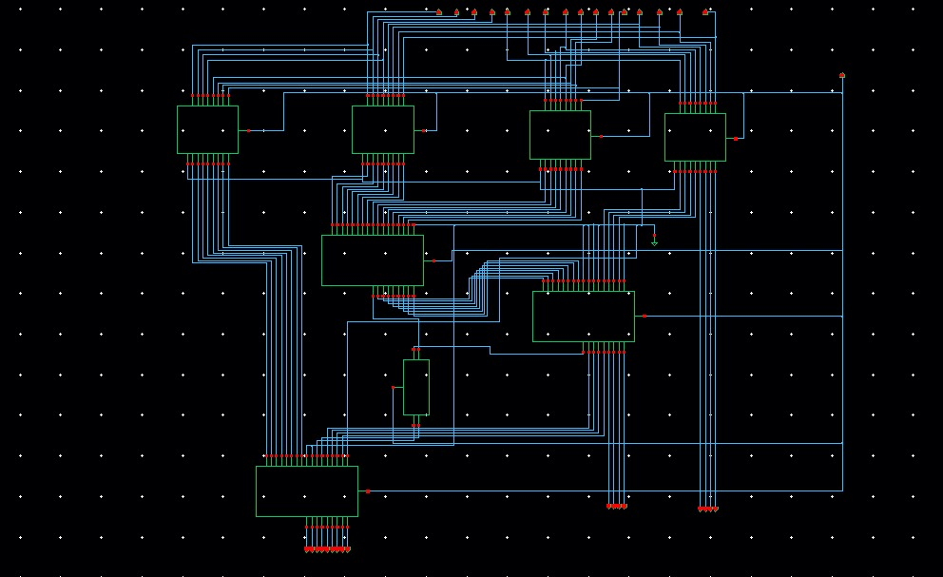
8x8 Vedic Multiplier
4x4
4x4
4x4
4x4
8-RCA
8-RCA
Half adder
8-RCA

Slide 18
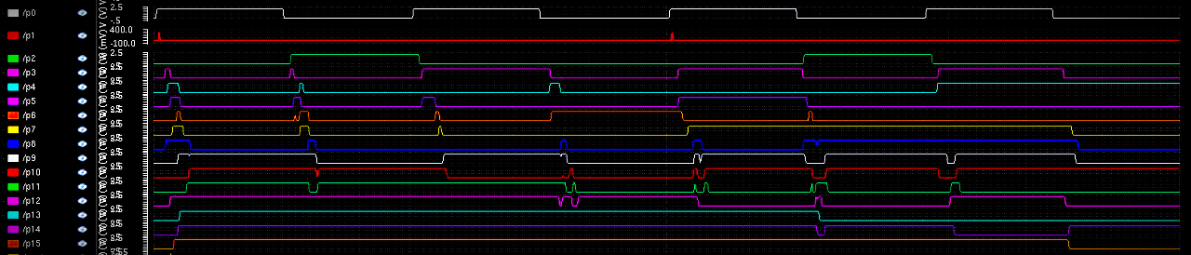
8-bit Vedic Multiplier Output Waveform

Slide 19
8-bit Vedic Multiplier
 | Power (mW) |  | Delay (ps)
 | MOSFET | FinFET | MOSFET | FinFET
P15 | 470.4 | 115.6 | 184.1 | 146.0
P14 | 618.6 | 320.8 | 273.4 | 180.7
P13 | 545.6 | 380.6 | 502.5 | 190.8
P12 | 576.8 | 590.2 | 180.4 | 116.2
P11 | 631.9 | 466.3 | 290.8 | 248.2
P10 | 387.4 | 566.3 | 1018 | 265.8
P9 | 746.2 | 595.2 | 230.3 | 180.5
P8 | 288.5 | 220.8 | 88.52 | 84.39
P7 | 349.3 | 390.7 | 203.3 | 137.6
P6 | 233.8 | 206.6 | 423.3 | 170
P5 | 263.6 | 203.9 | 158.6 | 119
P4 | 555.8 | 582.6 | 191.8 | 98.57
P3 | 199.1 | 202.8 | 145.3 | 79.69
P2 | 1.583 | 205.6 | 1201.9 | 1060
P1 | 380.3 | 0.934 | 85.3 | 56.57
P0 | 805.6 | 603.0 | 75.34 | 11.88

Slide 20
Block Diagram
Fig a. Block diagram of 4:2 compressor
Fig b. Block diagram of 5:2 compressor
Fig c. Block diagram of 7:2 compressor
Fig d. Proposed 4:2 compressor
Fig e. Proposed 5:2 compressor
Fig f. Proposed 7:2 compressor

Slide 21
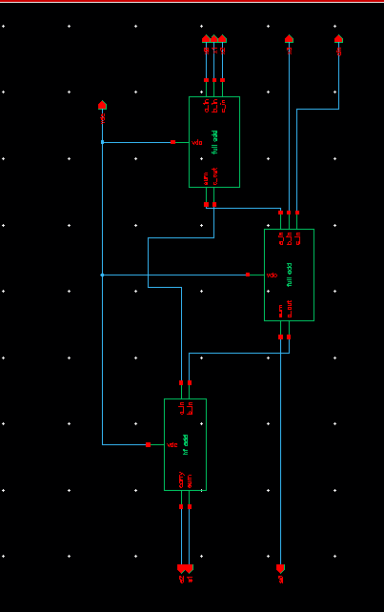
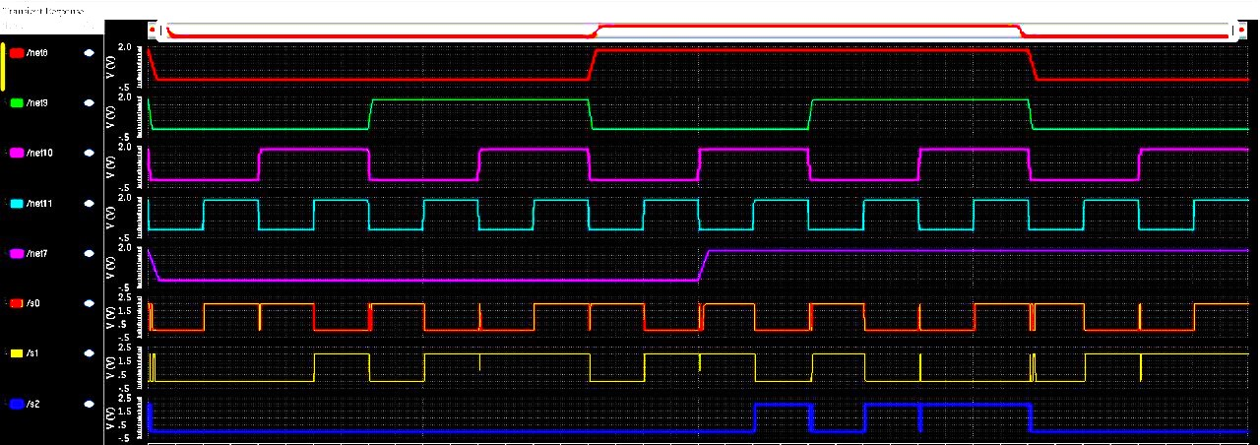
Schematic Diagram
4:2 compressor
4:2 Compressor Output waveform

Slide 22
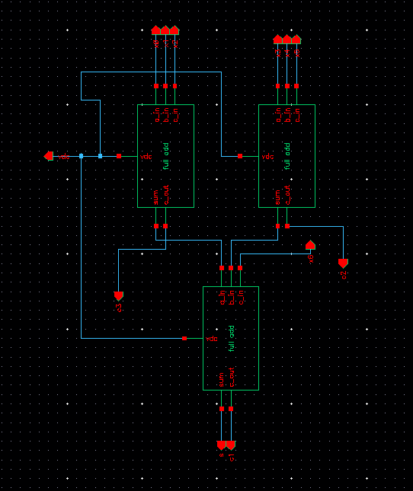
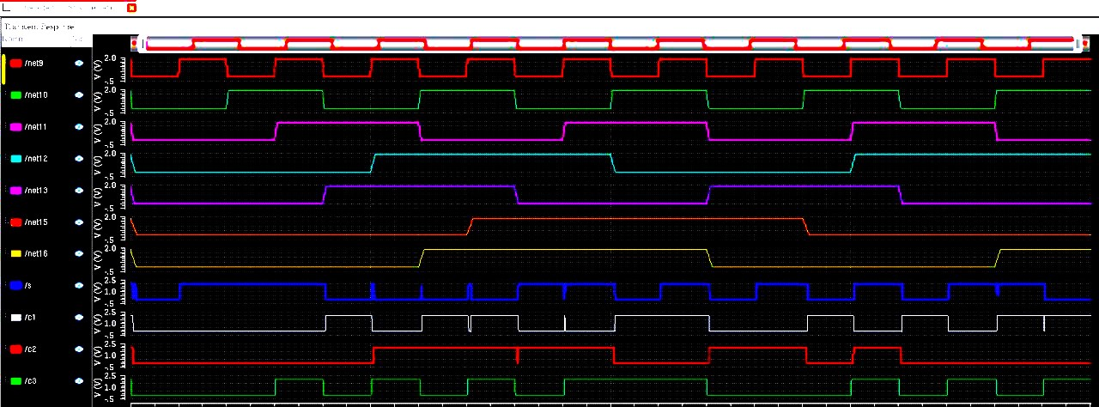
Schematic Diagram
5:2 compressor Output waveform

Slide 23
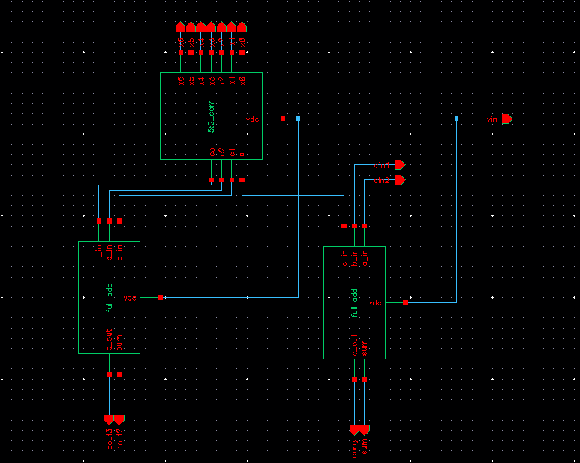
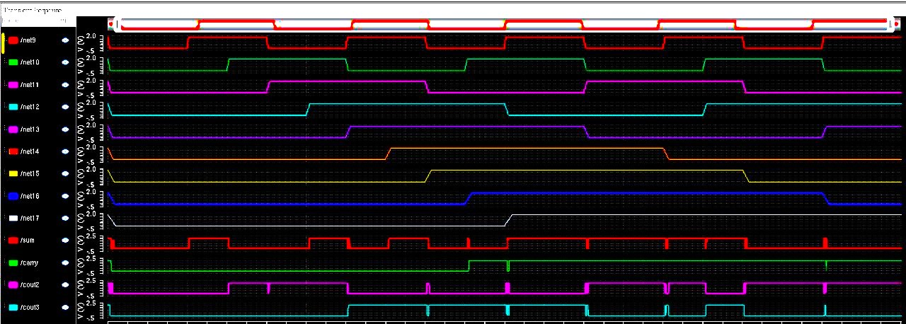
Schematic Diagram
7:2 compressor
7:2 Compressor Output waveform

Slide 24
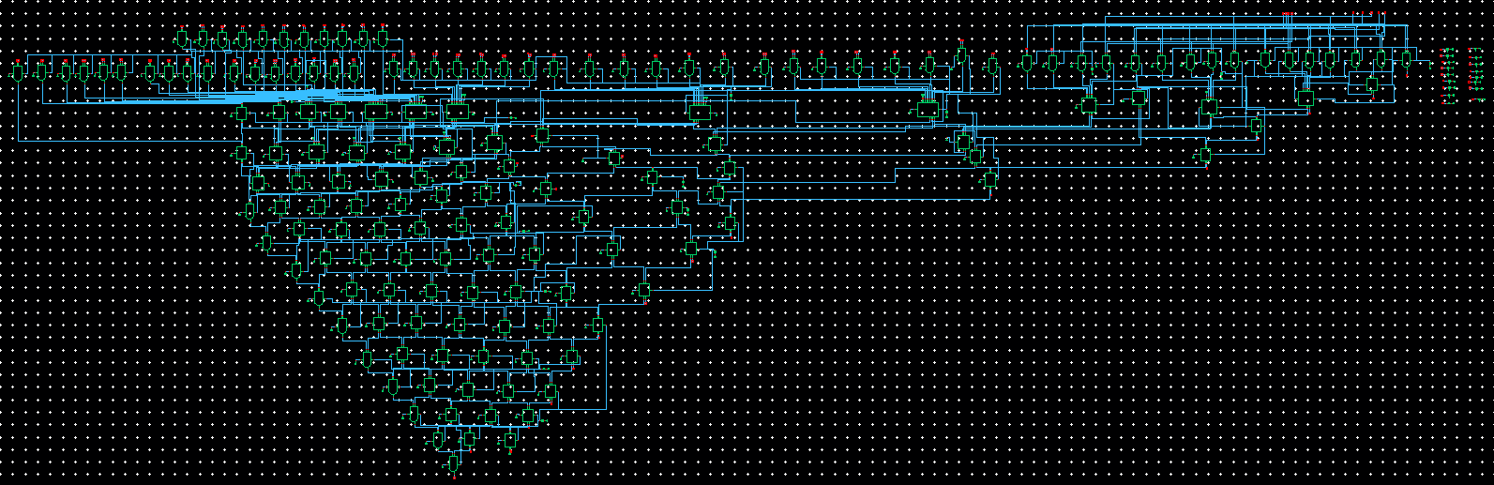
8-bit Vedic Multiplier using Compressors

Slide 25
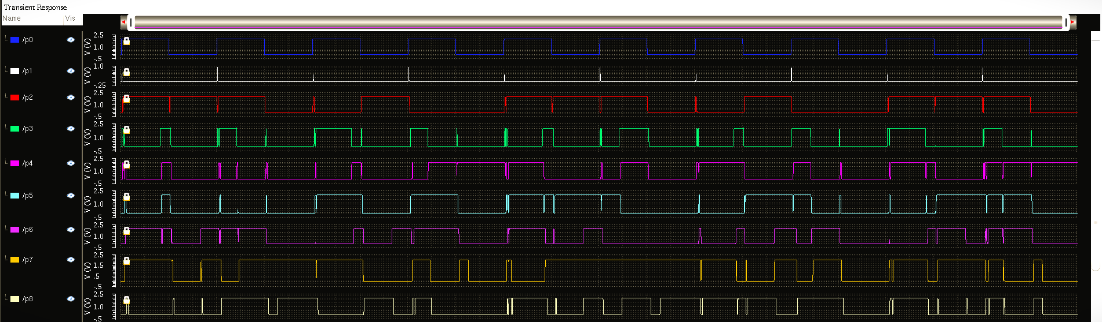

Slide 26
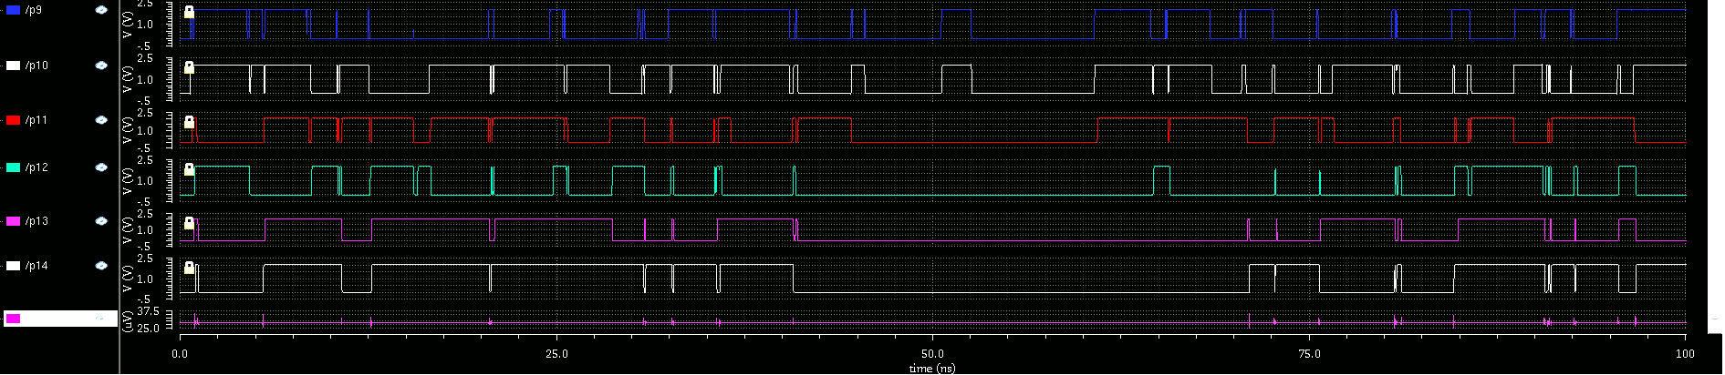

Slide 27
Comparison of delay (ps) of Vedic Multiplier using conventional method and using compressor
Pins | Using Adders | Using Compressors
P15 | 184.1 | 463.2
P14 | 273.4 | 628.7
P13 | 502.5 | 556.3
P12 | 180.4 | 723.7
P11 | 290.8 | 562.7
P10 | 1018 | 460.8
P09 | 230.3 | 382.8
P08 | 88.52 | 434.9
P07 | 203.3 | 365.2
P06 | 423.3 | 303.8
P05 | 158.6 | 2192
P04 | 191.8 | 182.1
P03 | 145.3 | 119.2
P02 | 1201.9 | 87.70
P01 | 85.3 | 63.43
P00 | 75.34 | 20.62

Slide 28
Applications
Digital Signal Processing (DSP): Vedic multipliers are commonly used in digital signal processing applications, such as filters, transforms, and other mathematical operations.
Fixed-Point Arithmetic: In embedded systems, especially those with limited resources like microcontrollers, an efficient 8x8 multiplier is used for fixed-point arithmetic.
Image and Video Processing: Image and video processing often involve pixel-wise operations, including multiplication.
Cryptographic Algorithms: Cryptographic algorithms often require extensive multiplication operations, and optimized multipliers like Vedic multipliers can be beneficial for encryption and decryption processes.
FPGA and ASIC Design: Field-Programmable Gate Arrays (FPGAs) and Application-Specific Integrated Circuits (ASICs) are often used for custom hardware design.

Slide 29
References
Radheshyam Gupta, Rajdeep Dhar, “Design of high performance 8 bit Vedic multiplier using Compressor”, ICAET 2020, DOI: 10.1109/ICAET.2014.7105239
Malti Bansal, Jasmeet Singh, “Comparative Analysis of 4-bit CMOS Vedic Multiplier and GDI Vedic Multiplier using 18nm FinFET Technology”, Proceedings of the International Conference on Smart Electronics and Communication (ICOSEC 2020), DOI: 10.1109/MIXDES.2015.7208523
Medhi Ghasemzadeh, Amin Akbari, “A New Ultra High Speed 7:2 Compressor with a New Structure ”, Proceedings of the 22nd International Conference, DOI: 10.1109/ICOSEC49089.2020.9215317
M Jurczak, N Collaert, T Hoffmann, “Review of FinFET Technology”, DOI: 10.1109/SOI.2009.5318794

Slide 30
Raj Kumari and Rajesh Mehra, "Power and Delay Analysis of CMOS Multipliers using Vedic Algorithm", IEEE, 978-1-4673-8587-9/16, 2019.
Chiranjit R Patel, Vivek Urankar, Vivek B A, V Keshav Bharadwaj, "Vedic Multiplier in 45nm Technology", IEEE, 978-1-7281-4889-2/20, 2020.
S. Karunakaran and B. Poonguzharselvi, "VLSI Architecture of an 8-bit Multiplier using Vedic Mathematics in 180nm Technology", IJATE, Vol. 10, Issue 3, 2017.
S. Prema, Ramanan S.V, R Arun Sekar, Rajan Cristin, "High Performance Reversible Vedic Multiplier Using Cadence 45nm technology", IJRAD. Volume 02, Issue 04, pp. 64-71, October 2018.
Nehru Kandasamy, Firdous Ahmad, Shashikanth Reddy, Ramesh Babu M, Nagarjuna Telagam, Somanaidu Utlapalli, "Performance evolution of 4-b bit MAC unit using hybrid GDI and transmission gate based adder and multiplier circuits in 180 and 90 nm technology", 0141-9331,Elsevier B.V, 2018.

Slide 31



