Slide 1
Shell Scripting
Sandeep Kumar Sharma

Slide 2
What is Kernel?

Slide 3
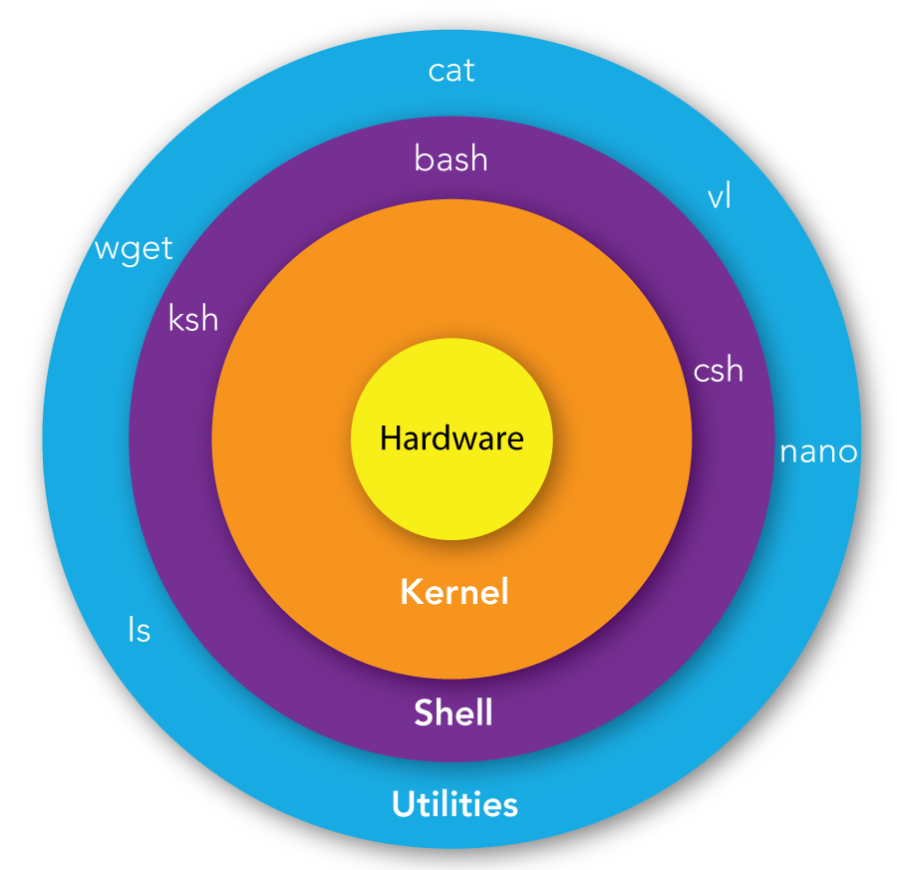
What is Kernel?
The kernel is a computer program that is the core of a computer’s operating system, with complete control over everything in the system. It manages the following resources of the Linux system –
File management
Process management
I/O management
Memory management
Device management etc.

Slide 4
What is Shell?
A shell is a special user program that provides an interface for the user to use operating system services. Shell accepts human-readable commands from users and converts them into something which the kernel can understand. It is a command language interpreter that executes commands read from input devices such as keyboards or from files. The shell gets started when the user logs in or starts the terminal.

Slide 5
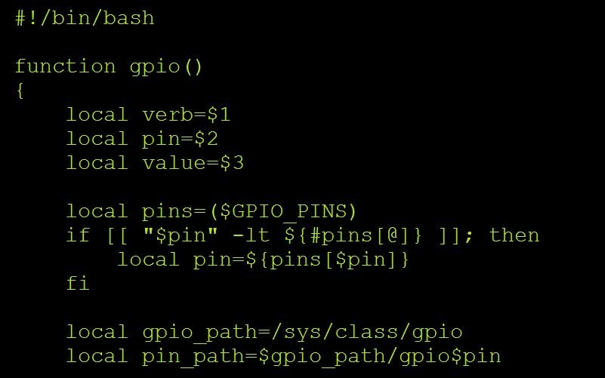
What is Shell Scripting?
A shell script is a text file that contains a sequence of commands for a UNIX-based operating system.
It is called a script because it combines a sequence of commands—that would otherwise have to be typed into a keyboard one at a time—into a single script.

Slide 6
What is Shell Scripting?
Most shells have their own scripting language, each with its own variables, control flow, and syntax.
What makes shell scripting different from other scripting languages is that it is optimized for performing shell-related tasks.
Creating command pipelines, saving results into files, and reading from standard input are baked into in shell scripting, making it easier to use compared to other scripting languages.

Slide 7
Basics of Bash Scripting
Bash scripting refers to writing a script for a bash shell (Bourne Again SHell).

Slide 8
Basics of Bash Scripting
Bash scripting refers to writing a script for a bash shell (Bourne Again SHell).
You can check what shell you are using by running
ps -p $$
6

Slide 9
Basics of Bash Scripting
Bash scripting refers to writing a script for a bash shell (Bourne Again SHell).
You can check what shell you are using by running
ps -p $$
If you are on Linux, your default shell should be a bash shell. If you are on macOS or Windows, your shell may be different but this shouldn't cause an issue given that your shell will still know how to "speak" bash.

Slide 10
Your Very First Script
Let's write a super simple shell script that says hello!

Slide 11
Your Very First Script
Here is a super simple bash script called hello.sh:
#!/usr/bin/env bash
echo "Hello world!"

Slide 12
Your Very First Script
Here is a super simple bash script called hello.sh:
#!/usr/bin/env bash
echo "Hello world!"
The shebang is the very first line of a script

Slide 13
Shebang
The shebang, also called a sharp exclamation, is the very first line of a script.
It is the combination of the pound symbol (#) and an exclamation mark (!).
The shebang is used to specify the interpreter that the given script will
be run with. In our case, we indicate that we want a interpreter (i.e.
bash
a bash shell). If you want to run your script with a change the shebang.
zsh
shell, you simply

Slide 14
Shebang
A note about shebangs:
There are a number of different ways to write your shebang such as
#!/usr/bin/env bash
and
#!/bin/bash
We recommend that you always use the former as it increases the
portability of your script. The command tells the system to resolve
env
the bash command wherever it lives in the system, as opposed to just
looking inside of
/bin

Slide 15
Running (Your Very First Script)
You can always run a shell script by simply prepending it with a shell interpreter program:
sh hello.sh
bash hello.sh
zsh hello.sh

Slide 16
Running (Your Very First Script)
You can always run a shell script by simply prepending it with a shell interpreter program:
sh
hello.sh
 | bash | hello.sh
zsh
hello.sh
Interpreter

Slide 17
Running (Your Very First Script)
You can also run a script by turning it into an executable program and then running it.

Slide 18
Running (Your Very First Script)
You can also run a script by turning it into an executable program and then running it.
First, turn the program into an executable using (change mode):
chmod
chmod +x hello.sh
16

Slide 19
Running (Your Very First Script)
You can also run a script by turning it into an executable program and then running it.
First, turn the program into an executable using (change mode):
chmod
chmod +x hello.sh
Makes the program executable

Slide 20
Running (Your Very First Script)
You can also run a script by turning it into an executable program and then running it.
First, turn the program into an executable using (change mode):
chmod
chmod +x hello.sh
Then run the program:
./hello.sh

Slide 21
Bash Scripting: Variables
To assign variables, use the following:
x=foo

Slide 22
Bash Scripting: Variables
To assign variables, use the following:
x=foo
You can access the value of x using the following:
$x

Slide 23
Bash Scripting: Variables
To assign variables, use the following:
x=foo
You can access the value of x using the following:
$x
Note: you cannot use (with spaces) because it is
x = foo
interpreted as trying to run a program
x
with two arguments:
=
and foo.

Slide 24
Bash Scripting: Strings
Next, we can define strings.
If we want to define a string literal, we will use single quotes:
'$x'

Slide 25
Bash Scripting: Strings
Next, we can define strings.
If we want to define a string literal, we will use single quotes:
'$x'
If we want to define a string that allows substitution, we will use double quotes:
"$x"

Slide 26
Bash Scripting: Strings
Here's the difference in behavior:
x=foo echo '$x'
# prints $x
x=foo echo "$x"
# prints foo

Slide 27
Your Very First Script
Let's use a variable in hello.sh:
#!/usr/bin/env bash
greeting="Hello world!" echo $greeting

Slide 28
Bash Scripting: Control Flow
Like other programming languages, bash scripts also have control flow directives such as if, for, while, and case.
26

Slide 29
Bash Scripting: Control Flow
Like other programming languages, bash scripts also have control flow directives such as if, for, while, and case.
#!/usr/bin/env bash
if [ CONDITION ] ;
then
# do something
fi

Slide 30
Bash Scripting: Control Flow
Like other programming languages, bash scripts also have control flow directives such as if, for, while, and case.
#!/usr/bin/env bash
num=101
if [ $num -gt 100 ]; then
echo "That's a big number!"
fi

Slide 31
Bash Scripting: Control Flow
Like other programming languages, bash scripts also have control flow directives such as if, for, while, and case.
#!/usr/bin/env bash
num=101
if [ $num -gt 100 ] && [ $num -lt 1000 ] then
echo "That's a big (but not a too big) number!"
fi

Slide 32
Bash Scripting: Control Flow
#!/usr/bin/env bash
if [ CONDITION ]
then
# do something elif [ CONDITION ]
then
# do something else else
# do something totally different
fi

Slide 33
Bash Scripting: Control Flow
#!/usr/bin/env bash
num=101
if [ $num -gt 1000 ] then
echo "That's a huge number!" elif [ $num -gt 100 ]
then
echo "That's a big number!" else
echo "That's a small number."
fi

Slide 34
Bash Scripting: Control Flow
Like other programming languages, bash scripts also have control flow directives such as if, for, while, and case.
#!/usr/bin/env bash
while [ CONDITION ] do
# do something done

Slide 35
Bash Scripting: Control Flow
Like other programming languages, bash scripts also have control flow directives such as if, for, while, and case.
#!/usr/bin/env bash
num=0
while [ $num -lt 100 ] do
echo $num num=$((num+1))
done

Slide 36
Bash Scripting: Control Flow
Like other programming languages, bash scripts also have control flow directives such as if, for, while, and case.
#!/usr/bin/env bash
for VARIABLE in {1..N}
do
# do something done

Slide 37
Bash Scripting: Control Flow
Like other programming languages, bash scripts also have control flow directives such as if, for, while, and case.
#!/usr/bin/env bash
num=0
for i in {1..100} do
echo $num num=$((num+1))
done

Slide 38
Bash Scripting: Exercise
Exercise 1: Write a shell script called that loops through
num_loop.sh
every number through
and prints each number to standard output.
1
20
The script should also conditionally print for every number
I'm big!
larger than 10.
36

Slide 39
Bash Scripting: Exercise
#!/usr/bin/env bash
for i in {1..20} do
echo $i
if [ $i -gt 10 ] then
echo "I'm big!"
fi done

Slide 40
Bash Scripting: Arguments
Let's take a look at how we might use command line arguments to make
our script a little more interesting.
big_num.sh

Slide 41
Bash Scripting: Arguments
Let's take a look at how we might use command line arguments to make
our script a little more interesting.
big_num.sh
In bash, the variables - refers to the arguments to a script.
$1
$9

Slide 42
Bash Scripting: Arguments
Let's take a look at how we might use command line arguments to make
our script a little more interesting.
big_num.sh
In bash, the variables - refers to the arguments to a script.
$1
$9
root@sandeep-computer ~ % sh my_script.sh ayelet

Slide 43
Bash Scripting: Arguments
Let's take a look at how we might use command line arguments to make
our script a little more interesting.
big_num.sh
In bash, the variables - refers to the arguments to a script.
$1
$9
root@sandeep-computer ~ % sh my_script.sh
ayelet
This is $1

Slide 44
Bash Scripting: Arguments
Let's take a look at how we might use command line arguments to make
our script a little more interesting.
big_num.sh
In bash, the variables - refers to the arguments to a script.
$1
$9
The variable
$0
refers to the name of the script.
root@sandeep-computer ~ % sh my_script.sh
ayelet
This is $1

Slide 45
Bash Scripting: Arguments
Let's take a look at how we might use command line arguments to make
our script a little more interesting.
big_num.sh
In bash, the variables - refers to the arguments to a script.
$1
$9
The variable
$0
refers to the name of the script.
root@sandeep-computer~ % sh
my_script.sh
ayelet
This is $0
This is $1

Slide 46
Bash Scripting: Arguments
Let's assign to be the first argument when calling the script.
num
root@sandeep-computer~ % sh big_num.sh 102

Slide 47
Bash Scripting: Arguments
Let's assign
num
to be the first argument when calling the script.
root@sandeep-computer~ % sh big_num.sh
 | 102
This is $1

Slide 48
Bash Scripting: Arguments
Let's assign to be the first argument when calling the script.
num
root@sandeep-computer~ % sh big_num.sh 102
#!/usr/bin/env bash
num=101
if [ $num -gt 100 ] then
echo "That's a big number!"
fi
46

Slide 49

Bash Scripting: Arguments
Let's assign to be the first argument when calling the script.
num
root@sandeep-computer~ % sh big_num.sh
102
#!/usr/bin/env bash
num=$1
if [ $num -gt 100 ] then
echo "That's a big number!"
fi

Slide 50
Bash Scripting: Functions
We can also define functions!

Slide 51
Bash Scripting: Functions
We can also define functions!
root@sandeep-computer~ % sh mcd.sh
#!/usr/bin/env bash
make_and_enter() {
# calls mkdir (including parent directories) # calls cd
}

Slide 52
Bash Scripting: Functions
We can also define functions!
root@sandeep-computer~ % sh mcd.sh
#!/usr/bin/env bash
make_and_enter(directory_name) { mkdir -p directory_name
cd directory_name
}

Slide 53
Bash Scripting: Functions
We can also define functions!
root@sandeep-computer~ % sh mcd.sh
#!/usr/bin/env bash
make_and_enter(directory_name) { mkdir -p directory_name
cd directory_name
}

Slide 54
Bash Scripting: Functions
We can also define functions!
root@sandeep-computer~ % sh mcd.sh
#!/usr/bin/env bash
make_and_enter() { mkdir -p "$1" cd "$1"
}

Slide 55
Bash Scripting: Functions
We can also define functions!
root@sandeep-computer~ % sh mcd.sh
#!/usr/bin/env bash
make_and_enter() { mkdir -p "$1" cd "$1"
}
make_and_enter new_folder

Slide 56
Bash Scripting: Functions
We can also define functions!
root@sandeep-computer~ % sh mcd.sh
#!/usr/bin/env bash
make_and_enter() { mkdir -p "$1" cd "$1"
}
make_and_enter new_folder

Slide 57
Bash Scripting: Functions
We can also define functions!
root@sandeep-computer~ % sh mcd.sh
#!/usr/bin/env bash
make_and_enter() { mkdir -p "$1" cd "$1"
}
make_and_enter new_folder

Slide 58
Bash Scripting: Functions
We can also define functions!
root@sandeep-computer~ % sh mcd.sh
#!/usr/bin/env bash
make_and_enter() { mkdir -p "$1" cd "$1"
}
make_and_enter new_folder
56

Slide 59
Bash Scripting: Functions
We can also define functions!
root@sandeep-computer~ % sh mcd.sh my_folder
#!/usr/bin/env bash
make_and_enter() { mkdir -p "$1" cd "$1"
}
make_and_enter new_folder

Slide 60
Bash Scripting: Functions
We can also define functions!
root@sandeep-computer~ % sh mcd.sh my_folder
#!/usr/bin/env bash
make_and_enter() { mkdir -p "$1" cd "$1"
}
make_and_enter new_folder

Slide 61
Bash Scripting: Functions
We can also define functions!
root@sandeep-computer~ % sh mcd.sh my_folder
#!/usr/bin/env bash
make_and_enter() { mkdir -p "$1" cd "$1"
}
make_and_enter $1

Slide 62

Bash Scripting: Functions
We can also define functions!
root@sandeep-computer~ % sh mcd.sh my_folder
#!/usr/bin/env bash
make_and_enter() { mkdir -p "$1" cd "$1"
}
make_and_enter $1

Slide 63
Bash Scripting: Functions
We can also define functions!
root@sandeep-computer~ % sh mcd.sh my_folder
#!/usr/bin/env bash
make_and_enter() { mkdir -p "$1" cd "$1"
}
make_and_enter $1

Slide 64
Bash Scripting: Exercise
Exercise 2: Write a shell script called that takes in two
my_folder.sh
arguments: your name (e.g. ayelet) and your name with the
.txt
ending (e.g. ayelet.txt). The script should call a function that creates a folder by the name of the first argument (e.g. ayelet) and then create a file inside by the name of the second argument (e.g. ayelet.txt).
For my name, my function would create a folder named and a file
ayelet
named inside of ayelet.
ayelet.txt

Slide 65
Bash Scripting: Exercise
root@sandeep-computer~ % my_folder.sh ayelet ayelet.txt
#!/usr/bin/env bash
make_my_folder() { mkdir "$1"
cd "$1" touch "$2"
}
make_my_folder $1 $2

Slide 66
Bash Scripting: Return Values
The notion of exit codes allows for verifying the success or failure of a previous command.

Slide 67
Bash Scripting: Return Values
The notion of exit codes allows for verifying the success or failure of a previous command.
An exit code or return value is the way scripts or commands can communicate with each other about how execution went.

Slide 68
Bash Scripting: Return Values
The notion of exit codes allows for verifying the success or failure of a previous command.
An exit code or return value is the way scripts or commands can communicate with each other about how execution went.
A return value of 0 means that everything went OK. A return value other than 0 means that an error occurred.
66

Slide 69
Bash Scripting: Return Values
The notion of exit codes allows for verifying the success or failure of a previous command.
An exit code or return value is the way scripts or commands can communicate with each other about how execution went.
A return value of 0 means that everything went OK. A return value other than 0 means that an error occurred.
$?
provides the return value from the most recently executed command

Slide 70
Bash Scripting: Return Values
If you ever need a placeholder for a command that succeeds or fails, you can use the true and false commands.

Slide 71
Bash Scripting: Return Values
If you ever need a placeholder for a command that succeeds or fails, you can use the true and false commands.
true
is a command that does nothing except return an exit status of 0.
false
is a command that does nothing except return an exit status of 1.

Slide 72
Bash Scripting: Return Values
root@sandeep-computer~ % sh success_or_failure.sh
#!/usr/bin/env bash
result=$(($RANDOM % 2)) if [ $result -eq 0 ] then
true
echo "$?" else
false echo "$?"
fi
73

Slide 73
Bash Scripting: Return Values
Return values are useful if you want to conditionally execute commands based on the execution of the previous command.

Slide 74
Bash Scripting: Return Values
Return values are useful if you want to conditionally execute commands based on the execution of the previous command.
In addition to using if-statements, we can also conditionally execute
commands using
&&
and
||
.

Slide 75
Bash Scripting: Return Values
Return values are useful if you want to conditionally execute commands based on the execution of the previous command.
In addition to using if-statements, we can also conditionally execute
commands using
&&
and
||
.
true && echo "Print if things went well!" # prints "Print if things went well!"

Slide 76
Bash Scripting: Return Values
Return values are useful if you want to conditionally execute commands based on the execution of the previous command.
In addition to using if-statements, we can also conditionally execute
commands using
&&
and
||
.
true && echo "Print if things went well!" # prints "Print if things went well!"
false && echo "Print if things went well!" # no output

Slide 77
Bash Scripting: Exercise
Exercise 3: Write a shell script called that checks if
file_checker.sh
a file exists or not. The script take in a file name as an argument and try
to run on that file. The script should then check the exit code of the
cat
cat
command to determine if the file exists or not. If the file exists, the
script should print . If the file does not exist, the script
File exists!
should print .
File does not exist!
Bonus: change the script to suppress the actual output of and only
cat
include your script's output (e.g. or
File exists!
File does not
exist!).

Slide 78
Bash Scripting: Exercise
#!/usr/bin/env bash
cat $1
if [ $? -eq 0 ] then
echo "File exists!" else
echo "File does not exist!"
fi
76

Slide 79
Bash Scripting: Exercise
#!/usr/bin/env bash
cat $1 &> /dev/null if [ $? -eq 0 ] then
echo "File exists!" else
echo "File does not exist!"
fi

Slide 80
Bash Scripting: Exercise
#!/usr/bin/env bash
cat $1 && echo "File exists!"
cat $1 || echo "File does not exist!"

Slide 81
Bash Scripting: Exercise
#!/usr/bin/env bash
cat $1 &> /dev/null && echo "File exists!"
cat $1 &> /dev/null || echo "File does not exist!"

Slide 82
Bash Scripting: Command Substitution
Command substitution is another useful feature of bash scripting.
You might want to run a command and then use its output as a variable to some other piece of code.

Slide 83
Bash Scripting: Command Substitution
Command substitution is another useful feature of bash scripting.
You might want to run a command and then use its output as a variable to some other piece of code.
Example:
#!/usr/bin/env bash
for element in $(ls ~/Desktop) do
echo "Desktop contains file named $element" done

Slide 84

Bash Scripting: Extra Syntax
Bash scripting has some specific syntax that is worth calling out.
If you're ever stuck, look something up

Slide 85
Bash Scripting: [ vs [[
When you have an if-statement, you need to encapsulate the condition. You can do this in two ways:

Slide 86
Bash Scripting: [ vs [[
When you have an if-statement, you need to encapsulate the condition. You can do this in two ways:
if [ condition ] then
# do something
fi
if [[ condition ]] then
# do something
fi

Slide 87
Bash Scripting: [ vs [[
When you have an if-statement, you need to encapsulate the condition. You can do this in two ways:
if [ condition ] then
# do something
fi
if [[ condition ]] then
# do something
fi
What's the difference?

Slide 88
Bash Scripting: [ vs [[
When you have an if-statement, you need to encapsulate the condition. You can do this in two ways:
if [ condition ]
if [[ condition ]]
86

Slide 89
Bash Scripting: [ vs [[
When you have an if-statement, you need to encapsulate the condition. You can do this in two ways:
[ condition ]
if
if [[ condition ]]
Single brackets are a
reference to the the command
test

Slide 90
Bash Scripting: [ vs [[
When you have an if-statement, you need to encapsulate the condition. You can do this in two ways:
[ condition ]
[[ condition ]]
if
if
Single brackets are a
Double brackets are bash specific. (Also works for zsh)
reference to the the command
test

Slide 91
Bash Scripting: [ vs [[
When you have an if-statement, you need to encapsulate the condition. You can do this in two ways:
if [ 1 < 2 ]
then
echo "Correct!"
fi
if [[ 1 < 2 ]]
then
echo "Correct!"
fi

Slide 92
Bash Scripting: [ vs [[
When you have an if-statement, you need to encapsulate the condition. You can do this in two ways:
if [ 1 < 2 ]
then
echo "Correct!"
fi
if [[ 1 < 2 ]]
then
echo "Correct!"
fi

Slide 93
Bash Scripting: [ vs [[
When you have an if-statement, you need to encapsulate the condition. You can do this in two ways:
if [ 1 < 2 ] then echo "Correct!" fi |  | if [[ 1 then echo fi | < 2 ]] "Correct!"
2: No such file or directory

Slide 94
Bash Scripting: [ vs [[
When you have an if-statement, you need to encapsulate the condition. You can do this in two ways:
if [ 1 < | 2 | ]
then echo "Correct!" fi
if [[ 1 < 2 ]]
then
echo "Correct!"
fi
2: No such file or directory

Slide 95
Bash Scripting: [ vs [[
When you have an if-statement, you need to encapsulate the condition. You can do this in two ways:
if [ 1 < 2 ] then echo "Correct!" fi |  | if [[ 1 then echo fi | < 2 ]] "Correct!"
2: No such file or directory |  | Correct!

Slide 96
Bash Scripting: [ vs [[
When you have an if-statement, you need to encapsulate the condition. You can do this in two ways:
if [ condition ]
if [[ condition ]]

Slide 97
Bash Scripting: [ vs [[
When you have an if-statement, you need to encapsulate the condition. You can do this in two ways:
if [ condition ]
if [[ condition ]]
In general, single brackets are recognized by more scripting languages and
are POSIX compliant. (Won't work with interpreter unless linked to bash.)
sh

Slide 98
Bash Scripting: [ vs [[
When you have an if-statement, you need to encapsulate the condition. You can do this in two ways:
if [ condition ]
if [[ condition ]]
In general, single brackets are recognized by more scripting languages and
are POSIX compliant. (Won't work with interpreter unless linked to bash.)
sh
Double brackets are less portable, but they align with what you would expect from high level coding languages. You can use comparison operators such
as or and logical operators such as
or ||.
<
>
&&
66

Slide 99
Bash Scripting: Comparison
In order to compare numbers in a bash script, use the following:
a -eq b
for checking if
a
is equal to
b

Slide 100
Bash Scripting: Comparison
In order to compare numbers in a bash script, use the following:
a -eq b
for checking if
for checking if
a
is equal to
b
a -ne b
a
is not equal to
b

Slide 101
Bash Scripting: Comparison
In order to compare numbers in a bash script, use the following:
a -eq b
for checking if
for checking if for checking if
a
is equal to
b
a -ne b
a
is not equal to
b
a -gt b
a
is greater than
b

Slide 102
Bash Scripting: Comparison
In order to compare numbers in a bash script, use the following:
a -eq b
for checking if
for checking if for checking if for checking if
a
is equal to
b
a -ne b
a
is not equal to
b
a -gt b
a
is greater than
b
a -ge b
a
is greater than or equal to
b

Slide 103
Bash Scripting: Comparison
In order to compare numbers in a bash script, use the following:
a -eq b
for checking if
for checking if for checking if for checking if for checking if
a
is equal to
b
a -ne b
a
is not equal to
b
a -gt b
a
is greater than
b
a -ge b
a
is greater than or equal to
b
a -lt b
a
is less than
b

Slide 104
Bash Scripting: Comparison
In order to compare numbers in a bash script, use the following:
a -eq b
for checking if
for checking if for checking if for checking if for checking if for checking if
a
is equal to
b
a -ne b
a
is not equal to
b
a -gt b
a
is greater than
b
a -ge b
a
is greater than or equal to
b
a -lt b
a
is less than
b
a -le b
a
is less than or equal to
b

Slide 105
Bash Scripting: Comparison
In order to compare strings in a bash script, use the following:
s1 = s2
for checking if
s1
is equal to
s2

Slide 106
Bash Scripting: Comparison
In order to compare strings in a bash script, use the following:
s1 = s2
for checking if
s1
is equal to
s2
s1 != s2
for checking if
s1
is not equal to
s2

Slide 107
Bash Scripting: Comparison
In order to compare strings in a bash script, use the following:
s1 = s2
for checking if
s1
is equal to
s2
s1 != s2
for checking if
s1
is not equal to
s2
s1 < s2
for checking if
s1
is less than
s2
by lexicographical order

Slide 108
Bash Scripting: Comparison
In order to compare strings in a bash script, use the following:
s1 = s2
for checking if
s1
is equal to
s2
s1 != s2
for checking if
s1
is not equal to
s2
s1 < s2
for checking if
for checking if is greater than to by lexicographical order
s1
is less than
s2
by lexicographical order
s1 > s2
s1
s2
106

Slide 109
Bash Scripting: Comparison
In order to compare strings in a bash script, use the following:
s1 = s2
for checking if
s1
is equal to
s2
s1 != s2
for checking if
s1
is not equal to
s2
s1 < s2
for checking if
for checking if is greater than to by lexicographical order
s1
is less than
s2
by lexicographical order
s1 > s2
s1
s2
-n s1
for checking if
s1
has a length greater than 0

Slide 110
Bash Scripting: Comparison
In order to compare strings in a bash script, use the following:
s1 = s2
for checking if
s1
is equal to
s2
s1 != s2
for checking if
s1
is not equal to
s2
s1 < s2
for checking if
for checking if is greater than to by lexicographical order
s1
is less than
s2
by lexicographical order
s1 > s2
s1
s2
-n s1
for checking if
for checking if
s1
has a length greater than 0
has a length of 0
-z s1
s1

Slide 111
Bash Scripting: Arithmetic
To do arithmetic, we need to follow bash syntax.

Slide 112
Bash Scripting: Arithmetic
To do arithmetic, we need to follow bash syntax.
To add two numbers and 2, and then assign to a variable a:
1
a=$((1+2))

Slide 113
Bash Scripting: Arithmetic
To do arithmetic, we need to follow bash syntax.
To add two numbers and 2, and then assign to a variable a:
1
a=$((1+2))
You can also use the
let
keyword:
let a=1+2

Slide 114
Bash Scripting: Arithmetic
To do arithmetic, we need to follow bash syntax.
To add two numbers and 2, and then assign to a variable a:
1
a=$((1+2))
You can also use the
let
keyword:
let a=1+2
You can use the expr keyword:
a=$( expr 1 + 2 )

Slide 115
Bash Scripting: Exercise
Exercise 4: Write a shell script called
timely_greeting.sh
that greets
you based on the current time. The script should call the
date
command, extract the current hour (look into using %H) and then print
the following greeting based on the time.
If it is between 5AM (05:00) and 12PM (12:00):
Good morning!
If it is between 12PM (12:00) and 6PM (18:00):
Good afternoon!
If it is between 6PM (18:00) and 5AM (5:00):
Good night!

Slide 116
Bash Scripting: Exercise
#!/usr/bin/env bash
time=$(date +%H)
if [ $time -gt 5 ] && [ $time -lt 12 ] then
echo "Good morning!"
elif [ $time -gt 12 ] && [ $time -lt 18 ] then
echo "Good evening!"
elif [ $time -gt 18 ] && [ $time -lt 5 ] then
echo "Good night!"
fi
117

Slide 117
Advanced Running
You can turn your shell script into a "command" by moving it to ~/bin. For example if you have a script called hello, you could do the following:
root@sandeep-computer~ % mv hello ~/bin/
You can then run the command by just calling hello:
root@sandeep-computer~ % hello
Note: this probably won't work yet on your computer but we will learn about it in a later lecture.
118

