Slide 1
Database management System Lab Presentation On Gym Management System
Under Supervision of: Presented by:
Ms.Neny Pandel Shyam Bihari Kumar
Assistant Professor(CEIT) CEIT 3rd Year(99695)

Slide 2
CONTENT:-
INTRODUCTION
OBJECTIVE
TECHNOLOGY USED
PURPOSE
Benefits
Admin panel Login
New member registration
Output of registration

Slide 3

INTRODUCTION:-
Gym Management System is an online service that can be setup for your gym to help manage classes, memberships, receive payments keep track with detailed statistics, customer management, surveys

Slide 4
OBJECTIVE:-
The Gym Management System Project aims to create a comprehensive and user-friendly software solution that facilitates the efficient management of all aspects of a gym.
1 .Member Management: The system will allow the gym staff to register new members, update member information, track membership plans, and manage membership payments.

Slide 5
2.Attendance Tracking: The system will enable the gym to monitor member attendance, recording when they access the gym facilities or attend fitness classes.
3.Trainer Management: The system will provide a platform to manage the trainers, including their profiles, schedules, and assignments
4.Equipment Management: The system will keep track of gym equipment, including information about its condition, maintenance schedules, and availability.

Slide 6
TECHNOLOGY USED:-
The technology stack used in the Gym Management System that is following
1.Programming Languages:
.Backend Development: PHP, SQL
2.Frontend Development: HTML, CSS, JavaScript (for web applications)
3.Database Management System:
Relational Database: MySQL, PostgreSQL, Microsoft SQL Server

Slide 7
4.Relational Database: MySQL,
NoSQL Database: MongoDB (if there's a need for flexible data models

Slide 8
PURPOSE:-
The purpose of the Gym Management System DBMS project is to create a software solution that efficiently manages and streamlines the operations of a gym or fitness center.
1.Efficient Operations Management: The primary purpose is to provide a centralized platform for managing all aspects of the gym's operations
2.Member Experience Improvement: The project aims to enhance the experience of gym members by providing them with easy

Slide 9
3.Billing and Payment Management: The system streamlines the billing process, generating invoices for different membership plans and services
4.Scalability and Growth: The project's purpose extends to facilitating the scaling of the gym's operations.

Slide 10
Features:-
1.User-friendly Interface: The system will have an intuitive interface for easy navigation by both gym staff and members.
2.Secure User Authentication: Access to the system will be controlled through secure user authentication mechanisms to protect member data.
3.Customizable Membership Plans: The system will accommodate different membership tiers and pricing options to cater to diverse member needs.

Slide 11
4.Integration with Payment Gateways: Integration with payment gateways will allow members to make online payments conveniently.
5.Maintenance Tracking: The system will schedule and track maintenance activities for gym equipment, ensuring their longevity and safety.

Slide 12
Benefits:-
Enhanced Member Experience:
Accurate Attendance Tracking
Optimized Trainer Management
Effective Billing and Payment Management:
Data-Driven Decision Making:
Scalability and Business Growth:
Ease of Reporting:
Time and Cost Savings
Member Retention and Loyalty

Slide 13
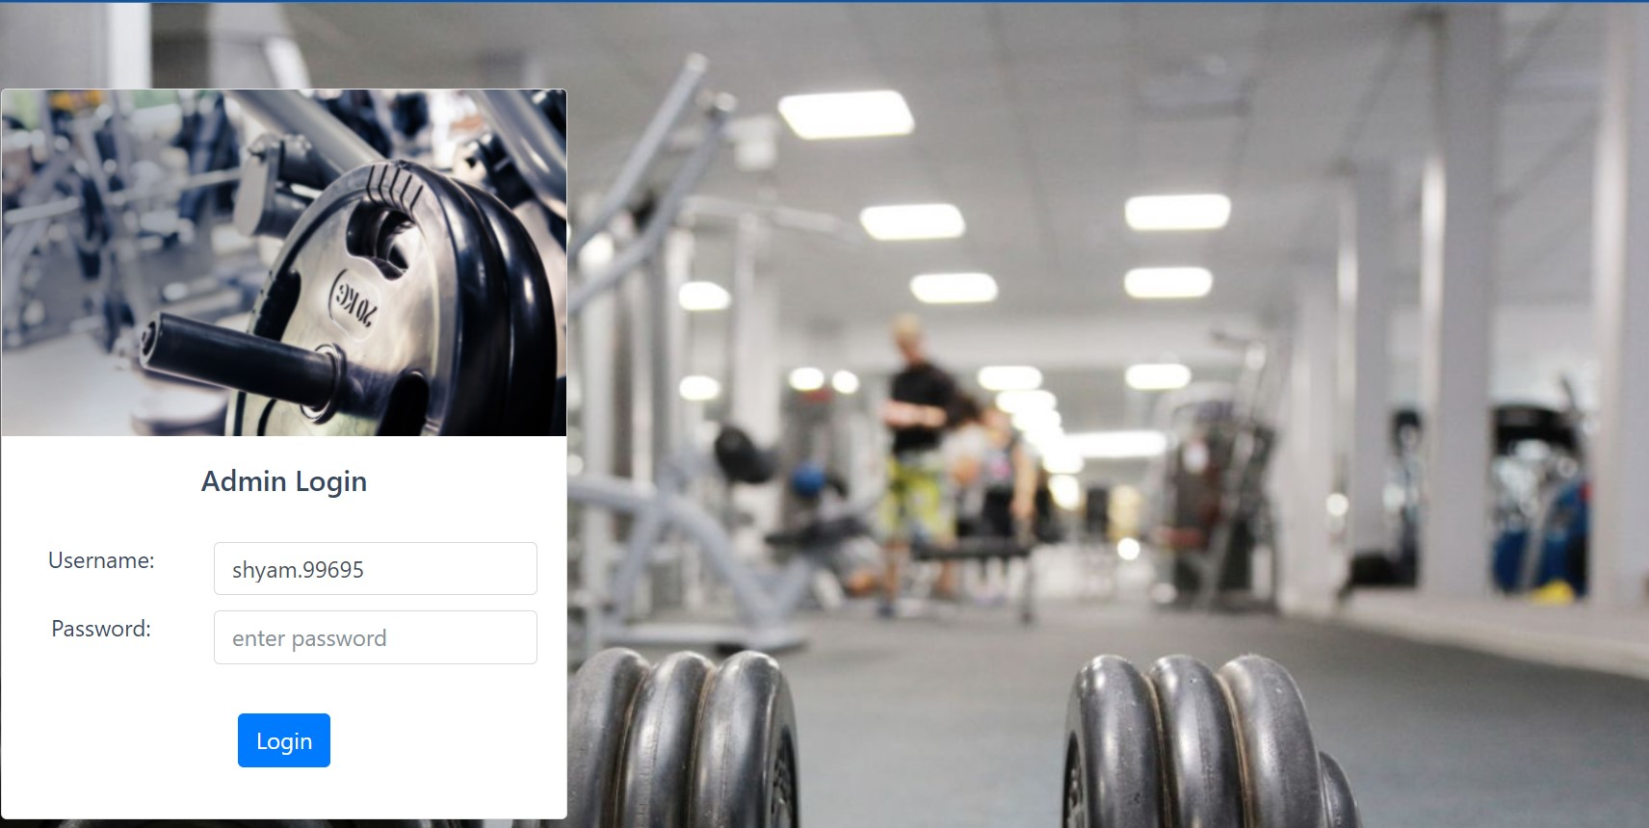
Admin Panel Login
In this project first admin will login with user id and password After that student registration page is open

Slide 14
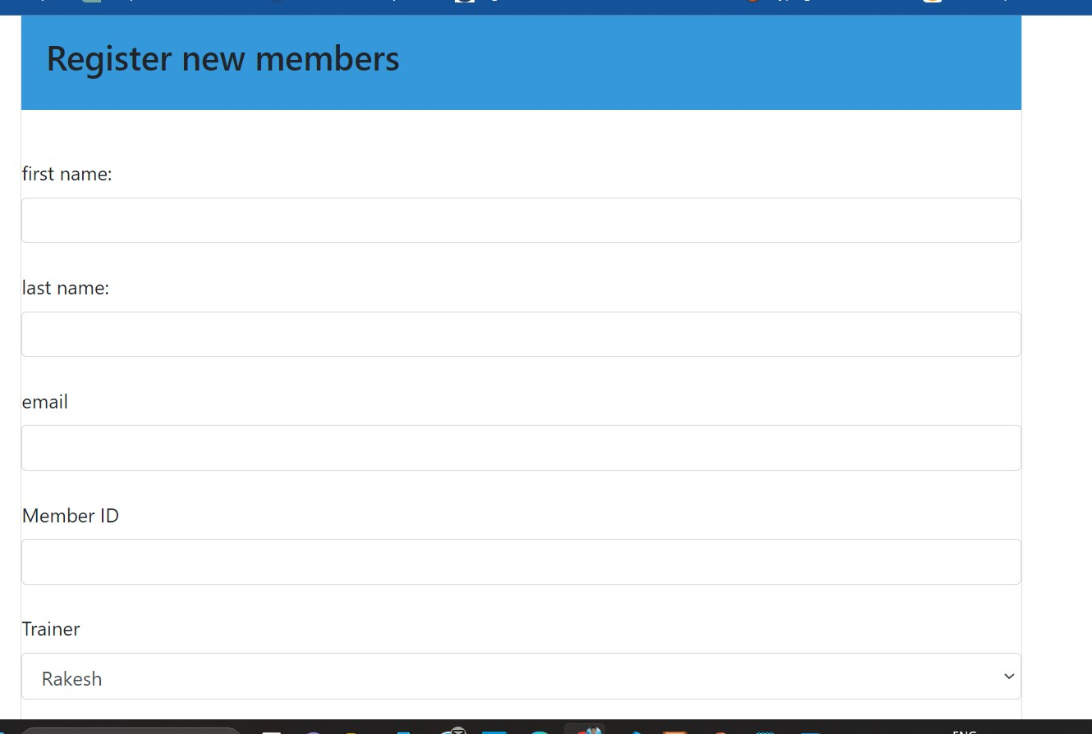
New member registration

Slide 15
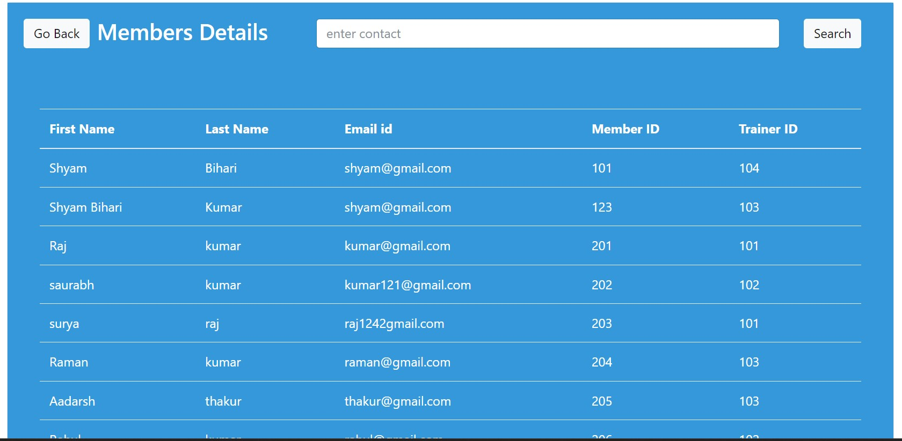
Output

Slide 16


