Slide 1
A LangGraph-Based Multi-Agent System for Brand-Compliant Marketing Content Generation
Shyam Sundar K
SRN: R22MSA55 | Date: 22/08/2026
M.Sc. in
Artificial Intelligence
Capstone Project 2 Presentation
Year: II

Slide 2
Introduction
📋
🔀
🎯
Background | Current Status | Why This Topic?
Short-form vertical video is the default unit of consumer marketing on Reels/Shorts A small D2C Shopify retailer needs a script, caption, hashtags and video per product, per revision | LLM tools exist but are fragmented across copy, narration and video with nothing carrying facts through Brand governance (tone, banned words, compliance) is enforced by human review, not by generation | Make brand voice, compliance and visual rules machine-readable and enforced during generation Cut the marginal cost of content per SKU while keeping every claim traceable to its source

Slide 3
Literature Review
No. | Title | Author and Year | Journal | Description | Insights | Research Gaps/Comments
1 | KOBE: Towards Knowledge-Based Personalized Product Description Generation | Chen et al. (2019) | KDD | Transformer generating personalised product descriptions conditioned on aspects, user categories and a knowledge base. | Catalogue attributes are a sufficient basis for usable copy. | Trained model, retargeting means retraining; produces one artefact, not a campaign.
2 | Survey of Hallucination in Natural Language Generation | Ji et al. (2023) | ACM Computing Surveys | Canonical taxonomy separating intrinsic hallucination (contradicts source) from extrinsic (unverifiable). | Names the grounding failure precisely for marketing copy. | Does not specify an enforcement mechanism during generation.
3 | On Faithfulness and Factuality in Abstractive Summarization | Maynez et al. (2020) | ACL | Shows models hallucinate content unfaithful to the input at high rates; overlap metrics (ROUGE) do not detect it. | Fluency scoring says nothing about whether facts are real. | No structural mitigation proposed; motivates schema-level validation.
4 | LangGraph: Build Stateful Multi-Actor Applications with LLMs | LangChain (2024) | Framework Docs | Compiled state graph with typed shared state and reducers for safe concurrent multi-agent writes. | Enables a deterministic, bounded agent pipeline instead of an emergent conversation. | General orchestration framework; not applied here to grounding or brand governance.

Slide 4
Problem Statement
One overwhelmed person, six disconnected tools
A small direct-to-consumer Shopify retailer must produce a script, caption, hashtag set and video for every product, variant and revision. Generative models can write this copy, but the failure that matters is not a clumsy sentence — it is a confident, brand-shaped claim about a specification or price that nobody can trace to a source, and that a reviewer may approve because it reads well.
Key Challenges
Tooling is fragmented across copy, narration and video, with nothing carrying product facts through all of them
Brand governance is treated as review, not as a constraint enforced during generation
Generative systems fall back to templates on failure — indistinguishable from real output at approval time
Unverified claims
⚠️
📝
🎬
Script
🧑‍💻
Video
🎙️
💬
Narration
Caption
#️⃣
Hashtags
The entire manual chain repeats for every product and every revision
Brand voice and factual claims are enforced only by human memory not by the tools themselves.

Slide 5
Project Objectives
1
2
3
4
5
6
🧩
🛠️
⚙️
🧪
✅
🚀
Design
Build
Implement
Test
Validate
Deploy
Design a brand-governed, multi-agent software architecture: LangGraph state graph, typed pipeline state and a provider-agnostic LLM gateway.
Build the end-to-end generation pipeline: scraper, five prompt-driven LLM agents, a pluggable TTS chain and a deterministic video renderer.
Implement the fact-grounding and validation layer: hardened JSON extraction, brand-derived schema validators, a repair-retry loop and a no-fallback rule.
Test every functional requirement with an automated, offline test suite covering parsing, validation, persistence and pipeline logic.
Validate the assembled system against a live product page: timing, audio/video sync, claim traceability and provenance.
Deploy the system as a demo-ready application: Streamlit dashboard, review page, job queue and human approve/reject gate.

Slide 6
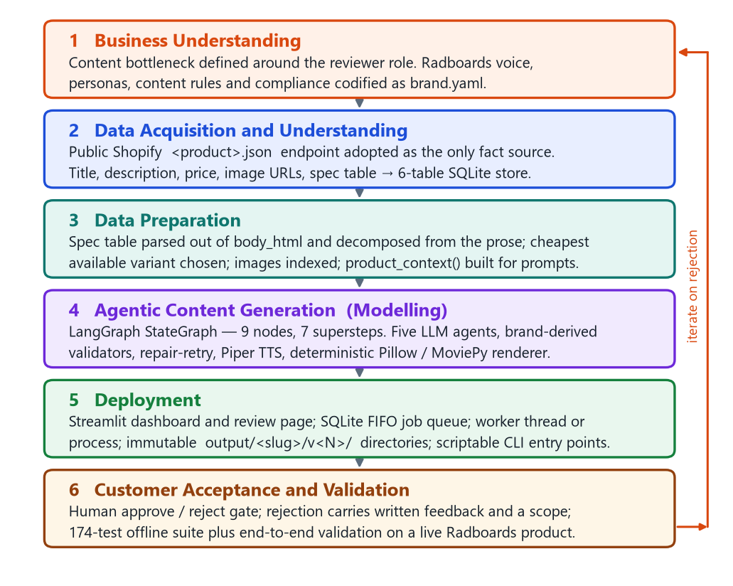
Project Methodology
Methodology: Team Data Science Process (TDSP)
Research Design
Research Type: Design and Development Research
System: Brand-Governed Multi-Agent Marketing Content Generator
Input: Single public Shopify product URL
Architecture: LangGraph + Streamlit + SQLite
Execution: 9-node state graph across 7 supersteps, 5 LLM agents
Workflow:

Slide 7
Resource Specifications
Software | Hardware | Other Resources
Python 3.9+ | Standard laptop CPU (no GPU) | Shopify product JSON (public)
LangGraph | 8+ GB RAM | LLM API (OpenAI / Gemini / Anthropic)
Streamlit + SQLite | Sufficient SSD for versioned outputs | ElevenLabs API (optional, for TTS)
Pillow / MoviePy renderer | Windows / Linux / macOS | Piper TTS (offline fallback)
pytest (174-test suite) |  | Environment variables (.env)
Key Highlights
No GPU required, runs on a standard laptop
Provider-agnostic LLM gateway
Every brand rule externalised into one YAML file

Slide 8
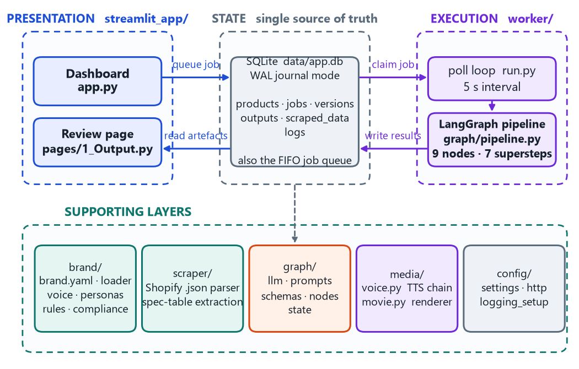
Software Design
Design Highlights
Nine-node LangGraph pipeline with a parallel fan-out superstep
Hardened JSON extraction with brand-derived schema validation
Repair-retry loop with a strict no-fallback rule
Six-table relational model; a version exists only when complete
Deterministic renderer retimed to the measured narration length

Slide 9
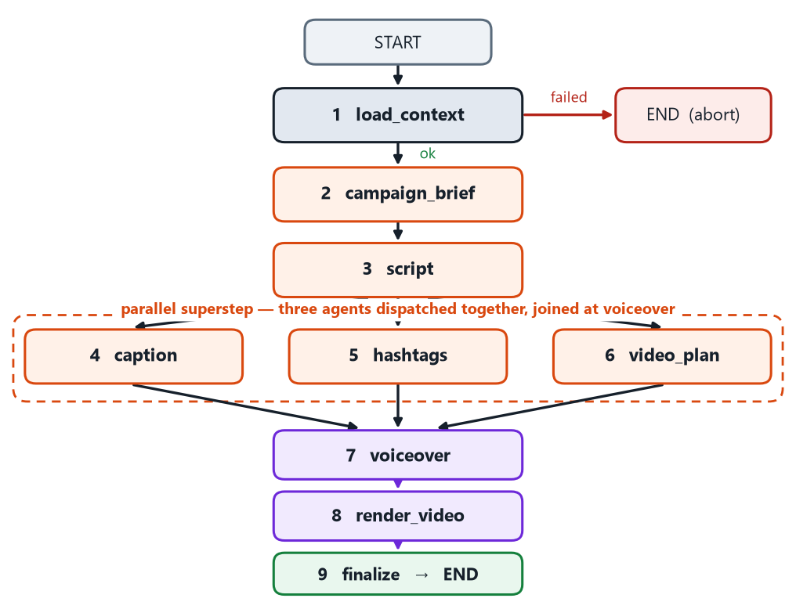
Implementation
Implementation Deliverables
Scraper & Data Layer
Shopify scraper separating specs from prose; SQLite persistence
is also the job queue.
Five LLM Agents
Brief, script, caption, hashtag and shot-plan agents; three run in a
parallel super step with explicit reducers.
Fact Grounding
Four-stage hardened JSON extractor, human in the loop fact validation and an error-fed repair-retry loop.
Speech & Video Rendering
Pluggable TTS chain (ElevenLabs → Piper → pyttsx3) and a deterministic
1080×1920 H.264 renderer retimed to the narration.
Review Application
Streamlit dashboard, worker, and human approve/reject gate with scoped
feedback and dependency cascade.

Slide 10
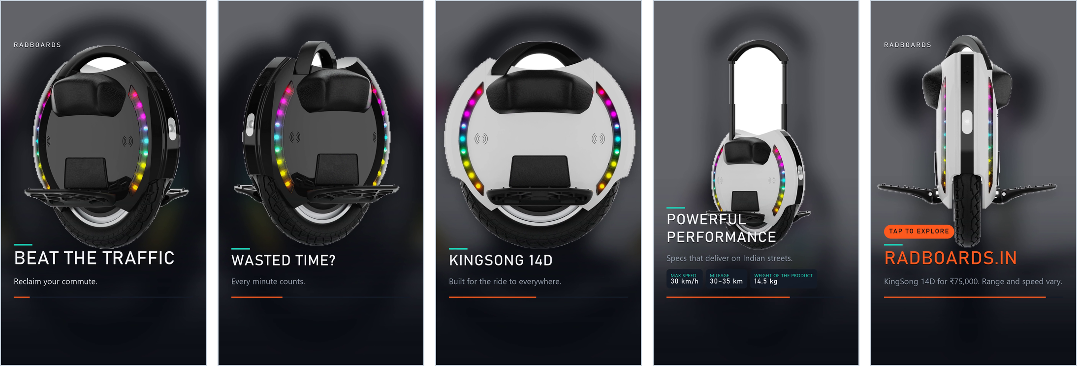
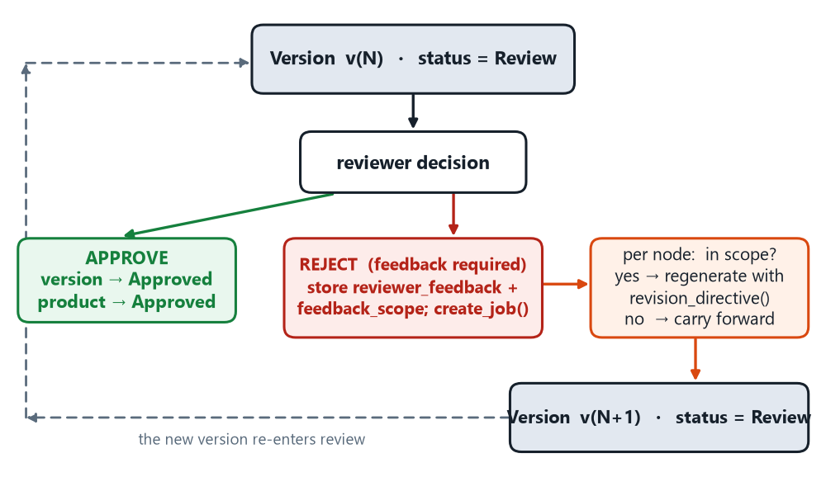
Demo
Rendered Video Frames: Title, Feature x2, Specification and Call-to-Action Scenes
Human-in-the-Loop Review & Regeneration Loop

Slide 11
Testing Validation, and Results
Testing & Validation
Test Scenario | Expected Outcome | Status
Duplicate product URL | Surfaced as already-exists; no second row created | Pass
Script duration inflated by model | Duration recomputed from word count, not model estimate | Pass
TTS engine failure | No partial WAV written; falls back to next engine in chain | Pass
Caption exceeds limit after 3 attempts | Job fails; no version or placeholder created | Pass
Live end-to-end product run | All artefacts produced; narration and MP4 duration matched exactly | Pass
Key Results
174 automated tests, all passed without errors
Live run: All artefacts from one URL in 214 seconds; every claim traced to the scraped record with human review
Rendered video duration (22.37s) matched the measured narration.

Slide 12
Conclusion and Future Scope
Conclusion
A generative system can produce a complete, reviewable marketing package without inventing product claims, provided it is willing to fail.
Brand-as-data governance: one YAML file drives prompts, validation limits and rendered visuals.
No-fallback architecture: absence of placeholder content is a structural property, asserted by a named test.
Future Scope
A claim-verification node cross-checking every number against the specification dictionary
A brand-compliance critique pass in the manner of Self-Refine
Multi-worker operation via atomic job-claiming
Direct publishing across all aspect ratios; an LLM-judge evaluation study
From fragmented chaos to one governed, repeatable pipeline
🔗
Product URL
⚙️
Brand-governed pipeline
📝
Script — verified
✓
💬
Caption — verified
✓
#️⃣
Hashtags — verified
✓
🎬
Video — verified
✓

Slide 13
References
Bibliography | Webliography
Z. Ji et al., “Survey of Hallucination in Natural Language Generation,” ACM Computing Surveys, 2023.
J. Maynez, S. Narayan, B. Mirylenka, R. McDonald, “On Faithfulness and Factuality in Abstractive Summarization,” ACL, 2020.
H. Chen et al., “KOBE: Towards Knowledge-Based Personalized Product Description Generation,” KDD, 2019.
H. Rashkin et al., “Measuring Attribution in Natural Language Generation Models,” 2021.
Y. Shen, C. Wu, “ReAct: Synergizing Reasoning and Acting in Language Models,” 2023.
Q. Wu et al., “AutoGen: Enabling Next-Gen LLM Applications via Multi-Agent Conversation,” 2023.
LangChain, “LangGraph: Build Stateful Multi-Actor Applications with LLMs,” https://langchain-ai.github.io/langgraph/.
B. J. Willard, R. Louf, “Efficient Guided Generation for Large Language Models,” 2023.
A. Blattmann et al., “Stable Video Diffusion,” 2023. [Online].
“Team Data Science Process,” Microsoft, https://learn.microsoft.com/azure/architecture/data-science-process-overview/.
Shopify, “The Product JSON Endpoint,” Shopify Developer Documentation.
ASCI, “Code for Self-Regulation of Advertising Content in India,” Advertising Standards Council of India.

Slide 14
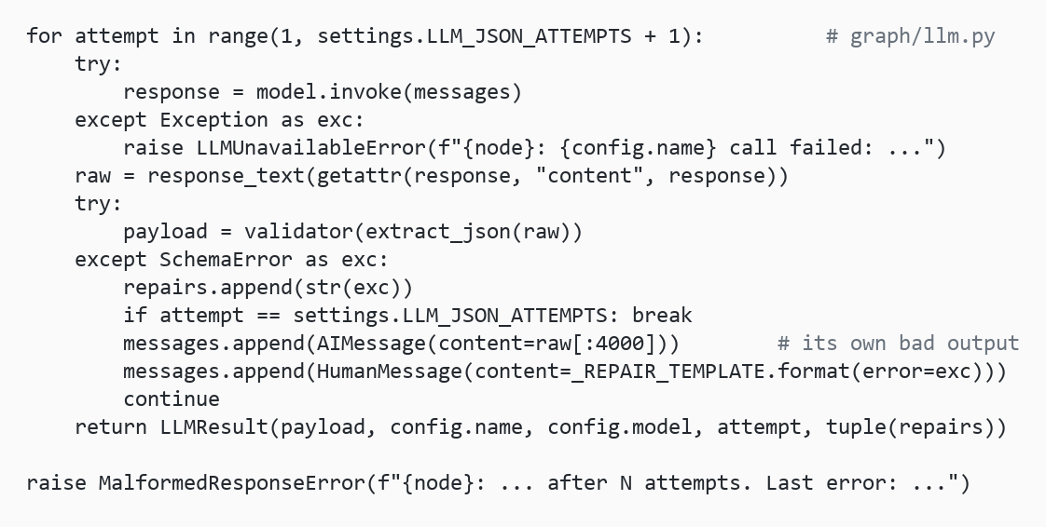
Annexure
Similarity Index
Turnitin similarity report pending — to be inserted (see report Appendix B).
Code Snippet: Repair-Retry Loop

Slide 15
GitHub Link
https://github.com/Shyamsundarkanaka/AI-Powered-Marketing-Content-Generation

