Slide 1
An application of Dijkstra’s Algorithm to shortest route problem.
Submitted by: -
Shyam Sundar Yadav
2) Ranveer Deshmukh
3) Parth Sunklod
Submitted to:-
Mrs. Rohini Sarode

Slide 2
Introduction
This research addresses the problem of Asian Paints Pvt. Ltd in transporting their products from their production plant to stores of sales by presenting analysis of the shortest path using Dijkstra’s Algorithm and it was concluded that the best paths found from the analysis will save the company less distance in transporting the paints and minimize time and cost of fueling their vehicles.
The analysis shows that the best route which provides the shortest distance will be from node 1 – 3 – 5 – 8 (Pune – Shivajinagar – Location – Akurdi ), when transporting from Pune (the production location) to Akurdi the company’s major’s.
Keywords: Directed Network, node, activity, Dijkstra’s Algorithm , Permissible route.

Slide 3
Aim and Objectives of Study
The aim of this project is to determine the shortest route from the production plant of a local paint company(Asian Paints Private limited) to 7 different dealers in the state with a permissible route.
This particular problem determines the route of minimum weight that connects two vertices namely a source and a destination in a weighted graph in a transportation network. Other situation can be represented by the same model like the Very Large Scale Integrated (VLSI) design, equipment replacement, and others. Different types of shortest path algorithm are used to determine the shortest path of a graph. The Dijkstra’s algorithm is the most efficient algorithm used to find the shortest path between a known vertex to other vertices. Some improvements on Dijkstra’s algorithm are done in terms of efficient implementation and cost matrix. In this project, we propose to implement the Dijkstra’s algorithm to determine the shortest route from the production plant of the company to any of the other location in the network.
The Shortest Route Problem

Slide 4

Principle of Dijkstra’s Algorithm
To find the shortest path between two given vertices of a graph, we will follow the following mentioned steps of the algorithm/approach, which are:
if dist(u) + len(u,v) < dist(v)
dist(v) = dist(u) + len(u,v)
Where,
dist(u) = Source Node
dist(v) = Destination Node
Note: By default, the source node's immediate and non-immediate distance to the other nodes in the graph is “∞ (Infinite).
Analysis Of Data
This section introduces the data and analytical approach of the methodology used in the project research. The locations used for this project work was obtained from Asian Paints Pvt. Ltd. and also the distance in kilometre (km) between each location in the graph was measured using Google maps location.

Slide 5
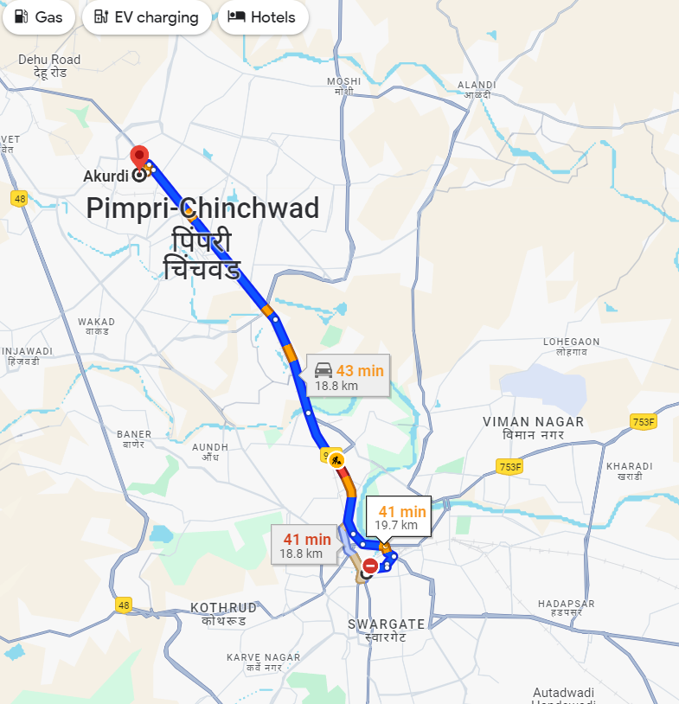
Fig.1.Permissible Route of the Road Network from Pune through Akurdi
7.2km
7
8
13.3km
4.8km
2km
3.8km
6
4
7.2km
2.6km
5
8.3km
7.6km
11.6km
3
4.5km
2
6.3km
6.2km
1

Slide 6
LOCATION NODES
PUNE(Production plant) 1 Shivajinagar 2 Khadki 3 Dapodi 4 Kasarwadi 5 Pimpri 6 Chinchwad 7 Akurdi 8
Table 4.0. Names of location and Nodes identification
4.1 Analytical Solution to the Problem.
Iteration 0: Assign the permanent label [0, ∞].
NODES LABLES STATUS
1 [0, ∞] Permanent
Table.1
1: Node 2 and node 3 can be reached from (the last permanent labelled) node 1, thus the list of labelled nodes becomes (temporary and permanent).
NODES LABLES STATUS
[0, ∞] Permanent [0+6.2, 1] Temporary [0+6.3, 1] Temporary
Table 2.

Slide 7
For the two temporary labels [6.2, 1] and [6.3, 1], node 2 yields the smaller distance (u2 = 6.2).thus the status of node 2 is changed to permanent.
NODES LABEL STATUS
1 [0, ∞] Permanent 2 [6.2, 1] Permanent 3 [6.3, 1] Temporary
Table .3a
Iteration 2:
The new starting node is node 2. Node 3 and node 5 can be reached from node 2. Thus the list of labelled nodes becomes:
NODES LABEL STATUS
1 [0, ∞] Permanent 2 [6.2, 1] Permanent 3 [6.3, 1] Temporary 3 [6.2+4.5, 2] Temporary 5 [6.2+11.6, 2] Temporary
Table .3b
Node 3 temporary label [6.3, 1] obtained in iteration 1 remains the same because in iteration 2 node 3 holds another label [10.7, 2] and the shorter distance found is that of label [6.3, 1].

Slide 8
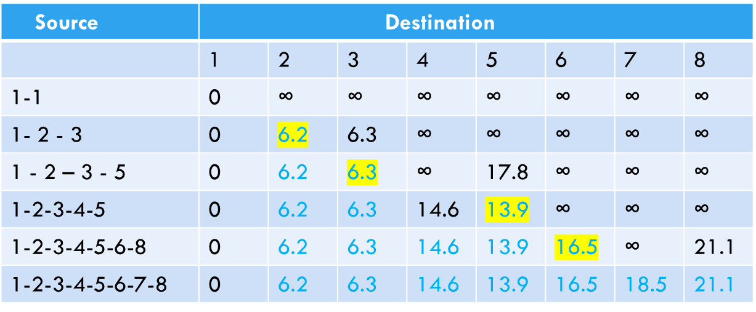
Short Analysis

Slide 9
NODES LABEL STATUS
1 [0, ∞] Permanent 2 [6.2, 1] Permanent 3 [6.3, 1] Permanent 5 [17.8,2] Temporary
Table 4
Node 3 yields the shorter distance (u3 = 6.3), thus the status of node 3 changed to permanent.
Iteration 3: Node 3 becomes the new start point. Node 3 connects to node 4 and node 5. Thus the list of labelled nodes is updated as:
NODES LABEL STATUS
1 [0, ∞] Permanent 2 [6.2, 1] Permanent 3 [6.3, 1] Permanent 5 [17.8,2] Temporary 4 [6.3+8.3, 3] Temporary 5 [6.3+7.6, 3] Temporary
Table5
Node 5 temporary label [17.8, 2] obtained from iteration 2, is thus changed to [13.9, 3] obtained in iteration 3 to indicate a shorter route through node 3. Thus the shorter distance is node 5 (u5 = 13.9) labelled [13.9, 3], thus we change the status of node 5 permanent. The list of labelled node now becomes;

Slide 10
NODES LABEL STATUS
1 [0, ∞] Permanent 2 [6.2, 1] Permanent 3 [6.3, 1] Permanent 5 [13.9, 3] Permanent 4 [14.6, 3] Temporary
Table 6
Iteration 4: Node 6 and node 8 can be reached from node 5. The list of labelled nodes thus becomes:
NODES LABEL STATUS
1 [0, ∞] Permanent 2 [6.2, 1] Permanent 3 [6.3, 1] Permanent 5 [13.9, 3] Permanent 4 [14.6, 3] Temporary 6 [13.9+2.6, 5] Temporary 8 [13.9+7.2, 5] Temporary
Table 7
Node 6 yields the shorter distance from node 5, thus the status of node 6 (u6 = 16.5) becomes permanent. The list is now updated to become;

Slide 11
NODES LABEL STATUS
1 [0, ∞] Permanent 2 [6.2, 1] Permanent 3 [6.3, 1] Permanent 5 [13.9, 3] Permanent 4 [14.6, 3] Temporary 6 [16.5, 5] Permanent 8 [21.1, 5] Temporary
Table 8
Iteration 5: From node 6, node 7 and node 8 can be reached
NODES LABEL STATUS
1 [0, ∞] Permanent 2 [6.2, 1] Permanent 3 [6.3, 1] Permanent 5 [13.9, 3] Permanent 4 [14.6, 3] Temporary 6 [16.5, 5] Permanent 8 [21.1, 5] Temporary 7 [16.5+2, 6] Temporary 8 [16.5+4.8, 6] Temporary
Table 9
Node 8 temporary label [21.3, 6] obtained from iteration 5, is thus changed to [21.1, 5] obtained in iteration 4 to indicate a shorter route through node 5. Thus the shorter distance is node 7 (u7 = 18.5) labelled [18.5, 6], thus we change the status of node 7 permanent. The list of labelled nodes now becomes;

Slide 12
NODES LABEL STATUS
1 [0, ∞] Permanent 2 [6.2, 1] Permanent 3 [6.3, 1] Permanent 5 [13.9, 3] Permanent 4 [14.6, 3] Temporary 6 [16.5, 5] Permanent 8 [21.1, 5] Temporary 7 [18.5,6] Permanent
Table 10
Node 8 can be reached only from node 7
NODES LABEL STATUS
1 [0, ∞] Permanent 2 [6.2, 1] Permanent 3 [6.3, 1] Permanent 5 [13.9, 3] Permanent 4 [14.6, 3] Temporary 6 [16.5, 5] Permanent 8 [21.1, 5] Temporary 7 [18.5,6] Permanent 8 [18.5+7.2, 7] Temporary
Table 11

Slide 13
Node 8 temporary label [25.7, 7] obtained from iteration 6, is changed to [21.1, 5] obtained in iteration 5 to indicate a shorter route has been found through node 5. Thus we change the status of node 8 (u8 = 21.1) permanent. The list of labelled node now becomes;
NODES LABEL STATUS
1 [0, ∞] Permanent 2 [6.2, 1] Permanent 3 [6.3, 1] Permanent 5 [13.9, 3] Permanent 4 [14.6, 3] Temporary 6 [16.5, 5] Permanent 8 [21.1, 5] Permanent 7 [18.5,6] Permanent
Table 12
Iteration 7: Again node 7 can be reached from node 4. The list of labelled nodes;
NODES LABEL STATUS
1 [0, ∞] Permanent 2 [6.2, 1] Permanent 3 [6.3, 1] Permanent 5 [13.9, 3] Permanent 4 [14.6, 3] Temporary 6 [16.5, 5] Permanent 8 [21.1, 5] Permanent 7 [18.5,6] Temporary 7 [14.6+13.3, 4] Temporary
Table 13

Slide 14
Node 7 temporary holds label [27.9, 4] obtained from iteration 7, is thus changed to [18.5, 6] obtained in iteration 6 to indicate a shorter route has be found through node 4. Therefore node 7 is updated as (u7 = 18.5) labelled [18.5, 6], we cannot change the status of node 7 since it is already permanent. The list of labelled node now becomes;
NODES LABEL STATUS
1 [0, ∞] Permanent 2 [6.2, 1] Permanent 3 [6.3, 1] Permanent 5 [13.9, 3] Permanent 4 [14.6, 3] Temporary 6 [16.5, 5] Permanent 8 [21.1, 5] Permanent 7 [18.5,6] Permanent
Iteration 8:
Table 14
NODES LABEL STATUS
1 [0, ∞] Permanent 2 [6.2, 1] Permanent 3 [6.3, 1] Permanent 5 [13.9, 3] Permanent 4 [14.6, 3] Temporary 6 [16.5, 5] Permanent 8 [21.1, 5] Permanent 7 [18.5,6] Permanent
Table 15

Slide 15
Since node 4 can only be accessed by node 3 therefore we make node 4 (u4 = 14.6) status permanent
NODES LABEL STATUS
1 [0, ∞] Permanent 2 [6.2, 1] Permanent 3 [6.3, 1] Permanent 5 [13.9, 3] Permanent 4 [14.6, 3] Permanent 6 [16.5, 5] Permanent 8 [21.1, 5] Permanent 7 [18.5,6] Permanent
Table 16
Now all nodes in the list have attained its status as permanent, we can therefore say we have obtained the maximum iteration for the problem. Therefore the solution to the shortest route and distance from node 1 to any other node in the network is thus;
NODES ROUTES DISTANCE
1 1 0 2 1 – 2 6.2 3 1 – 3 6.3 4 1 – 3 – 4 14.6 5 1 – 3 – 5 13.9 6 1 – 3 – 5 – 6 16.5 7 1 – 3 – 5 – 6 – 7 18.5 8 1 – 3 – 5 – 8 21.1
Table 17

Slide 16
Conclusion
The shortest route between node 1 (production plant) and any other node in the network can be determined by starting at the desired destination and back-tracking through the nodes using the information given by the permanent labels (Table.4.1.16), for example the sequence or route determines the shortest route from node 1 to node 7. (7) – [18.5, 6] – (6) – [16.5, 5] – (5) – [13.9, 3] – (3) – [6.3, 1] – (1) Thus the desired route is; 1 – 3 – 5 – 6 – 7

