Slide 1


ABSTRACT
Speech Emotion Recognition (SER) is a significant area of research with diverse applications, including human-computer interaction, affective computing, and mental health monitoring. This paper presents a comprehensive approach to SER using machine learning techniques, with a focus on the Toronto Emotional Speech Set (TESS) dataset, which provides high-quality audio recordings of emotional speech from female speakers. The proposed system involves data loading, preprocessing, feature extraction, model design, training, and evaluation. Feature extraction is performed using Mel Frequency Cepstral Coefficients (MFCC) to capture relevant acoustic characteristics from the audio signals. The model architecture consists of a Long Short-Term Memory (LSTM) neural network, capable of learning temporal dependencies in speech sequences.
The system is trained using categorical cross-entropy loss and optimized with the Adam optimizer. Through extensive experimentation and validation, the proposed SER system demonstrates promising performance in accurately recognizing emotions from speech signals. The effectiveness of the system is evaluated through various metrics, including accuracy, precision, recall, and F1-score. Overall, the proposed SER system offers a robust framework for emotion recognition in speech, with potential applications in diverse real-world scenarios
Keywords - Detection, Speech Input, Feature Extraction, SVM
2

Slide 2

LITERATURE SURVEY
In contemporary human-computer interaction, the ability to discern and understand the emotional content of spoken language has become a pivotal aspect. Emotion detection, particularly in speech, plays a vital role in enhancing the responsiveness and adaptability of machines to human emotions. This paper delves into the fundamental task of detecting emotions elicited by speakers during their discourse. Notably, emotions like fear, anger, and joy exhibit distinct pitch patterns, with characteristic higher and wider ranges. Recognizing and classifying these emotional cues in speech is instrumental in advancing human-machine interactions. The study employs various classification algorithms, including Support Vector Machine and Multi-layer Perception, coupled with audio features such as MFCC, MEL, chroma, and Tonnetz. Through extensive training on emotions like Calm, Neutral, Surprise, Happy, Sad, Angry, Fearful, and Disgust, the models achieved an accuracy of 86.5%, demonstrating their effectiveness in emotion recognition. The findings of this research contribute to the broader field of emotional intelligence in machines, fostering more nuanced and responsive communication between humans and computers.
3

Slide 3

PROBLEM STATEMENT
In natural human communication, emotions play a crucial role in conveying meaning and intent beyond the literal content of speech. The challenge is to develop a robust and accurate system that can automatically recognize and classify emotions expressed in spoken language. Specifically, the goal is to create a model that can analyze audio signals, detect emotional cues, and categorize the emotions into predefined classes such as happiness, sadness, anger, surprise, disgust, and neutral.
4

Slide 4

EXISTING SYSTEM:
In natural human communication, emotions play a crucial role in conveying meaning and intent beyond the literal content of speech. The challenge is to develop a robust and accurate system that can automatically recognize and classify emotions expressed in spoken language. Specifically, the goal is to create a model that can analyze audio signals, detect emotional cues, and categorize the emotions into predefined classes such as happiness, sadness, anger, surprise, disgust, and neutral. we have data imbalance and limited naturalness which are to be solved.
5

Slide 5

Proposed System:
In natural human communication, emotions play a crucial role in conveying meaning and intent beyond the literal content of speech. The challenge is to develop a robust and accurate system that can automatically recognize and classify emotions expressed in spoken language. Specifically, the goal is to create a model that can analyze audio signals, detect emotional cues, and categorize the emotions into predefined classes such as happiness, sadness, anger, surprise, disgust, and neutral. we have data imbalance and limited naturalness which are to be solved.
6

Slide 6

METHODOLOGY
In Speech Emotion Recognition (SER), various methodologies are employed to effectively detect and classify emotions from spoken language.
1. Signal Processing Techniques
Feature Extraction
Prosodic Features:
Pitch: Measures the frequency of speech
Speech Rate: The speed of speech, which can correlate with emotional states (e.g., excitement or anxiety).
Intensity: The loudness of speech,
2. Traditional Machine Learning Methods
Classification Algorithms
Support Vector Machines (SVM):
Classify emotional states and separates different classes in the feature space.
Decision Trees
Random Forests:
K-Nearest Neighbors (KNN)
3.Deep Learning Methods
Neural Networks
Feedforward Neural Networks (FNN):
Convolutional neural network(CNN)
7

Slide 7
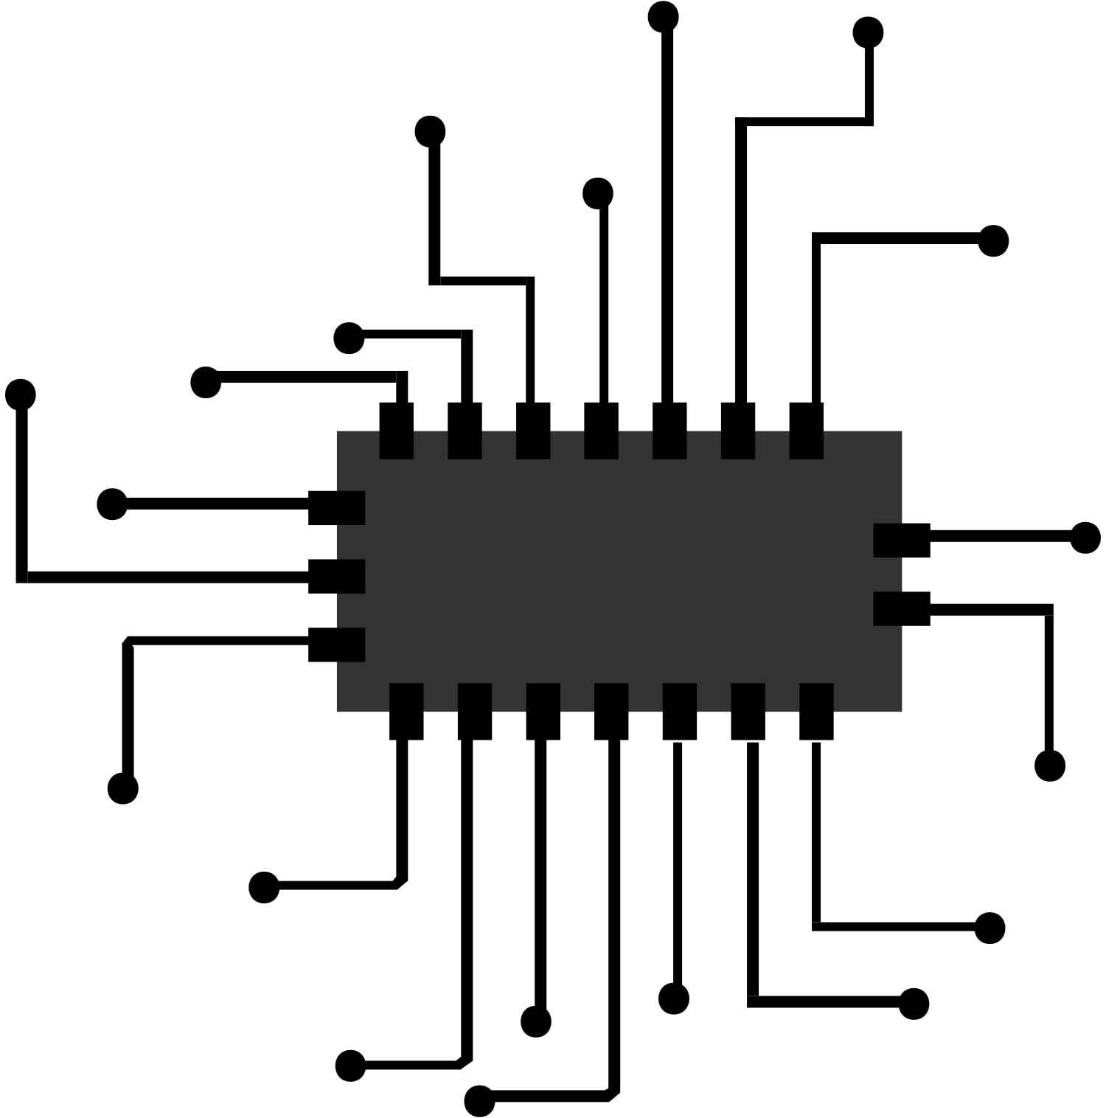
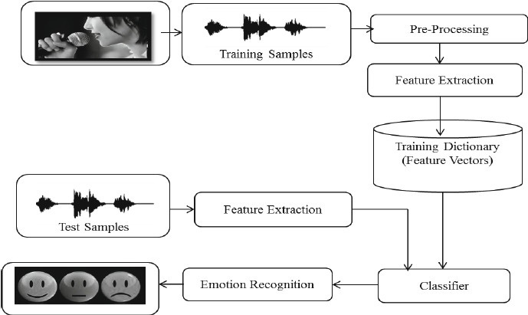
BLOCK DIAGRAM
8

Slide 8

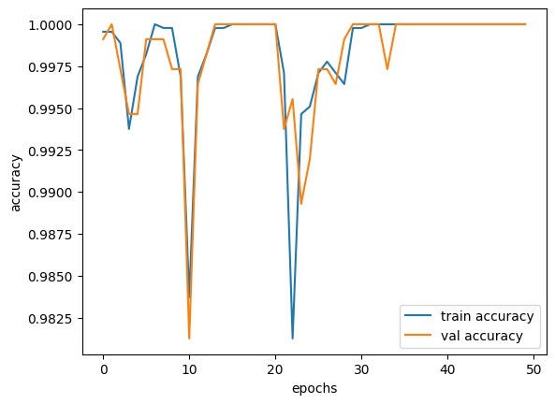
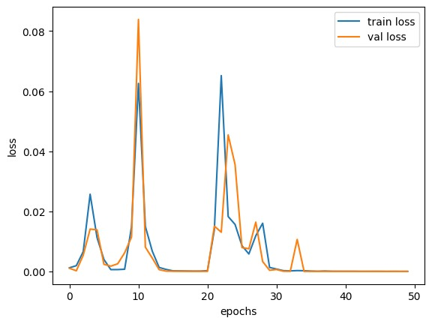
RESULT:
The accuracy of model is shown by taking the data sets.
9

Slide 9

CONCLUSION:
In summary, the Speech Emotion Recognition (SER) project represents a significant advancement in human-computer interaction, particularly in understanding and responding to emotional cues in spoken language. The project has demonstrated the efficacy of machine learning algorithms and feature extraction techniques in accurately detecting and categorizing emotions expressed in speech.
The implementation of SER addresses challenges in various domains, including mental health monitoring, personalized responses, improved communication, and fine-grained sentiment analysis. The project has showcased the potential of SER in creating emotionally aware systems that can adapt their behaviour based on the detected emotional states of users
10

Slide 10

REFERENCES
[1] Kottursamy, Kottilingam. “A review on finding efficient approach to detect customer emotion analysis using deep learning analysis.” Journal of Trends in Computer Science and Smart Technology 3, no. 2 (2021): 95-113.
[2] Thakur, Amrita, Pujan Budhathoki, Sarmila Upreti, Shirish Shrestha, and Subarna Shakya. “Real Time Sign Language Recognition and Speech Generation.” Journal of Innovative Image Processing 2, no. 2 (2020): 65-76.
[3] Kaur, Jasmeet, and Anil Kumar. “Speech Emotion Recognition Using CNN, k-NN, MLP and Random Forest.” In Computer Networks and Inventive Communication Technologies, pp. 499-509. Springer, Singapore, 2021.
[4]Gamage, Kalani Wataraka, Vidhyasaharan Sethu, Phu Ngoc Le, and Eliathamby Ambikairajah. "An i-vector gplda system for speech based emotion recognition." In 2015 Asia-Pacific Signal and Information Processing Association Annual Summit and Conference (APSIPA), pp. 289-292. IEEE, 2015.
[5]Han, Jing, Zixing Zhang, Fabien Ringeval, and Björn Schuller. "Reconstruction-error-based learning for continuous emotion recognition in speech." In 2017 IEEE international conference on acoustics, speech and signal processing (ICASSP), pp. 2367-2371. IEEE, 2017.
11

Slide 11


THANK
YOU

