Slide 1
Customer Segmentation for Online Retail
Using Unsupervised Machine Learning

Slide 2
Problem Statement
Businesses struggle to understand diverse customer behaviors.
Personalized marketing strategies are needed.
Goal: Segment customers based on purchasing patterns to drive business insights.

Slide 3
Dataset Overview
Source: Online Retail Dataset (UCI Repository)
500,000+ transactional records
Key features: CustomerID, InvoiceDate, Quantity, UnitPrice
Time period: Dec 2010 - Dec 2011

Slide 4
Methodology
RFM Analysis: Recency, Frequency, Monetary Value
Data Cleaning: Remove missing IDs, cancellations, negative quantities
Standardize Features
K-Means Clustering

Slide 5
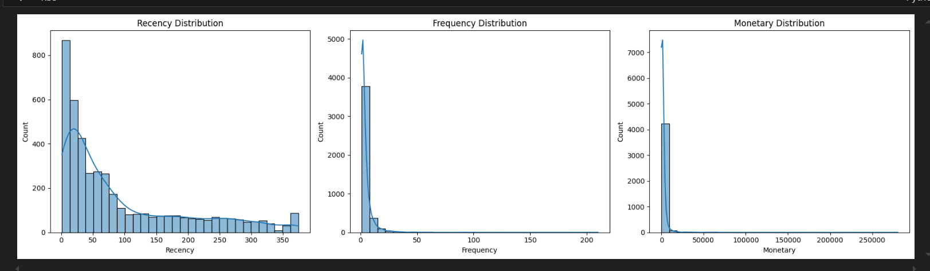
EDA Highlights
Recency: Most customers purchased long ago
Frequency: Most customers purchased once or twice
Monetary: Heavy right-skew; few big spenders
Strong presence of outliers

Slide 6
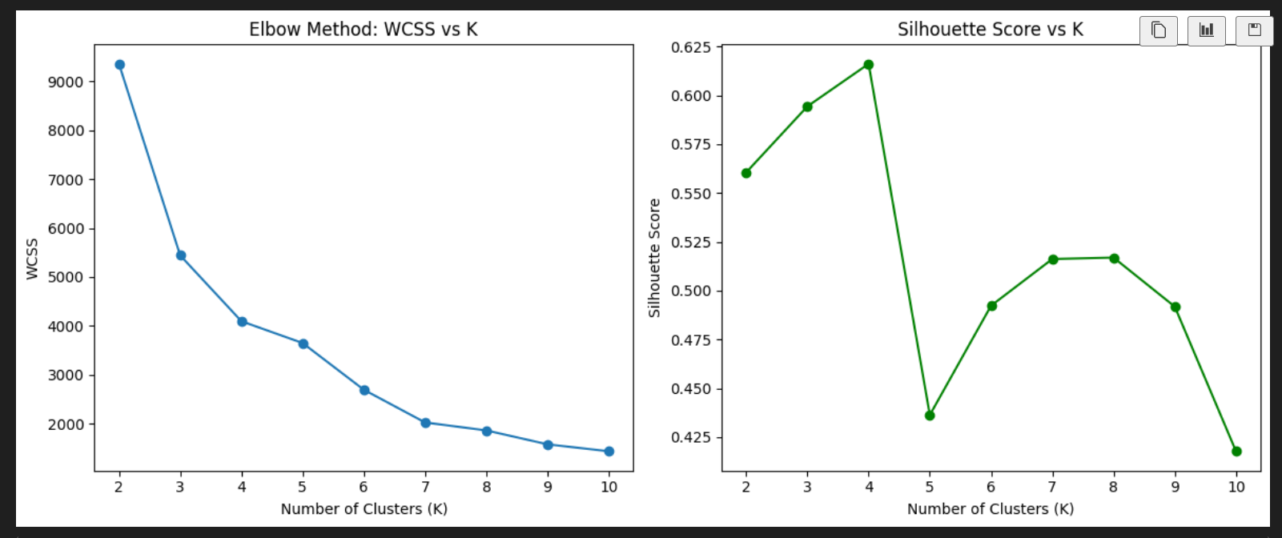
Finding Optimal K
Elbow Method: WCSS elbow around K=4
Silhouette Score: Highest at K=4 (~0.62)
Decided on 4 clusters

Slide 7
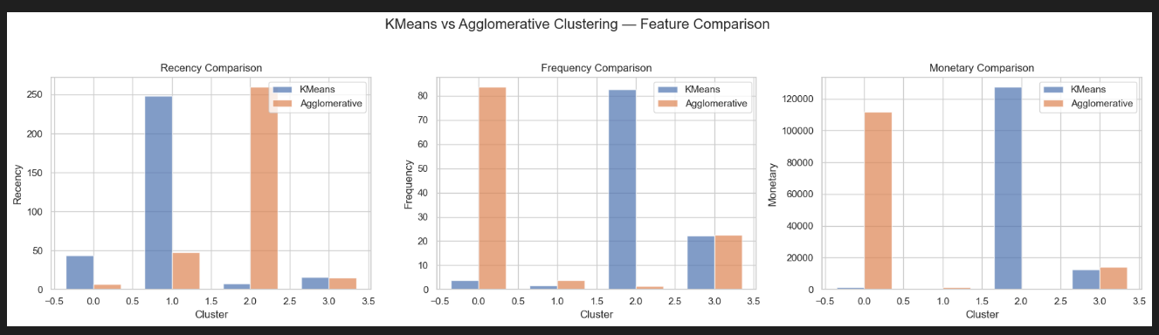
Validation Using Agglomerative Clustering
Applied Agglomerative Clustering to validate KMeans customer segments.
Hierarchical method — no assumption of spherical clusters
Detected similar customer groups as KMeans.
Confirmed robustness and stability of segmentation findings.

Slide 8
Final Clusters
Cluster 0: Valuable Loyal Customers
Cluster 1: Lost or Dormant Customers
Cluster 2: Ultra VIP Customers
Cluster 3: Average Customers

Slide 9
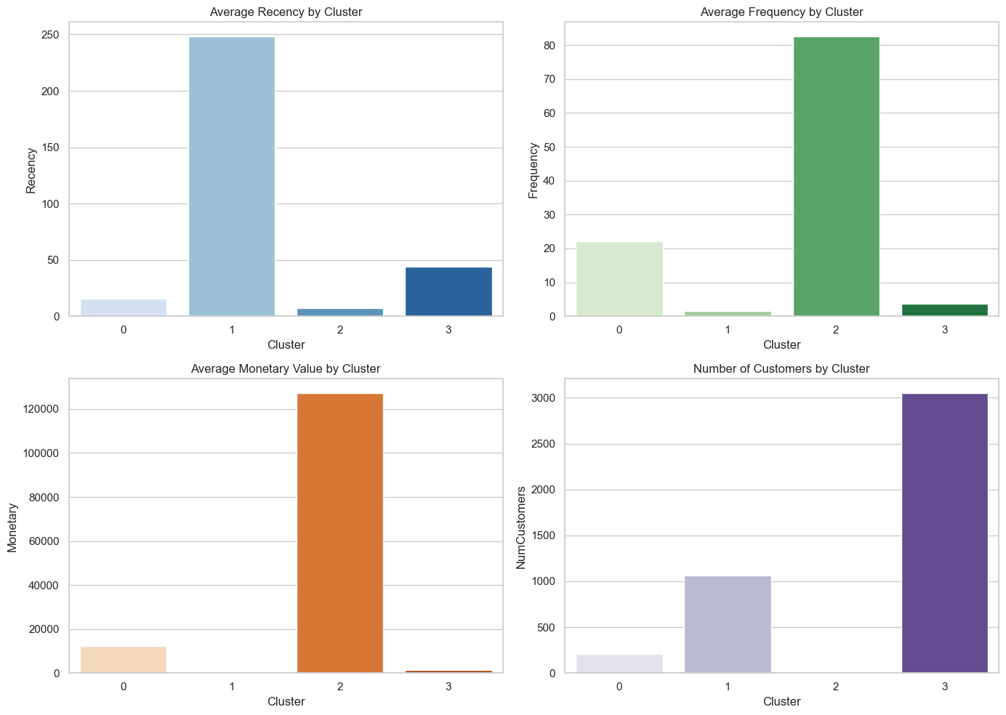
Cluster Visualizations
Bar plots comparing:
Average Recency
Average Frequency
Average Monetary Value
Number of Customers per Cluster

Slide 10
Business Insights
Retain and reward VIP customers (Clusters 0 and 2)
Design reactivation campaigns for lost customers (Cluster 1)
Nurture average customers (Cluster 3)

Slide 11
Conclusion and Future Work
Effective segmentation achieved using K-Means
Business can target segments smartly
Future: include seasonality, test DBSCAN/Hierarchical Clustering

