Slide 1
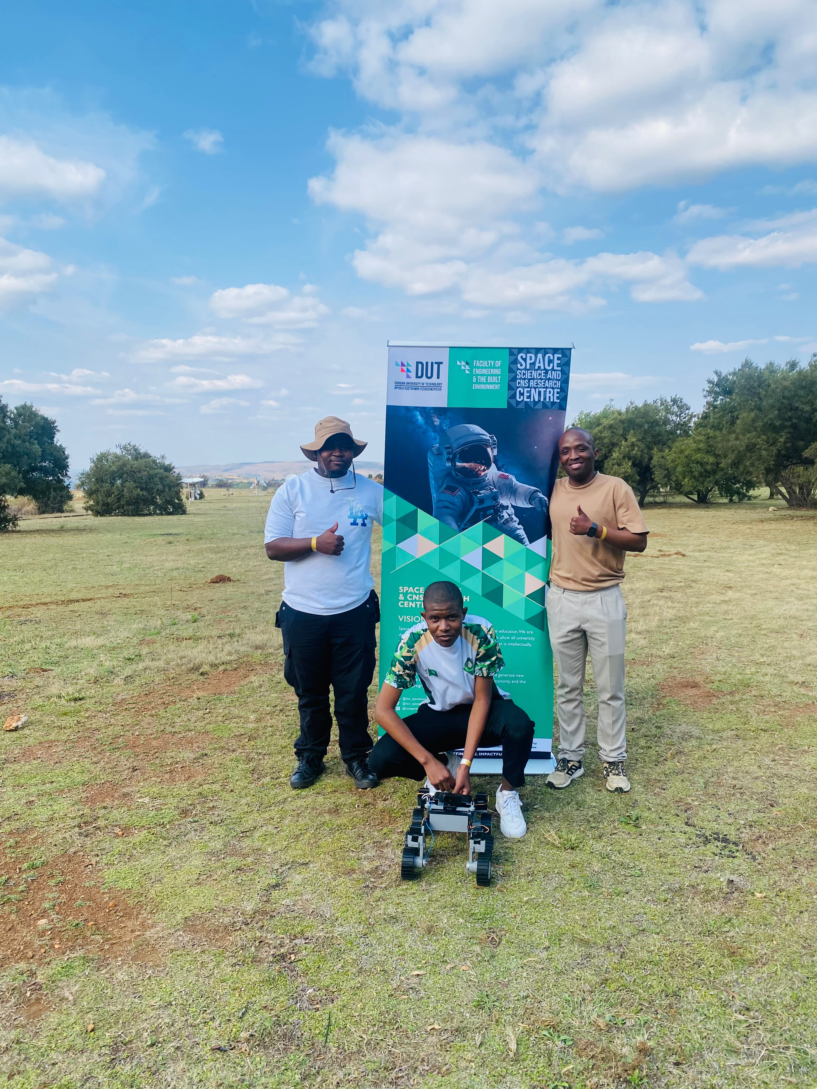
Cars4Mars: Building South Africa’s Next-Gen Mars Rover
Durban University of Technology | SSC Mars Rover Team
5th Annual DUT-DSTI Space Science & CNS Symposium | 29 October 2026

Slide 2
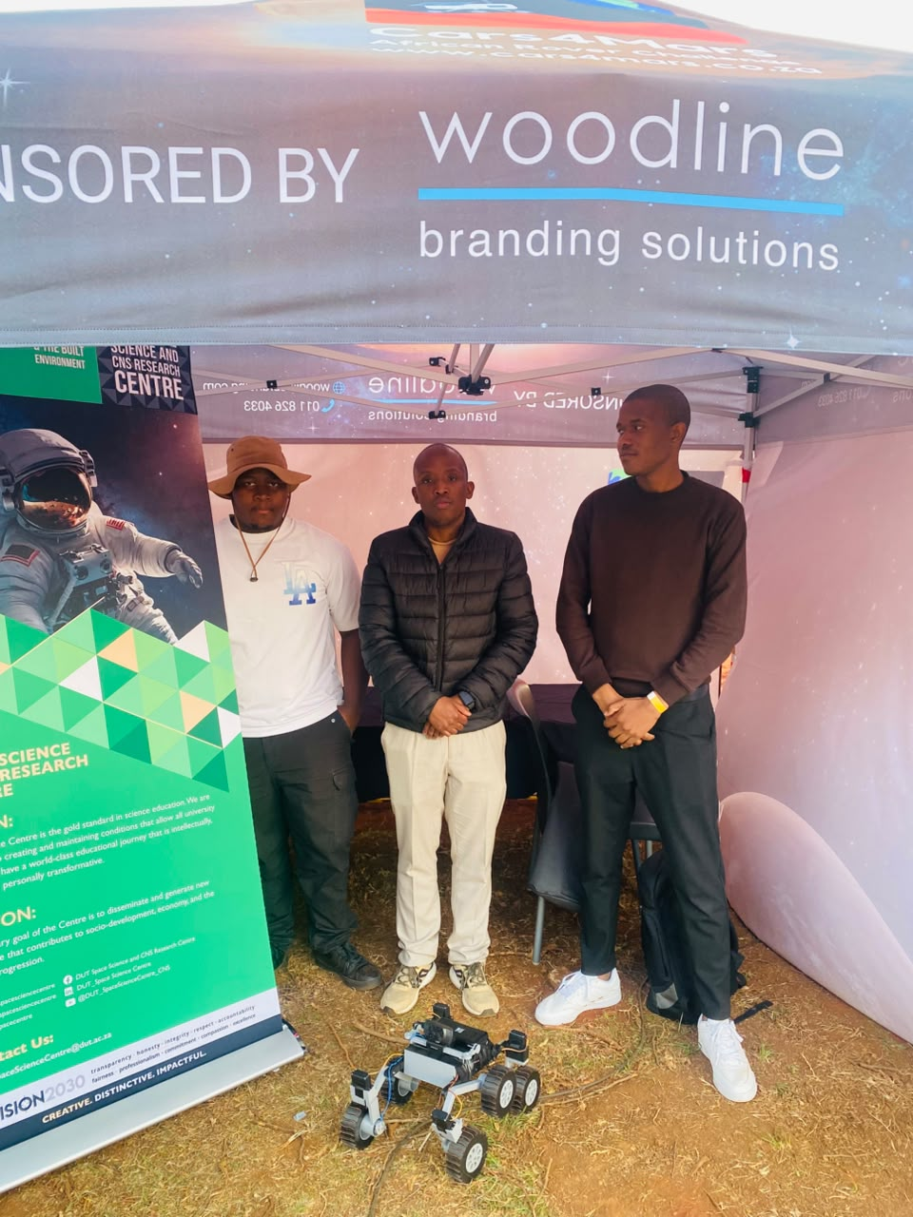
Our Vision
Develop a functional Mars rover prototype beyond competition
Train the next generation of space engineers
Solve real planetary exploration challenges
Build toward a larger, research-capable rover

Slide 3
Interdisciplinary Team Driving Innovation
Mechanical • Power & Electronics • Software/AI
CAD, Chassis, Suspension & Fabrication
Embedded Systems, Sensors & Motor Control
Computer Vision, Autonomy & Wireless Comms
Marketing, Documentation & Stakeholder Engagement

Slide 4
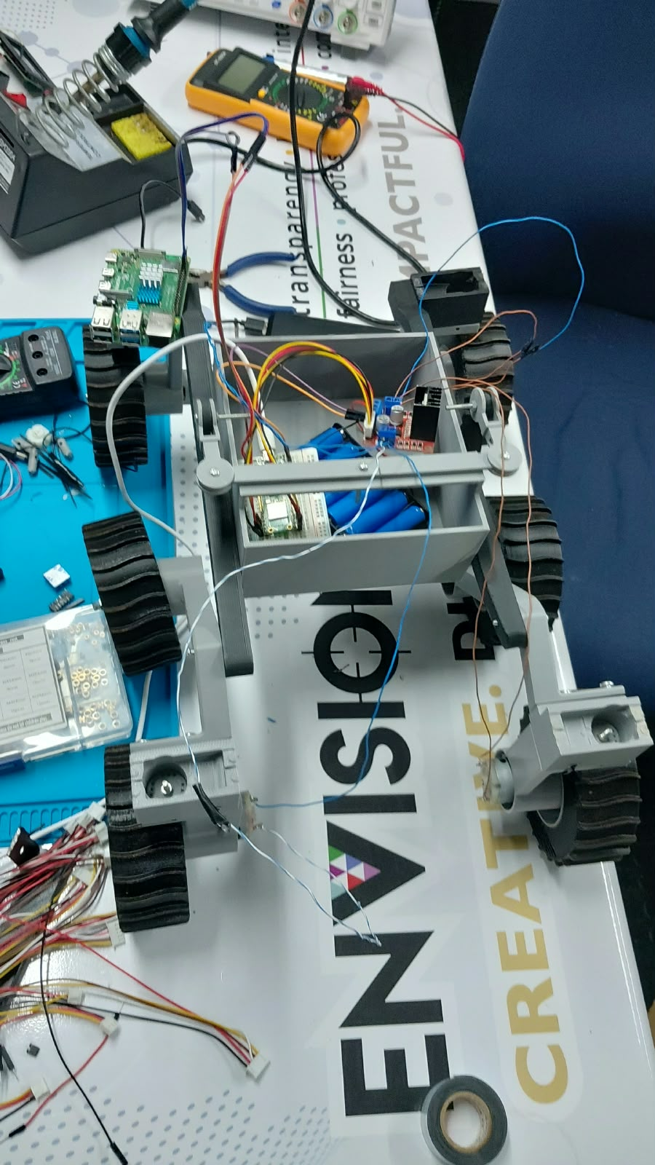
Our Current Rover – Competition Ready
6-wheel independent drive – Rocker-bogie inspired
Terrain-adaptable for sand, rocks & slopes
Wirelessly controlled up to 80m with onboard camera
Object detection: hammer, tennis ball, traffic cone
Modular, repairable & built in-house

Slide 5
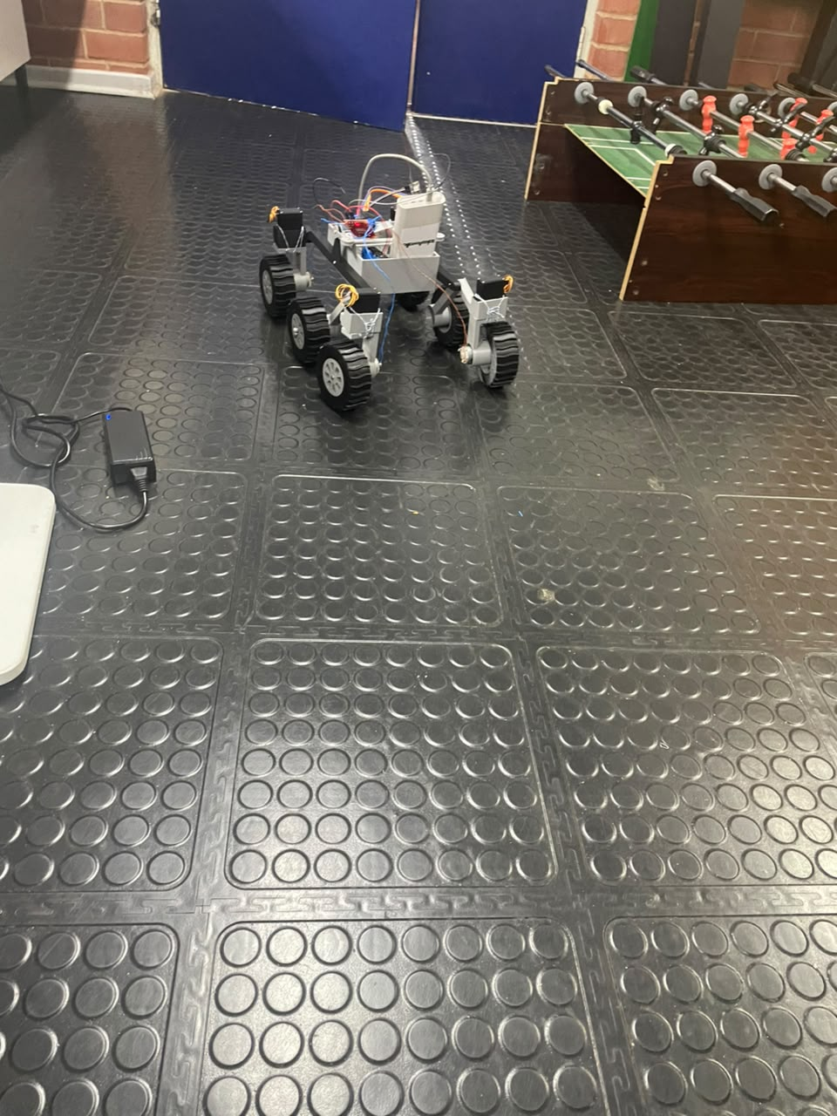
Cars4Mars 2026 – Mission Focus
Launch Stage: Reports, video & presentation
Mars Stage: Traversal (250 pts) + Autonomous (150 pts)
Reliable video streaming is critical (-60% penalty if lost)
Balloon detection & sequential navigation
Ready to compete at national level

Slide 6
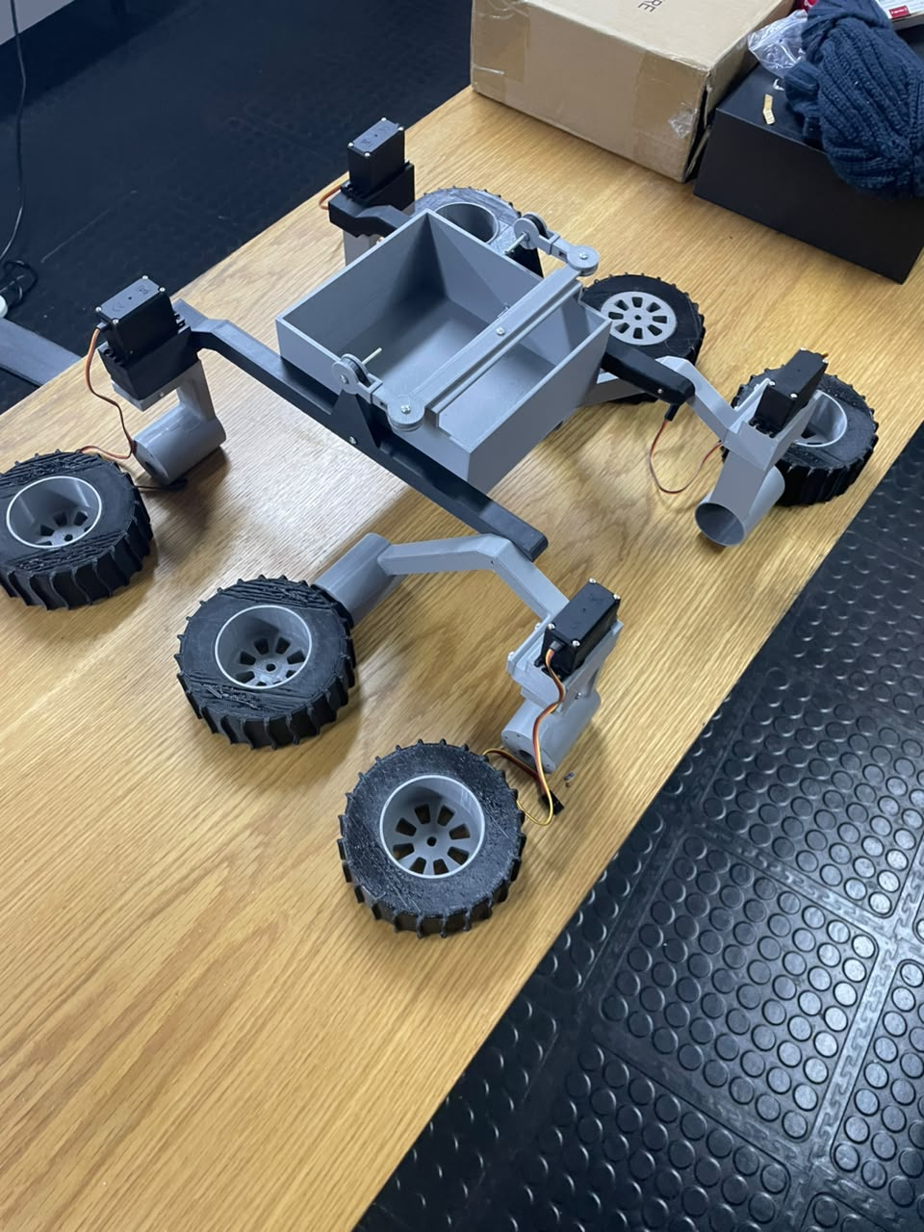
Next Step: A Bigger, Research-Capable Rover
Larger payload for scientific instruments
Enhanced autonomy: AI/SLAM navigation
Improved power system for extended missions
Ruggedized for harsh terrain & longer range
Platform for DUT space robotics research

Slide 7
Investment Opportunity
Larger chassis, motors & drive system
Advanced computing, sensors & autonomy stack
Robust power management & battery systems
Manufacturing, testing & field trials
Help DUT lead South African planetary robotics R&D

Slide 8
Partner With Us
Proven team with competition track record
Strong university backing & lab facilities
Clear roadmap to research-grade rover
Build local space tech capability
Invest in African space exploration
Let's build South Africa's next Mars rover - together.

