Slide 1

Notification Management System
Supervisor:
Natali Levi- Ph.D.
Date:
09/05/2024
Students:
Shymaa Titi
Carolin Mansour
23-2-D-5

Slide 2

Concise description
Project objective: Facilitate easy dissemination of important messages or updates among users.
Platform functionality: Users can manage and send notifications to individuals or groups.
Ensuring awareness: The system ensures everyone stays informed about critical matters through effective notification management.
Notes:
Our project is like a tool that helps people send important messages to each other easily. It's kind of like a platform where you can manage and send notifications to your friends or groups, so everyone knows what's going on.
Our project is essentially creating a system where people can easily send out important messages or updates to others.
It's like a platform where users can manage and send notifications to individuals or groups, making sure everyone stays informed about important stuff.

Slide 3
The Problem
Digital age challenges: Surging daily notifications due to multiple communication platforms.
Risk of oversight: Important alerts can be missed amid the volume of communication.
Importance of streamlining: Critical messages require prompt attention amidst digital noise.
Notes:
- Today's digital world has many communication platforms and apps.
- People use various messaging services and social media platforms.
- As a result, the number of notifications and messages received daily has grown.
- With so much information coming in, important notifications might be missed.
- Users struggle to manage and prioritize messages effectively.
- This can lead to critical alerts being neglected.
- The abundance of communication channels can cause information overload.
- Important messages get lost among less urgent ones.
- There's a need for a solution to streamline notifications and ensure prompt attention to crucial messages despite the high volume of digital communication.

Slide 4
Motivation
Project aim: Enhance communication and engagement via timely information delivery across multiple channels.
System features: Users send/receive vital notifications, subscribe to interest groups, and schedule alerts.
Notification accessibility: All critical notifications saved for user access, ensuring none are missed.
Notes:
-Our goal is to create a system that makes communication better and more engaging for users. We want to send them important information when they need it, using different ways to reach them. Users will be able to send important messages and get messages from groups they like. They can also set up messages to be sent later, like setting an alarm. This way, they won't miss anything important.
-In our system, we store all the important notifications, so users can check them whenever they want. This means users won't miss any important messages or alerts because they can see them whenever they have time. It's like having a safe place for all the important stuff, so nothing gets overlooked.
---------------- Our aim is to develop a system that improves communication and engagement by delivering timely and relevant information across multiple channels, allowing users to send and receive important notifications, subscribe to groups of interest, and schedule future alerts akin to setting alarms.
In this system, all important notifications will be saved, allowing users to access them at their convenience. This ensures that users are secure in not missing any important messages or alerts.

Slide 5
Introduction
Our web notification platform offers customizable preferences and security measures enabling effortless communication. Manage group interactions, send scheduled messaging, and access comprehensive notification history. Join us for seamless digital connectivity and enhanced communication.
Notes:
Our web notification platform is all about making communication easy and secure. You can pick how you want to get notifications, and we make sure your data stays safe. Manage groups, schedule messages, and check your notification history—all in one place. Join us for smoother online connections and better communication.

Slide 6
Main requirements
Real-time Messaging and Notifications: Instant message delivery for timely communication.
Group Management: Create, join, leave, and manage groups, with options to control group notifications.
Mute Functionality: Temporarily silence notifications from specific groups or chats.
Scheduled Notifications: Set notifications to be sent at a chosen time for planned communication.
Notes:
Real-time Messaging and Notifications: Ability to send and receive messages and notifications instantly, ensuring timely communication between users.
Group Management: Provide features for creating, joining, leaving, and managing groups, including options to mute/unmute group notifications and manage group settings.
Mute Functionality: Allow users to mute notifications from specific groups or conversations temporarily, providing them with control over their notification preferences.
Scheduled Notifications: Enable users to schedule notifications to be sent at a specified time or date, allowing for planned and timely communication with other users or groups

Slide 7
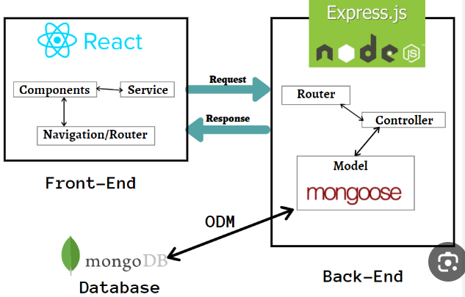
Software architecture

Slide 8

Technologies and specialized software tools
Vite:
Vite: Fast tool for modern web dev, perfect for React.
Speed: Instant server, hot module replacement for quick edits.
Optimization: Faster builds via native ES module imports.
Seamless setup: Built-in React support, no extra config needed.
Flexibility: Extensible with plugins, optimized for production.
Notes:
Vite is a rapid build tool tailored for modern web development, especially suited for React projects.
It provides a fast development server with instant hot module replacement for quick iteration.
Vite optimizes build processes by leveraging native ES module imports, resulting in faster build times.
With built-in support for React and JSX syntax, setup is seamless without additional configuration.
Vite's plugin system offers flexibility to extend functionality as needed, while optimizing production builds for performance.

Slide 9

Technologies and specialized software tools
Socket.IO:
Socket.IO is a JavaScript library that enables real-time, bidirectional communication between web clients and servers.
It works like a super-fast messenger, making sure that when you send a message, it reaches the recipient right away.
This helped us create a smooth chatting experience.
Notes:
Socket.IO is like a super-fast messenger for web applications. It allows web clients, like browsers, to talk to servers instantly and vice versa. This means when you send a message from your browser, it gets to the recipient without delay, making chatting or any real-time interaction smooth and seamless.

Slide 10

Technologies and specialized software tools
Chakra UI:
Chakra UI is a simple, modular, and accessible component library for building user interfaces with React.
We used Chakra UI to make building our website's look and feel easier.
With its ready-made components , we quickly created a good-looking and easy-to-use interface.
Chakra UI's built-in features made sure our website is accessible to everyone, making it even better for all users.
Notes:
Chakra UI is like a toolbox full of pre-made building blocks for creating user interfaces with React, a popular JavaScript library for building web applications. It simplifies the process of designing your website's appearance by providing ready-made components that you can easily plug into your project. These components are not just visually appealing; they are also designed with accessibility in mind, ensuring that everyone can use your website comfortably. So, with Chakra UI, we were able to quickly put together a good-looking and user-friendly interface while ensuring it's accessible to all users.

Slide 11
Enhancing Security
We encrypt passwords using bcrypt before storing them in the database.
Messages exchanged between users and groups are encrypted to ensure confidentiality.
Encryption enhances the security of our system by protecting user data from unauthorized access.
Notes:
In our system, we take security seriously by using encryption in important ways. Firstly, when users create passwords, we use encryption techniques to transform them into a format that's nearly impossible for someone to figure out. This means that even if someone gets access to our database, they won't be able to see the actual passwords. Secondly, we encrypt the messages that users send to each other and within groups. This ensures that even if someone intercepts those messages, they won't be able to understand them without the right decryption key. By doing all this, we're making sure that our system is as safe as possible for everyone to use.

Slide 12
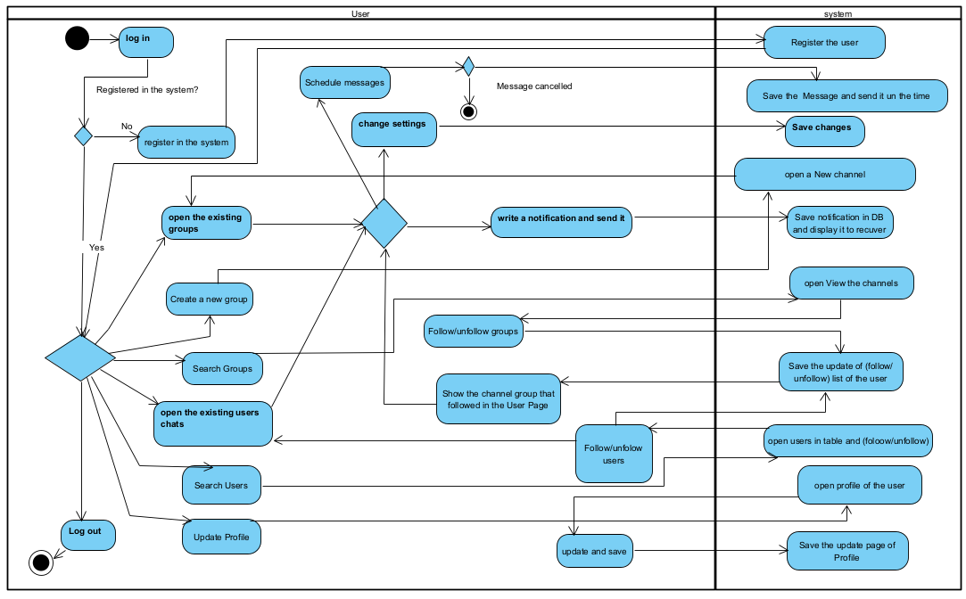
Activity Diagram:

Slide 13
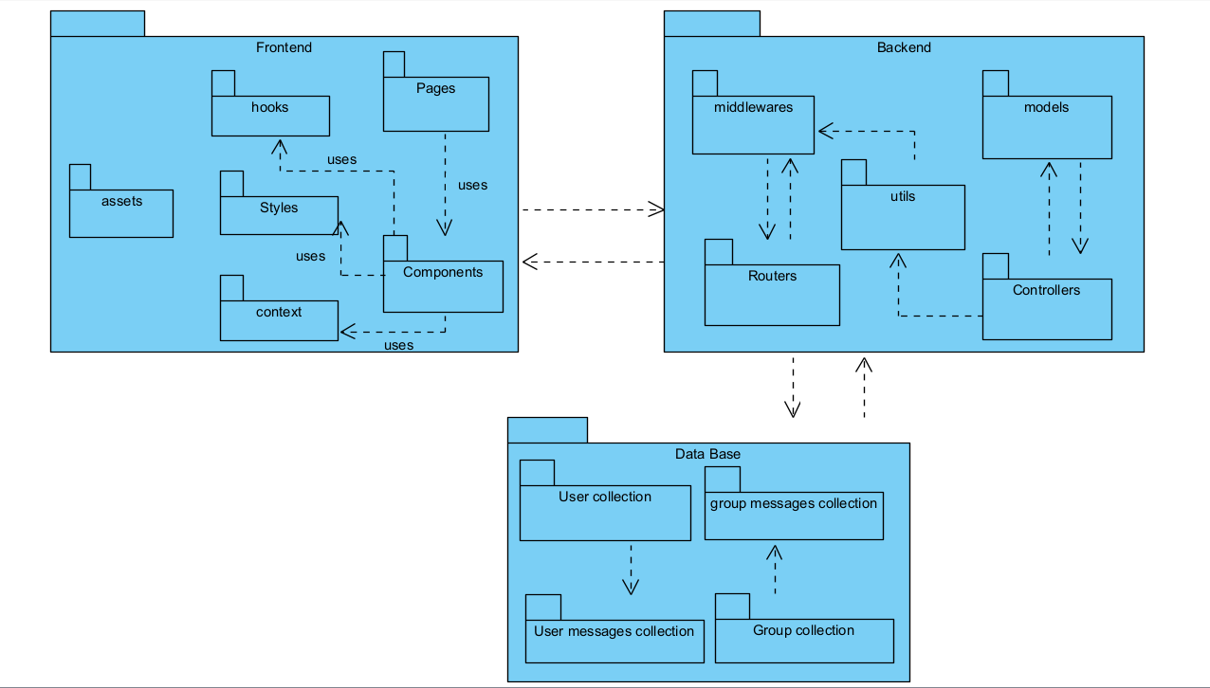
Package diagram:

Slide 14

Testing
We documented each action in a table and then verified their functionality on the system.
The results of our tests were recorded in the table, allowing us to ensure that our system is working correctly, and users can perform their desired actions without any problems.
Notes:
For testing our system, We documented each action in a table and then verified their functionality on the system. The results of our tests were recorded in the table, allowing us to ensure that our system is working correctly, and users can perform their desired actions without any problems.

Slide 15
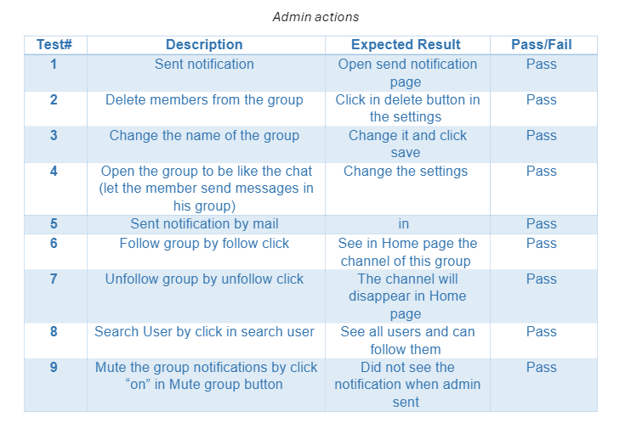
Testing

Slide 16
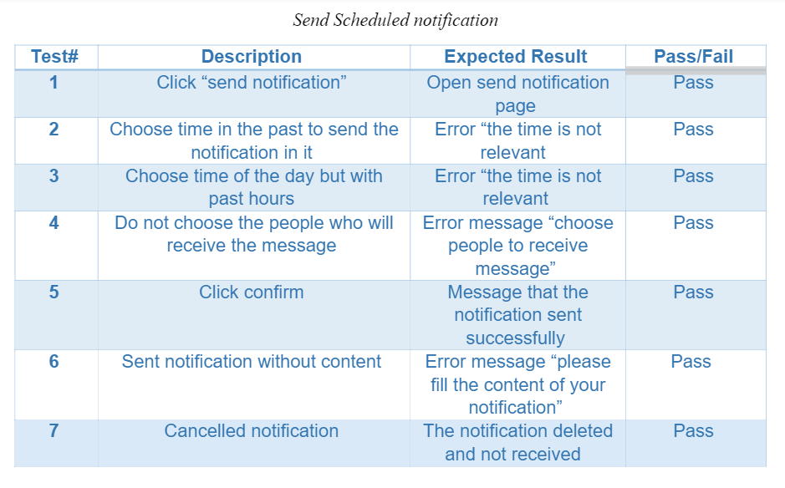
Testing

Slide 17
We use several important metrics to monitor the development and performance of our project.
User satisfaction:We tested our method on members of our own family and friends to ensure user satisfaction. Their suggestions enabled us to make the platform better for everyone.
Notification delivery speed: Measuring the time it takes for notifications to reach recipients.
Performance Optimization: We make sure our system runs smoothly by keeping an eye on how fast it responds, how long it takes to load, and how efficiently it uses resources. This helps us fix any problems quickly and ensures a better experience for users.

Slide 18

Challenges:
Data structures: Managing complexity of data structures for user profiles, messages, and media storage.
Real-time messaging: Implementing real-time messaging functionality using socket.io.
Scheduled messages: Implementing scheduled messages and effective management of message queues and scheduling mechanisms.
Time: An unforeseen delay in implementing other features caused us to exceed the allocated time for completing the system, leaving us with the pending task of implementing email notifications for the customer.
Notes:
**Data Structures:**
We use different ways to organize and handle information for things like user profiles, messages. This helps us keep everything organized and easy to manage, even as we handle more and more data.
**Real-time Messaging:**
We've built a system where messages show up instantly as soon as they're sent, just like in a chat app. We use a tool called socket.io to make this happen. It's like having a super-fast highway for messages to travel on.
**Scheduled Messages:**
Sometimes, we want to send messages at specific times, like reminders or announcements. We've set up a way to do this where the messages get sent out exactly when they're supposed to, and we can manage a whole bunch of them without any getting lost or sent at the wrong time. It's like having a really reliable alarm clock for messages! Time Challenge: We didn't manage to complete the system implementation; we still have the task of sending notifications to the customer's email. There were numerous tasks, and despite allocating the work according to a given timeframe, we exceeded the time because we got stuck implementing other things in the code that were not planned to take up so much time.

Slide 19
Video for how the system works:
https://mega.nz/file/MwI1GI4T#baq0XDO8TubTqCkHmpeTgKh1xbB-mhLUik_0eWpKo7s

Slide 20
Thank you

