Slide 1
Monte Carlo simulation
About Authors

Slide 2

What is Monte Carlo simulation?

Slide 3
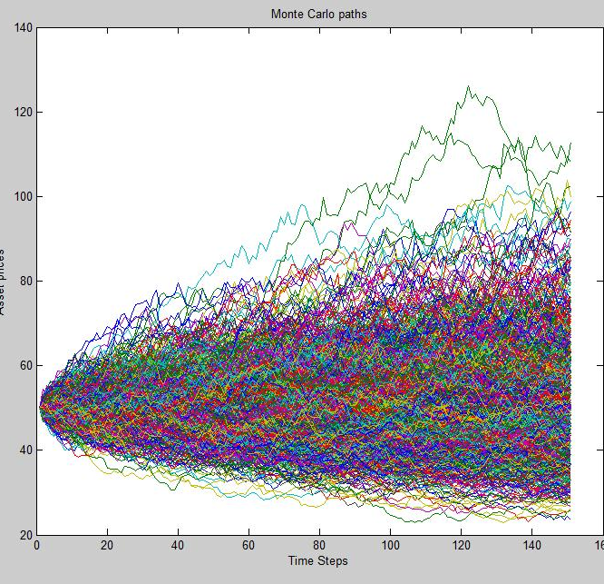
Monte Carlo methods
Monte Carlo methods are a large family of computational algorithms that rely on random sampling. These methods are mainly used for:
Numerical integration
Stochastic optimization
Characterizing distributions

Slide 4
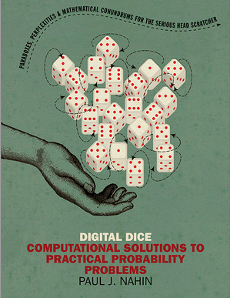
Monte Carlo simulation
A series of random variables, each with probability distribution
Randomly selects a value from each variable, and computes output. Repeats thousands of times

Slide 5
Why Monte Carlo simulation?

Slide 6
Motivation
No matter how smart you are, there will always be probabilistic problems, that are too hard to solve analytically.
Despite (1), if you know a good scientific programming language that incorporates a random number generator, you may still be able to get numerical answers to those “too hard” problems.

Slide 7
Advantages
Full valuation: no problems with non linear or non monotonic variables
Flexibility: possibility to use any probability distribution functional form

Slide 8
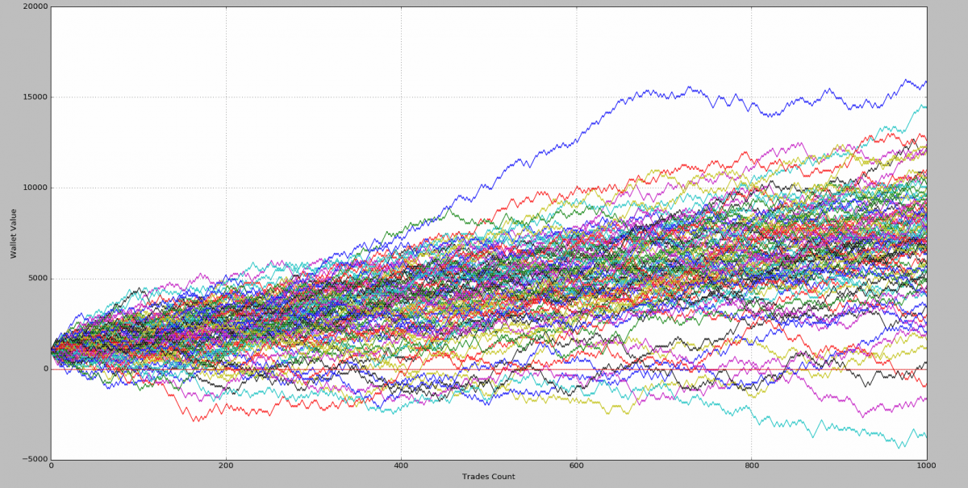
Application: trades simulation

