Slide 1
Introduction to Deep Learning
About Authors

Slide 2

What is Deep Learning?

Slide 3
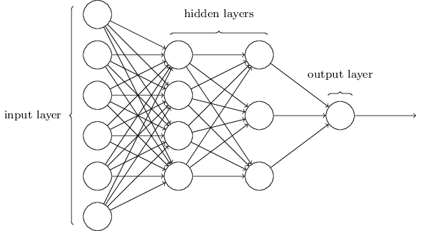
Simple Neural Network

Slide 4
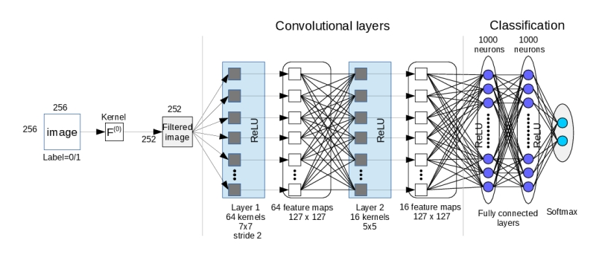
Deep Neural Network

Slide 5
Why is Deep Learning Effective?

Slide 6
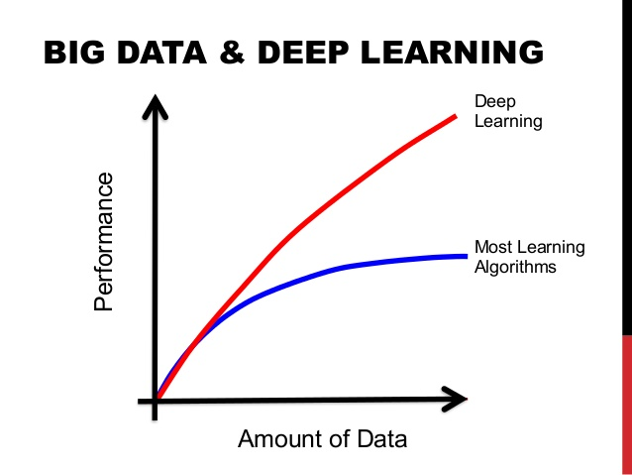
Every day, we create 2.5 quintillion bytes of data — so much that 90% of the data in the world today has been created in the last two years alone. This data comes from everywhere: sensors used to gather climate information, posts to social media sites, digital pictures and videos, purchase transaction records, and cell phone GPS signals to name a few. (IBM)

Slide 7

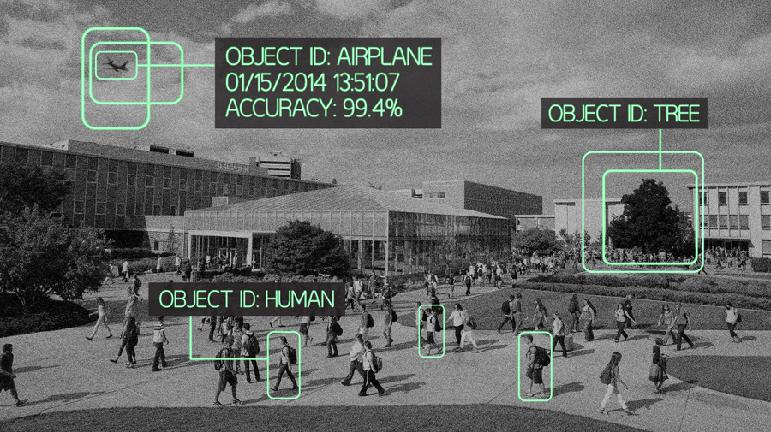
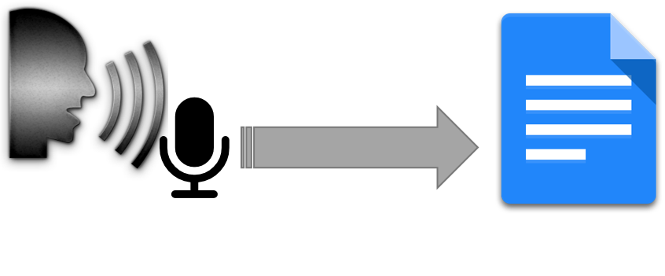
Applications of Deep Learning
Computer Vision
Speech Recognition
Business Analytics!

Slide 8
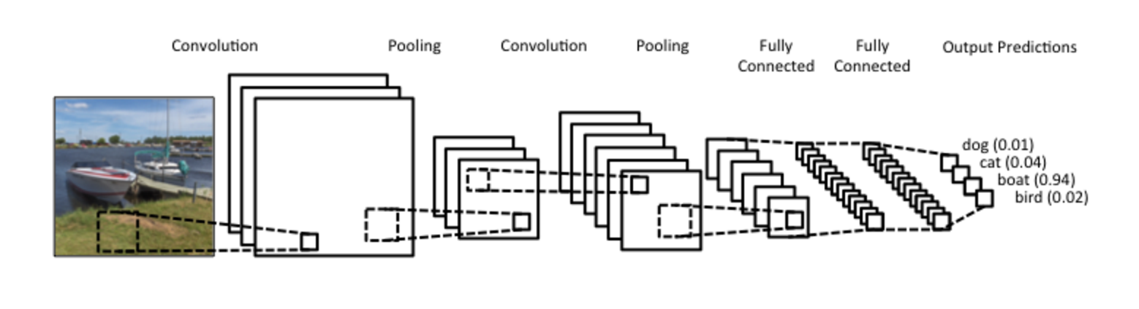
Types of Deep Neural Networks
Convolutional Neural Network:

Slide 9
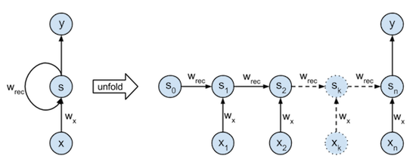
Types of Deep Neural Networks
Recurrent Neural Network:

Slide 10
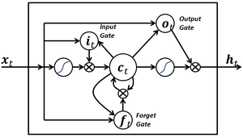
Types of Deep Neural Networks
LSTM:

Slide 11
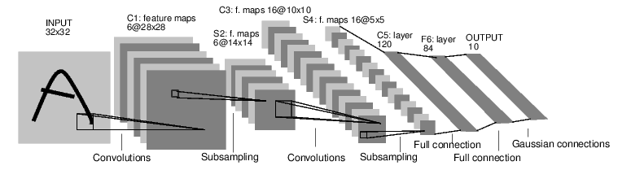
CNN for Handwritten Digit Recognition
LeNet CNN, Created by Yahn Le Cun - http://yann.lecun.com/exdb/lenet/

Slide 12
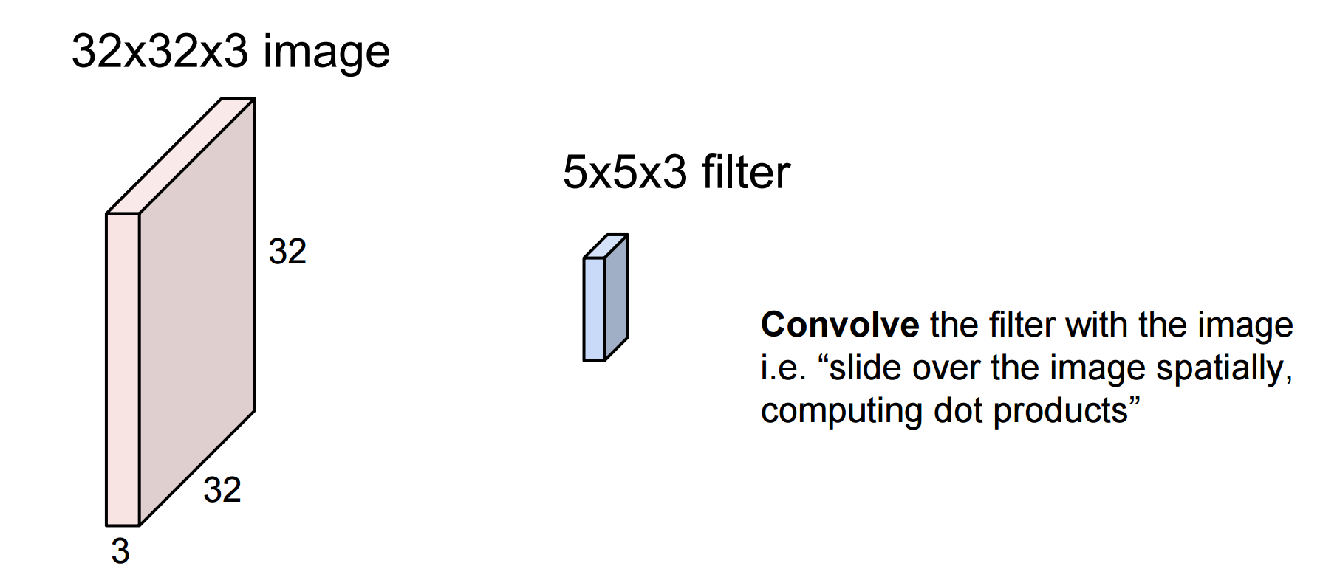
CNN for Handwritten Digit Recognition
Convolution Layer
Fei-Fei Li & Andrej Karpathy & Justin Johnson (Stanford 2016)

Slide 13
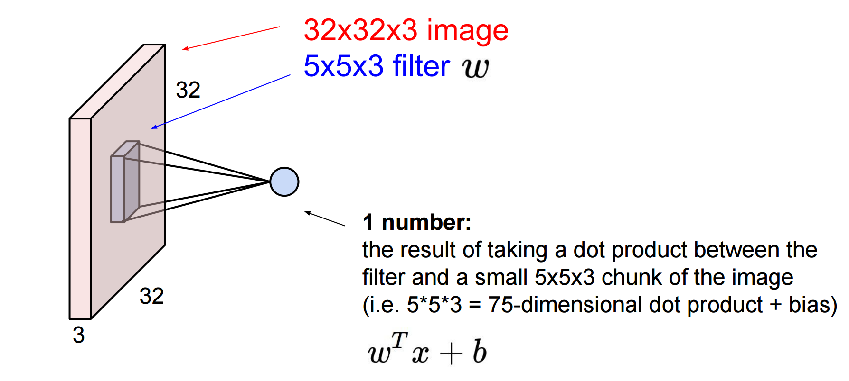
CNN for Handwritten Digit Recognition
Convolution Layer
Fei-Fei Li & Andrej Karpathy & Justin Johnson (Stanford 2016)

Slide 14
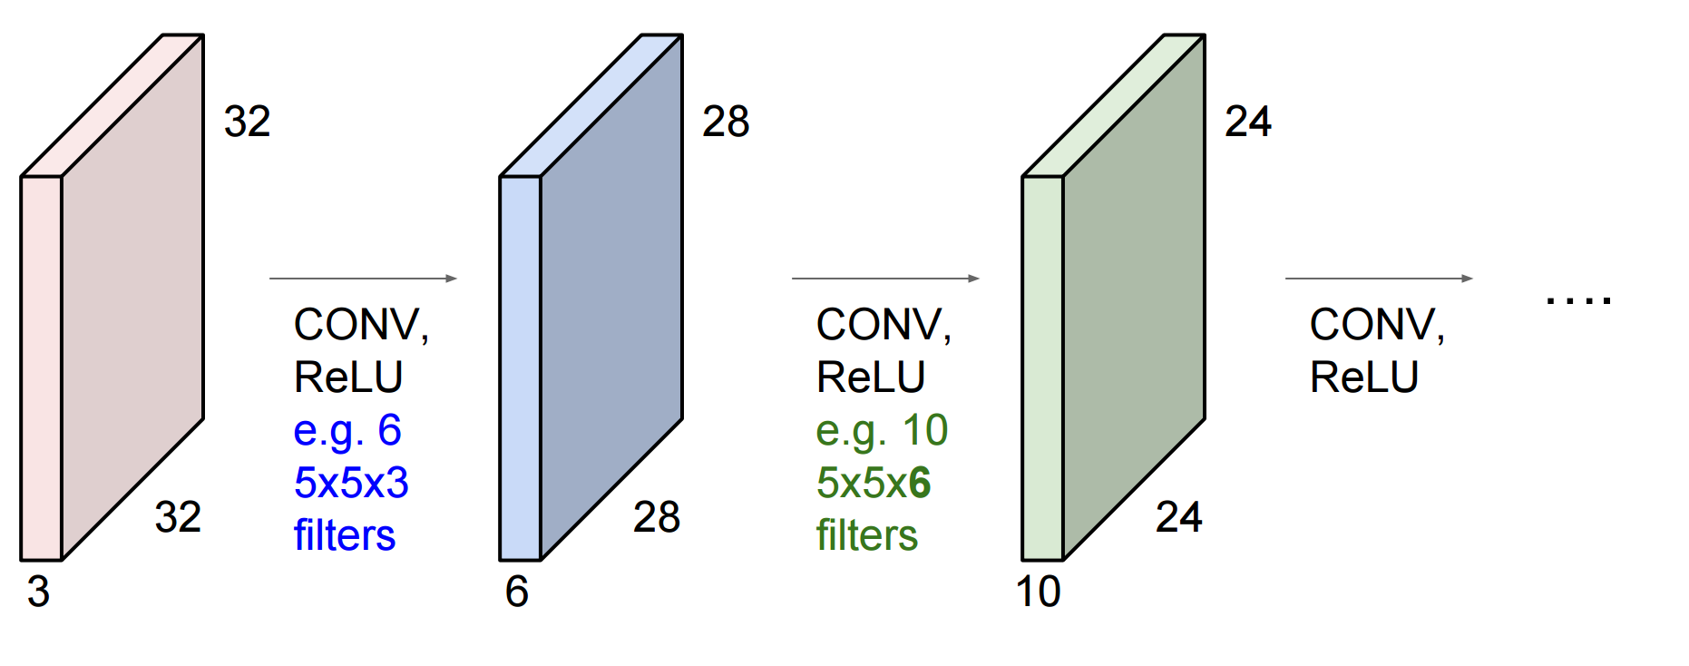
CNN for Handwritten Digit Recognition
ConvNet is a sequence of Convolutional Layers, interspersed with
activation functions
Fei-Fei Li & Andrej Karpathy & Justin Johnson (Stanford 2016)

Slide 15
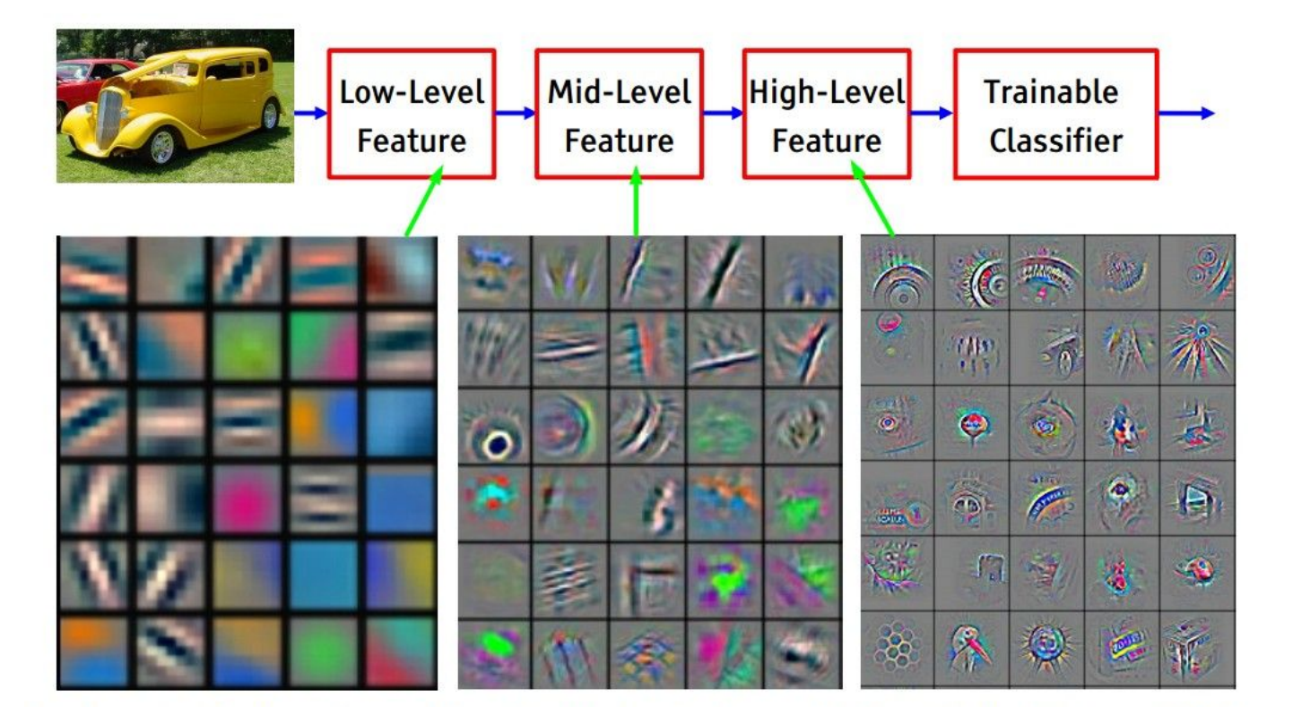
Layers Visualization
Feature visualization of convolutional net trained on ImageNet from [Zeiler & Fergus 2013]

Slide 16
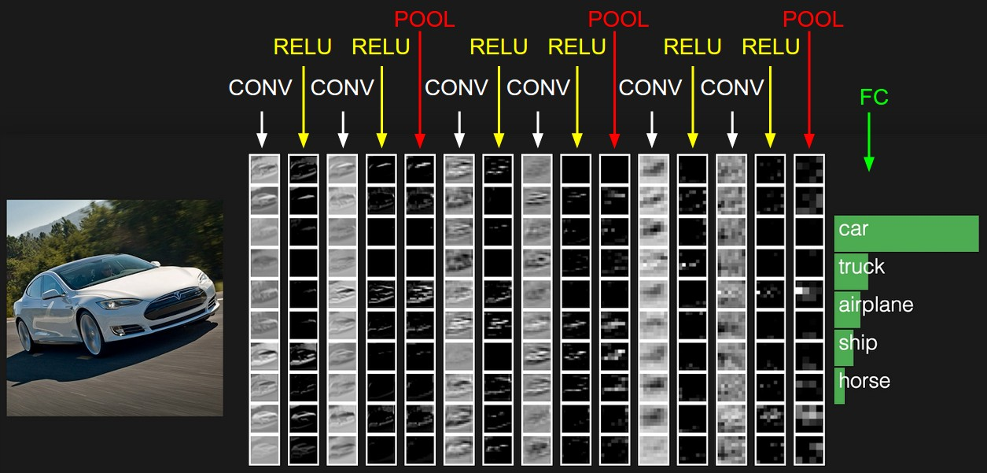
Another example of Deep CNN

Slide 17
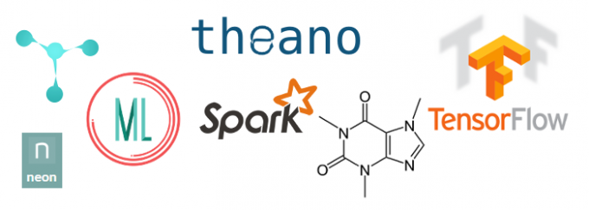
Deep Learning Frameworks
We will look at the example of a TensorFlow code. TensorFlow is an open source software library for machine learning in various kinds of perceptual and language understanding tasks developed by Google Brain.

Slide 18

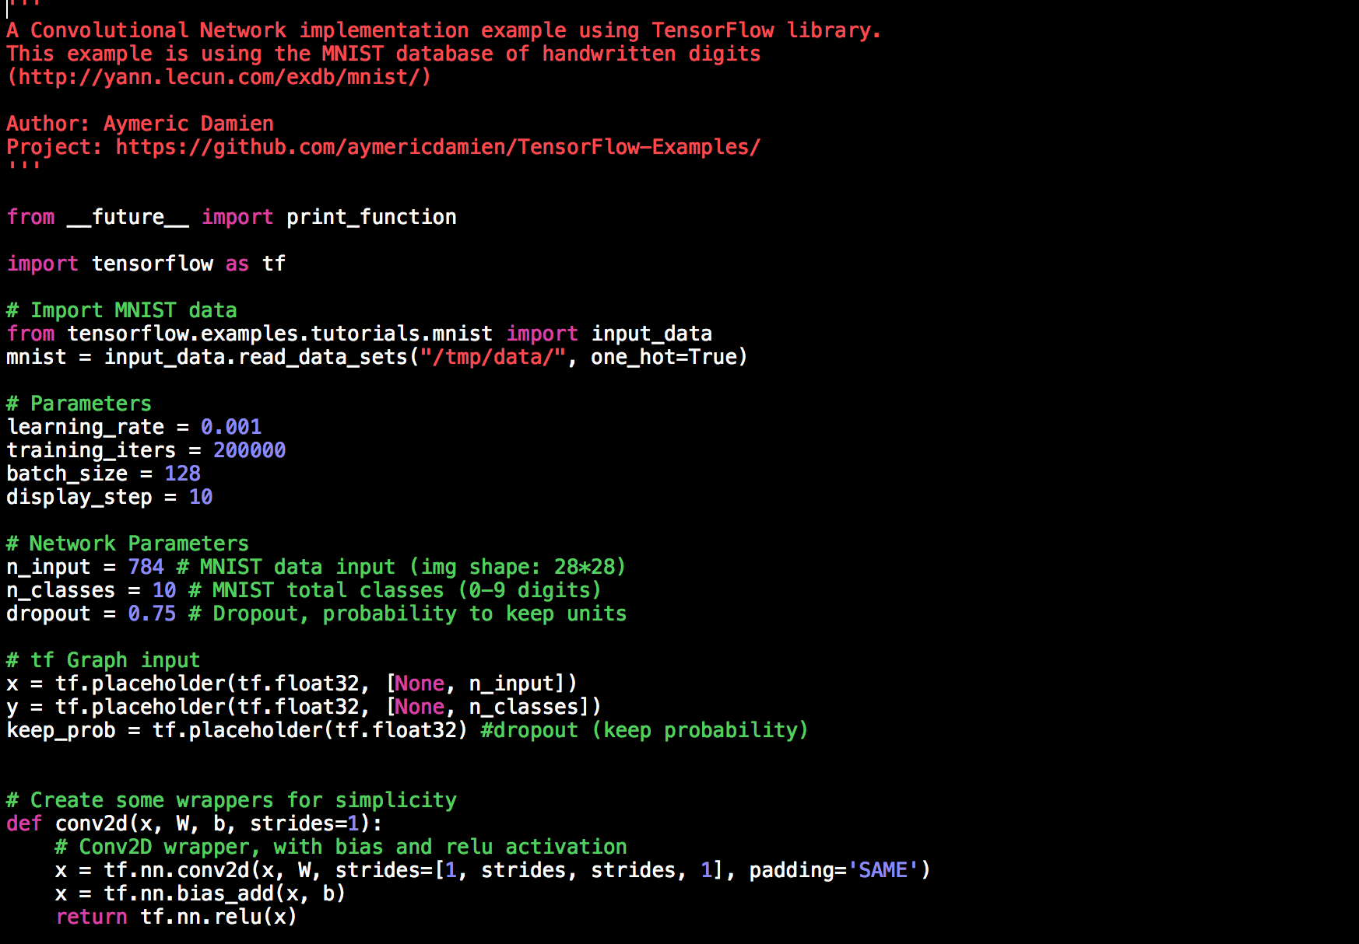
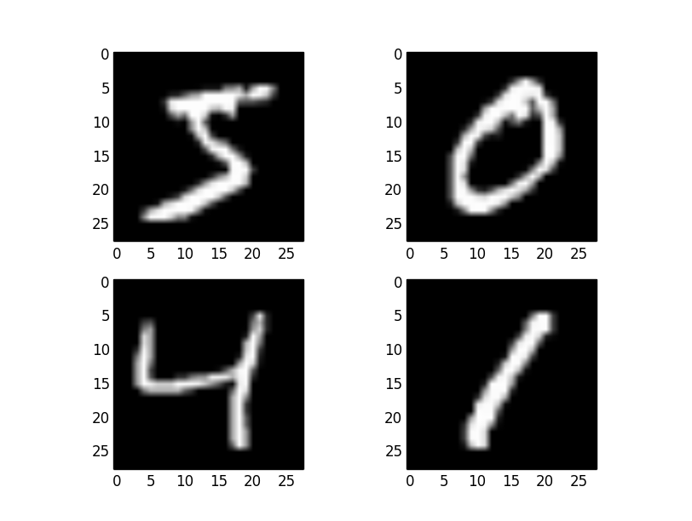
MNIST Example

