Slide 1

COURSE：HUMAN-AI INTERACTION
Case study: designing and implementing a conversational assistant
18.02.2026
Stock-Elf: A Conversational Stock Analysis Prototype
Group 5: Xinchen Li, Shuming Si, Shisen Meng, Noemi Romani

Slide 2
Definition & Capabilities
This app helps investors interested in stocks understand stock information through a conversational format.
Target users: Beginner investors/people interested in stocks
Scenario: Daily Stock Information Consultation
Goal: Provide clear and intuitive information on stock trends, timing, and other relevant details.

Slide 3
Conversational Design
Dialogues & Tone
The agent supports three main dialogue types:
Explain recent stock performance
Summarize general market trends
Answer beginner investment questions
Example:
→ “How is TSLA doing?”
→ “What are the risks of NVDA?”
UI Design
Screenshot
Supports both text and vocal interaction
Default interface: chat-based text
Tone design:
Professional but friendly
Educational
Calm and neutral
Non-authoritative
Example:
→ “I can explain recent trends, but I don’t provide financial advice.”
→ “This app is intended for educational purposes only.”

Slide 4
Conversational Design
Error recovery + Guidelines
UI Design
Error recovery strategy:
Ask clarification questions
Suggest supported stock tickers
Rephrase system limitations
Example:
→ “I didn’t understand. We recommend checking for spelling errors in the stock name.”
Screenshot
Information design:
Search for the latest stock information in real time
4–7 sentences per response
Beginner-friendly explanations
No financial jargon overload

Slide 5
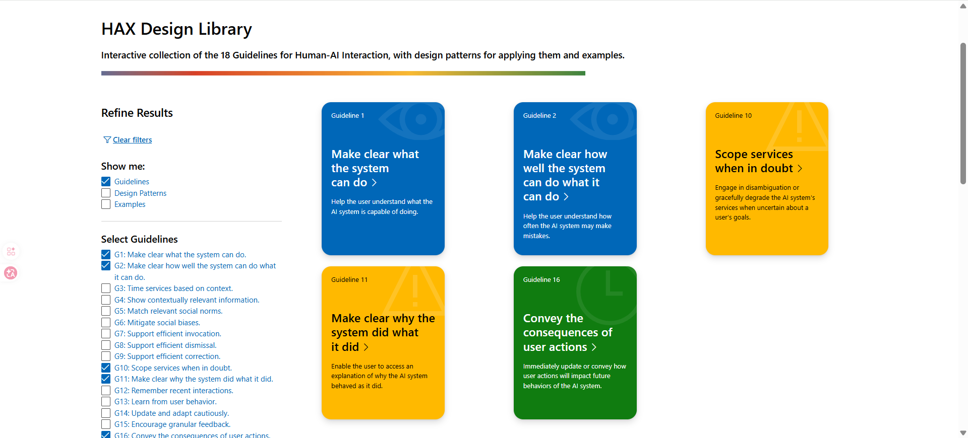
Guidelines
According Microsoft HAX Guidelines:
G1: Make clear what the system can do
G2: Make clear how well the system can do what it can do
G10: Scope services when in doubt
G11: Make clear why the system did what it did
G16: Convey the consequences of user actions
Some key point apply:
Set clear expectations
Communicate uncertainty
Avoid overconfidence
Encourage user judgment
Maintain transparency
https://www.microsoft.com/en-us/haxtoolkit/library/

Slide 6
Prototype Implement
Stock-Elf is an introductory example of a chat user interface based on large language models (LLMs).
It uses the OpenAI API. Inspired by: https://beebom.com/how-build-own-ai-chatbot-with-chatgpt-api/.
Pipeline:
User asks about a stock
↓
Agent explains performance
↓
Agent offers more details
↓
User continues or ends conversation
Technology: OpenAI API (GPT)
Interface: Web chat prototype
Supported intents: stock queries
Fixed structured responses
Real-time financial data

Slide 7
Prototype Present
SHOW TIME!

Slide 8
Thank you!
18.02.2026
Stock-Elf: A Conversational Stock Analysis Prototype
Group 5: Xinchen Li, Shuming Si, Shisen Meng, Noemi Romani

