Slide 1
AI Tool Dataset Browser
A REST API to manage a dataset of AI tools, made in Django
Connor George

Slide 2




Key Features
Multiple REST endpoints for Django models
User roles, permissions and JWT authentication
Automatic Swagger documentation with drf-spectacular
Asynchronous WebSocket connections
Background Task Workers
Natural Language Recommendations
Email Alerts

Slide 3
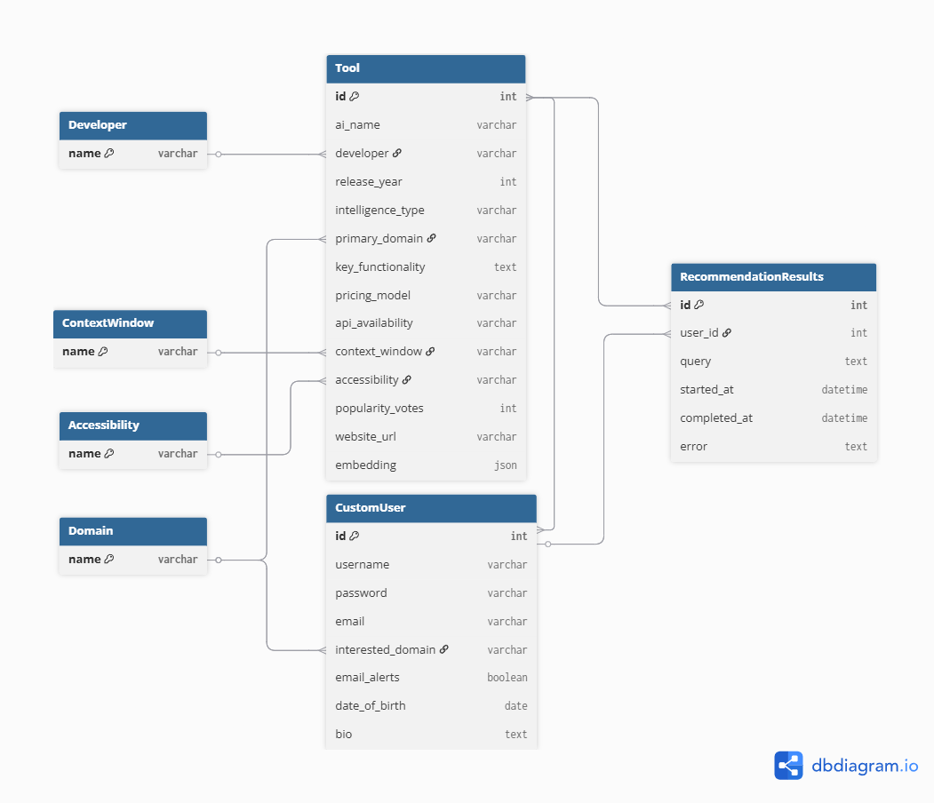
Database Layout
CustomUser model extends the default Django User model with extra fields
Tool has foreign keys to fields which are categories such as Developer
RecommendationResults stores the results of background tasks so that they can be retrieved after processing
CustomUser has a many-to-many relationship to Tool to store a list of favourite tools

Slide 4
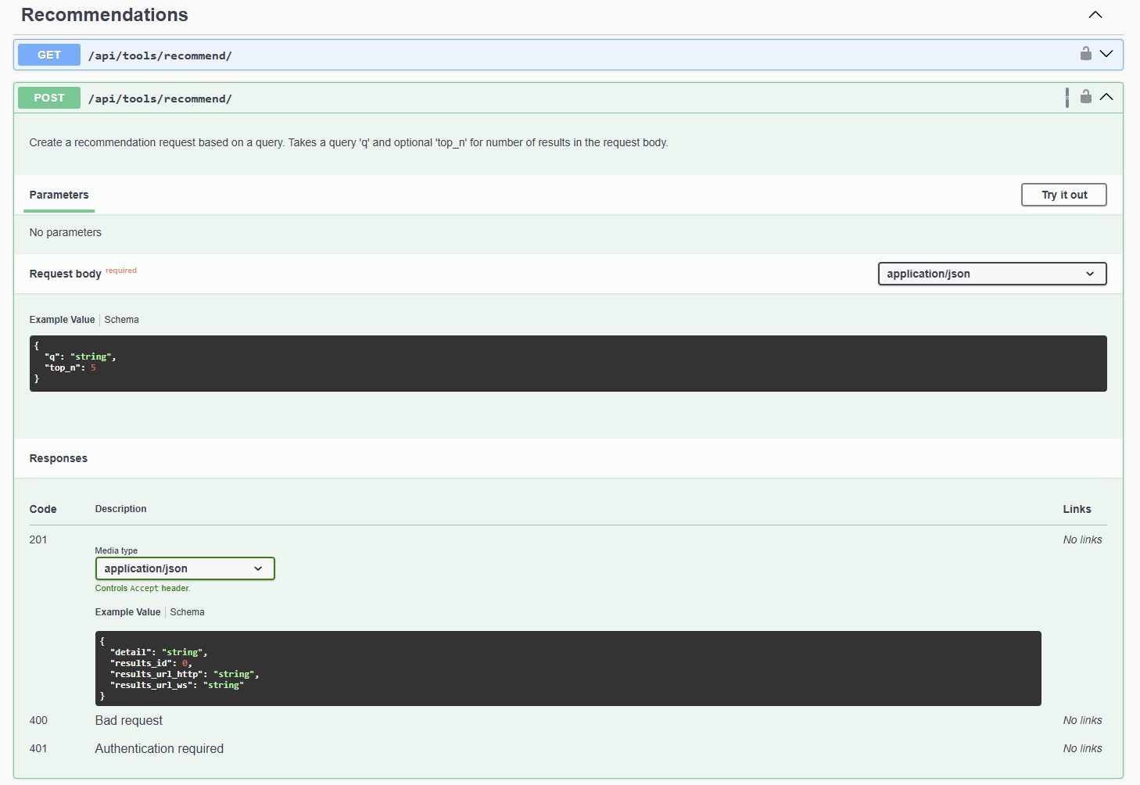
Documentation
Swagger documentation generated by drf-spectacular
Expected request and response structure
Parameter descriptions
Example Usages
Interactive when running the Django server

Slide 5
Demo

Slide 6
Technical Report
The technical report summarises:
Architecture
Implementation
Testing
Challenges Faced
Limitations
GenAI usage
The report is written in Overleaf with Latex, allowing for professional, academic formatting.
A highlight of the report is where I describe the potential room for improvement, by implementing vector databases for faster natural language queries and adding structured logging for debugging errors.

Slide 7

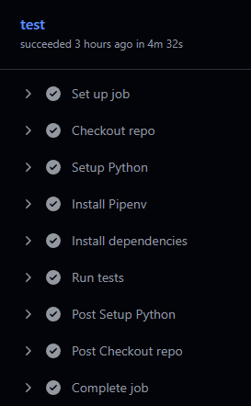
GitHub Version Control
Commits for new features or bugfixes with concise messages
Branch for development and production
GitHub Actions CI workflow to run Django tests
Detailed README.md summarising the project, key features and API documentation

Slide 8
Q&A

