Slide 1
5G Utility Pole Planner
Yanyu Zhang, Luxuan Qi, Zhou Fang

Slide 2
Product
Mission
In order to help company to install 5G equipments on utility Poles, our first aim is to build our first dataset by Google street imagery. With machine learning, we will import the dataset and analyse the poles in every image so that we can build a 2D model of the whole neighbourhood. At the same time, our team members are going to use the knowledge of 5G and make an abstraction of each equipment as to make the final model.

Slide 3
Target Users
5G Operator
5G Maintenance Company

Slide 4
User stories
I, the 5G operator, want to identify the poles in the picture and get their coordinates.
I, the 5G operator, want to know the distribution of poles on the street.
I, the 5G operator/maintenance company, want to know how to achieve full coverage of 5G signals with a minimum of 5G devices.

Slide 5
MVP
Detect the poles from the pictures.
Label poles on a 2D map in a small area.
Reasonably distribute 5G equipment

Slide 6
How it works
Get an access to Google Api and utilize it to crawl the pictures from Google Street View.
Use machine learning to detect poles from pictures if it is necessary.
Build a map that shows how the poles scattered around the area we choose.
Make a module for each 5U Utilities, including its coverage area.
Combine 3 & 4 to reach the final design.

Slide 7
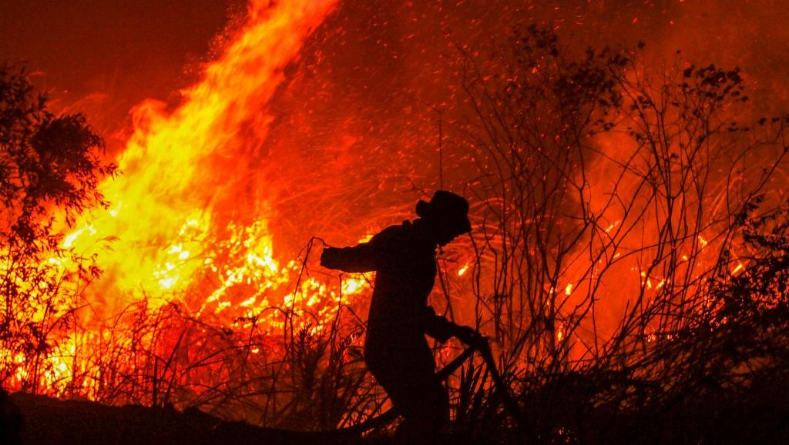
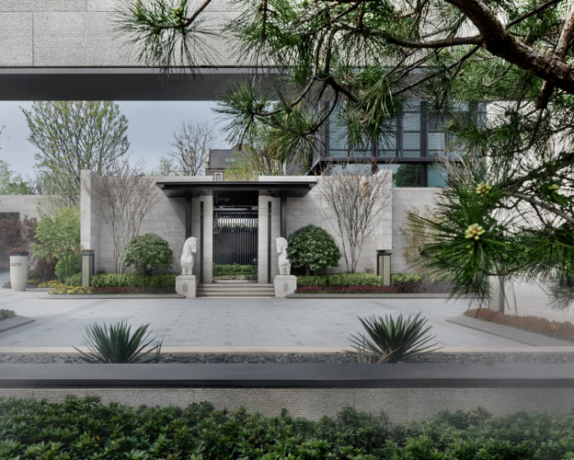
Non-Poles

Slide 8
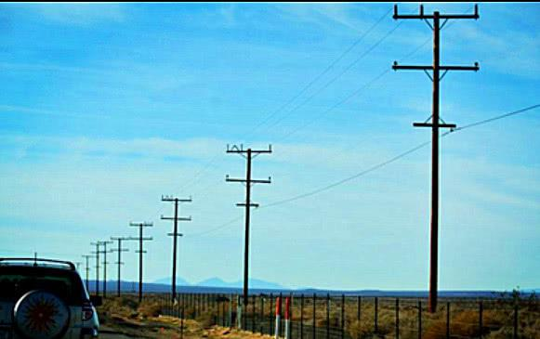
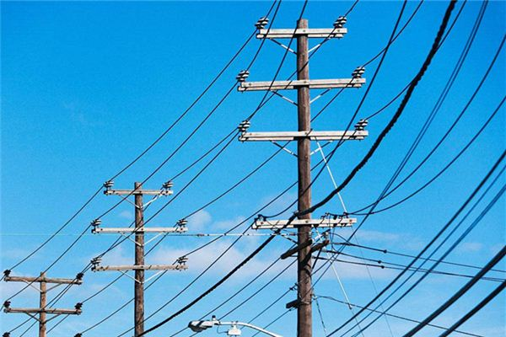
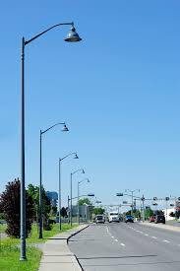
Poles

Slide 9
Technology Selection
Street View Static Api
get the images of the set coordinate points.
get images of different angles from the same coordinate point.
set the size of image.
Trained model/algorithm
CNN ( Python )
easy to use
very convenient when learning machine

Slide 10
Current Completed

Slide 11
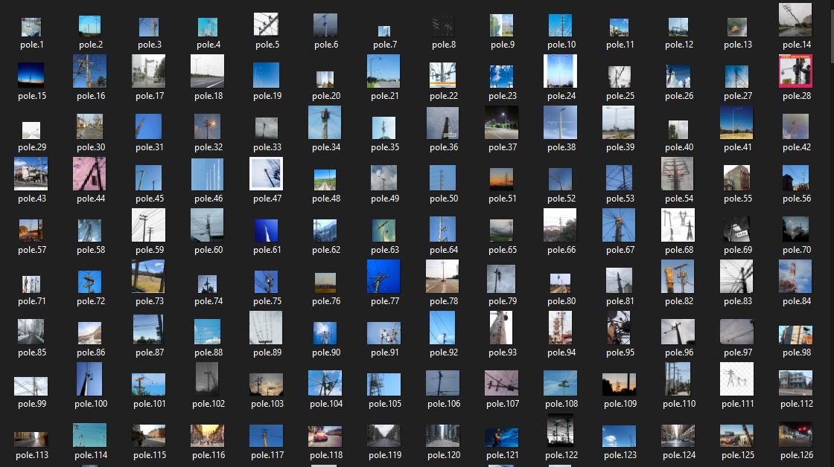
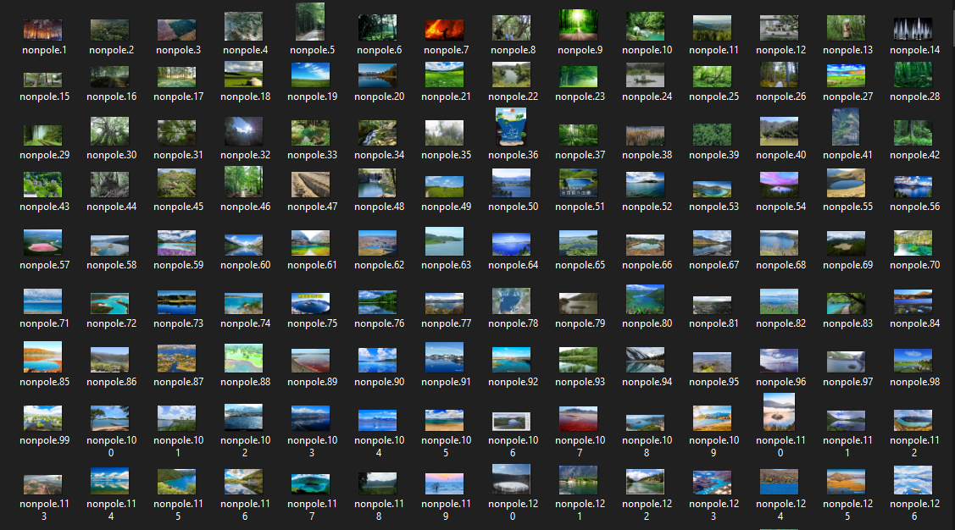
POLES
NOPOLES

Slide 12
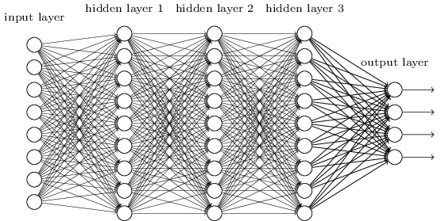
Arithmetic and package
CNN. Why do not use SVM, Decision Trees or other arithmetic?
Keras. Why do not use TF or Pytorch?
Why data set only contains 2000 pictures?

Slide 13
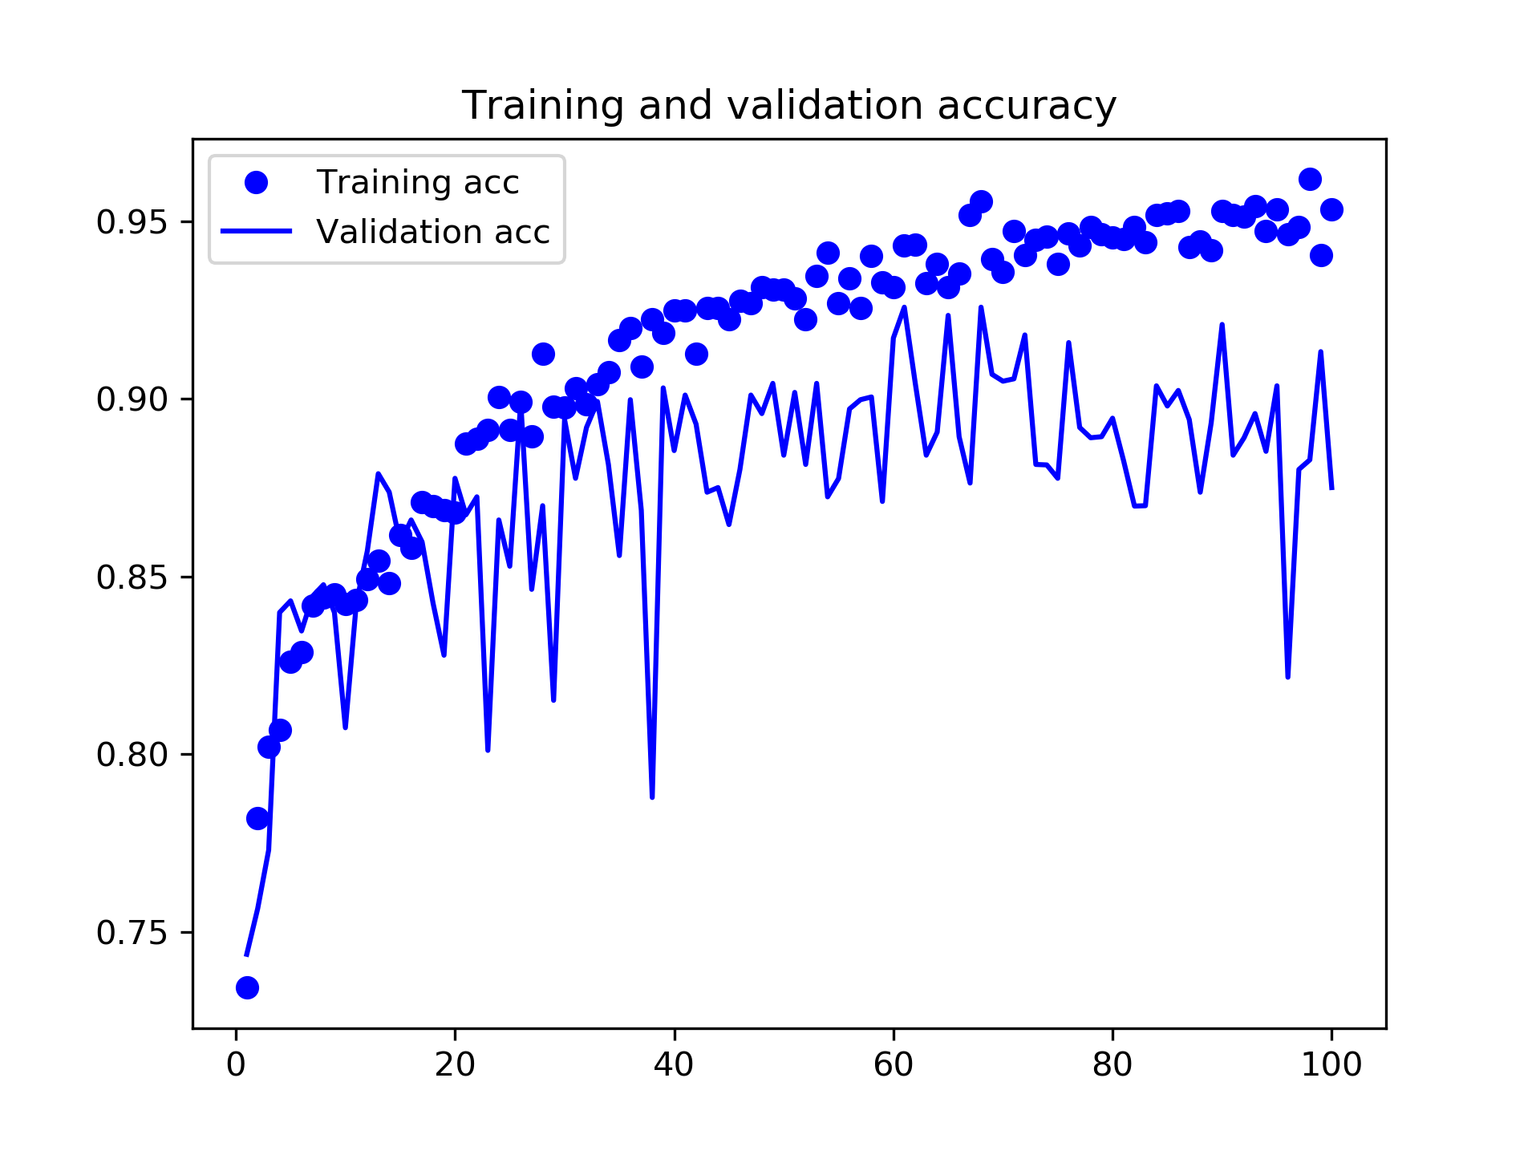
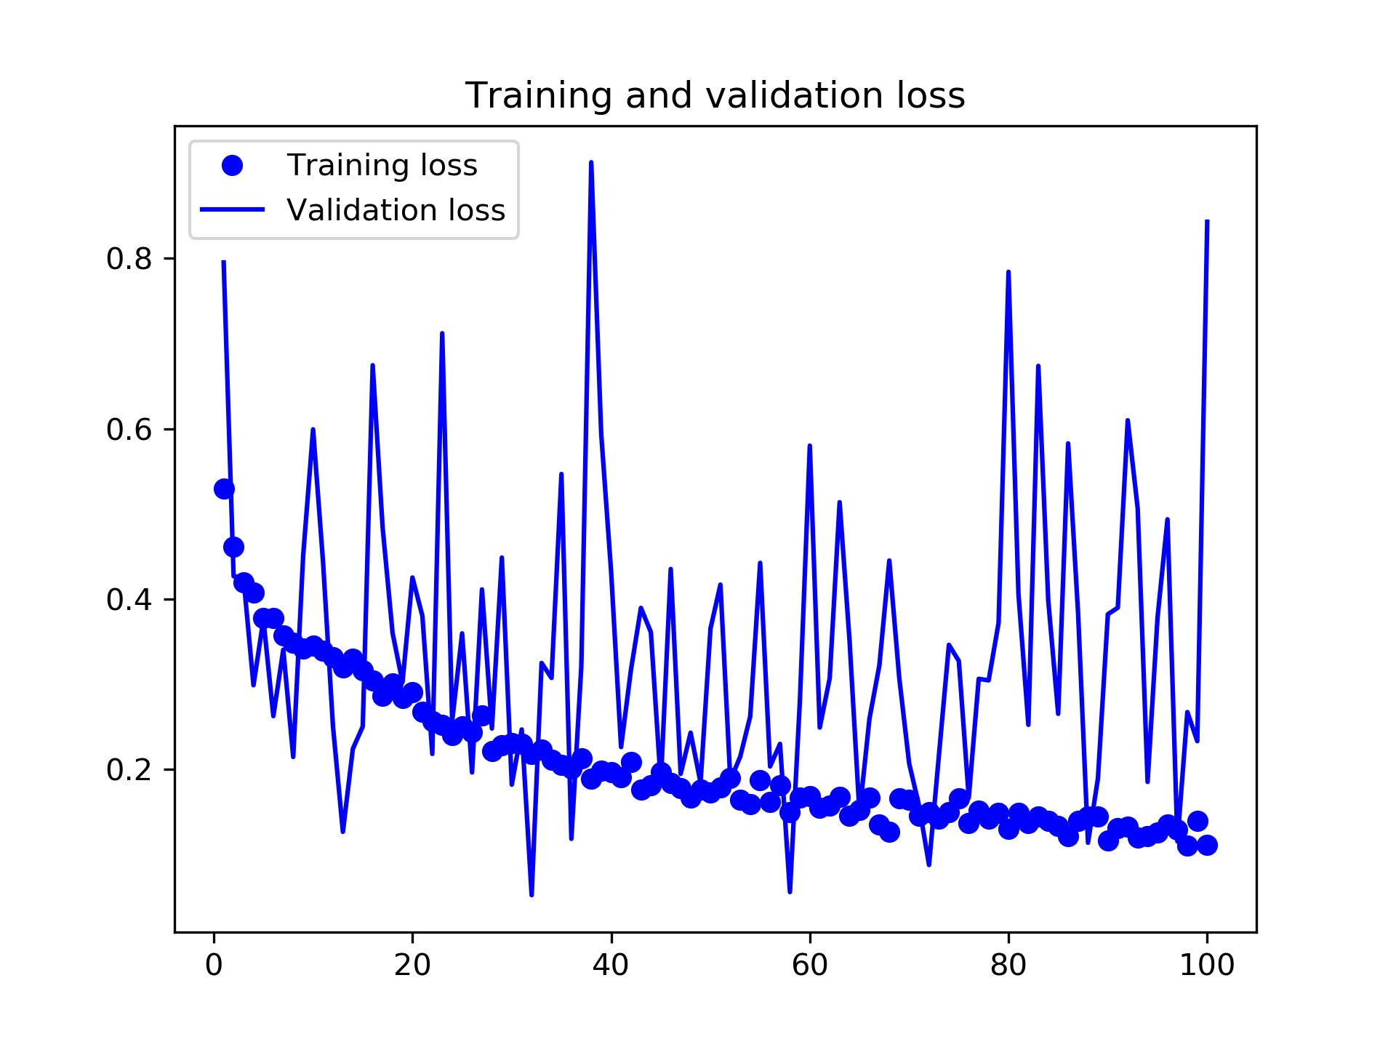

Slide 14
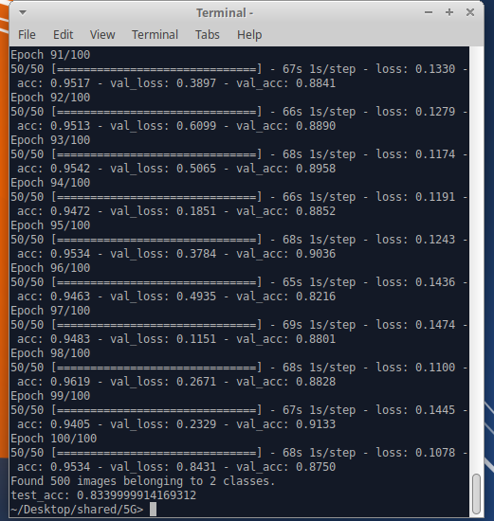

Slide 15
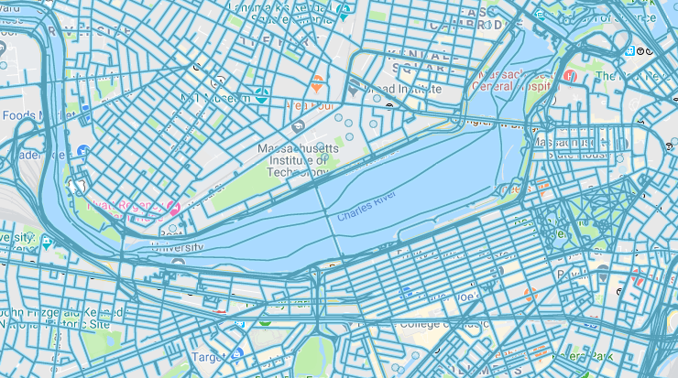
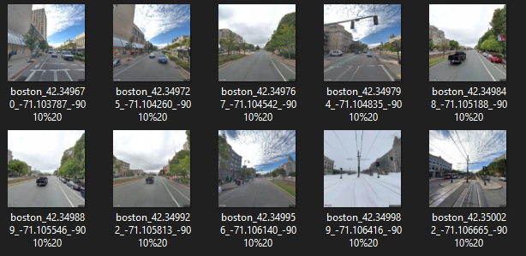

Slide 16
Looking Forward
Download the google street view photos in Boston (need to choose available distance between two photos).
Use the current model to test these photos and filter the photos contain poles.
Show these poles in a 2D graph and assume place 5G Utility on these poles.
Assume signal expend as circles, use Matlab to simulate the setting up.

Slide 17
Thank you

