Slide 1
Amazon Warehouse / Kiva
Patrick Robinson
Bastian Mager
Daniel Pyka

Slide 2
Content
General
Communication
Order assignment
Order processing
Monitoring
Configuration

Slide 3
General
Data transferal: JSON
Action differentiation: JADE Performatives
Configurability: JADE or JSON
Customer simulation:
Ticking: Repeatedly spawns random orders
Parse: Takes orders as parameters
Part of json config
Entered in JADE on customer agent creation

Slide 4
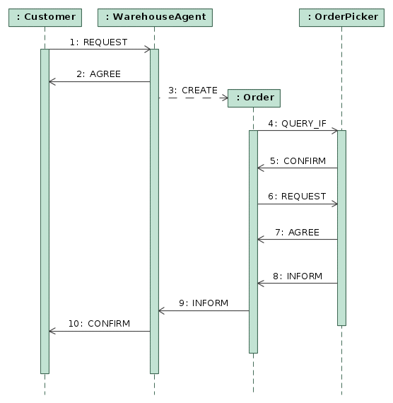
Communication
Order assignment
Data flow:
REQUEST: {id:0,products:[{name:count}]}

Slide 5
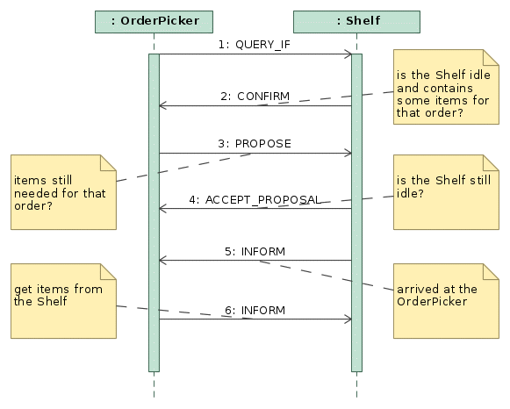
Communication
Order processing

Slide 6
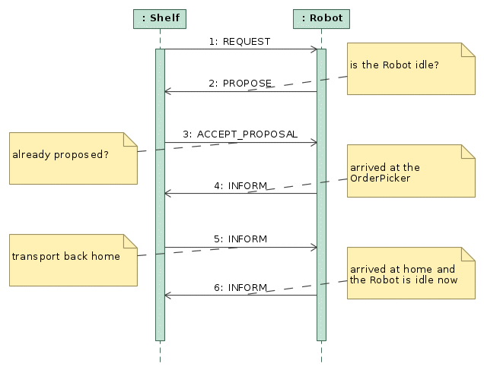
Communication
Order processing

Slide 7
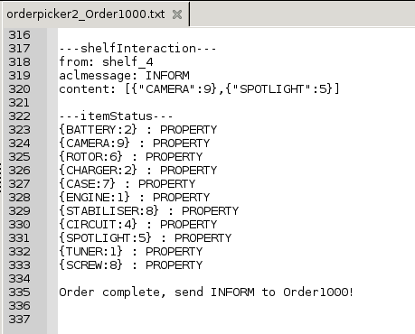
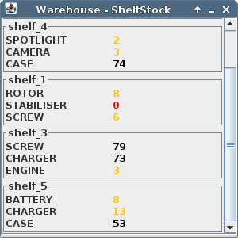
Monitoring
General Warehouse logs to console
OrderPickers generate logfiles for every Order due to communication complexity and better traceability
Shelfs update their stocks „live“ in a window

Slide 8
Configuration
{
shelves: [ {uid:0, products:[
{name:“x“,stock:{current:10}},
{name:“y“,stock:{current:10}}
]}],
pickers: [{uid:0}, {uid:1}],
robots: [{uid:0}, {uid:1}],
orders: [{uid:0, products:[
{name:“x“, quantity:1},
{name:“y“, quantity:3}
]}]
}
Define kiva.config.json
Execute parse.js to get JADE call

