Slide 1
Amazon Warehouse / Kiva
Patrick Robinson
Bastian Mager
Daniel Pyka
Multiagent and Agent Systems
21.01.2015

Slide 2
Content
General
Communication
Order assignment
Order processing
Orderpicker
Internal data structure
Control flow
Monitoring
Configuration
Scale-up the system

Slide 3
General
Data transferal: JSON
Action differentiation: JADE Performatives
Configurability: JADE or JSON
Customer simulation:
Ticking: Repeatedly spawns random orders
Parse: Takes orders as parameters
Part of json config
Entered in JADE on customer agent creation

Slide 4
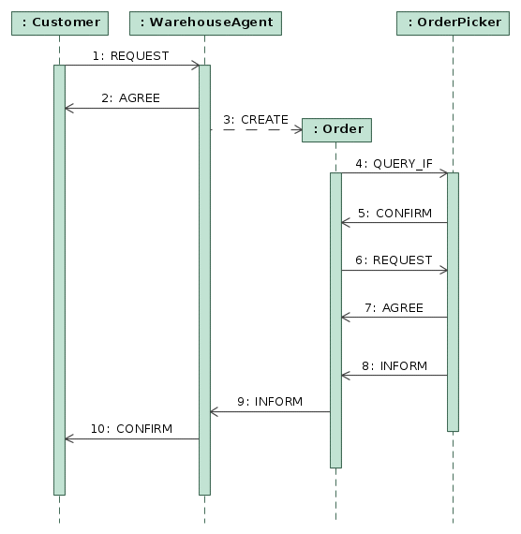
Communication
Order assignment
Data flow:
REQUEST: {id:0,products:[{name:count}]}

Slide 5
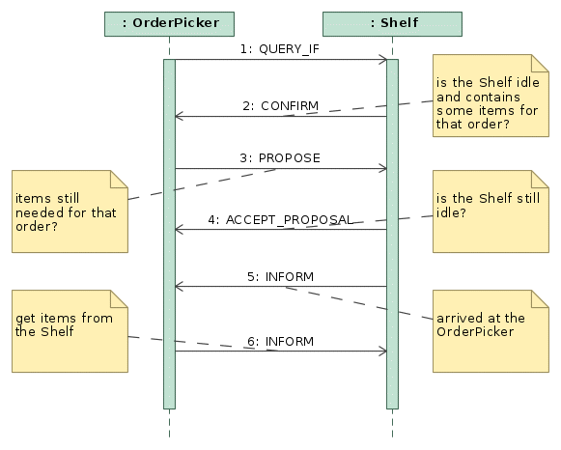
Communication
Order processing

Slide 6
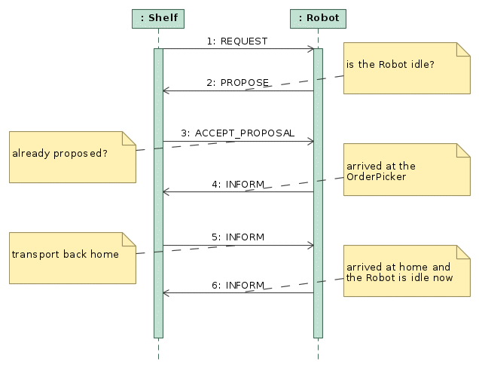
Communication
Order processing

Slide 7
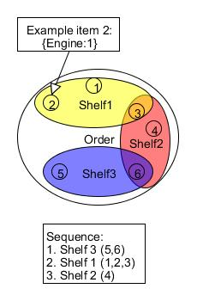
Orderpicker
Internal data structure
Item status enumeration: broadcasted, shelf_proposed, shelf_accepted, property
Hashmap <item, item status>
Hashmap <item, shelf>
No fixed order

Slide 8
Orderpicker
Control flow
Processing the order can fail
No shelfs instantiated, all shelfs busy, shelfs are empty, “reject proposal”
Broadcast missing items again (ticker behaviour)
Immediately rebroadcast items after receiving “reject proposal”
Abort the order after several broadcasts (timeout)
Return incomplete order to OrderAgent (ACLMessage.FAILURE)
Failed order reported to CustomerAgent

Slide 9
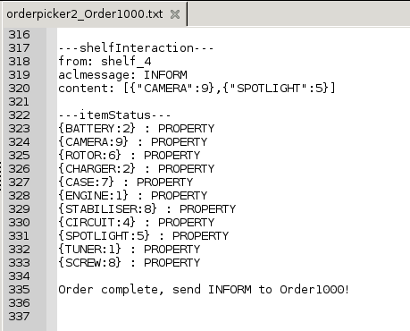
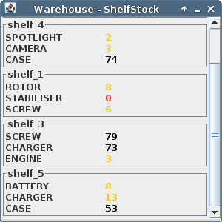
Monitoring
General Warehouse logs to console
OrderPickers generate logfiles for every Order due to communication complexity and better traceability
Shelfs update their stocks „live“ in a window

Slide 10
Configuration
{
shelves: [ {uid:0, products:[
{name:“x“,stock:{current:10}},
{name:“y“,stock:{current:10}}
]}],
pickers: [{uid:0}, {uid:1}],
robots: [{uid:0}, {uid:1}],
orders: [{uid:0, products:[
{name:“x“, quantity:1},
{name:“y“, quantity:3}
]}]
}
Define kiva.config.json
Execute parse.js to get JADE call

Slide 11
Scale-up the system/ limits
Scenario: 3 new orders per second, 10 orderpickers, 20 shelfs. How many robots are at least required to process each order without timeout?
=> You can not say for sure, estimate
Several variables (number of orderpickers, number of rebroadcasts, interval, robot travel delay, item distribution among shelfs, message queue)
Number of robots too low: Very slow order processing? -> No order processing most likely (timeout)
Unless you chose “extreme” values for instantiating agents, the system will work

