Slide 1
Modelling Cancer
Computational Modelling SSC
Mitchell Lab

Slide 2
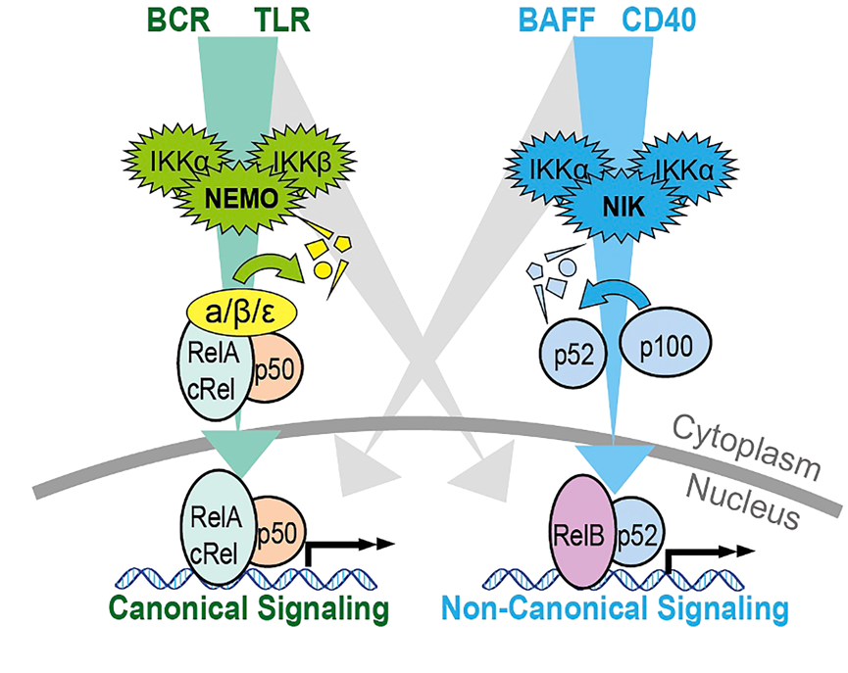
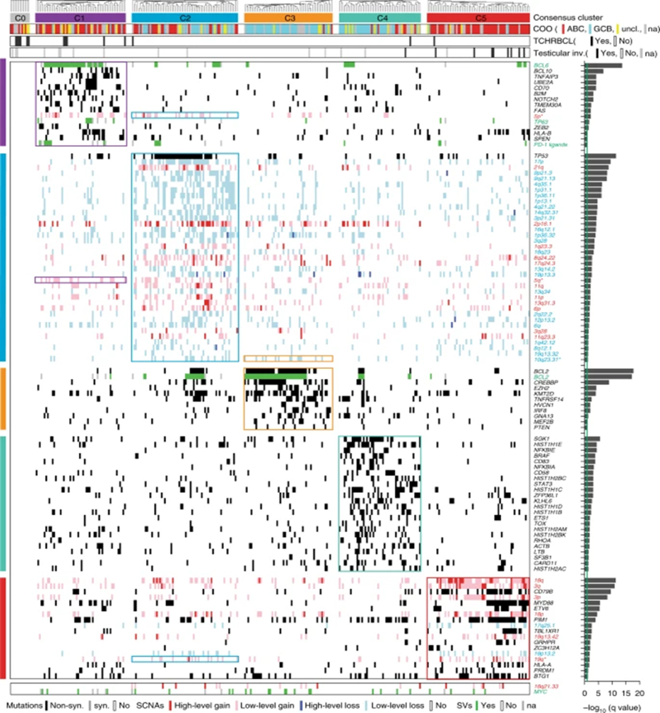
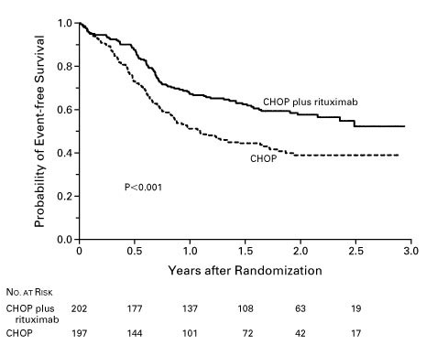

Diffuse Large B-cell Lymphoma
The most common type of Non-Hodgkin’s Lymphoma in adults (25-30%) >6000 annual cases in the UK
Highly heterogenous
R-CHOP is the gold standard treatment for DLBCL, with a 60% success rate
O’Donnel et al, Front. Oncol., 2023
The transcription factor NF-κB is a key regulator of inflammation and immunity
NF-κB is activated by viral & bacterial infections, DNA damage, pro-inflammatory cytokines, oxidative stress
Stimulation via cell surface receptors stimulate either the canonical or non-canonical NF-κB pathway via NEMO or NIK.
Coiffier et al., N Enl J Med, 2002

Slide 3
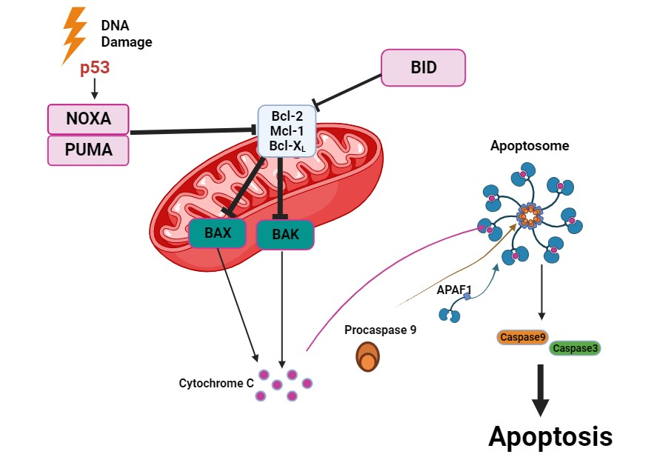
Knock out of NF-κB is toxic, therefore we need to find alternatives
NF-κB regulates the expression of the BCL2- family anti-apoptotic proteins: BCL2, MCL1, BCLXL
When NF-κB is upregulated by the TME, so are anti-apoptotic proteins, causing cancer cells to ‘escape’ apoptosis
NF-κB
BH3-only protein binding selectivity has formed the basis of rational drug design strategies to antagonize distinct anti-apoptotic BCL2- family members.
Examples of BH3 Mimetics
ABT199 BCL2 Inhibitor
AZD5991 MCL1 Inhibitor
A-1331852 BCLXL Inhibitor

Slide 4
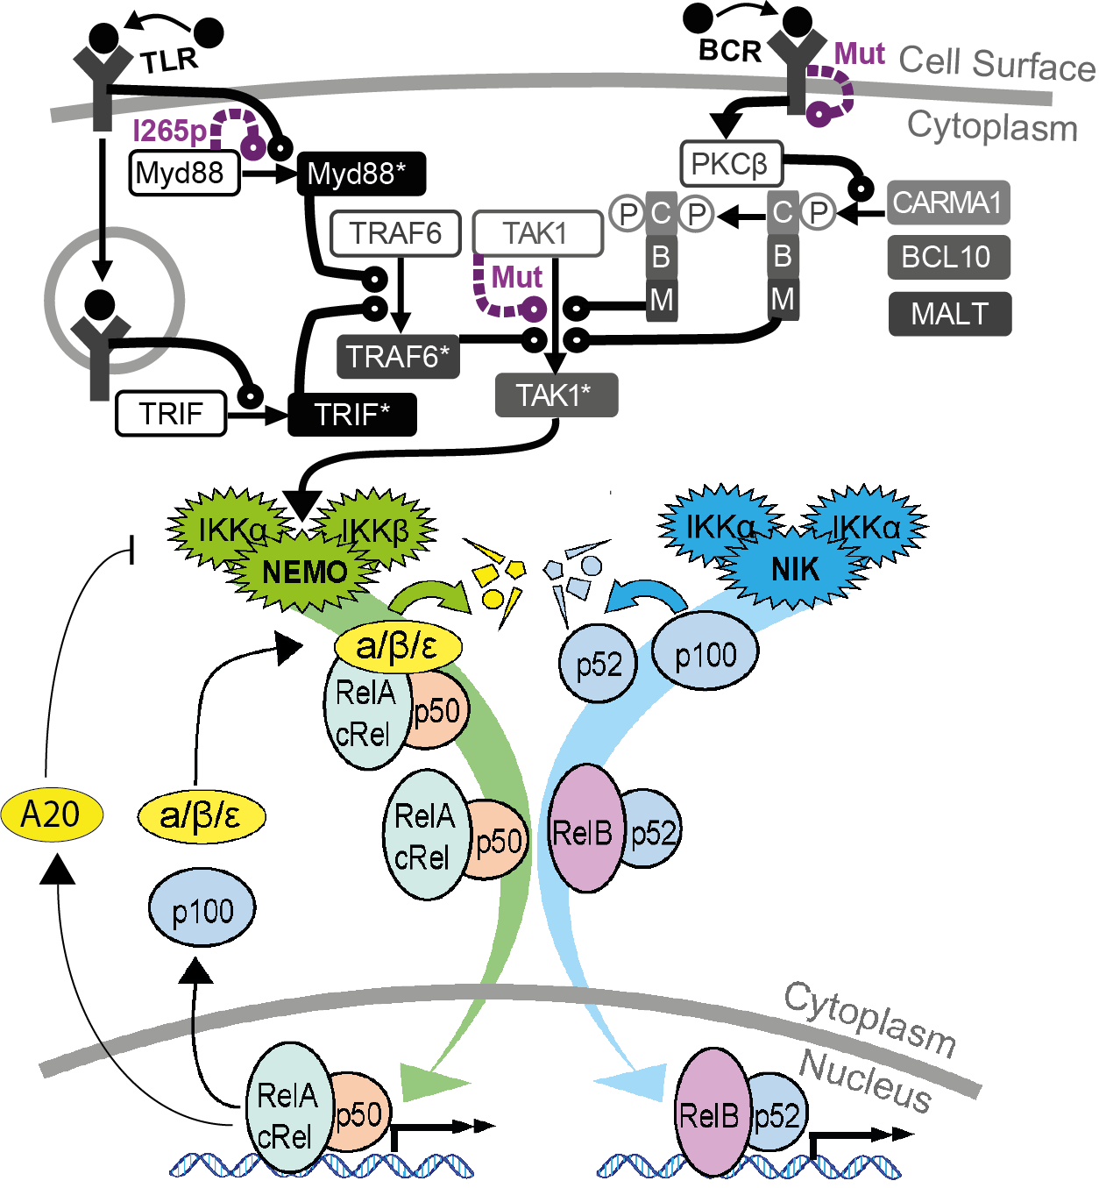
3 Inputs:
Steady state
Time course
Steady state
Time course
(well 6 really)
TLR
BCR
Steady state
Time course
NIK

Slide 5
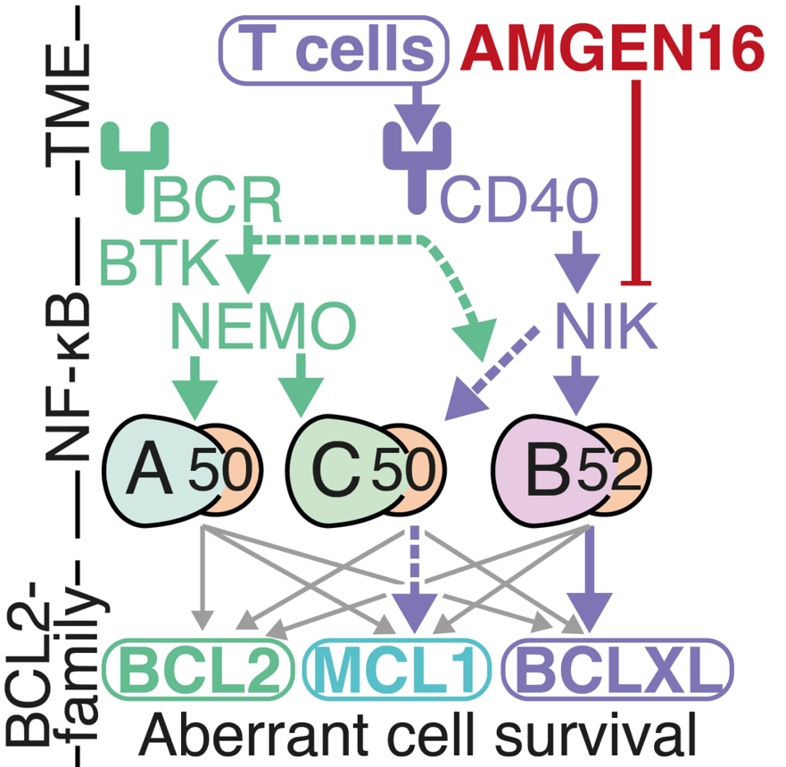
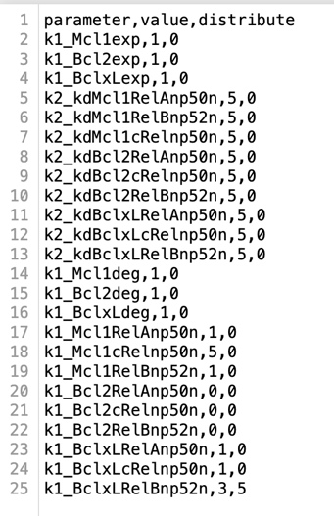
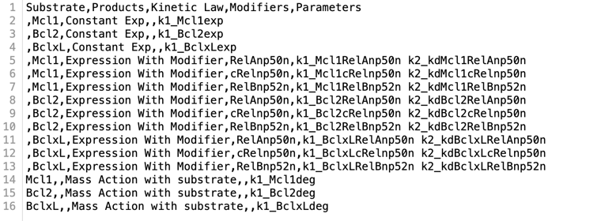
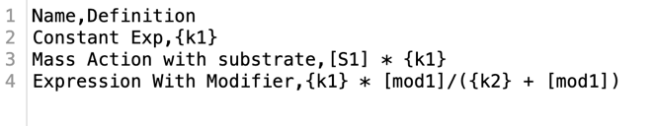
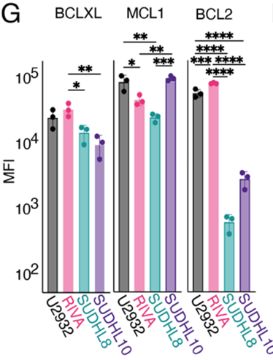
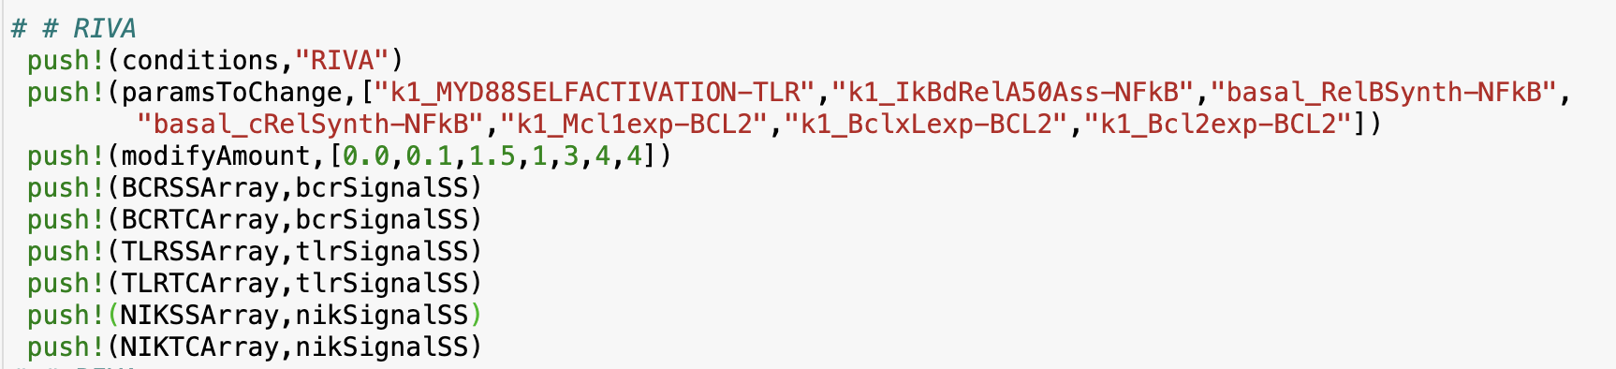
Building a NF-κΒ – BCL2 Model
Parameter file
Reaction file
Rate laws file
+
+
+
Wet lab data
Generation of virtual DLBCL cell lines

Slide 6
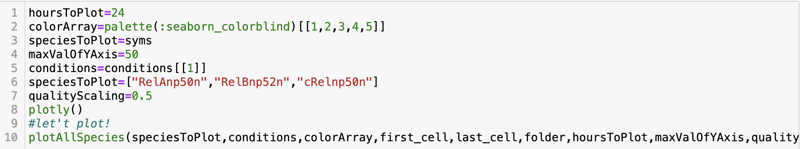
Let’s plot NF-κΒ activity!
Go to:
http://139.184.170.218:9001/hub/login?next=%2Fhub%2F - cancerModelling/Emily
Run the code
“RelAnp50n” = RelA:p50 in the nucleus
“RelBnp52n” = RelB:p52 in the nucleus
“cRelnp50n” = cRel:p50 in the nucleus

Slide 7
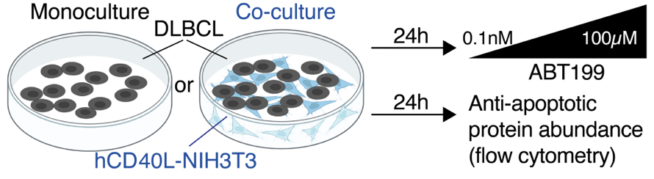
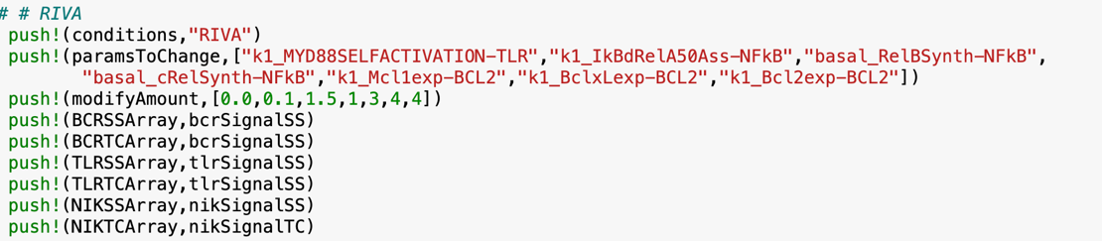
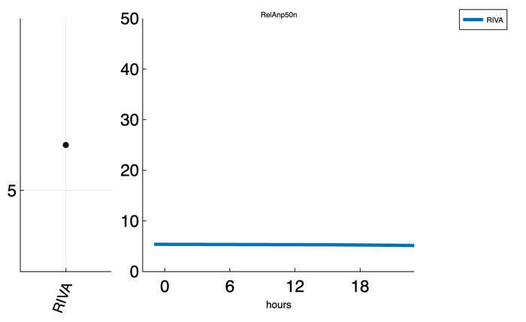
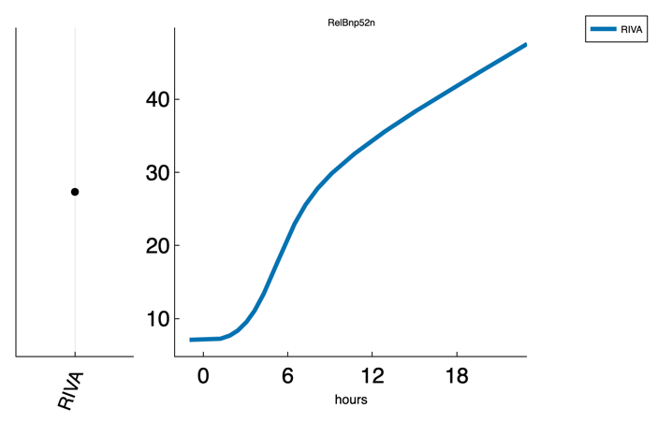
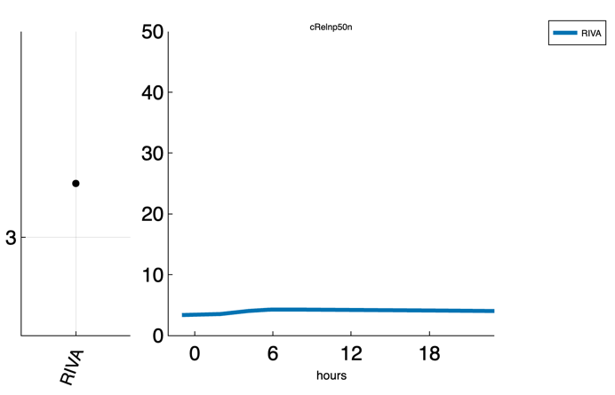
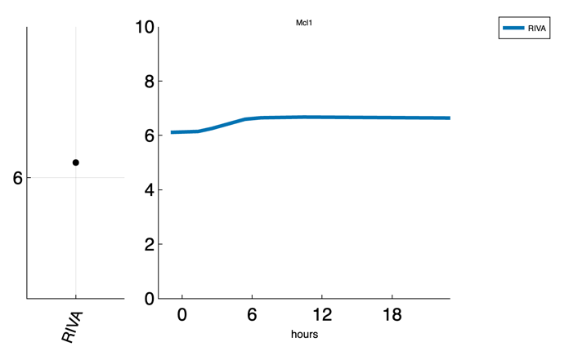
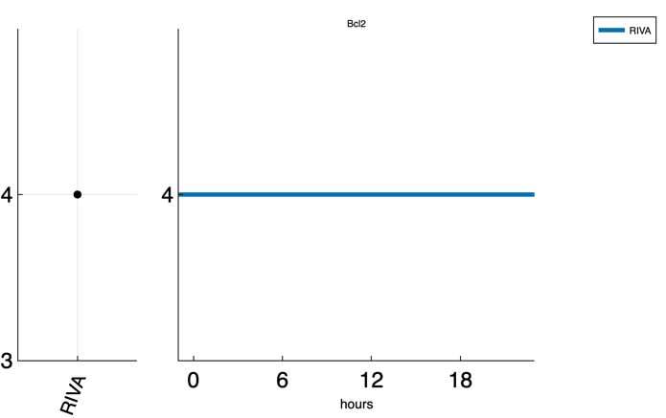
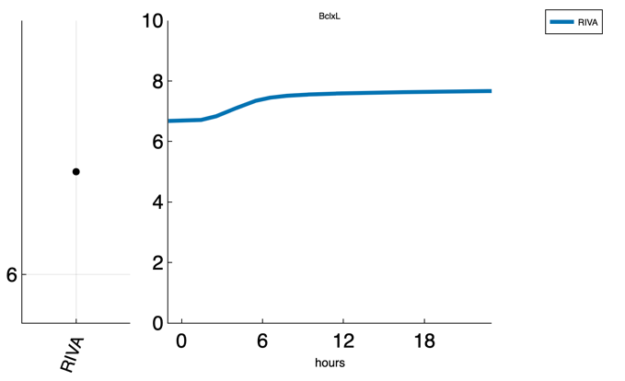
Modelling TME inputs
Now let’s plot BCL2-family outputs!

Slide 8

Now let’s simulate more TME signals
1. Create a new virtual “RIVA” cell line with high BCR steady-state for both BCRSSArray and BCRTCArray, keeping NIKTC
Hint
In your code you can find the name of the high BCR steady-state function to asign
2. Run your code and plot outputs for Bcl2, Mcl1, BclxL, RelAnp50n, RelBnp52n and cRelnp50n
3. Can you spot any patterns?
4. Assesment suggestions: - Examine the effect of different basal TME activities in virtual RIVA cells,
- Model drugs that target NF-κΒ and reduce BCL2-family expression in the presence of TME signals
Contact details: A.Vareli@bsms.ac.uk

