Slide 1
Modelling SSC week 2
Cancer Modelling
Simon Mitchell

Slide 2
Cancer-causing mutations
Cells become cancerous following an accumulation of mutations that disrupt the control of cell proliferation.
Many different mutations can drive the cell cycle, different cancers have different mutations.
Getting the right treatments to the right patients requires understanding which mutations matter.
For example, Myc, a transcription factor that is involved in regulating several cellular processes is overexpressed in up to 70% of human cancers (Gurel et al., 2008; Palaskas et al., 2011).
Notes:
Set the scene
2

Slide 3
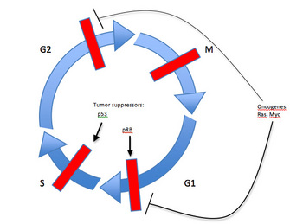
Components of the cell cycle machinery are frequently altered in human cancer.
Deregulation of proteins that regulate cell division events can lead to aberrant progression from one cell cycle stage to the next.
Tumour suppressors
p53
Oncogenes
Ras, Myc
pRB
G1 and G2 are growth phases and DNA synthesis happens in S phase
Chow et al, Nature Education, 2010
Notes:
Discuss cell cycle phases and control of transitions

Slide 4
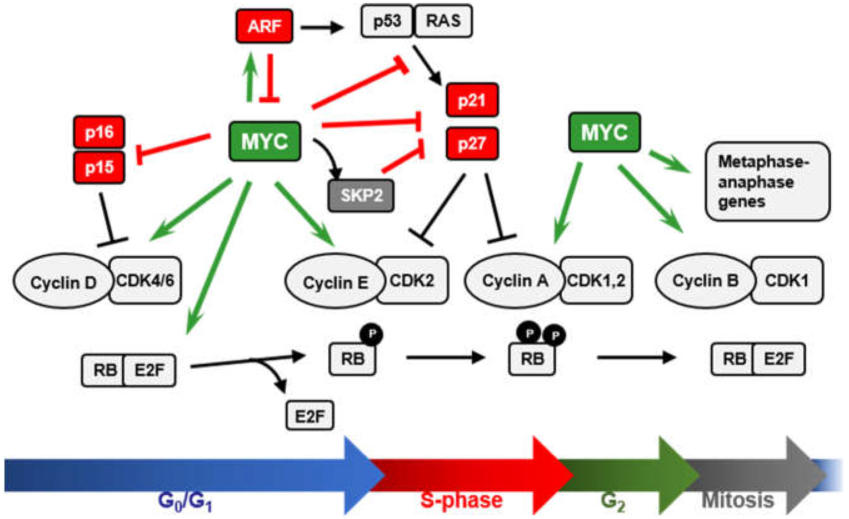
Plotting the output of the cell cycle model
Progress through the cell cycle is characterised by levels of specific cell cycle regulators.
Cyclin E/cdk2 drives initiation of DNA replication
Cyclin A regulates progression through S phase and the timing of progression into mitosis
Cyclin B/cdk1 is required for entry into and progression through mitosis
Cdh1 negatively regulates DNA replication and cell proliferation to establish and maintain the G0/G1 state Jeffrey R. Skaar and Michele Pagano, Nat Cell Biol 2009

Slide 5
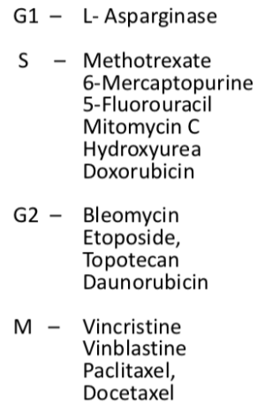
Drugs that target the cell cycle

Slide 6
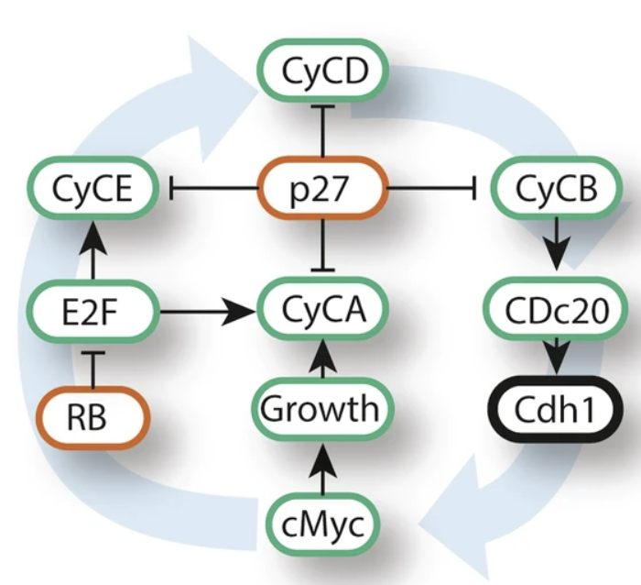
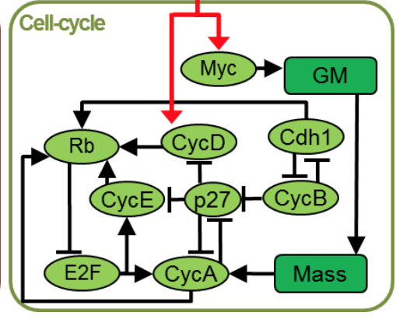
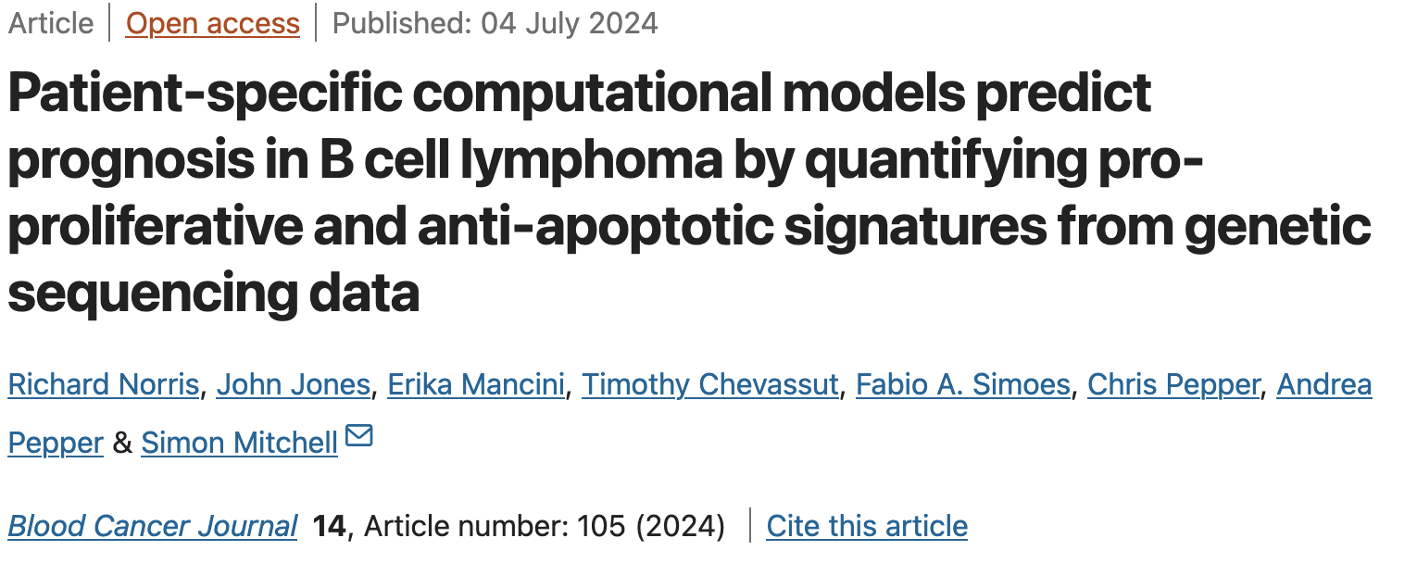
Why use systems biology?
Research in biology has historically used a reductionist approach, but with huge datasets available today we can build models enabling us to take an holistic approach to studying complex systems.
This allows us to model the effect of mutations on whole systems and potentially find new avenues for treatment.
Conradie et al, FEBS Journal, 2010

Slide 7
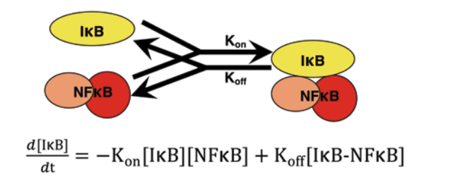
Remember This?
It starts with a picture
We write some equations
How does IkB change over time
Proportional to the amount of
IkB and NF-kB
Proportional to the amount of the complex IkB:NF-kB
Goes down
Goes Up
Mitchell S…. Hoffmann A. Methods in molecular biology. 2015

Slide 8

Models consist of Ordinary Differential Equations
ks is the rate of protein synthesis
R(t) is the amount of RNA that codes for the protein present in the cell at time t
kd is the rate of protein degradation
P(t) is the concentration of the protein at time t
An example from our model of the cell cycle. At time t:
cMyc = 0.004*cMyct - 0.002 * cMyc

Slide 9
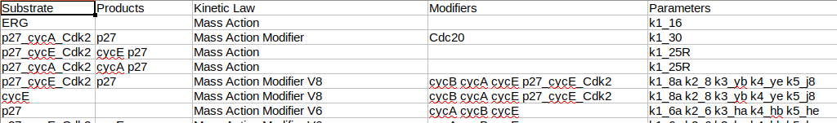
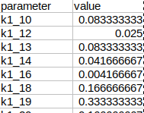
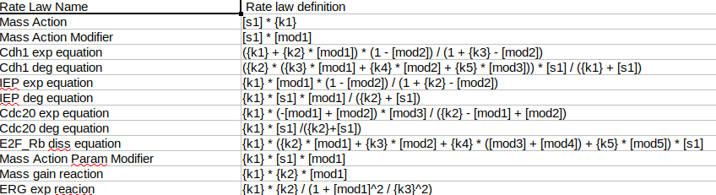
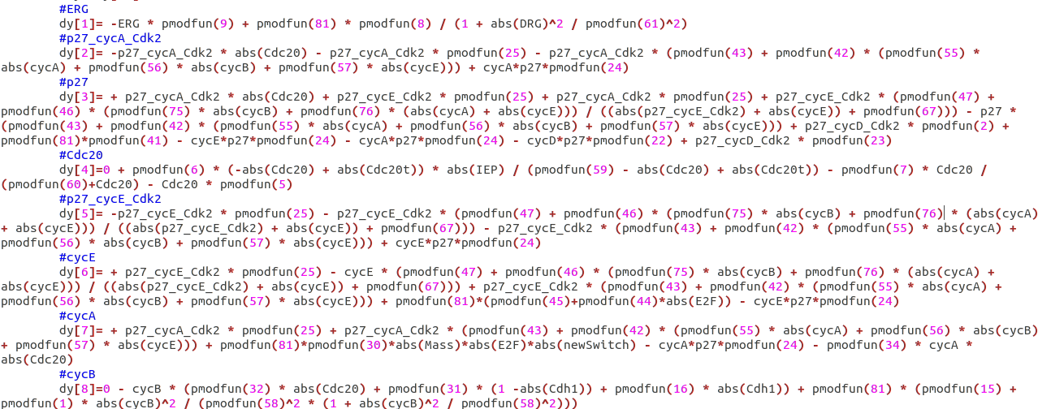
Building an ODE model
Reactions file
Parameters file
Rate laws file

Slide 10
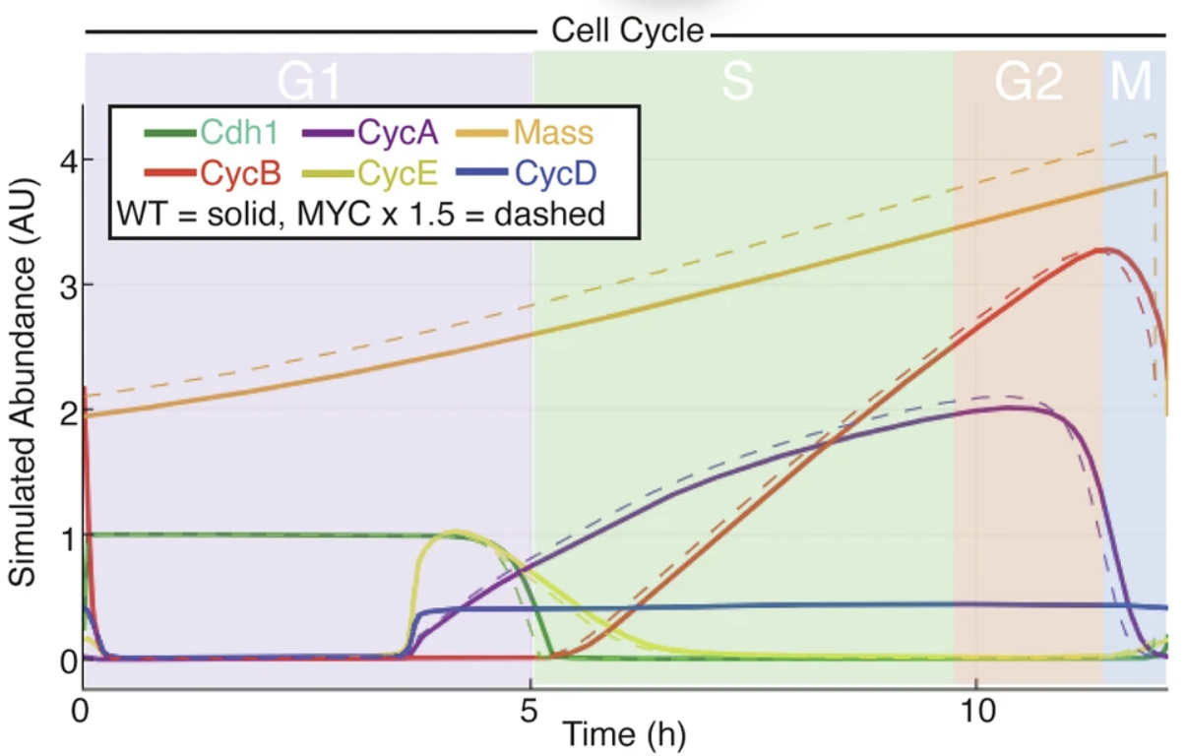
Plotting the output of the model II

Slide 11
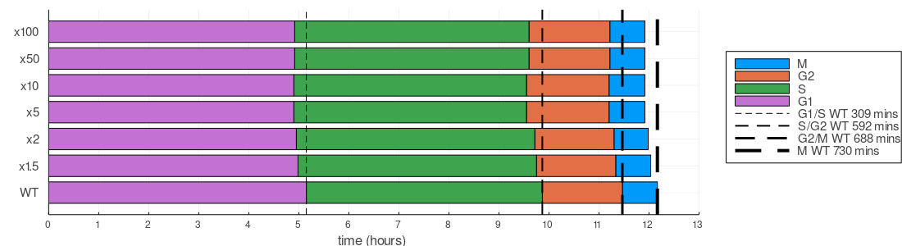
Plotting the output of the model III
The model predicts that overexpression of Myc shortens the cell cycle, but this effect is limited.
Notes:
Point out variation in transition times

Slide 12
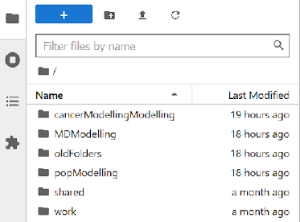
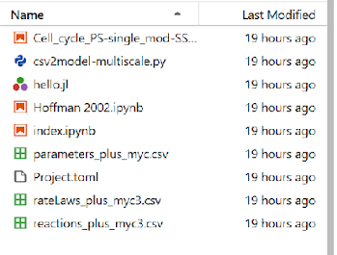
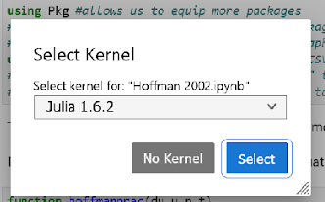
In a browser, go to: 139.184.170.218:9001
Log In with your unique login
>cancerModellingModelling
>Hoffman 2002.ipynb
>Julia 1.6.2

Slide 13
Now let’s simulate other mutations…
Instructions:
Here is a list of parameters to modify.
Modifying these parameters enables simulation of mutations that change the expression and degradation levels of associated genes.
You can see which genes correspond to each parameter using the paramNames dictionary.
Edit the parameter name as highlighted, run the simulation and plot the cell cycle.
k1_13 Cdc20 expression
k1_14 Cdc20 degradation
k2_15 ERG expression
k1_16 ERG degradation
k2_29 Cyclin A expression
k1_30 Cyclin A degradation
k2_1a Cyclin B expression
k2_9 Cyclin D expression
k1_3a Cdh1 expression
k1_J4 Cdh1 degradation
Notes:
Set the scene
13

