Slide 1
Modelling Across Scales From Molecules to Pandemics
SSC Intro and Overview
Simon Mitchell
Notes:
Template version 15_12_21

Slide 2

Thank you for choosing this SSC!
Part taught, part interactive.
Research lead.
Second time we’re offering this SSC.
No coding or maths knowledge required.
But we will show you how things work.
Sorry in advance for any technical problems!

Slide 3
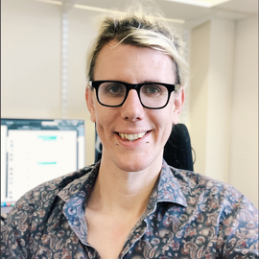
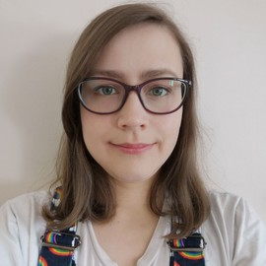
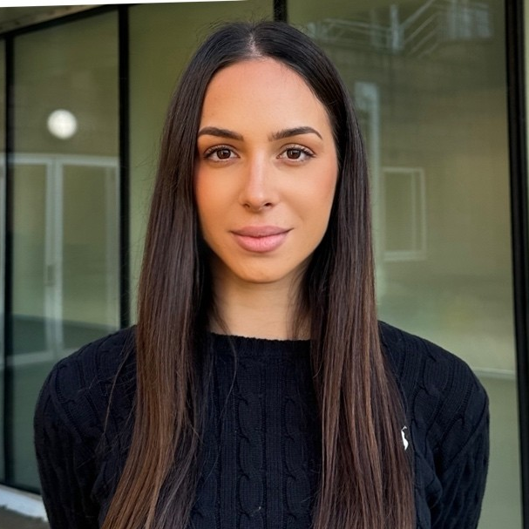
Introductions
Who we are:
Dr Simon Mitchell. Dr Eleanor Jayawant. Aimilia Vareli
Our research:
“Computational systems biology/medicine” – trying to understand biology and medicine using computational simulations.
https://mitchell.science/

Slide 4
Introductions
Who we are:
Dr Simon Mitchell. Dr Eleanor Jayawant. Aimilia Vareli
Introduce yourselves!

Slide 5
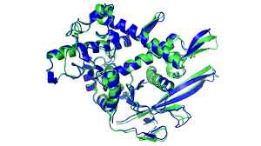
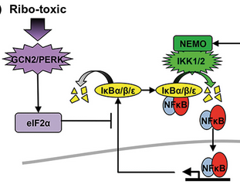
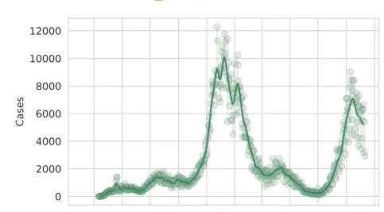
Introductions
Who we are:
Dr Simon Mitchell. Dr Eleanor Jayawant. Aimilia Vareli
Scale: Molecular Dynamics Signalling/Cancer Populations

Slide 6
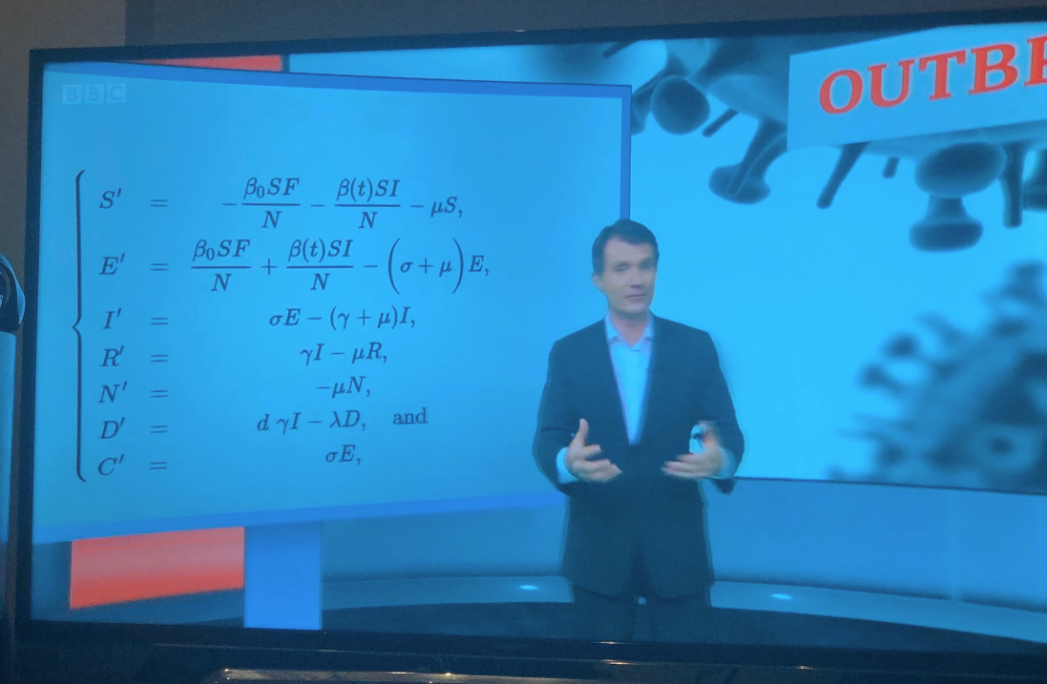
Why Modelling?
Timely!
Key to all aspects of medicine.
From drug discovery to public health
The future of medicine?
Personalised medicine
Active research area

Slide 7
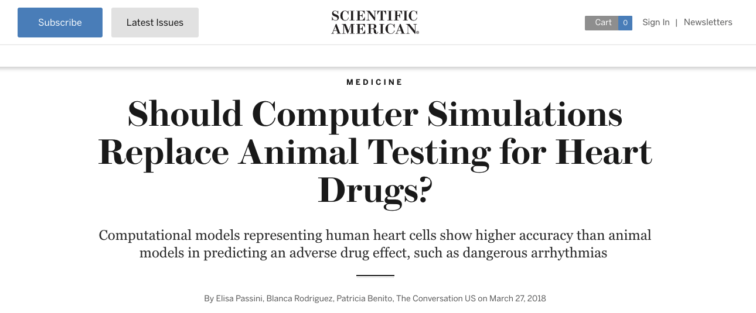
Why Modelling?
Timely!
Key to all aspects of medicine.
From drug discovery to public health
The future of medicine?
Personalised medicine
Active research area
Quicker, cheaper, (more accurate!?) than animal models.

Slide 8
Learning Outcomes
• Understand how computers and mathematics are used to simulate biology and how that is useful for medicine.
• Be able to run models of biological systems across a number of scales.
• Be able to present results generated from simulations, and understand the insight generated along with the limitations of modelling.

Slide 9

Learning Outcomes
• Understand how computers and mathematics are used to simulate biology and how that is useful for medicine.
• Be able to run models of biological systems across a number of scales.
• Be able to present results generated from simulations, and understand the insight generated along with the limitations of modelling.
6-minute presentations - present one modelling result.
Using any of the techniques we’ll show you.
A little background on the biology and what you did
A result and how you interpret it
Some discussion of its limitations and what you could do next
Answer a question or two!
Assessment

Slide 10
Learning Outcomes
• Understand how computers and mathematics are used to simulate biology and how that is useful for medicine.
• Be able to run models of biological systems across a number of scales.
• Be able to present results generated from simulations, and understand the insight generated along with the limitations of modelling.
6-minute presentations - present one modelling result.
Using any of the techniques we’ll show you.
A little background on the biology and what you did
A result and how you interpret it
Some discussion of its limitations and what you could do next
Answer a question or two!
Assessment
Any Questions?

Slide 11
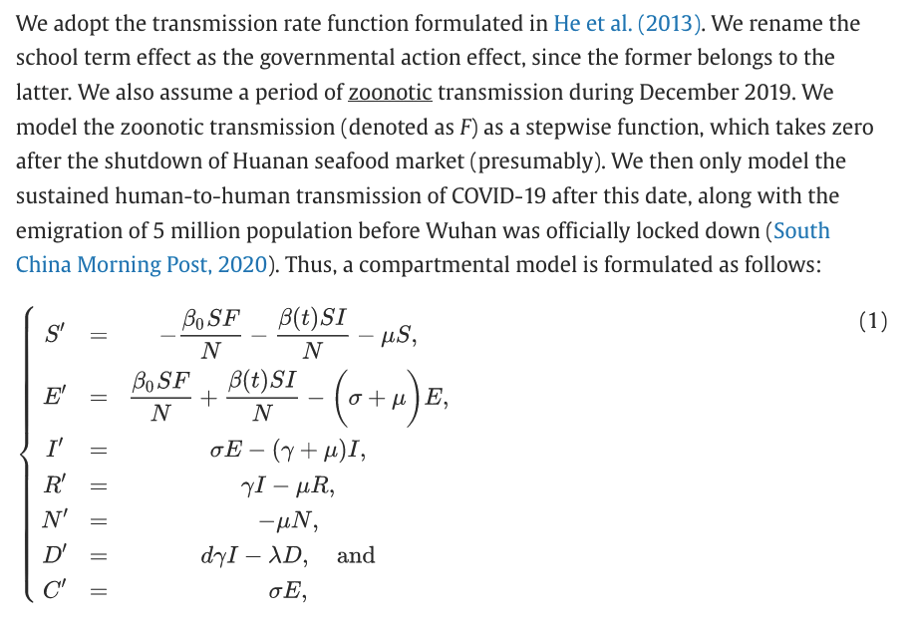
Population–Scale Modelling
Lin, Qianying, et al. "A conceptual model for the coronavirus disease 2019 (COVID-19) outbreak in Wuhan, China with individual reaction and governmental action." International journal of infectious diseases 93 (2020): 211-216.

Slide 12
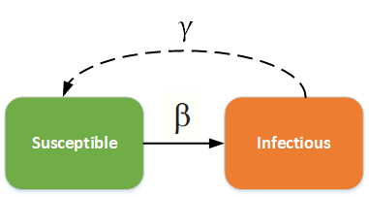





SI model
What happens if the recovery rate gets higher?
What happens if the probability of transmission changes?
Recovery rate
equals
minus
Recovery rate * infected people
S
Infection rate
I
Rate of change of infected people over time
Infection rate * susceptible people * infected people total number of people
What do you think the infection rate is affected by?
= number of contacts * probability of transmission
Let’s simulate it, open a web browser and go here:
www.Mitchell.science/ssc
Adapted from: https://docs.idmod.org/projects/emod-generic/en/2.20_a/model-si.html

Slide 13
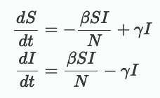
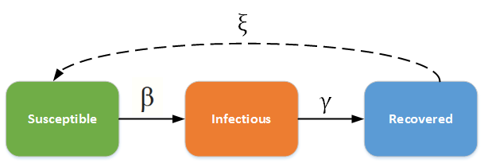
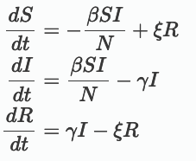
SIR model
Rate of return to susceptible
Infection rate
Recovery rate

Slide 14
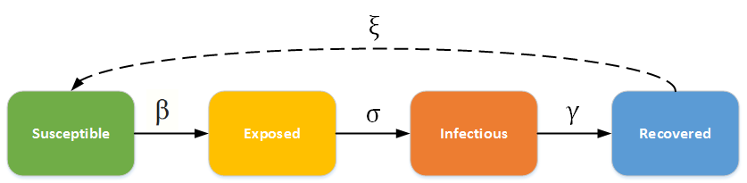
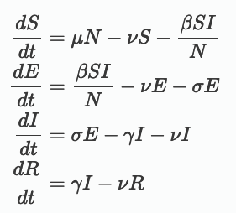
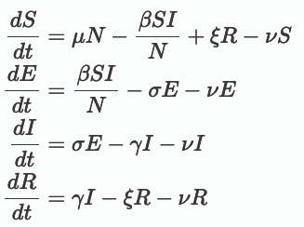
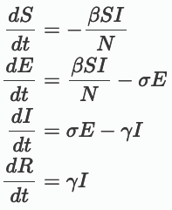
SEIR
Birth rate
Death rate
Death rate
Death rate
Death rate

Slide 15
Things you might ask of population-scale models:
How does lowering the infection rate affect the dynamics of a pandemic
How does reducing contacts affect the dynamics of a pandemic
Next time:
Cancer modelling!

