Slide 1
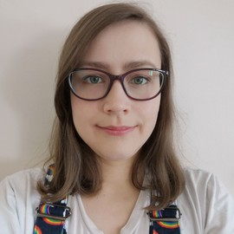
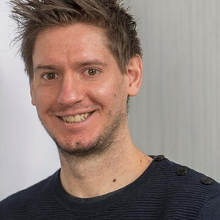
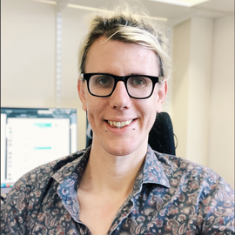
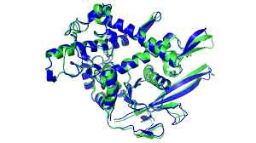
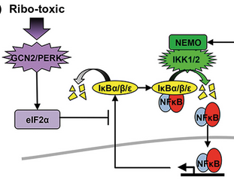
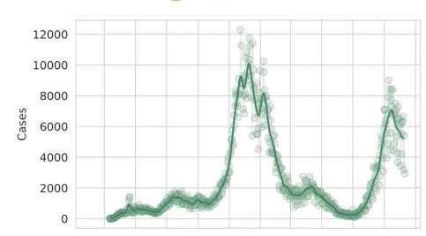
What we covered
Dr Eleanor Jayawant. Dr Richard Norris. Dr Simon Mitchell
Scale: Molecular Dynamics Signalling/Cancer Populations

Slide 2
Learning Outcomes
• Understand how computers and mathematics are used to simulate biology and how that is useful for medicine.
• Be able to run models of biological systems across a number of scales.
• Be able to present results generated from simulations, and understand the insight generated along with the limitations of modelling.

Slide 3
Assessment
7-minute presentations - present one modelling result.
Using one of the techniques we’ve shown you.
Potential slides:
A little background on the biology
What you did (method)
A result graph (or two) and how you interpret it
Some discussion of limitations of the approach
What you could do next.
Answer a question or two!

Slide 4
Assessment
7-minute presentations - present one modelling result.
Using one of the techniques we’ve shown you.
Potential slides:
A little background on the biology
What you did (method)
A result graph (or two) and how you interpret it
Some discussion of limitations of the approach
What you could do next.
Answer a question or two!
Everyone attends weeks 7 and 8 ( and asks questions):
Week 7 presentations: Hin Yip, Lealahni Woulfe, Molly Oakley, Anudi Dharmarathn, Shaiat Uddin, Benedic Phillip
Week 8 presentations: Hannah Wright, Susannah Snowdon, Fahad Saif, Alicja Imrak, Megan Crossman, Agisha Ampikaibalan
Harsha Pendyala | Shaheer Imran | William Phillips | Ben Brown | Alan Peter
Febin D’Silva | Kinsha Dave | Aaron Neaves | Kumal Mapa Mudiyanselage | Saad Bakr

Slide 5

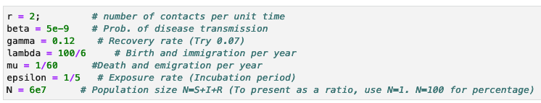
Example assessment task 1 – Population Scale
Run the SEIR (Susceptible, Exposed, Infected, Recovered) population model.
http://139.184.170.218:9001
Create a graph with the default parameters (shift enter through entire sheet).
Alter a parameter or two
Create a new graph with the new parameters, and describe the difference.
Relate the parameter change to public health measures or new viral strains.

Slide 6
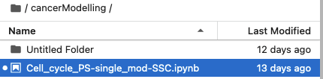
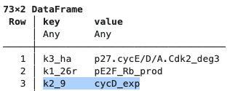
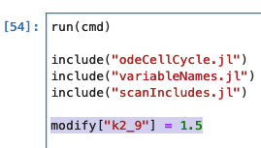
Example assessment task 2 – Cancer modelling
Run the Cell Cycle Model
http://139.184.170.218:9001
Create a graph with the default parameters (shift enter through entire sheet).
Alter a parameter to simulate a mutation.
Create a new graph with the new parameters, and describe the difference.
Relate the parameter change to mutations and what the change in cell cycle might mean for cancer.

Slide 7
Example assessment task 3 – MD
Run a simulation
Use the PDB from class, another PDB in the data folder, or potentially download a SMALL PDB file
Run a simulation and describe the characteristics of the simulation:
End to end distance
Ramachandran plot properties
Change a parameter (temperature, time but keep both reasonable) and re-run. Describe what changes about the above results.
Discuss what these changes mean and discuss how you might ensure you get the most accurate structures if you were trying to develop new drugs

