Slide 1
Modelling Across Scales: From Molecules to Pandemics
Molecular Dynamics II
Dr Eleanor Jayawant
Notes:
10 mins talking, 35 mins activity, 10 mins discussion.

Slide 2
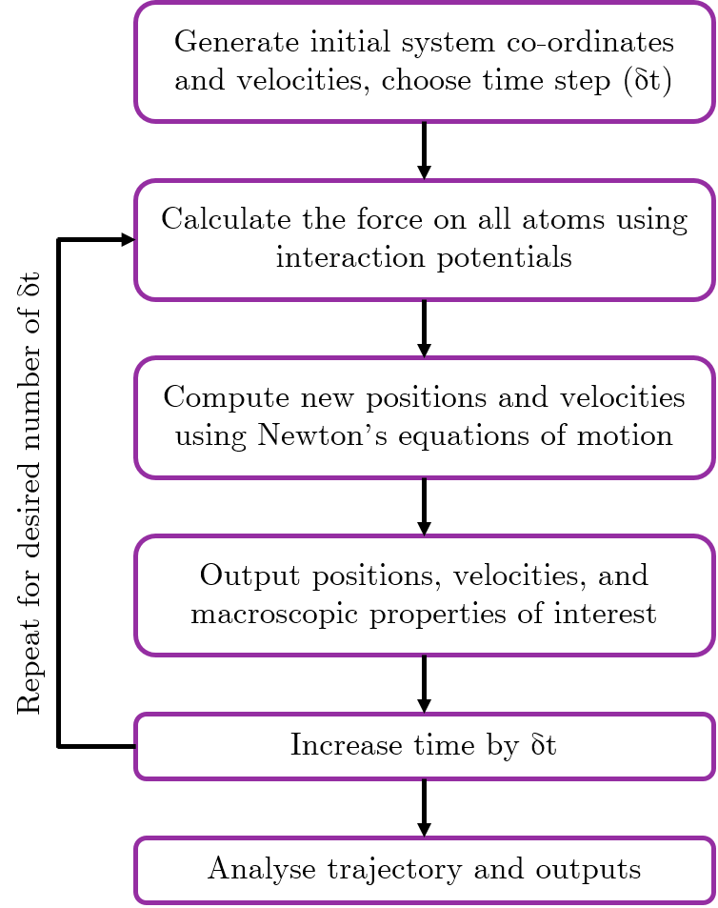
Previously on 104 SSC…
Molecular dynamics can help us understand how molecules move and interact with each other
This is very important for drug discovery
MD involves solving Newton’s equations of motion iteratively for a system, using a set of interaction potentials called a force field
Force fields have a bonded and a non-bonded component
Running an MD simulation produces a trajectory of how the atoms move, which can be visualised as a movie
Most MD simulations start with a .pdb file, which we looked at for the activity

Slide 3
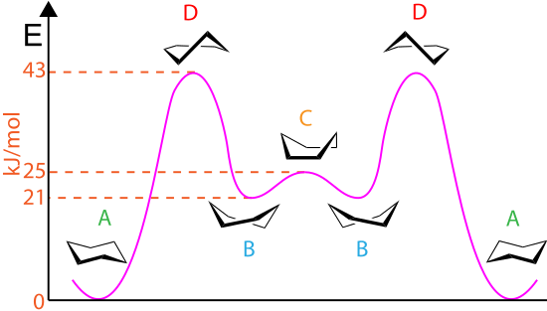
Energy landscapes are complicated!
J, Clayden (2003). Organic chemistry (2nd ed.). Oxford. p. 373.
Notes:
Even for a molecule as simple as glucose, there are multiple possible conformations. If you did A-level chemistry, you may remember learning about glucose boats and chairs, where chairs are the lowest energy state, but there is a significant energy barrier to overcome in order for a boat to become a chair. (Molymod example)

Slide 4
Energy landscapes are complicated!
even though this state has lower energy
we might get trapped in this state
Energy
Conformational State
This is called “the sampling problem”
Notes:
For a complicated system such as a protein, there may be multiple energy states that the system can be in, part of a complex energy landscape. Even rotation about a single bond can have a significant energy barrier associated with it (e.g. cis to trans peptide bond). If we don’t have the right conditions, we might get stuck with the protein being in the wrong state the whole time, because in our system it might not be possible to overcome an energy barrier associated with a conformational change.

Slide 5
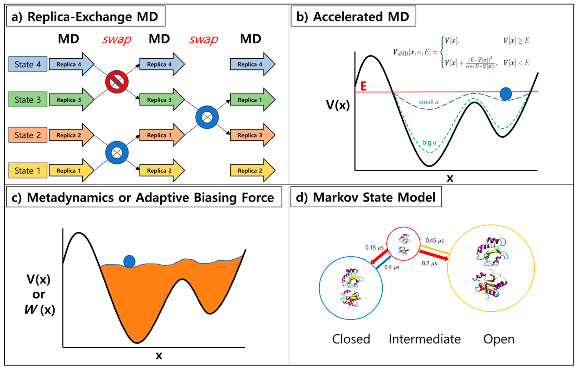
Advanced sampling techniques can help!
Lazim, R., Suh, D. and Choi, S., 2020. Advances in molecular dynamics simulations and enhanced sampling methods for the study of protein systems.
International journal of molecular sciences, 21(17), p.6339.
Notes:
I’m not going to describe these techniques, if you want to learn a bit about them then I can recommend a review article: https://www.ncbi.nlm.nih.gov/labs/pmc/articles/PMC4339458/ but for now the point I want to make it that when thinking about MD we can use extra ‘tricks’ to overcome problems in sampling, and if you read a paper on MD you might come across some of these terms.

Slide 6
Analysis of MD simulations
MD simulations can give us lots of information, including:
Secondary structure estimation
Hydrogen bonding
Angles and dihedrals
Root mean squared deviation (how the structure changes over time)
Distances between atoms/motifs
Solvent accessible surface area
Radius of gyration
Potential energies
Estimates of parameters for experimental techniques (e.g. NMR)
And more!
Notes:
We can obtain a lot of information from MD simulations, I’ll quickly run through why we care about a couple of these in a little more detail.

Slide 7
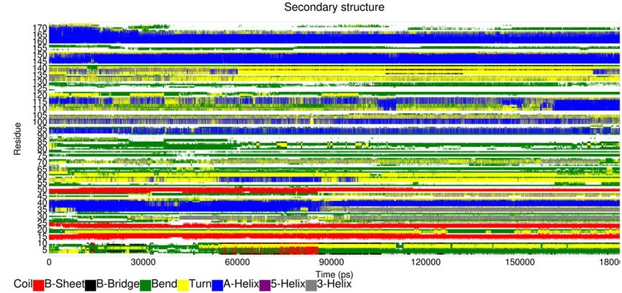
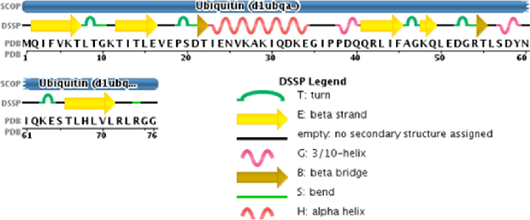
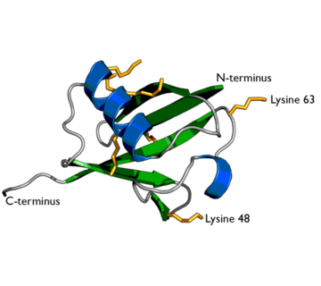
Analysis of MD simulations: secondary structure
Secondary structure is very important for overall protein structure and stability
Different types of structures are associated with different functions, e.g. alpha-helices are often found in membrane proteins and have important biological functions such as cell signalling initiator
We can predict secondary structure for each amino acid in a simulation, using algorithms such as DSSP (Define Secondary Structure of Proteins)
This allows us to easily identify regions of secondary structure, and see how it changes over the course of the simulation

Slide 8
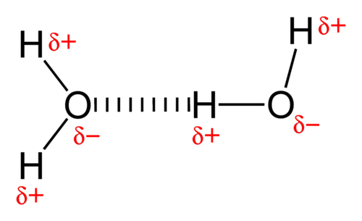
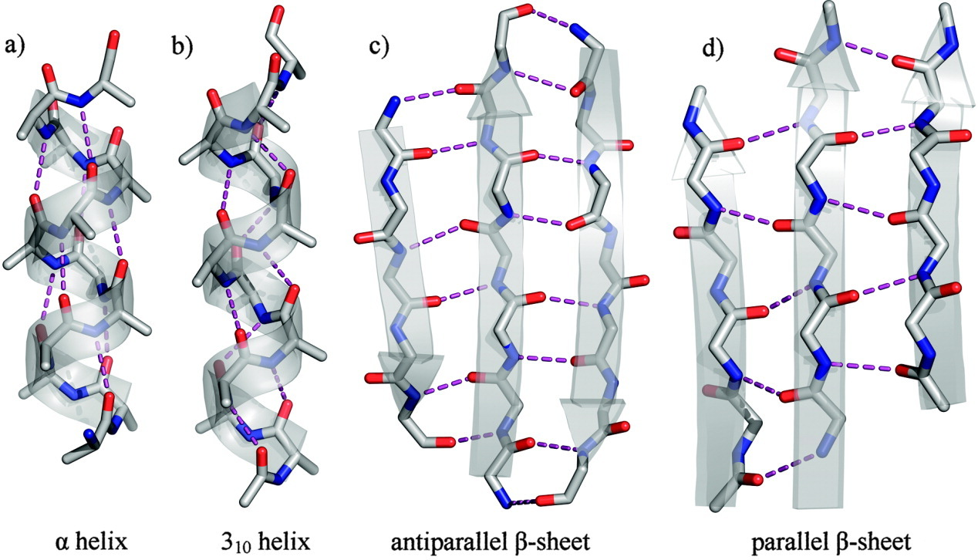
Analysis of MD simulations: hydrogen bonding
Hydrogen bonds form between a hydrogen atom (donor) bound to a more electronegative atom, and another electronegative atom (acceptor)
They play an important role in determining the three-dimensional structures and properties of proteins, and are important for stability between subunits in proteins
If we can understand the hydrogen bonding pattern of a macromolecule, we can better understand its structure, properties and function
Notes:
Hydrogen bonding is a special type of dipole-dipole attraction between molecules, not a covalent bond to a hydrogen atom. It results from the attractive force between a hydrogen atom covalently bonded to a very electronegative atom such as a N, O, or F atom and another very electronegative atom.

Slide 9
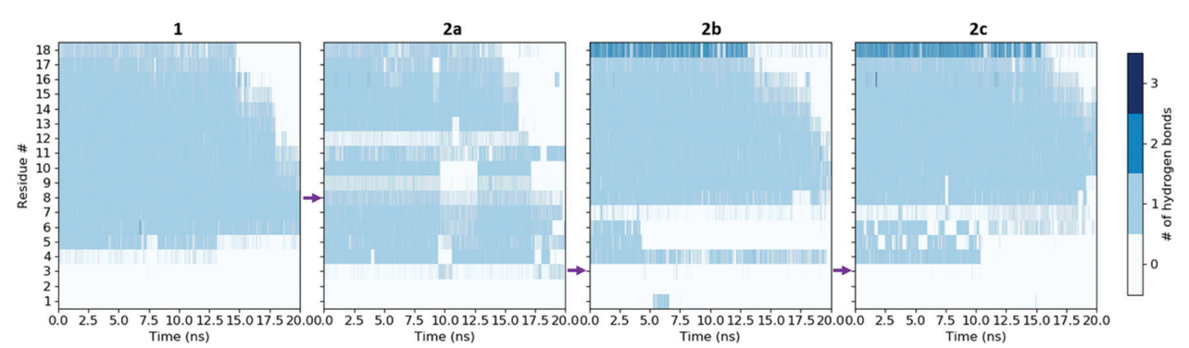
Analysis of MD simulations: hydrogen bonding
Hydrogen bonds form between a hydrogen atom (donor) bound to a more electronegative atom, and another electronegative atom (acceptor)
They play an important role in determining the three-dimensional structures and properties of proteins, and are important for stability between subunits in proteins
If we can understand the hydrogen bonding pattern of a macromolecule, we can better understand its structure, properties and function
Jayawant, E.S., Beadle, J.D., Wilkening, I., Raubo, P., Shipman, M., Notman, R. and Dixon, A.M., 2020.
Impact of oxetane incorporation on the structure and stability of alpha-helical peptides.
Physical Chemistry Chemical Physics, 22(43), pp.25075-25083.
Notes:
Hydrogen bonding is a special type of dipole-dipole attraction between molecules, not a covalent bond to a hydrogen atom. It results from the attractive force between a hydrogen atom covalently bonded to a very electronegative atom such as a N, O, or F atom and another very electronegative atom.

Slide 10
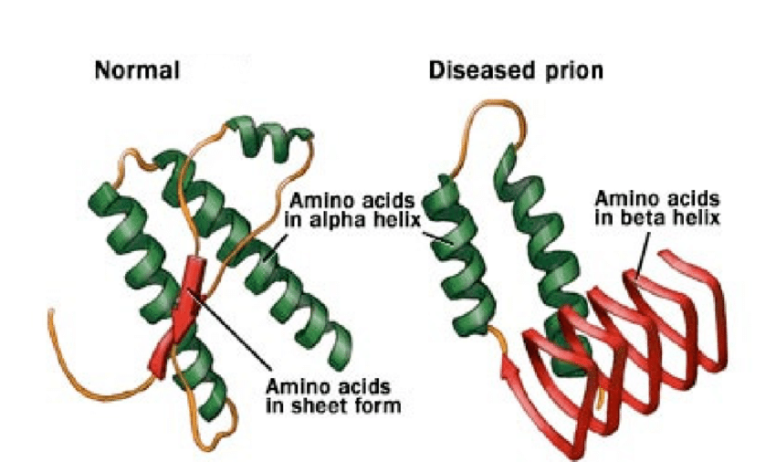
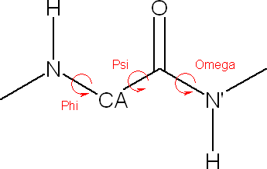
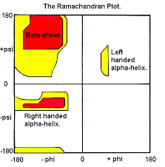
Analysis of MD simulations: angles and dihedrals
Understanding how the angles and dihedrals inside a molecule change over time gives an indication of how the molecule is moving dynamically and which areas might be more flexible/rigid
This can also give an indication of secondary structure – if we plot the phi vs. psi angles for each amino acid, we can produce a Ramachandran plot
Different secondary structure motifs have different characteristic phi/psi angles, corresponding to different regions on the plot
We’ll make a Ramachandran plot in the activity!
https://www.mayoclinic.org/diseases-conditions/creutzfeldt-jakob-disease/multimedia/normal-and-diseased-prions/img-20007478
Notes:
Use molymod to show phi and psi angles

Slide 11
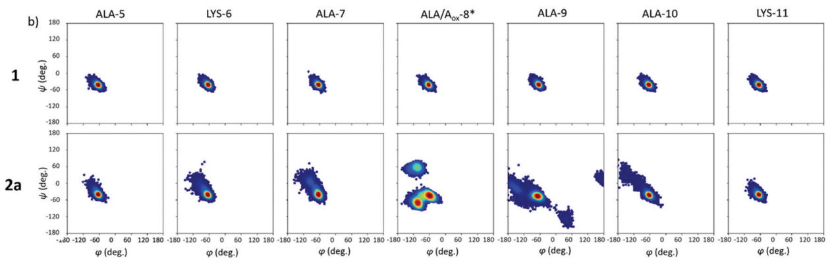
Analysis of MD simulations: angles and dihedrals
Jayawant, E.S., Beadle, J.D., Wilkening, I., Raubo, P., Shipman, M., Notman, R. and Dixon, A.M., 2020.
Impact of oxetane incorporation on the structure and stability of alpha-helical peptides.
Physical Chemistry Chemical Physics, 22(43), pp.25075-25083.
Notes:
Use molymod to show phi and psi angles

Slide 12
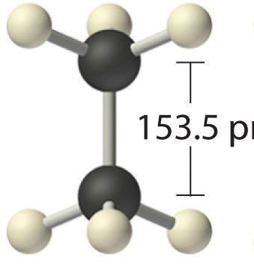
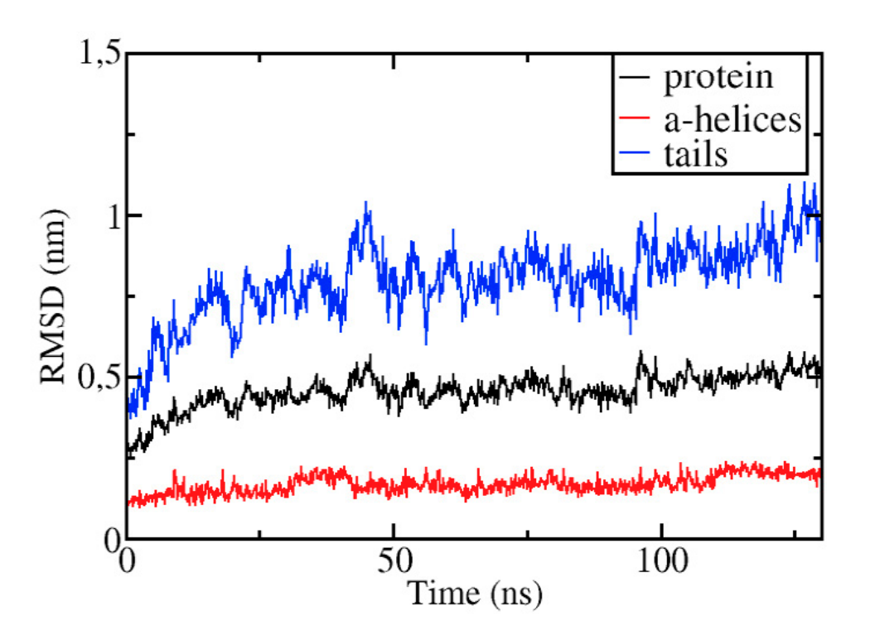
Analysis of MD simulations: RMSD
RMSD is a measure of difference between two structures
This is used as an indicator of accuracy of a model, and to ensure that a system is in equilibrium (i.e. not changing still)
The smaller the deviation, the more spatially equivalent the two structures
More flexible regions of proteins may have large deviations in RMSD, while more stable structures will change less – the overall RMSD will be an average of all residues
0.154 nm
Arnittali, M., Rissanou, A.N. and Harmandaris, V., 2019. Structure of biomolecules through molecular dynamics simulations.
Procedia Computer Science, 156, pp.69-78.

Slide 13
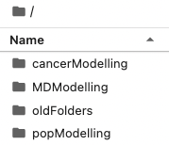
Activity
Task:
Open Jupyter Notebook (http://mitchell.science/ssc)
Click “Run” for each cell to:
Load a PDB file
Run a basic MD simulation
Perform some analysis
You do not need to write any code!
Questions to answer:
What happens to end-to-end distance?
Are there any important structures that emerge in the Ramachandran plot?
What happens if you change the temperature of the simulation? This can be a thought experiment if you don’t have time to actually run this simulation!
Last 15 mins – class discussion and briefing about assessment

