Slide 1
Template Fit – Summary and Results
Jonas Kasper, 08.05.2018

Slide 2
Outline
Investigated Spectra
Templates
Energy model
Fit concept
Results:
  Fit with two templates
  Fit with six templates

Slide 3
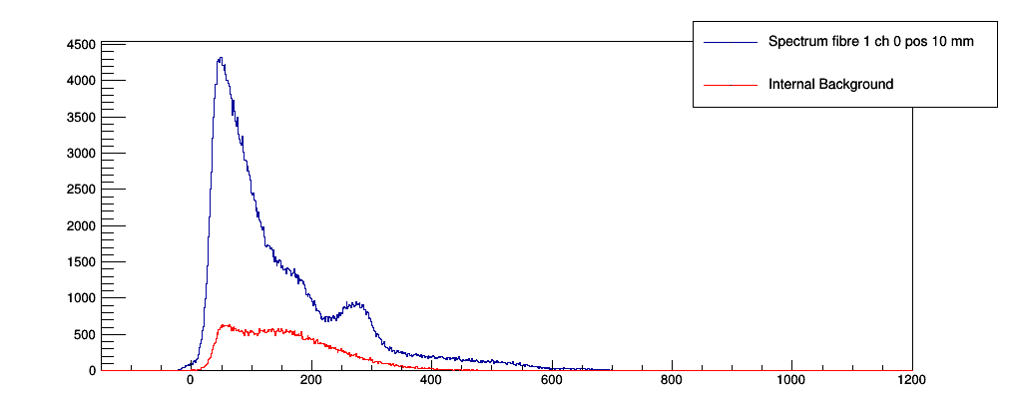
Investigated Spectra
Recorded in Cracow:
  Series 1&3 → Fibre 1
  Series 2&4 → Fibre 2
Corresponding internal background measurements

Slide 4
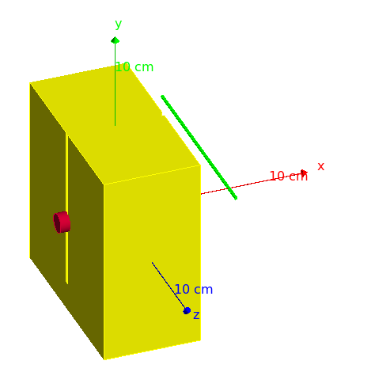
Templates
Generated with Geant4 simulation including the shielding and the position of the source
→ one simulation for each position that was measured in the series
→ 10 templates sets

Slide 5
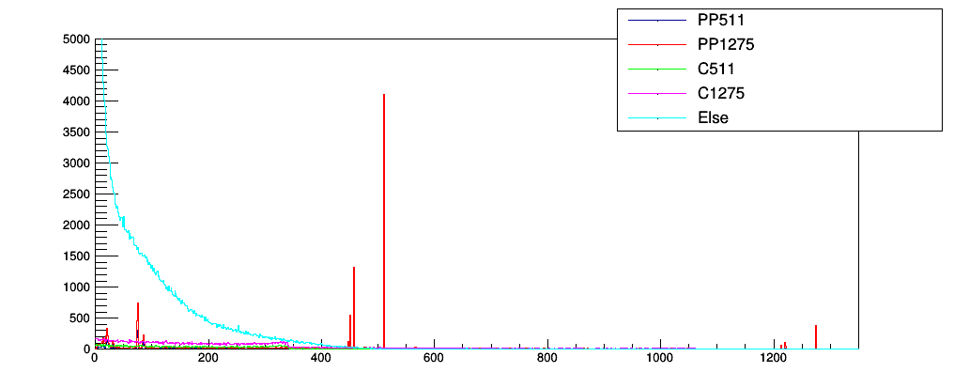
Templates
Templates are:
  P511/P1275: Photons with corresponding starting energy and interacting with photo effect in the fibre
  C511/C1275: Photons with corresponding starting energy and interacting with Compton effect in the fibre

Slide 6


Energy Model
Processing of the templates:
  need to be calibrated to P.E. spectra
  need to be smeared with a not linear resolution
Model:
→ Bin per bin
  calibrated and
    smeared

Slide 7
Fit Concept
→ Variation of energy model parameters and single fit for each combination
Fit with two templates:
  Internal background measurement (weight 0-1)
  Sum of all Geant4 templates
Fit with six templates:
  Internal Background
  Compton 511 keV
  Compton 1275 keV
  Photoeffect 511 keV
  Photoeffect 1275 keV
  All other energy depositions

Slide 8
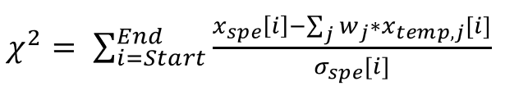
Fit Concept
Chi² fit:
The energy parameters are variated in:
  parameter a in 50 steps of 0.5 around 200
  parameter b in 20 steps of 0.01 around 0.5
  parameter c in 20 steps of 0.01 around (taken von precali)
Fit for each energy parameter constellation

Slide 9
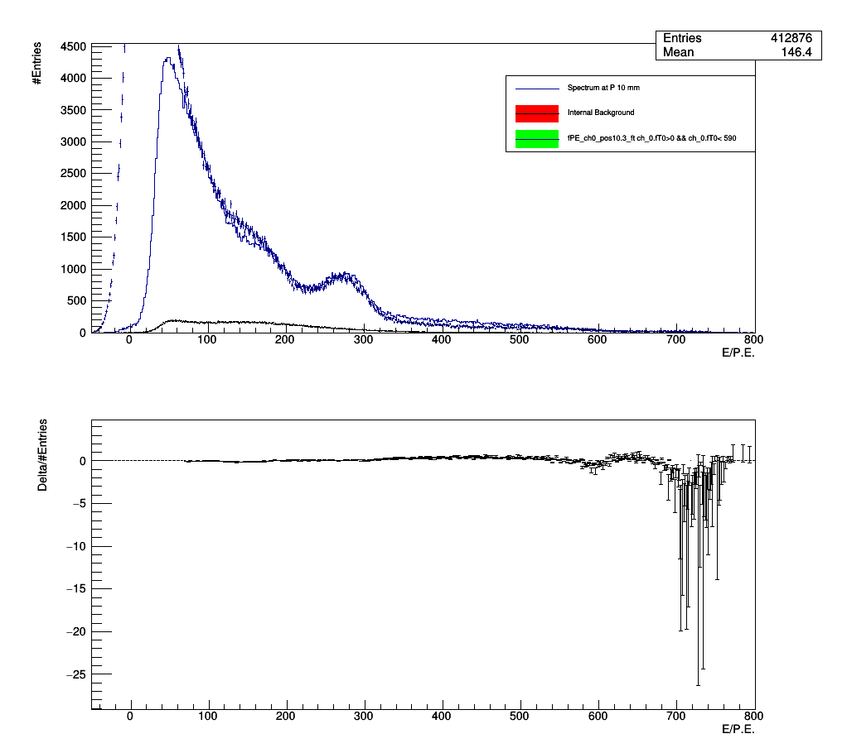
Results fit with two templates
Example: spectrum with fitted templates
Start at 70 P.E
Simulated data not able to represent recorded spectra
Bins with more than 10 entries taken into account

Slide 10
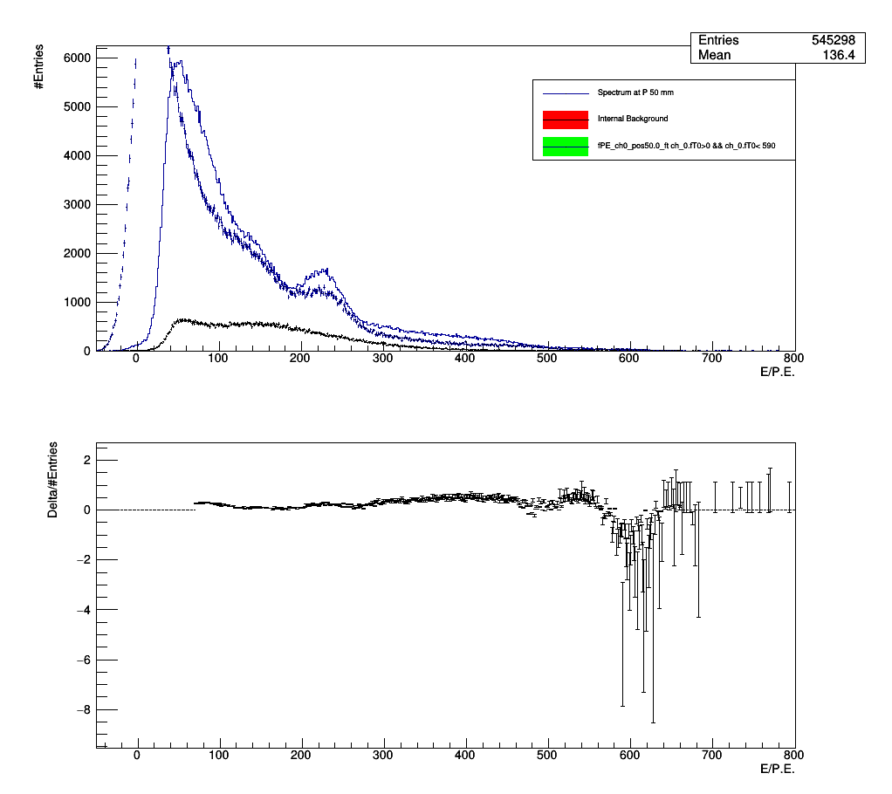
Results fit with two templates
Example: spectrum with fitted templates
Start at 70 P.E
Simulated data not able to represent recorded spectra
Bins with more than 10 entries taken into account

Slide 11
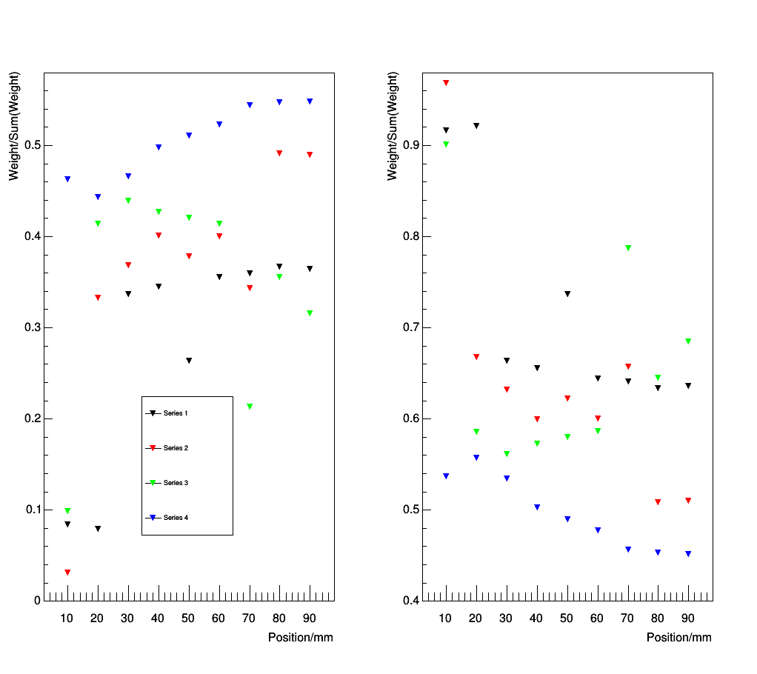
Results fit with two templates
Template weights
IB
G4Sum
Weights: Integral of template/Integral of sum
Not stable for the different positions
No matches between series 1&3 and 2&4
Weight for IB >0.5 not reasonable

Slide 12
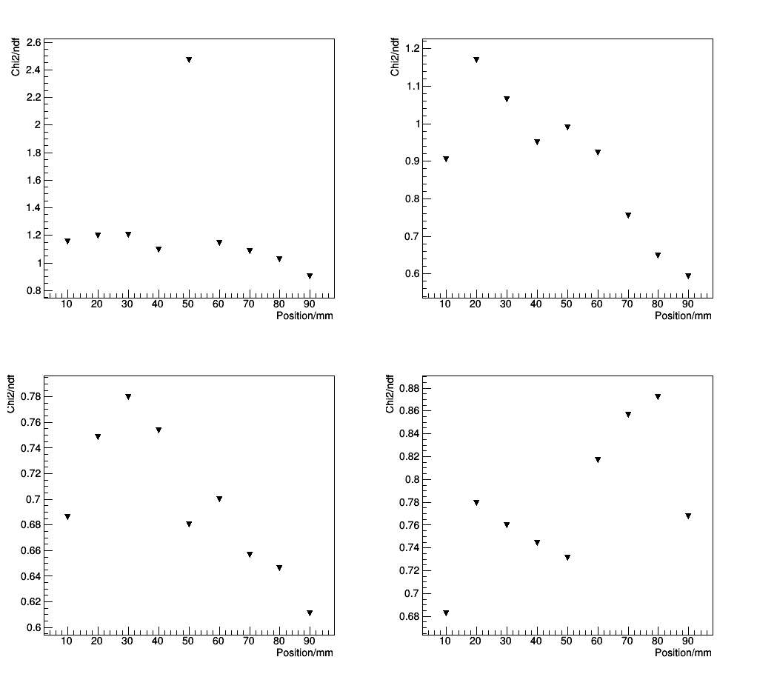
Results fit with two templates
Chi2/ndf distribution
Chi²/ndf with surprisingly reasonable values
Series 1
Series 2
Series 3
Series 4

Slide 13
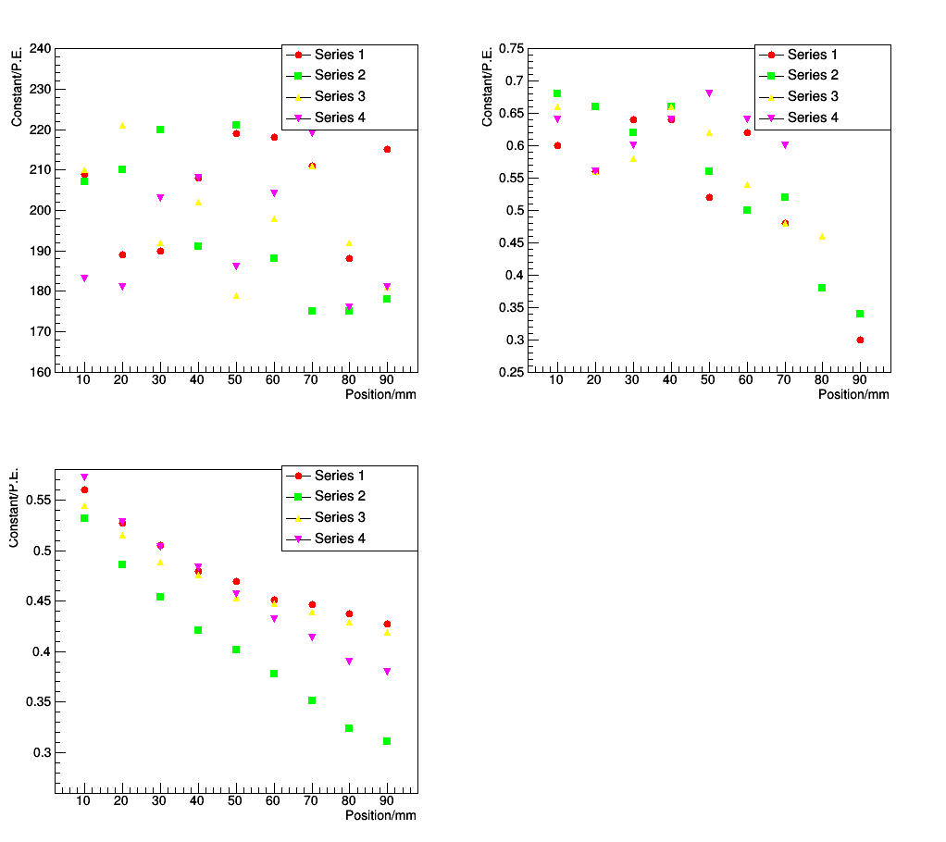
Results fit with two templates
Energy parameter
a
Parameter a and b not stable and the series does not fit
Parameter c shows the expected behavior
b
c

Slide 14
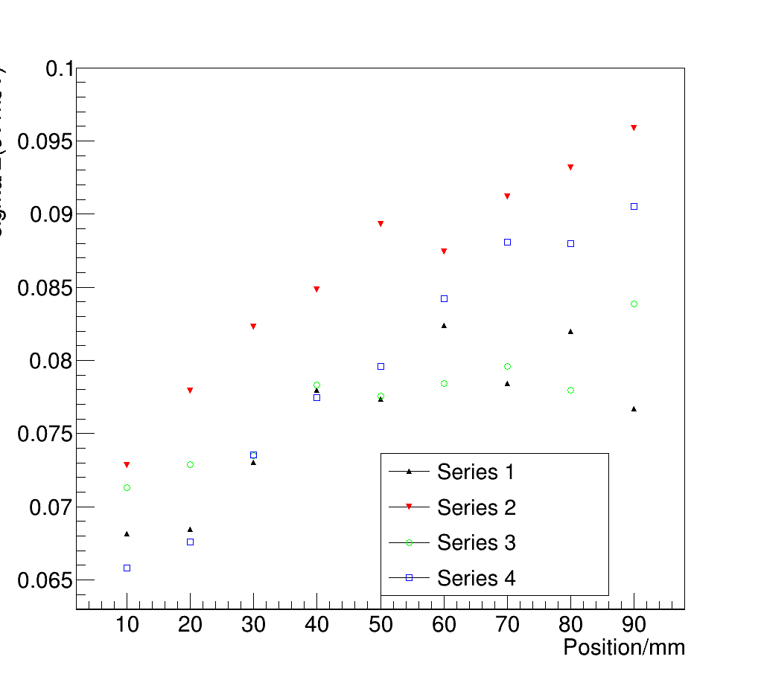
Results fit with six templates
Energy resolution
Energy resolution in the range of 7 to 10 %
Energy resolution position dependent

Slide 15
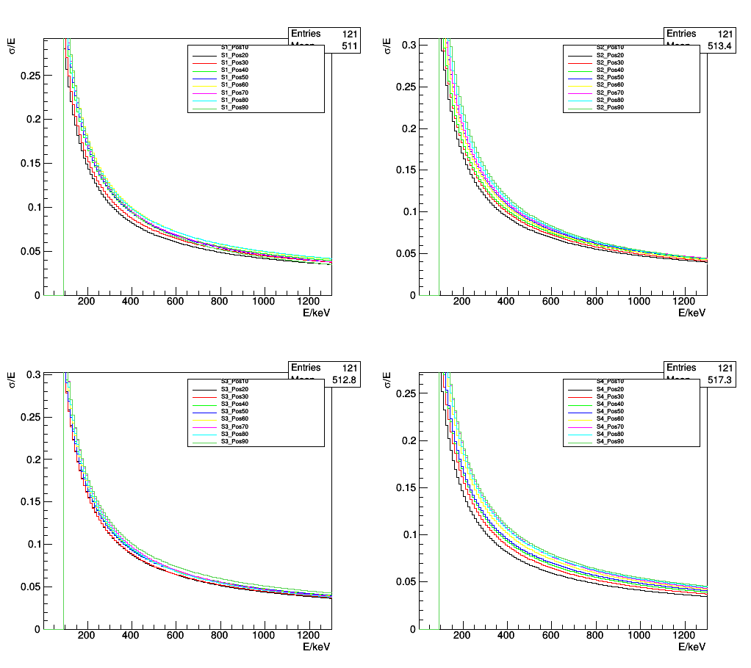
Results fit with two templates
Energy resolution - Position dependency

Slide 16
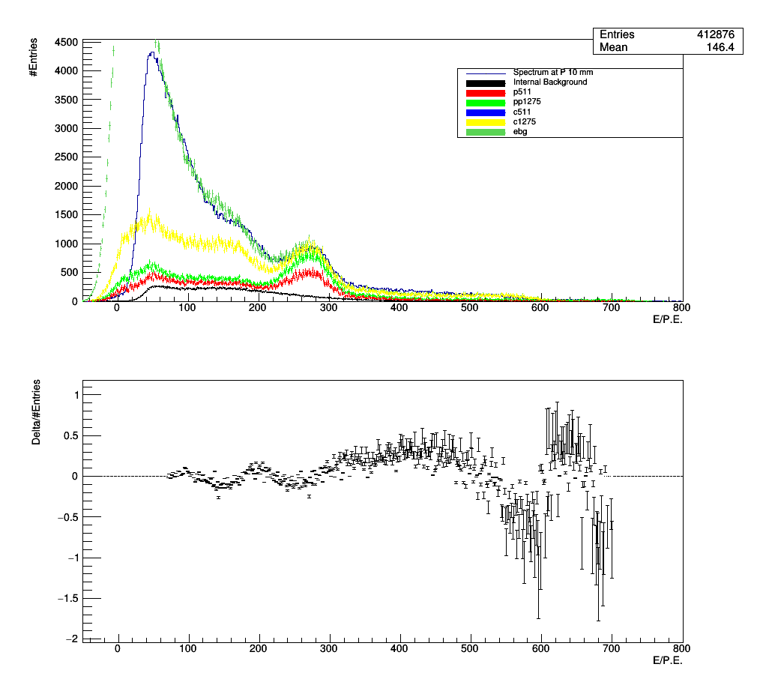
Results fit with six templates
Example: spectrum with fitted templates
Start at 70 P.E
C511 totally compressed
Bins with more than 10 entries taken into account → low entries yield to high residuals

Slide 17
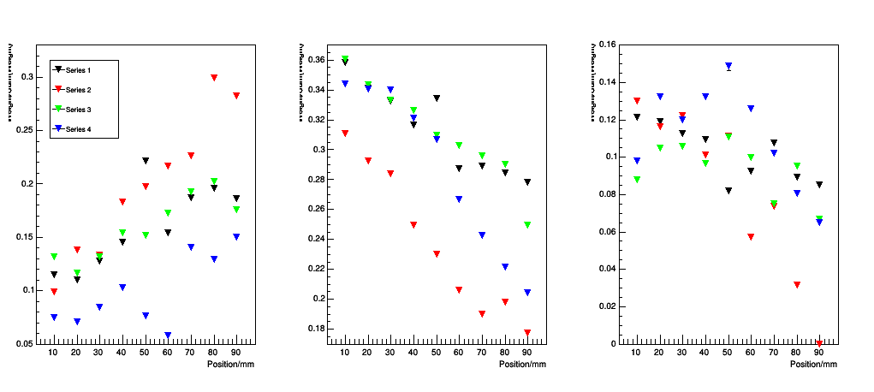
Results fit with six templates
Template weights
Weights: Integral of template/Integral of sum
Not stable for the different positions
No matches between series 1&3 and 2&4
Sometimes general trends visible
IBG
EBG
P511

Slide 18
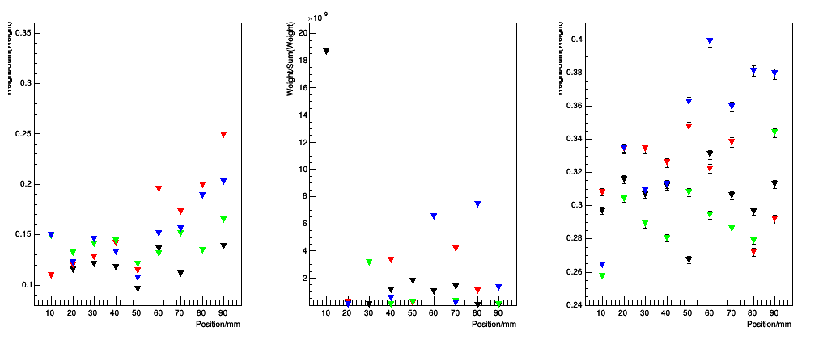
Results fit with six templates
Template weights
Weights: Integral of template/Integral of sum
Not stable for the different positions
No matches between series 1&3 and 2&4
Sometimes general trends visible
P1275
C511
C1275

Slide 19
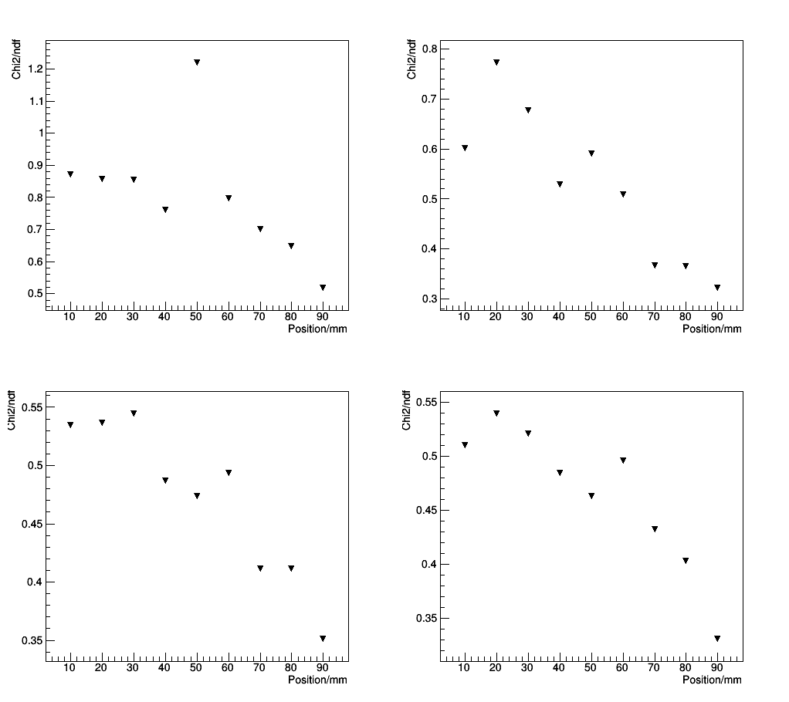
Results fit with six templates
Chi2/ndf distribution
Chi²/ndf with reasonable values

Slide 20
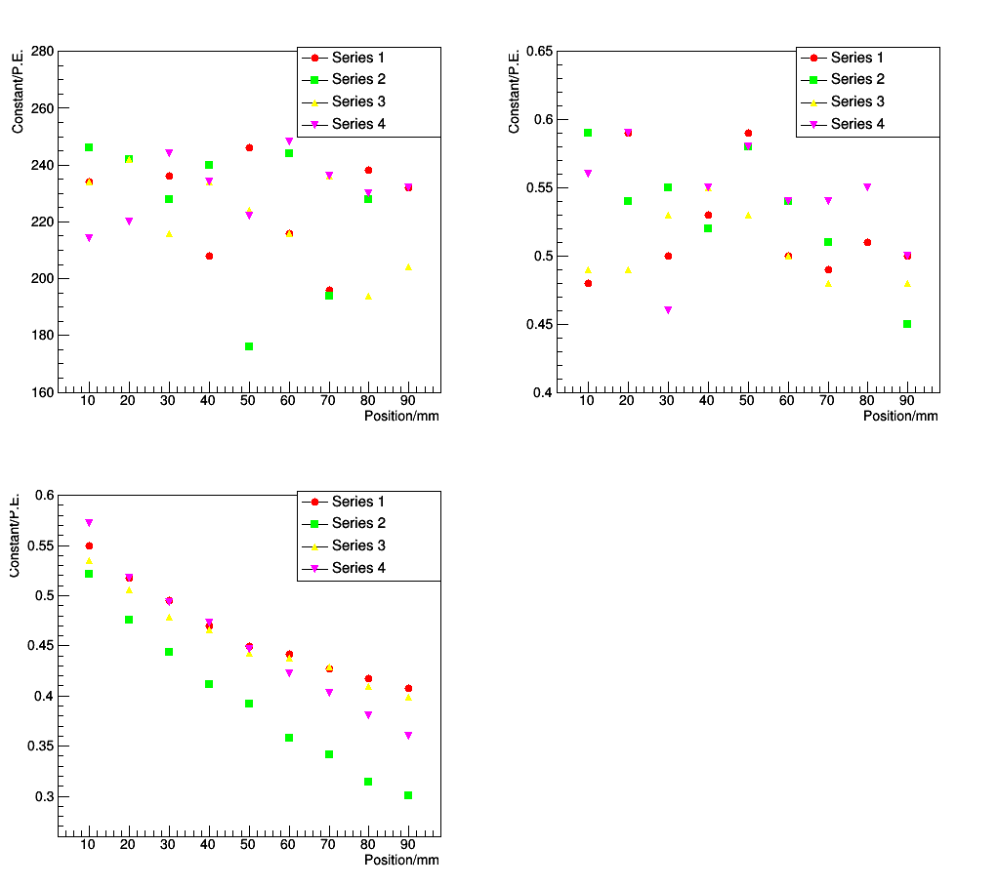
Results fit with six templates
Energy parameter
Parameter a and b not stable and the series does not fit
Parameter c shows the expected behavior
a
b
c

Slide 21
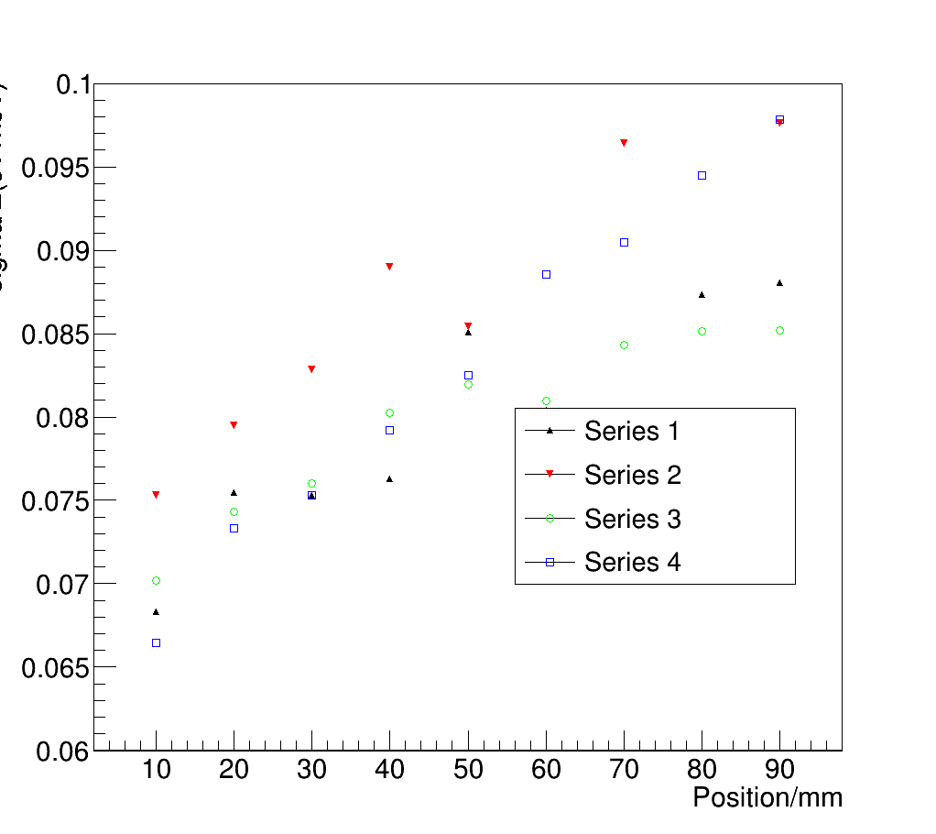
Results fit with six templates
Energy resolution
Energy resolution in the range of 7 to 10 %
Energy resolution position dependent
Behavior similar to two template fit

Slide 22
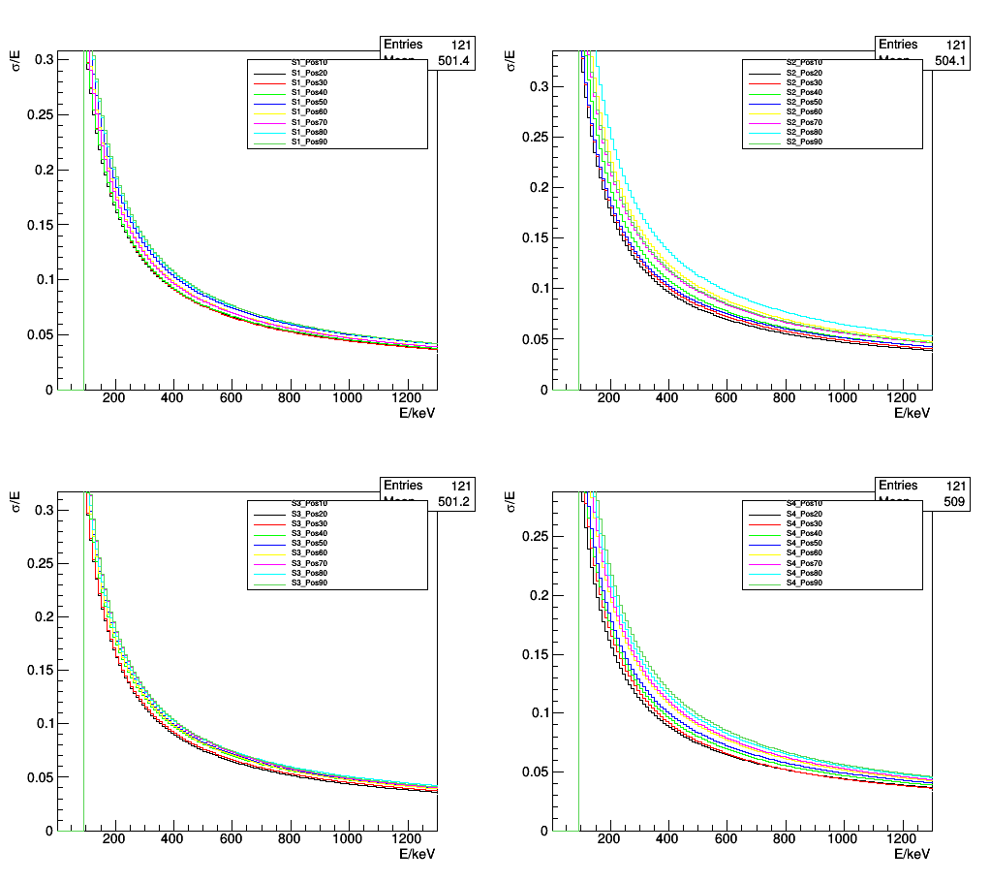
Results fit with six templates
Energy resolution -Position dependecy

Slide 23
Fazit
Geant4 energy deposition not able to describe measurements:
  Shielding wrong
  Fibre material wrong
  Pile up
With splitting better description but still not stable results
Energy resolution around 7-10 %

