Slide 1
Scintillating Fibers – analysis report
Kasia Rusiecka
May 2018

Slide 2
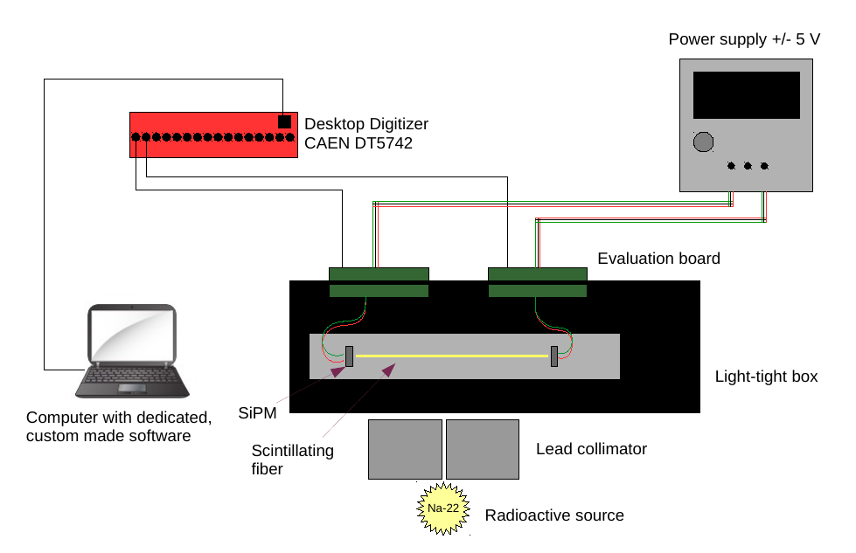
January measurements – setup and collected data
SiPM model: S13360-3050VE
Evaluation board: C12332-01
Power supply: C11204-01
Series number | Fiber type | Number of measurements | Source | Source positions [mm] | Description
1 | LuAG:Ce (1) Crytur | 9 | Na-22 6MBq | 10.3, 20, 30, 40, 50, 60, 70, 80, 90 | First measurement
2 | LuAG:Ce (2) Crytur | 9 | Na-22 6MBq | 10.2, 20, 30, 40, 50, 60, 70, 80, 90 | First measurement
3 | LuAG:Ce (1) Crytur | 9 | Na-22 6MBq | 10.4, 20, 30, 40, 50, 60, 70, 80, 90 | Remeasured
4 | LuAG:Ce (2) Crytur | 9 | Na-22 6MBq | 10.5, 20, 30, 40, 50, 60, 70, 80, 90 | Remeasured
5 | LuAG:Ce (1) Crytur | 9 | Na-22 6MBq | 10.4, 20, 30, 40, 50, 60, 70, 80, 90 | With Al coating
6 | LuAG:Ce (1) Crytur | 5 | Na-22 6MBq | 50, 50, 50, 50, 50 | Influence of different couplings
7 | LuAG:Ce (1) Crytur | 1 | - | - | Internal activity measurement
8 | LuAG:Ce (2) Crytur | 1 | - | - | Internal activity measurement
9 | - | 2 | - | - | PE calibration
1

Slide 3
ScintillatingFibers – software structure
Preparatory classes
Analysis classes
SFData
Loads and prepares experimental data. Returns: spectra of all types (single/series), signals (single/averaged), ratio histograms (single/series). Custom cuts on data possible.
SFAttenuation
Determines attenuation length using two methods: (1) using averaged signal from two ends of fiber, (2) separately for each fiber end. Returns numerical values as well as attenuation graphs.
SFMC
Loads data from Monte Carlo simulations. Returns spectra of requested type and with custom cut. Necessary for the template fit.
SFTimingRes
Determines timing resolution using two methods: (1) excluding scattered events only, (2) with the cut on 511 keV peak and excluding scattered events. Returns numerical values, timing spectra and graph ch_0.T0 – ch_1.T0 vs. source position.
BGFit
Functions used for fitting in other classes. Contains: Pol2, Pol3, Expo.
SFTimeConst
Determines time constants of recorded signals: rise time and decay time in two modes – single decay and double decay. Returns signals with fitted functions and numerical values.
SFPeakFinder
Locates 511 and 1270 keV peaks and performs background subtraction. Returns background-subtracted peak, its range and other parameters, e.g. position, sigma.
TFit
Class for the template fit.
On-line class reference [link]
2

Slide 4
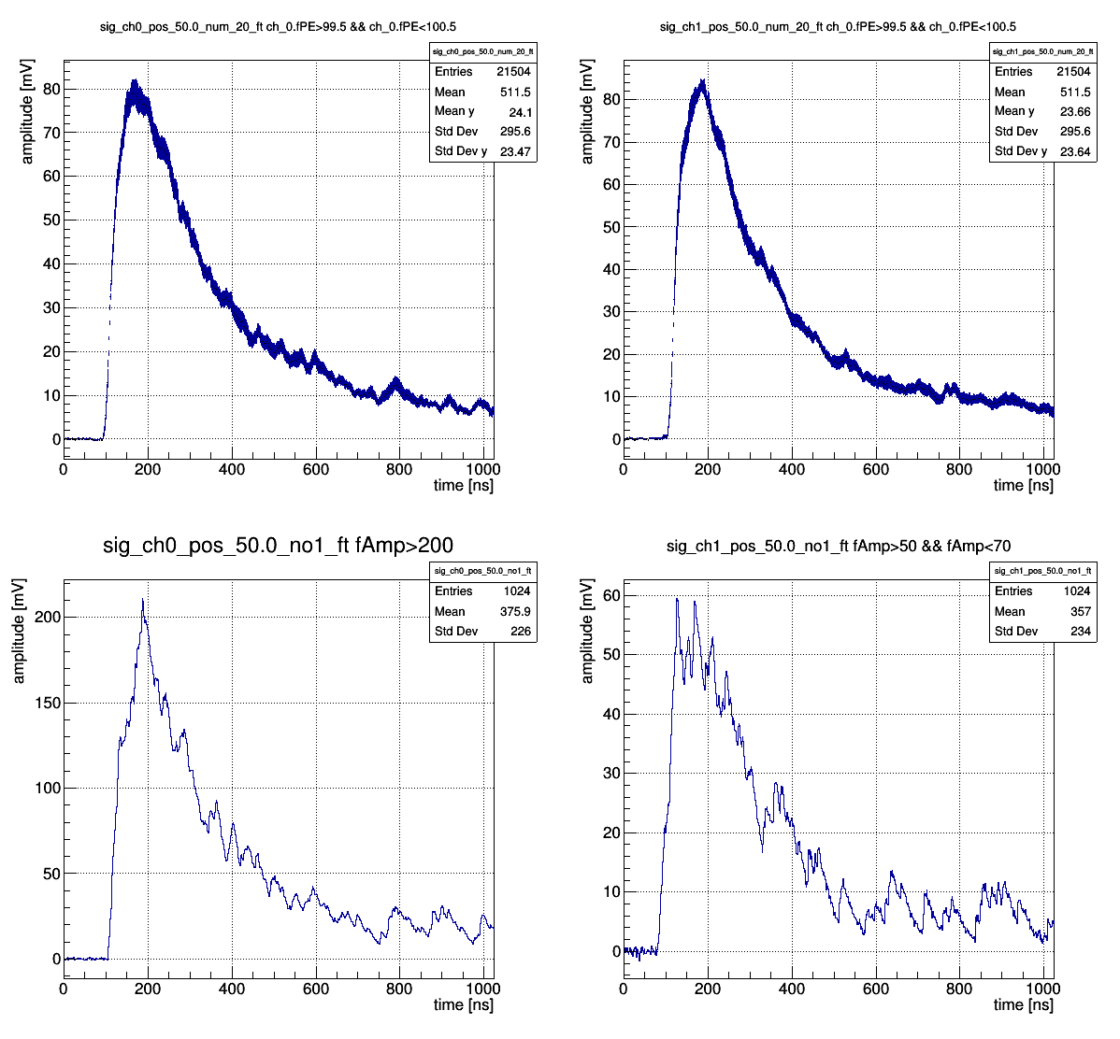
Raw data examples - signals
Series 3, channel 0, source position 50 mm,
20 signals of PE ~100 averaged
Series 3, channel 1, source position 50 mm,
20 signals of PE ~100 averaged
Series 3, channel 1, source position 50 mm, first signal with amplitude between 50 and 70 mV
Series 3, channel 0, source position 50 mm, first signal with amplitude larger than 200 mV
3

Slide 5
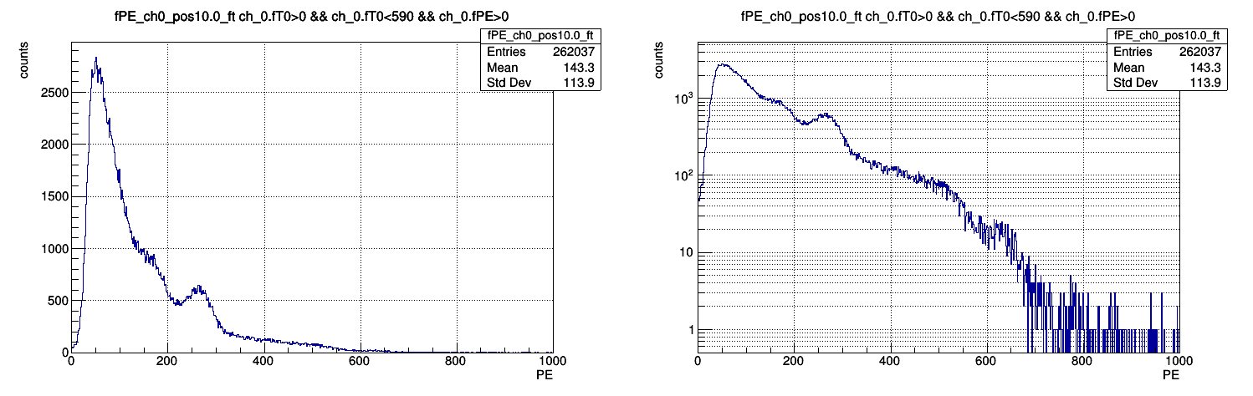
Raw data examples – charge spectra
Series 3, channel 0,
source position 10 mm
Intrinsic activity + scattered photons
Compton edge
Compton edge
1270 keV photopeak
511 keV photopeak
4

Slide 6
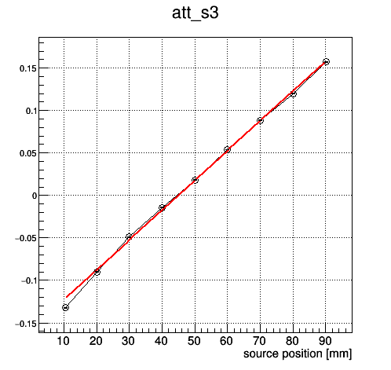
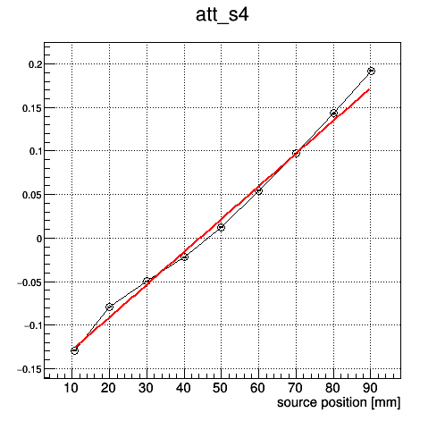
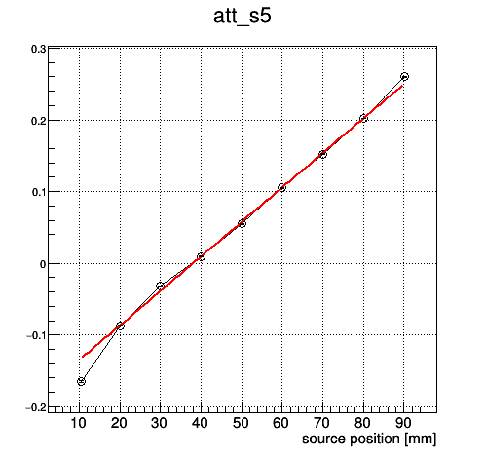
Attenuation length – averaged signal from both channels
ln(M_{FB})
Series 3 – attenuation curve
ln(M_{FB})
Series 4 – attenuation curve
ln(M_{FB})
Series 5 – attenuation curve
L_{att} = (284.40 ± 0.37) mm
L_{att} = (265.72 ± 0.36) mm
L_{att} = (207.51 ± 0.28) mm
LuAG:Ce Fiber #1
LuAG:Ce Fiber #2
LuAG:Ce Fiber #1 with Al wrapping
5

Slide 7
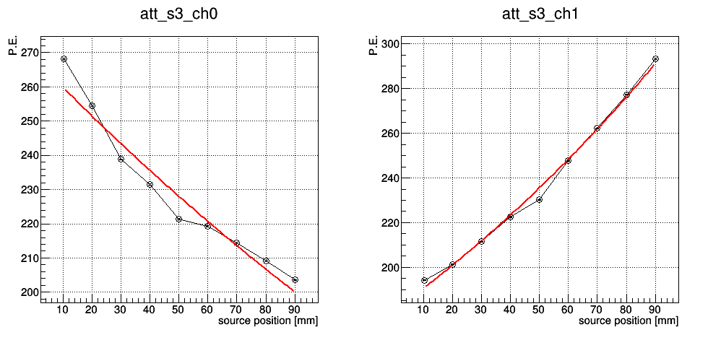
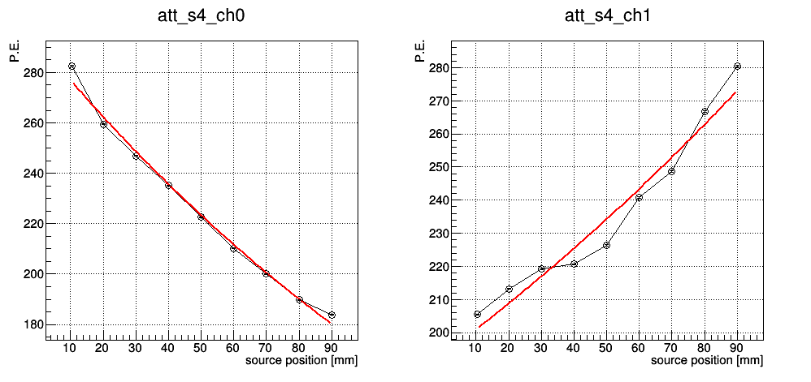
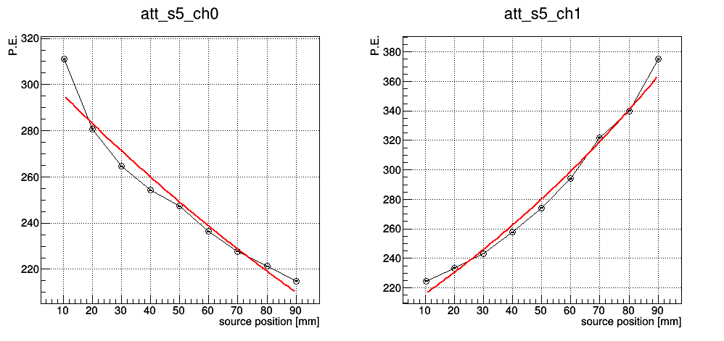
Attenuation length – independent channels
Series 3 Channel 0
Series 3 Channel 1
LuAG:Ce Fiber #1
L_{att ch0} = (306.18 ± 0.88) mm
L_{att ch1} = (188.66 ± 0.35) mm
(L_{att ch0} + L_{att ch1})/2 = 247.42 mm
Series 4 Channel 0
Series 4 Channel 1
LuAG:Ce Fiber #2
L_{att ch0} = (188.08 ± 0.35) mm
L_{att ch1} = (260.82 ± 0.67) mm
(L_{att ch0} + L_{att ch1})/2 = 224.45 mm
Series 5 Channel 0
Series 5 Channel 1
LuAG:Ce Fiber #1 with Al coating
L_{att ch0} = (234.29 ± 0.53) mm
L_{att ch1} = (153.61 ± 0,23) mm
(L_{att ch0} + L_{att ch1})/2 = 193.95 mm
6

Slide 8
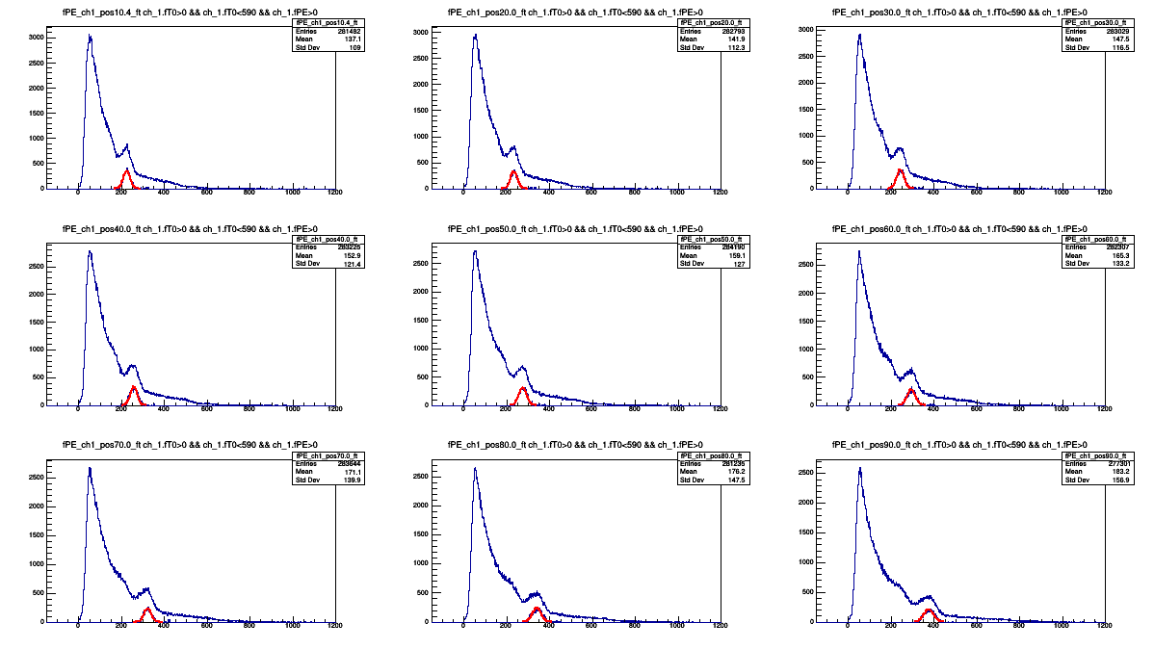
Background subtraction – example
Series 5, channel 1
7

Slide 9
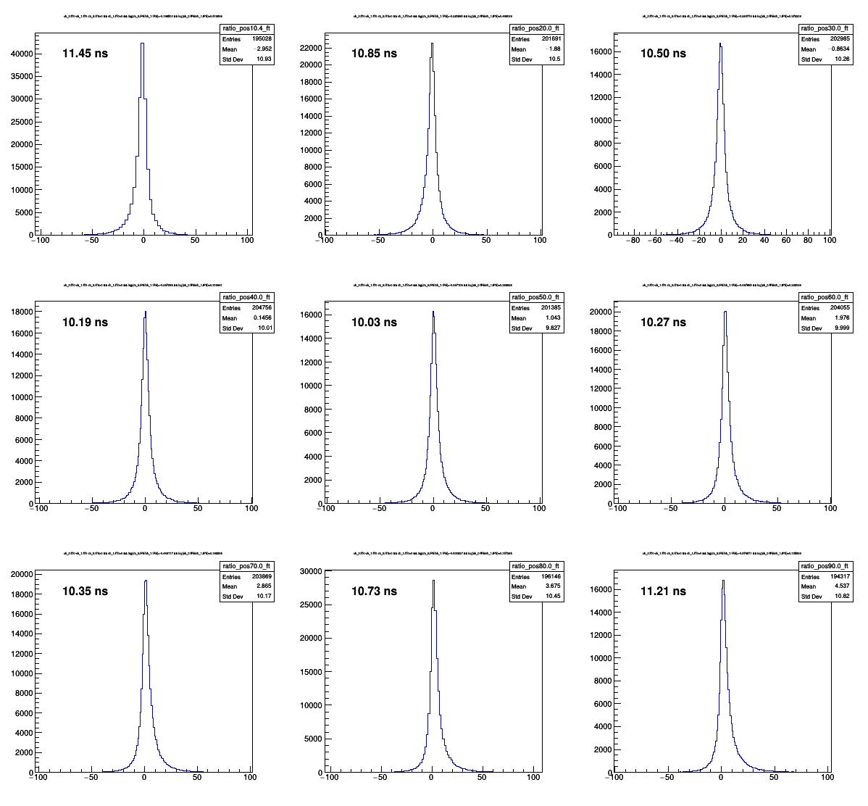
Timing resolution – cut on scattered events
Ch_0.fT0 – Ch_1.fT0, position 10 mm
Ch_0.fT0 – Ch_1.fT0, position 20 mm
Ch_0.fT0 – Ch_1.fT0, position 30 mm
Series 3
LuAG:Ce Fiber #1
Ch_0.fT0 – Ch_1.fT0, position 40 mm
Ch_0.fT0 – Ch_1.fT0, position 50 mm
Ch_0.fT0 – Ch_1.fT0, position 60 mm
Ch_0.fT0 – Ch_1.fT0, position 70 mm
Ch_0.fT0 – Ch_1.fT0, position 80 mm
Ch_0.fT0 – Ch_1.fT0, position 90 mm
8

Slide 10
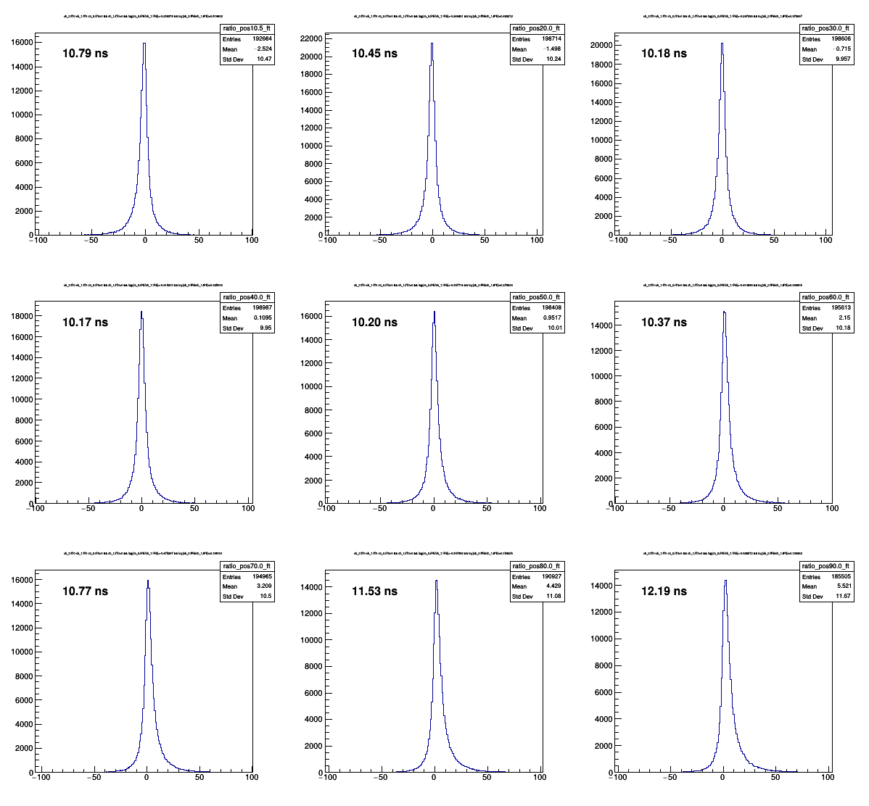
Timing resolution – cut on scattered events
Ch_0.fT0 – Ch_1.fT0, position 10 mm
Ch_0.fT0 – Ch_1.fT0, position 20 mm
Ch_0.fT0 – Ch_1.fT0, position 30 mm
Series 4
LuAG:Ce Fiber #2
Ch_0.fT0 – Ch_1.fT0, position 40 mm
Ch_0.fT0 – Ch_1.fT0, position 50 mm
Ch_0.fT0 – Ch_1.fT0, position 60 mm
Ch_0.fT0 – Ch_1.fT0, position 70 mm
Ch_0.fT0 – Ch_1.fT0, position 80 mm
Ch_0.fT0 – Ch_1.fT0, position 90 mm
9

Slide 11
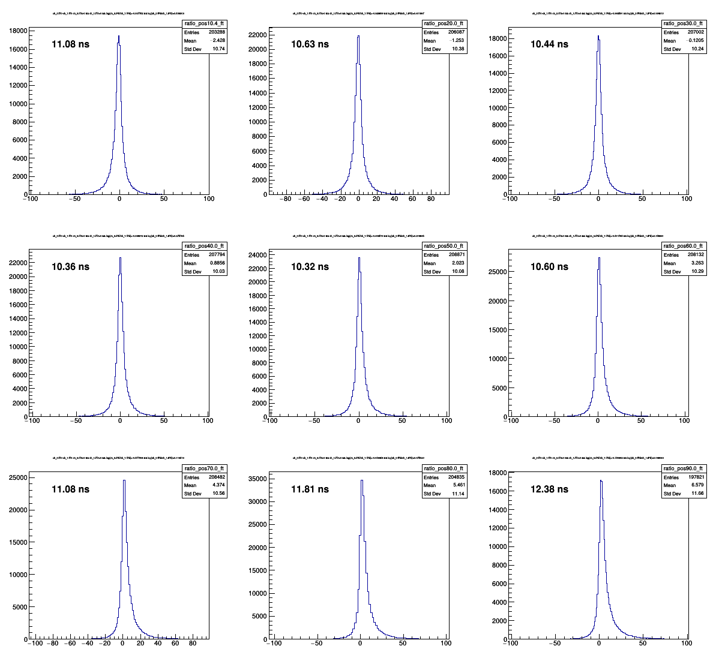
Timing resolution – cut on scattered events
Ch_0.fT0 – Ch_1.fT0, position 10 mm
Ch_0.fT0 – Ch_1.fT0, position 20 mm
Ch_0.fT0 – Ch_1.fT0, position 30 mm
Series 5
LuAG:Ce Fiber #1 +
Al coating
Ch_0.fT0 – Ch_1.fT0, position 40 mm
Ch_0.fT0 – Ch_1.fT0, position 50 mm
Ch_0.fT0 – Ch_1.fT0, position 60 mm
Ch_0.fT0 – Ch_1.fT0, position 70 mm
Ch_0.fT0 – Ch_1.fT0, position 80 mm
Ch_0.fT0 – Ch_1.fT0, position 90 mm
10

Slide 12
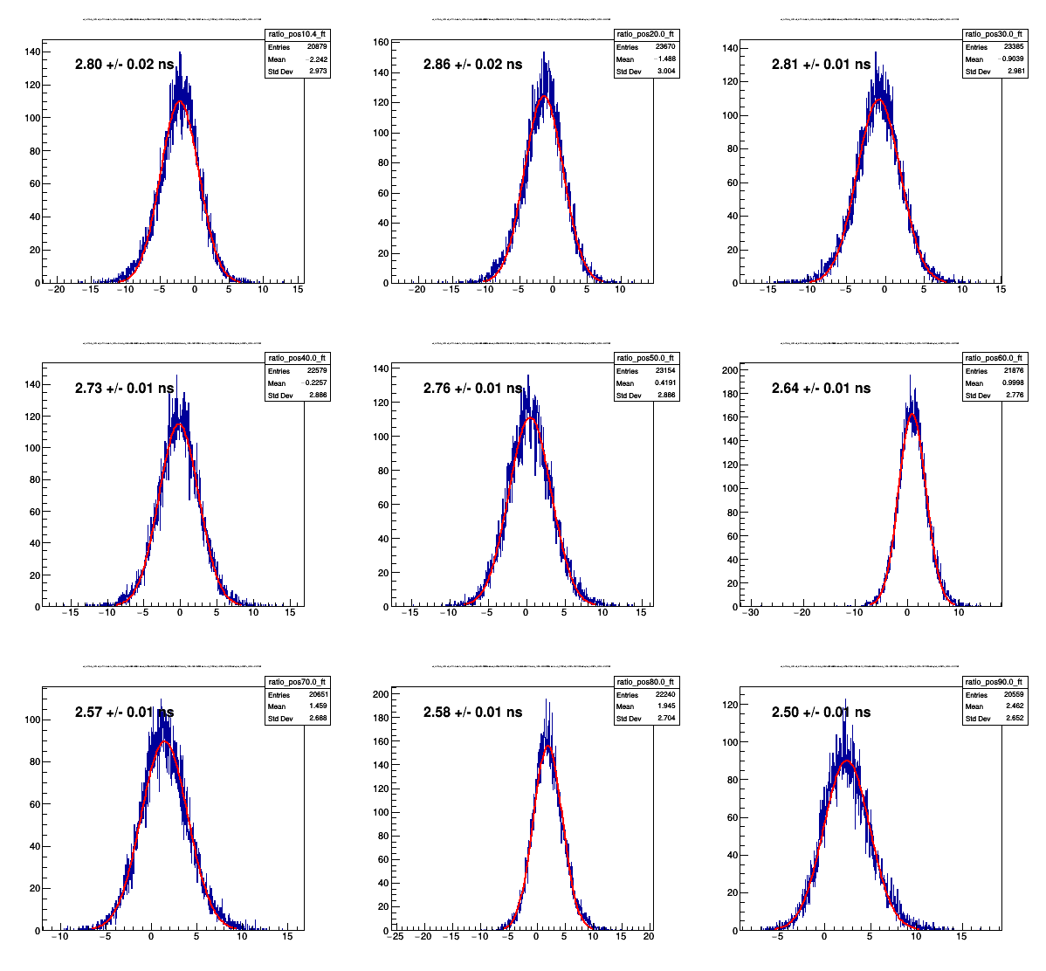
Timing resolution – energy cut on 511 keV peak + scattered events
Ch_0.fT0 – Ch_1.fT0, position 10 mm
Ch_0.fT0 – Ch_1.fT0, position 20 mm
Ch_0.fT0 – Ch_1.fT0, position 30 mm
Series 3
LuAG:Ce Fiber #1
Ch_0.fT0 – Ch_1.fT0, position 40 mm
Ch_0.fT0 – Ch_1.fT0, position 50 mm
Ch_0.fT0 – Ch_1.fT0, position 60 mm
Ch_0.fT0 – Ch_1.fT0, position 70 mm
Ch_0.fT0 – Ch_1.fT0, position 80 mm
Ch_0.fT0 – Ch_1.fT0, position 90 mm
11

Slide 13
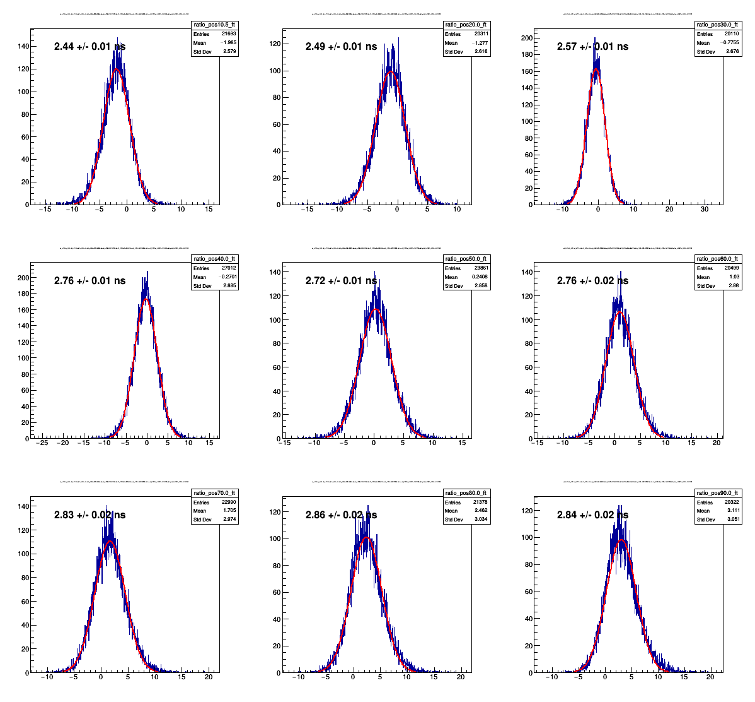
Timing resolution – energy cut on 511 keV peak + scattered events
Ch_0.fT0 – Ch_1.fT0, position 10 mm
Ch_0.fT0 – Ch_1.fT0, position 20 mm
Ch_0.fT0 – Ch_1.fT0, position 30 mm
Series 4
LuAG:Ce Fiber #2
Ch_0.fT0 – Ch_1.fT0, position 40 mm
Ch_0.fT0 – Ch_1.fT0, position 50 mm
Ch_0.fT0 – Ch_1.fT0, position 60 mm
Ch_0.fT0 – Ch_1.fT0, position 70 mm
Ch_0.fT0 – Ch_1.fT0, position 80 mm
Ch_0.fT0 – Ch_1.fT0, position 90 mm
12

Slide 14
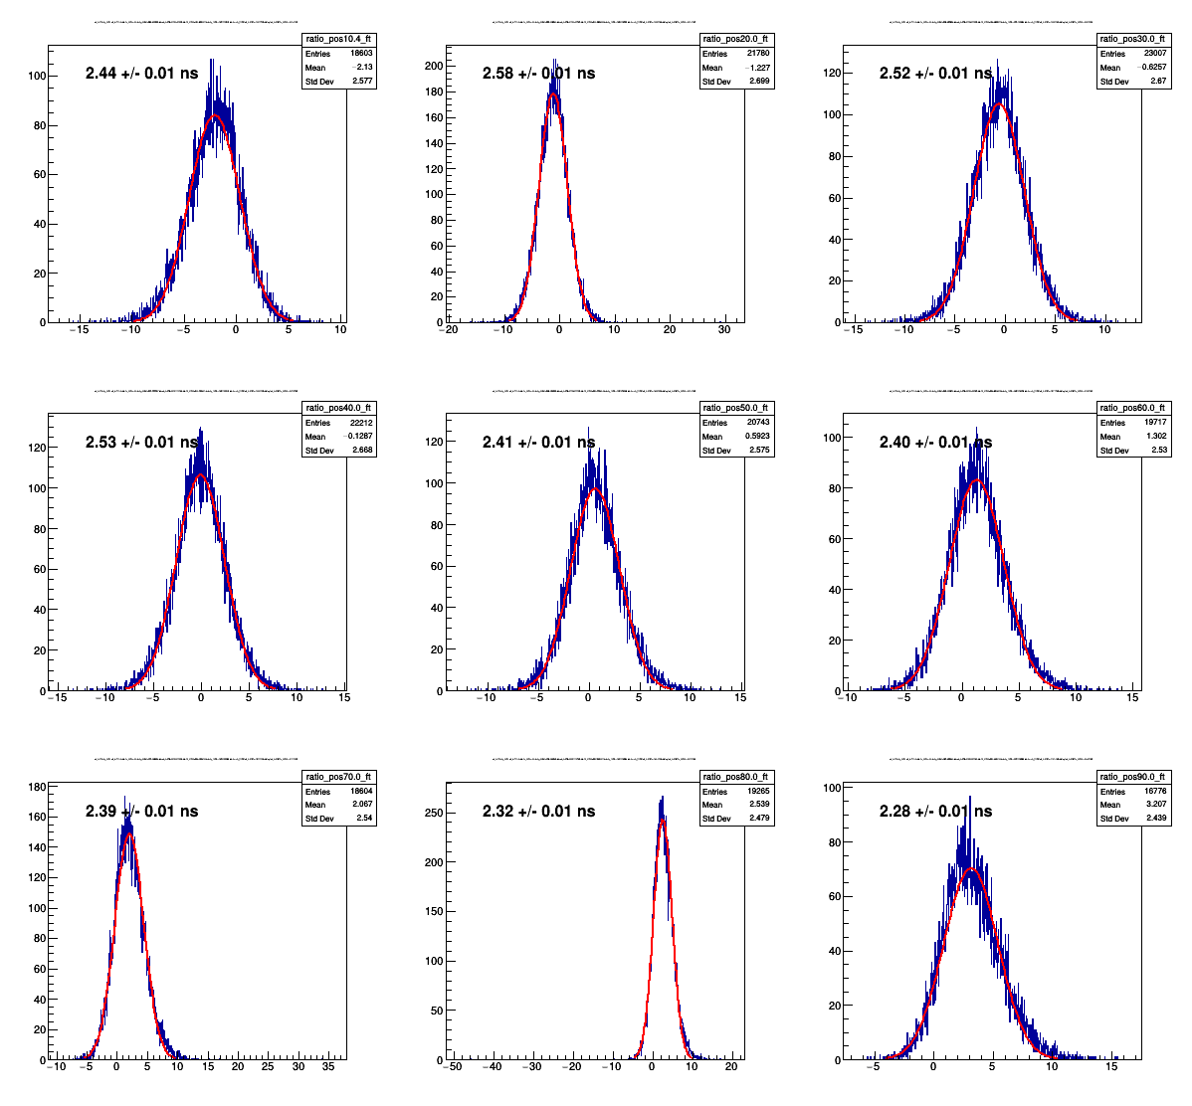
Timing resolution – energy cut on 511 keV peak + scattered events
Ch_0.fT0 – Ch_1.fT0, position 10 mm
Ch_0.fT0 – Ch_1.fT0, position 20 mm
Ch_0.fT0 – Ch_1.fT0, position 30 mm
Series 5
LuAG:Ce Fiber #1
+ Al coating
Ch_0.fT0 – Ch_1.fT0, position 40 mm
Ch_0.fT0 – Ch_1.fT0, position 50 mm
Ch_0.fT0 – Ch_1.fT0, position 60 mm
Ch_0.fT0 – Ch_1.fT0, position 70 mm
Ch_0.fT0 – Ch_1.fT0, position 80 mm
Ch_0.fT0 – Ch_1.fT0, position 90 mm
13

Slide 15
title
00

