Slide 1

An Introduction to Explainable AI
Post-hoc
Black Box
AI Model
Input
Output
Transparency
Si Hao Shen 01.02.2021

Slide 2
Agenda
Current Trends in XAI
Principles of XAI
Definition of XAI and other terminologies
Different Purposes in XAI
Taxonomy of different explainability techniques in ML and DL models
Existing Open-Source Tools in XAI
A Use Case of XAI for Robot Task Planning
Conclusion and Outlook

Slide 3
Agenda
Current Trends in XAI
Principles of XAI
Definition of XAI and other terminologies
Different Purposes in XAI
Taxonomy of different explainability techniques in ML and DL models
Existing Open-Source Tools in XAI
A Use Case of XAI for Robot Task Planning
Conclusion and Outlook

Slide 4
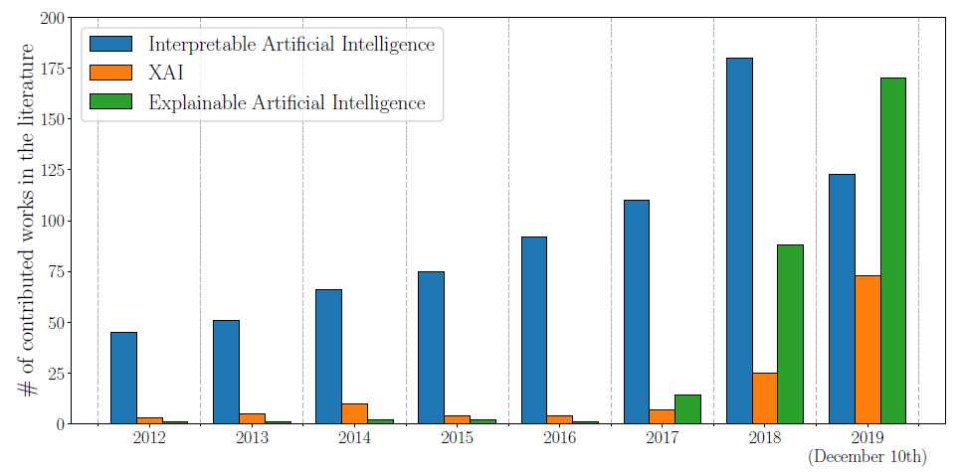
Current Trends in XAI
Trends of Interest in XAI
Number of total publications
Rising trend of contributions on XAI and related concepts
Data from Scopus
Explainable Artificial Intelligence (XAI): Concepts, Taxonomies, Opportunities and Challenges toward Responsible AI

Slide 5
Agenda
Current Trends in XAI
Principles of XAI
Definition of XAI and other terminologies
Different Purposes in XAI
Taxonomy of different explainability techniques in ML and DL models
Existing Open-Source Tools in XAI
A Use Case of XAI for Robot Task Planning
Conclusion and Outlook

Slide 6


Principles of XAI
Explainable AI
“We will design AI systems that provide appropriate opportunities for feedback, relevant explanations, and appeal. Our AI technologies will be subject to appropriate human direction and control”
“The Explainable AI program aims to create a suite of machine learning techniques that produce more explainable models, while maintaining a high level of learning performance and enable users to understand, trust and effectively manage the emerging generation of artificially intelligent partners”
https://www.darpa.mil/program/explainable-artificial-intelligence; https://ai.google/principles/

Slide 7
Agenda
Current Trends in XAI
Principles of XAI
Definition of XAI and other terminologies
Different Purposes in XAI
Taxonomy of different explainability techniques in ML and DL models
Existing Open-Source Tools in XAI
A Use Case of XAI for Robot Task Planning
Conclusion and Outlook

Slide 8
Definition of XAI and other terminologies
Fair, interpretability, transparency and explainability
Fair
Interpretability
Unbiased decisions
Treat all user fairly
Able to explain the technology
Provide understandable terms
Transparency
Explainability
Level of accessibility to the data or algorithm
Decomposable
Algorithmic Transparency
Interface between humans and the model
Comprehensible to humans
Explainable Artificial Intelligence and Machine Learning: A reality rooted perspective; Explainable AI the basics

Slide 9
Agenda
Current Trends in XAI
Principles of XAI
Definition of XAI and other terminologies
Different Purposes in XAI
Taxonomy of different explainability techniques in ML and DL models
Existing Open-Source Tools in XAI
A Use Case of XAI for Robot Task Planning
Conclusion and Outlook

Slide 10
Different Purposes in XAI
Domain experts
Gain scientific knowledge, trust the AI model
Data scientists and product owners
Increase product efficiency and productivity
Regulators and policy makers
Reasoning the prediction of AI, data privacy
Target Users in XAI
and their purposes of XAI
Non-expert users
Data privacy, unbiased and fair decisions
Managers and stakeholders
Understand AI applications, confident evaluation
Explainable Artificial Intelligence (XAI): Concepts, Taxonomies, Opportunities and Challenges toward Responsible AI

Slide 11
Agenda
Current Trends in XAI
Principles of XAI
Definition of XAI and other terminologies
Different Purposes in XAI
Taxonomy of different explainability techniques in ML and DL models
Existing Open-Source Tools in XAI
A Use Case of XAI for Robot Task Planning
Conclusion and Outlook

Slide 12
Taxonomy of different explainability techniques in ML models
Algorithmic transparency
XAI in ML
Decision Tree,
Linear Regression,
K-Nearest Neighbors, Bayesian Models
Decomposability
Simulatability
Transparent Model
XAI in ML
Local explanation
Multi-Layer NN
Text and Visual explanation
Post-Hoc Explainability
Model
Feature relevance explanation
CNN, RNN, SVM
Explanation by simplification
Explainable Artificial Intelligence (XAI): Concepts, Taxonomies, Opportunities and Challenges toward Responsible AI

Slide 13
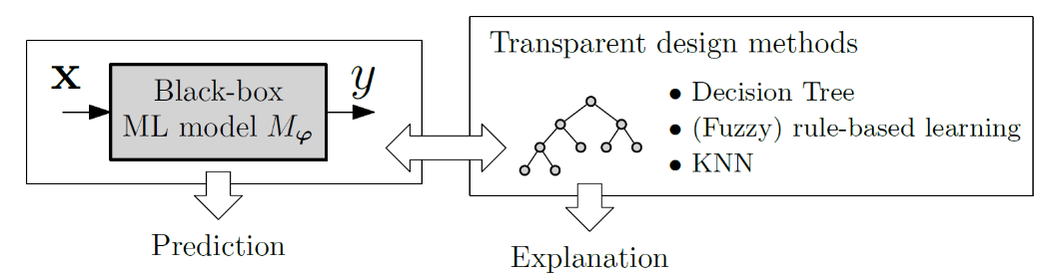
Taxonomy of different explainability techniques in DL models
XAI in DL
Explanation of Deep Network Processing
Linear Proxy Model
Decision Trees
Explanation of Deep Network Representation
Role of Hyperparameters
(Layers, Units, Representation Vectors)
XAI in DL
Attention Networks
Explanation Producing Systems
Explanation Generation
Deep Formulation
Hybrid Modeling
Neural-symbolic Systems
Relational Reasoning
Explainable Artificial Intelligence (XAI): Concepts, Taxonomies, Opportunities and Challenges toward Responsible AI; Deep k-nearest neighbors: Towards confident, interpretable and robust deep learning

Slide 14
Agenda
Current Trends in XAI
Principles of XAI
Definition of XAI and other terminologies
Different Purposes in XAI
Taxonomy of different explainability techniques in ML and DL models
Existing Open-Source Tools in XAI
A Use Case of XAI for Robot Task Planning
Conclusion and Outlook

Slide 15
Existing Open-Source Tools in XAI
Tool | Functionality
ELI5 | Visualize and debug ML models
What-If Tool | Data visualization
Yellowbrick | Diagnostic tool, Visual analysis
LIME | Local Interpretable Model-Agnostic Explanations
InterpretML | Train Interpretable Model
Lucid | A collection of infrastructure and tools
DALEX | Uses local explanation technique
https://github.com/marcotcr/lime; https://pair-code.github.io/what-if-tool/; https://github.com/interpretml/interpret; https://github.com/tensorflow/lucid; https://github.com/ModelOriented/DALEX; https://eli5.readthedocs.io/en/latest/ ; https://www.scikit-yb.org/en/latest/

Slide 16
Agenda
Current Trends in XAI
Principles of XAI
Definition of XAI and other terminologies
Different Purposes in XAI
Taxonomy of different explainability techniques in ML and DL models
Existing Open-Source Tools in XAI
A Use Case of XAI for Robot Task Planning
Conclusion and Outlook

Slide 17

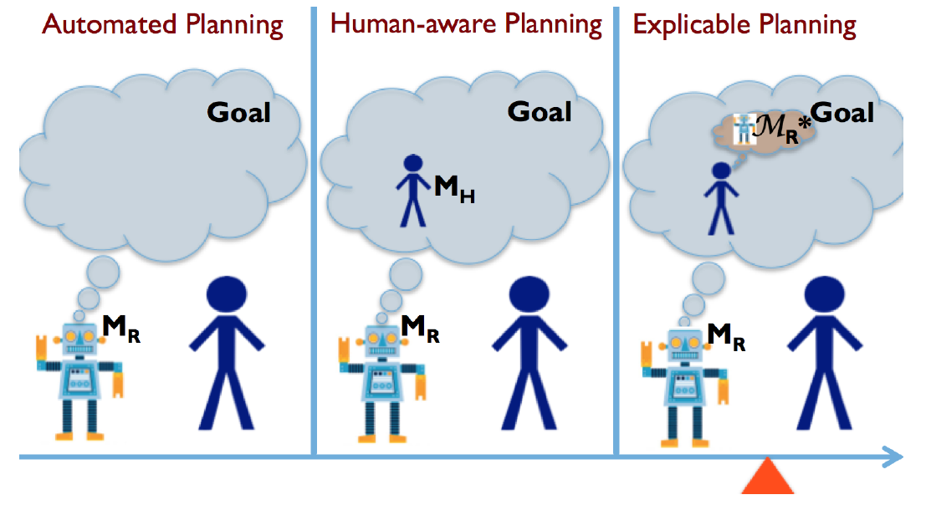
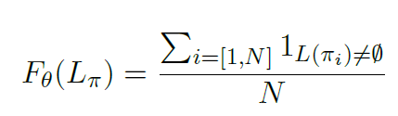
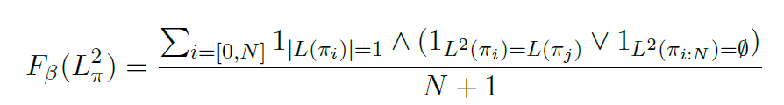
A Use Case of XAI for Robot Task Planning
Motivation and Applied Methods
Explainability
Predictability
Plan Explicability and Predictability for Robot Task Planning

Slide 18
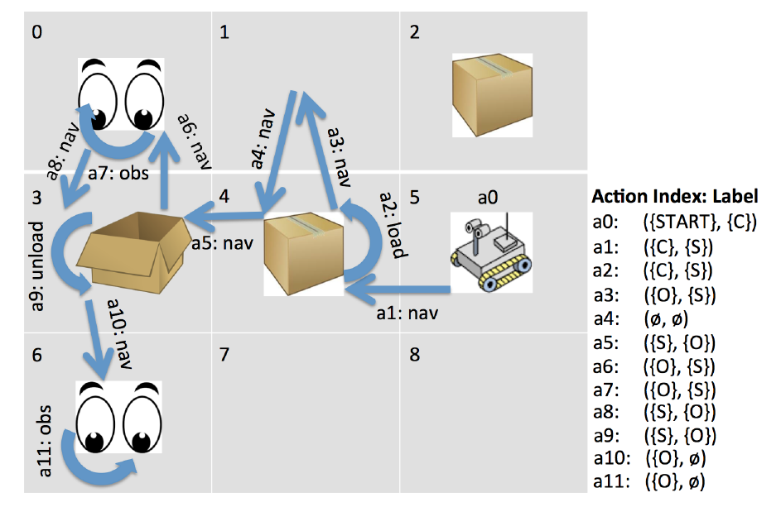

A Use Case of XAI for Robot Task Planning
A Concrete Example
Collect
Store
Observe
Explainability
Predictability
Plan Explicability and Predictability for Robot Task Planning

Slide 19
Agenda
Current Trends in XAI
Principles of XAI
Definition of XAI and other terminologies
Different Purposes in XAI
Taxonomy of different explainability techniques in ML and DL models
Existing Open-Source Tools in XAI
A Use Case of XAI for Robot Task Planning
Conclusion and Outlook

Slide 20
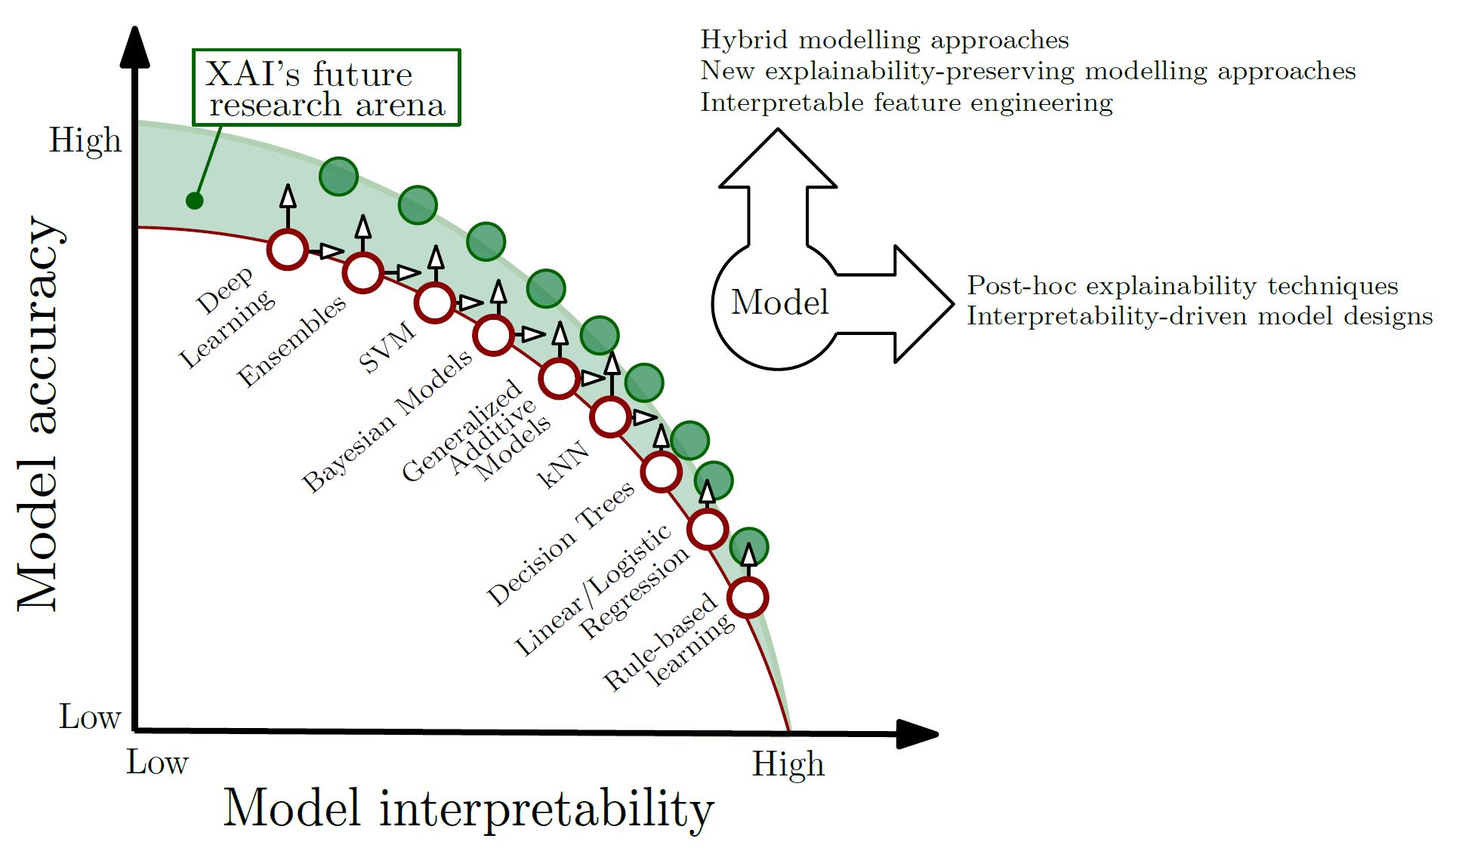
Conclusion and Outlook
Challenges and Opportunities
Challenges
Explanations not necessarily reliable
Performance-Accuracy trade off
Explainability is limited by the sample of data
Opportunities
Hybrid Modelling approaches
General purpose evaluation metrics
Responsible AI
Explainable Artificial Intelligence (XAI): Concepts, Taxonomies, Opportunities and Challenges toward Responsible AI

Slide 21
Bibliography
Explainable Artificial Intelligence (XAI): Concepts, Taxonomies, Opportunities and Challenges toward Responsible AI
https://www.darpa.mil/program/explainable-artificial-intelligence
https://ai.google/principles/
Explainable Artificial Intelligence and Machine Learning: A reality rooted perspective
Explainable AI the basics
Deep k-nearest neighbors: Towards confident, interpretable and robust deep learning
https://github.com/marcotcr/lime;
https://pair-code.github.io/what-if-tool/
https://github.com/interpretml/interpret
https://github.com/tensorflow/lucid
https://github.com/ModelOriented/DALEX
https://eli5.readthedocs.io/en/latest/
https://www.scikit-yb.org/en/latest/
Plan Explicability and Predictability for Robot Task Planning

