Slide 1
GROUP 1:
TITLE:
Digital Library Management System

Slide 2
Objectives of the Study
This study aims to design and develop a library attendance system organizing and making the attendance much easier for students, faculty, and staff.
Specifically, the study aims to:

Slide 3
1. To design and develop a library management system that will be able to:
Monitor the log in and log out of the library user by QR code;
Categorize the reading materials as: Books, Journal, Article, News, Paper … etc;
Monitor the record of borrowed and returned items.
Generate statistical output reports but not limited to borrowed, return and category of damage level.
Provide decision support on the purchase of books for next year's academic year.

Slide 4
2. Evaluate the system based on ISO 25010 in terms of functional stability, reliability, usability, performance efficiency, security, compatibility, maintainability, and portability.

Slide 5
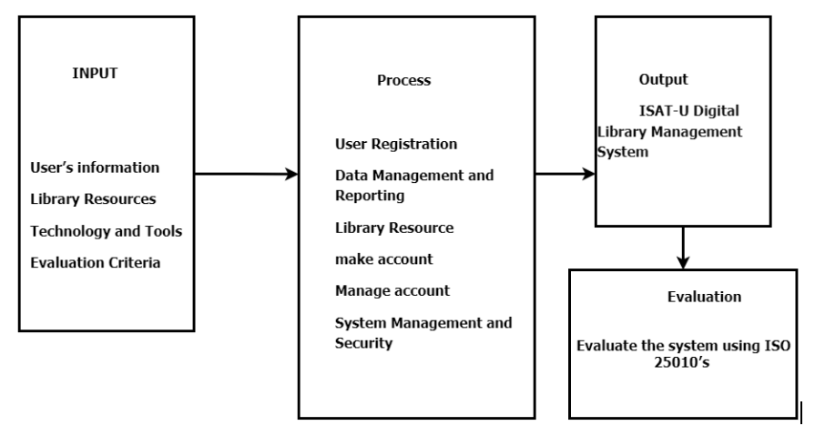
Conceptual Framework

Slide 6
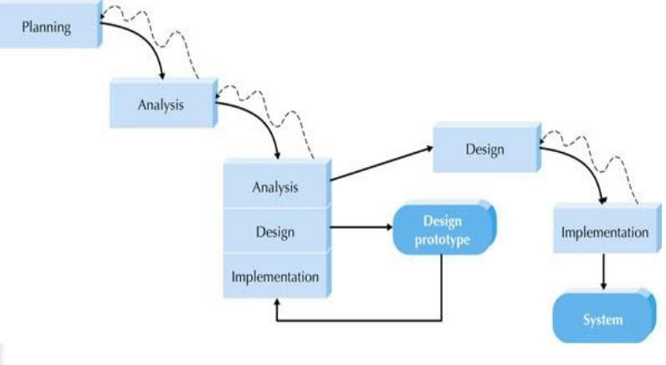
Throwaway Prototyping model

