Slide 1
Primary measurement results of the Test-IC (4 ADCs)
Hans Krueger, Tomasz Hemperek and Lamine Hafiane

Slide 2
Highlights!
- The 4 ADCs are fully functioning and the first results are very encouraging!
- So far we have tested 2 ICs
- We are still optimizing the test workbench Firmware / Software / Hardware
! Work on progress!

Slide 3
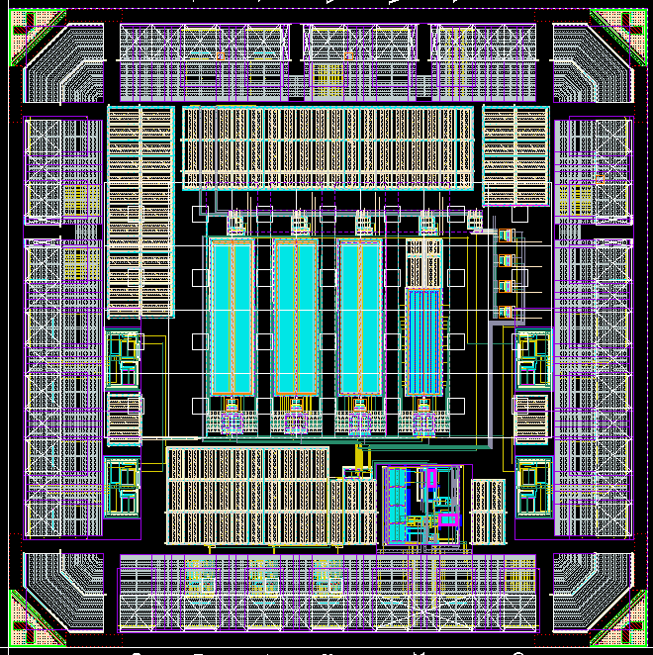
Overview of the Test-IC (designer : Tianyang Wang)
Top level Layout
decap
4 comparator channels
ADCs

Slide 4
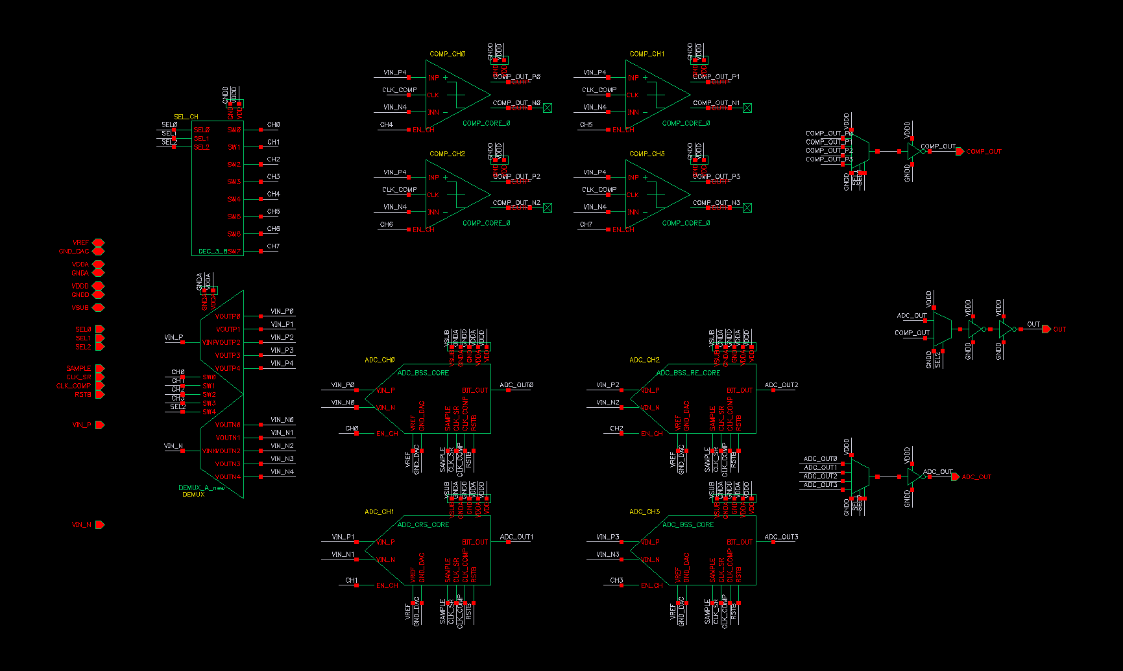
Overview of the Test-IC (designer : Tianyang Wang)
Top level schematic
4 channels of comparator (only 1 design for now)
3-8 decoder
Output multiplexer
4 channels of ADC (3 designs for now)
Analog switches

Slide 5
Overview of the Test-IC (designer : Tianyang Wang)
ADC scheme
ADC00 | BSS | TESTED: OK
ADC01 | CRC | TESTED: OK
ADC02 | BSS RE | TESTED: OK
ADC03 | BSS AW RE | TESTED: OK
BSS switching – Bidirectional Single-Sided switching
CRS – Correlated reverse switching
AW – attenuated weighting
RE – short for redundancy here

Slide 6
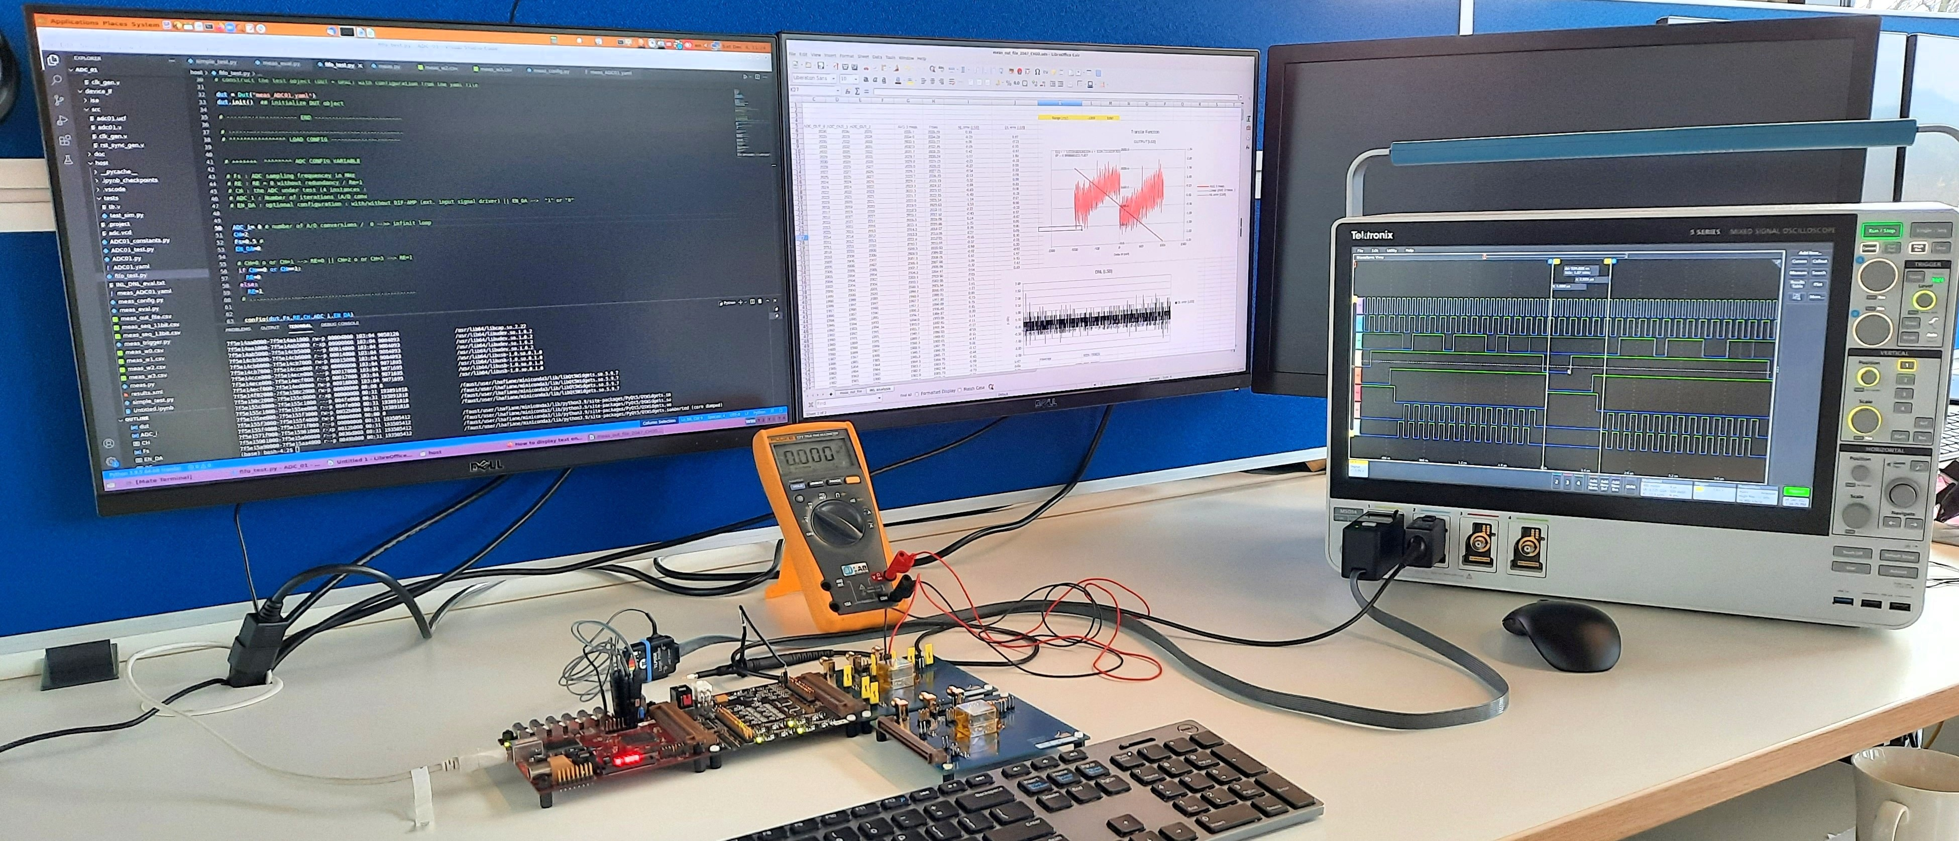
Testing workbench
Overview

Slide 7
Testing workbench
Hardware
BASIL
environment
FPGA
USB controller
SRAM
…...
DACs
ADCs
Power supplies
LVDS digital Ios
--------
DUT
USB
MIO
GPAC

Slide 8
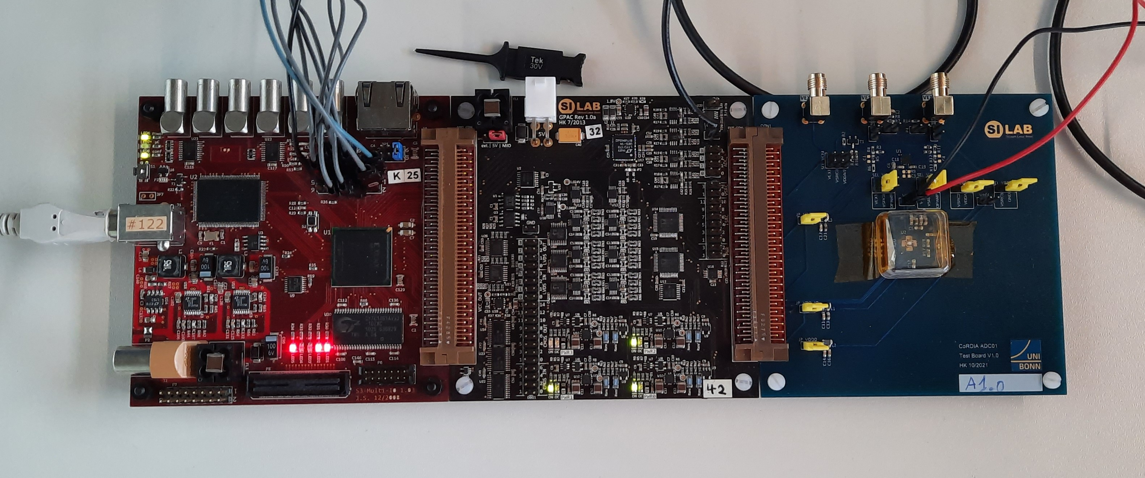
Testing workbench
Hardware
MIO2
GPAG
DUT

Slide 9
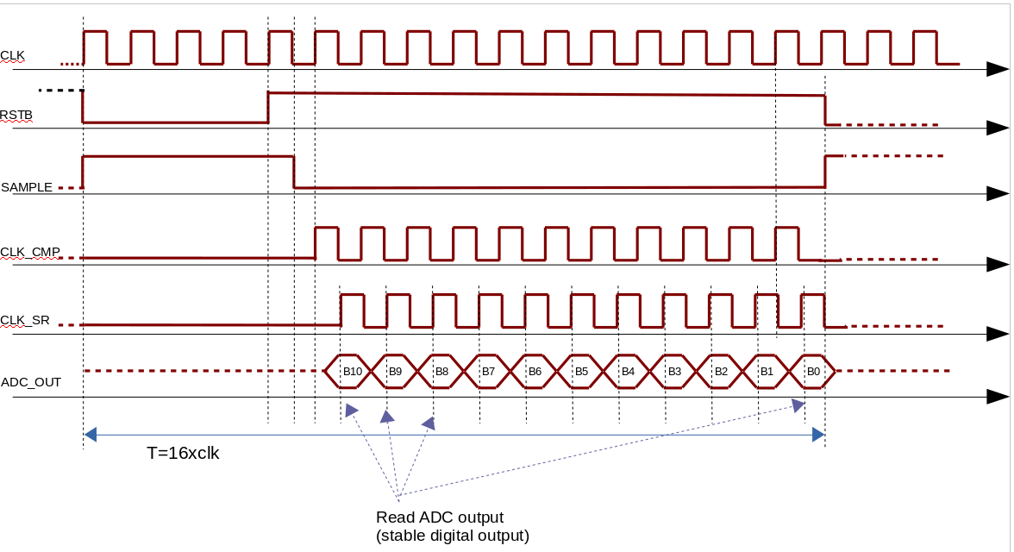
Testing workbench
ADC control signals

Slide 10
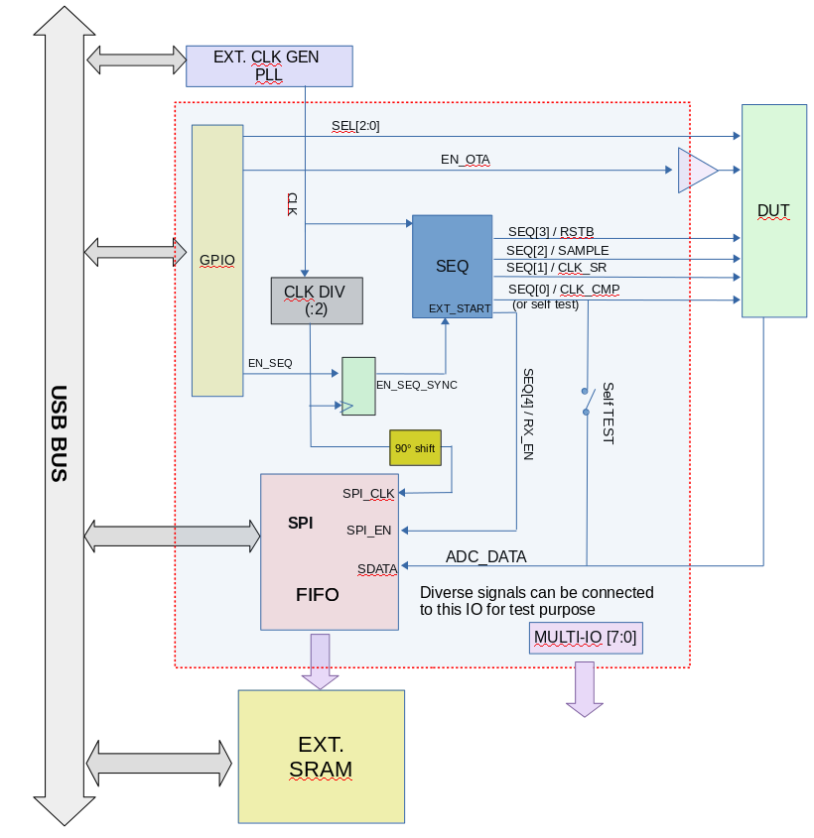
Testing workbench
Firmware diagram

Slide 11
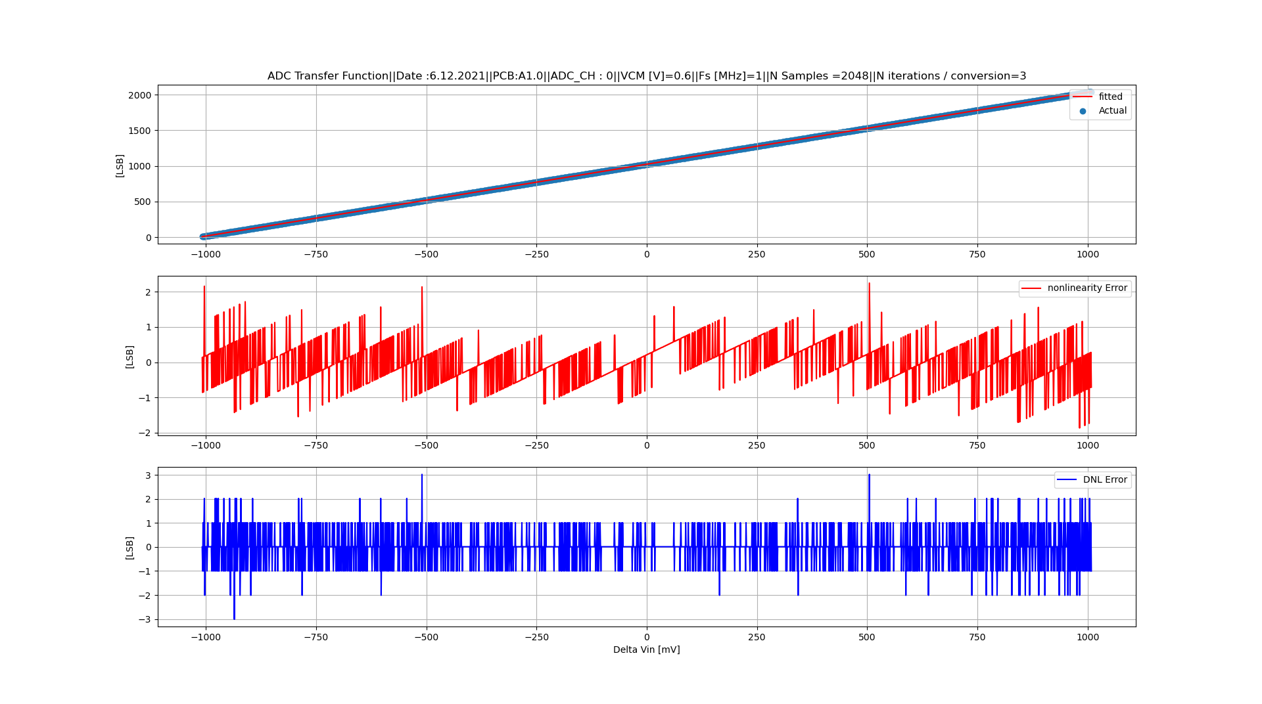
Measurement results
INL/DNL

Slide 12
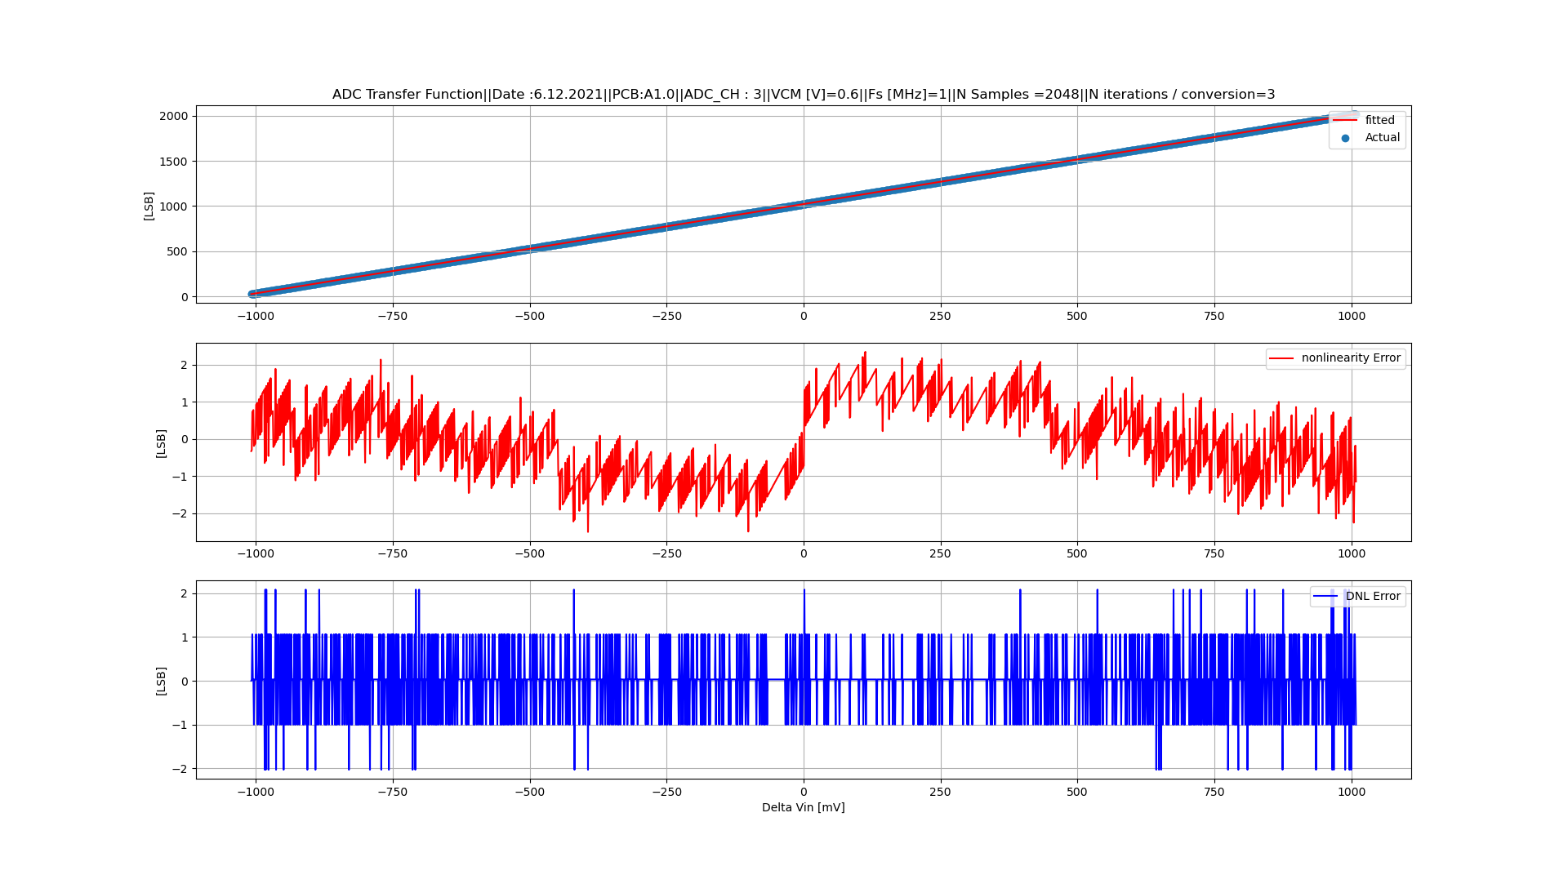
Measurement results
INL/DNL

Slide 13
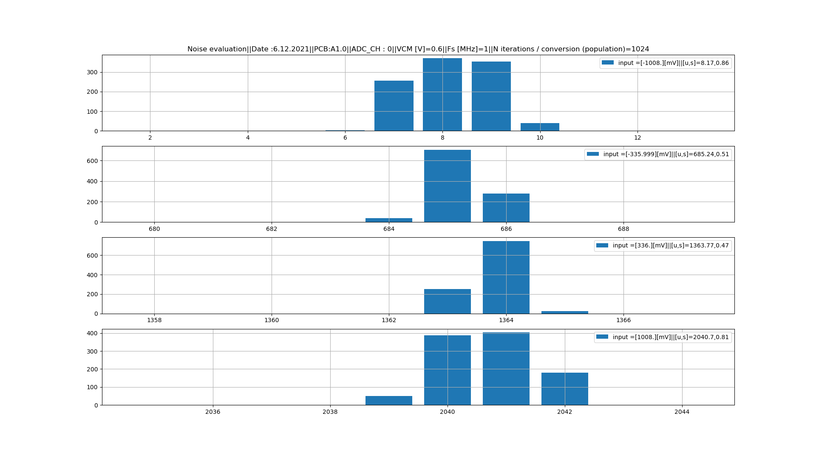
Measurement results
Noise evaluation

Slide 14
Thanks ...

