Slide 1
Following-up
Primary measurement results of the Test-IC (4 ADCs)
Test with higher sampling rate
Hans Krueger, Tomasz Hemperek and Lamine Hafiane

Slide 2
Highlights!
- The 4 ADCs performances are tested with higher sampling rate
- Up to 3MS/s (mega sample per second) for ADCs : „0“ and „1“ and 2.7MS/s for ADCs : „2“ and „3”
- The ADCs are Designed and optimized for 2.5MS/s
! Work on progress!

Slide 3
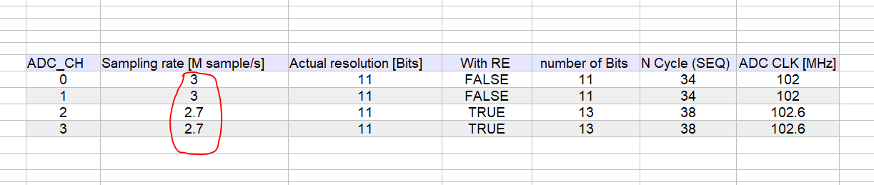
Measurement
Sampling rate vs. ADC clock

Slide 4
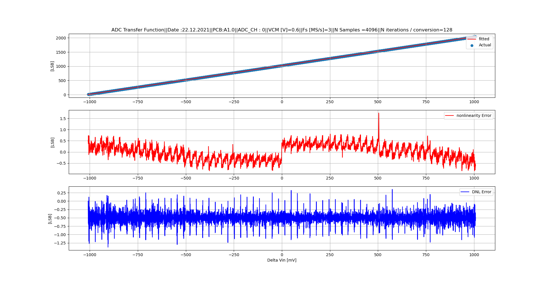
Measurement

Slide 5
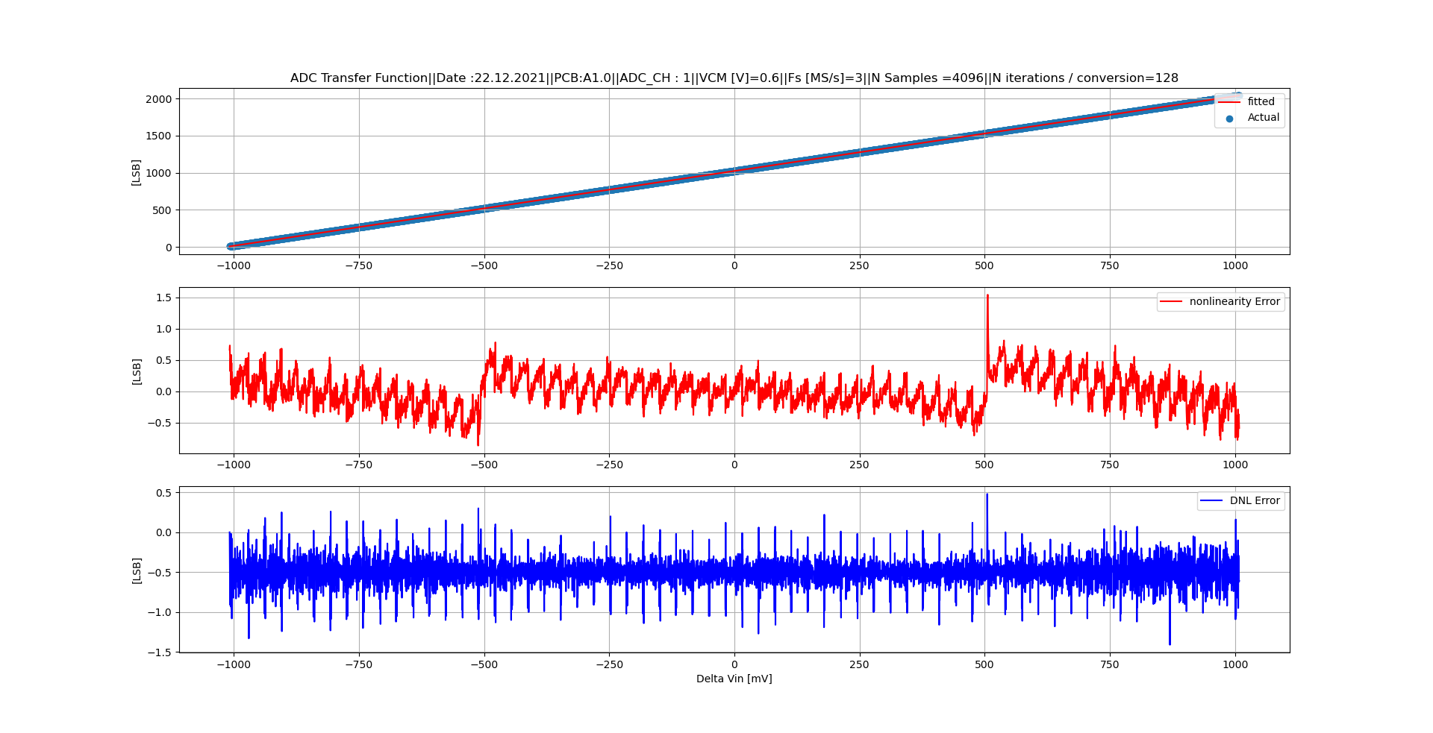
Measurement

Slide 6
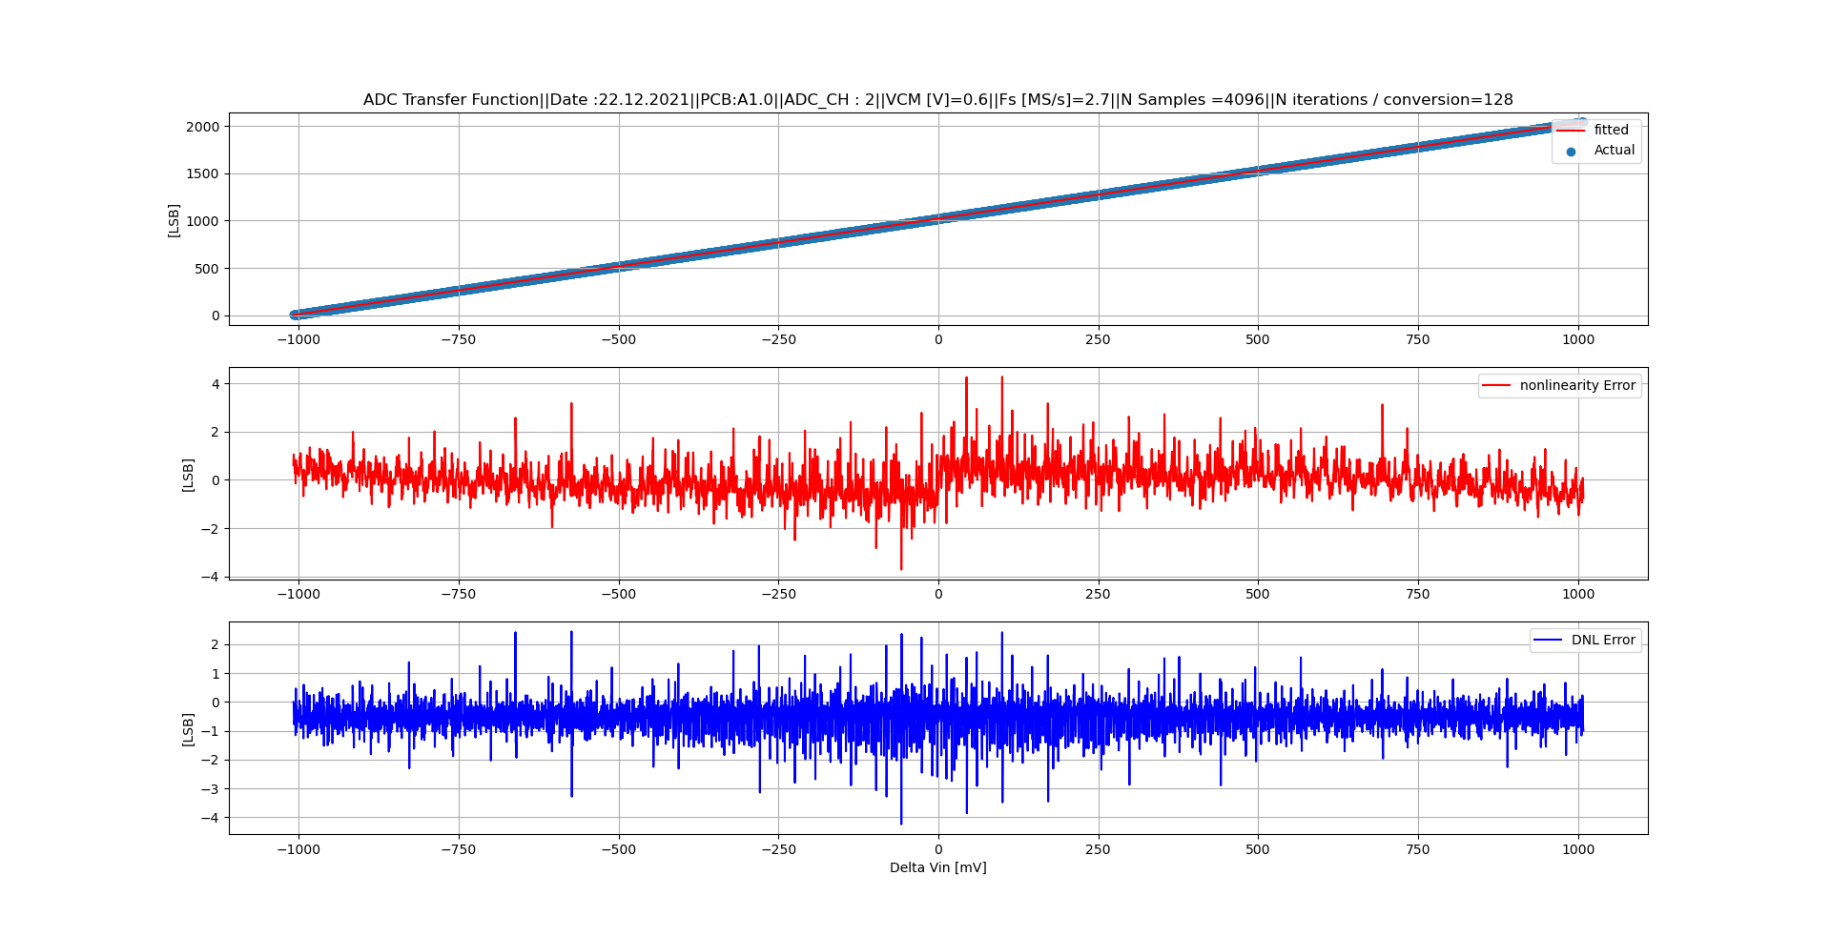
Measurement

Slide 7
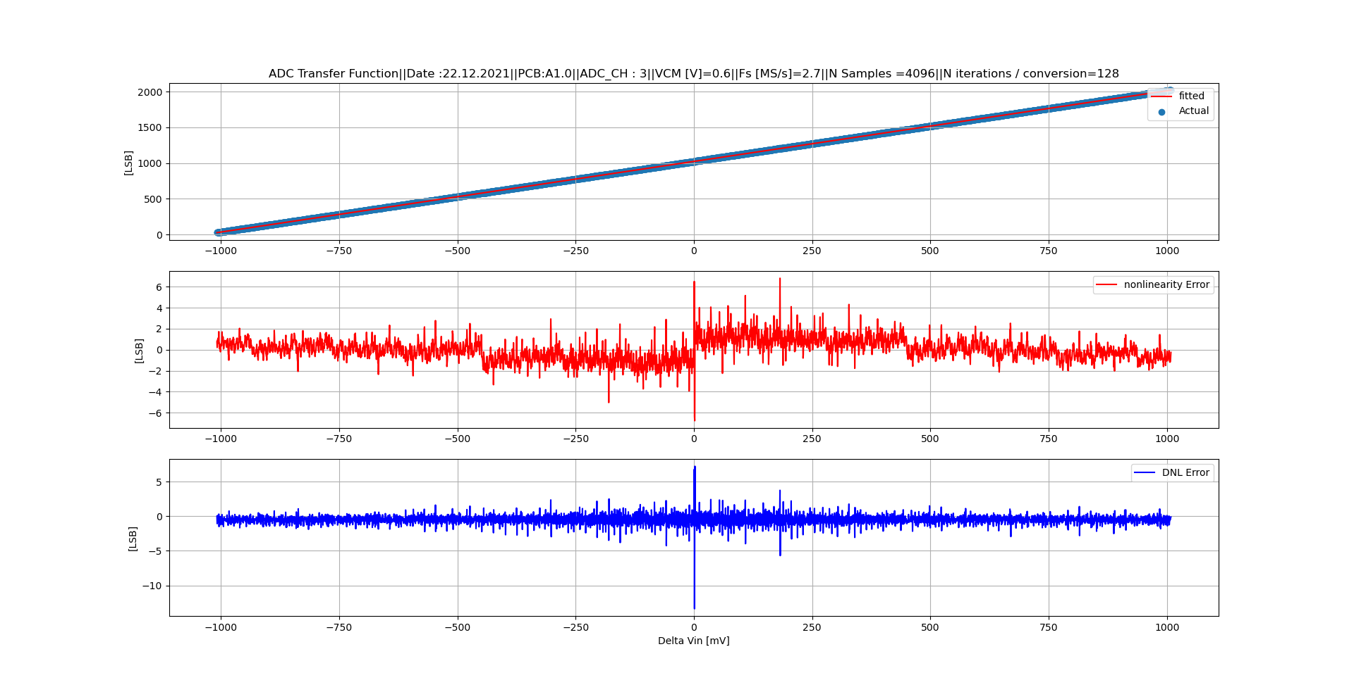
Measurement

Slide 8
Thanks ...

