Slide 1
DAT250
Design and prototyping
Gruppe 9: Silje, Magnus, Isabel og Sindre

Slide 2
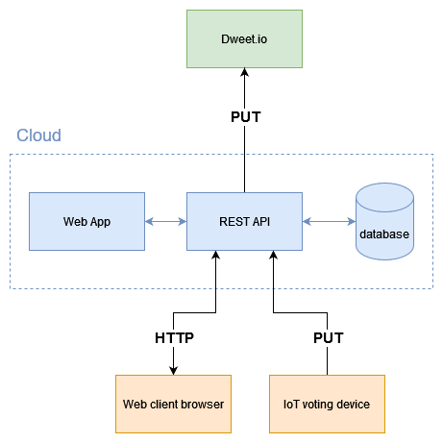
Architectural diagram
Notes:
So I’ll just start with a broad strokes overview. This is how we envision the system as a whole would be set up. With the Web application doing all the business-logic stuff, while sending and receiving the necessary data through the RESTful API.
I don’t have that much to say about this seeing as we haven’t begun implementing this yet. I also imagine this will change to some degree in the future. But essentially the RESTful API would work as the communication channel sending and receiving the data which the web app then decides what to do with. Either storing in a database or deleting from it, or publishing results externally through dweet.io. The web app would probably also decide if a vote sent from the web client would be valid or not. Say if a client has already voted on the poll they wish to vote on again. In this case the vote record would probably be replaced or updated if necessary, instead of stored as an additional duplicate vote from the same user.

Slide 3
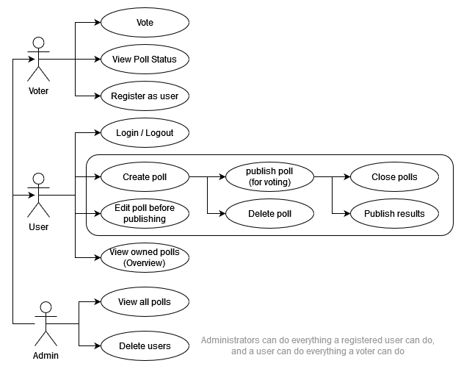
Use case diagram
Registered users should be able to do the same as unregistered users.
Admins should have the same rights as registered users, and unregistered users (voters)
Notes:
We imagine three types of roles, a voter which is an unregistered user. They’ll be able to view and vote on a poll as long as they have the Poll-ID for it. Additionally they should be able to register as a user.
A registered user should be able to log in and out of their account, and get an overview of their created and closed polls. Of course they’ll be able to create a new poll, edit one before it’s made available for voting. They’ll be able to delete polls, close polls manually and publish results of closed polls to dweet.io. This might be done automatically, we haven’t really decided.
An admin should be able to access all polls and should have owner/user rights over those polls so could potentially delete or publish polls. Additionally they should be able to delete registered users. Admin accounts are currently the least defined of the roles, we’re not sure what additional rights they would need to maintain the system yet, and if there are any rights they should not have.
Currently we don’t think a user should be able to edit a poll after it becomes available to vote on. Should probably not be able to change the topic or question after votes have been given. We might drop editing polls entirely and require a user to delete and create a new poll if they make a mistake.

Slide 4
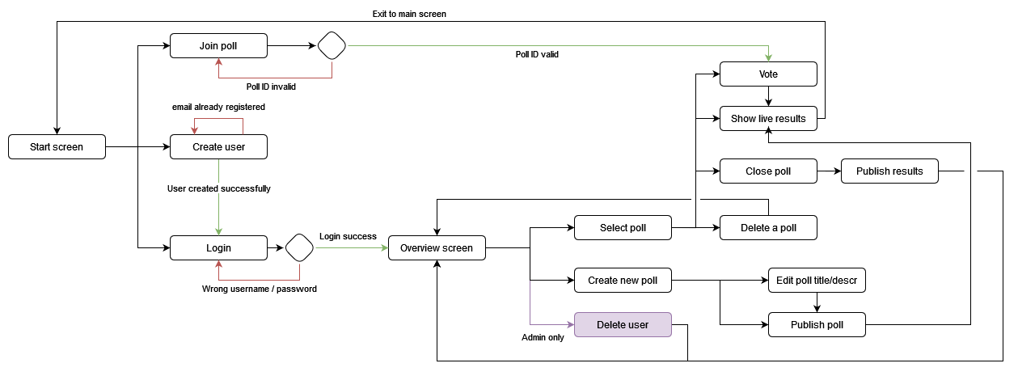
Application flow
Notes:
This is how we imagine the web application will flow. We ended up going into a bit more detail with nodes for every action instead of every screen. The options available for the admin role is again a bit loosely defined here so we’ll likely add or make other changes to it as we get further ahead in the development.
So starting from the front, At the start screen a user will be prompted to either login, register or enter a pollcode to access a poll directly.
An unregistered user can enter a valid pollcode and then cast a yes or no vote, once a vote has been cast the live results can be shown. We might make these results available without voting, we’ll see. When the unregistered user is done here they can return to the start screen and enter a new code if they wish.
Alternatively a user can log in, (or create an account and then log in). This should bring the user to an overview page where they can view their previous polls, I’ll show a mockup later of how we imagine it could look. From this overview page the user should be able to select a given poll, close it, delete it, show live results for it or vote on it. We’re not sure yet if we think publishing results to dweet.io for example, should be done automatically or through an action from the user. From the same overview screen the user should be able to create a new poll, here they would be forwarded to a poll-creation page or popup.

Slide 5
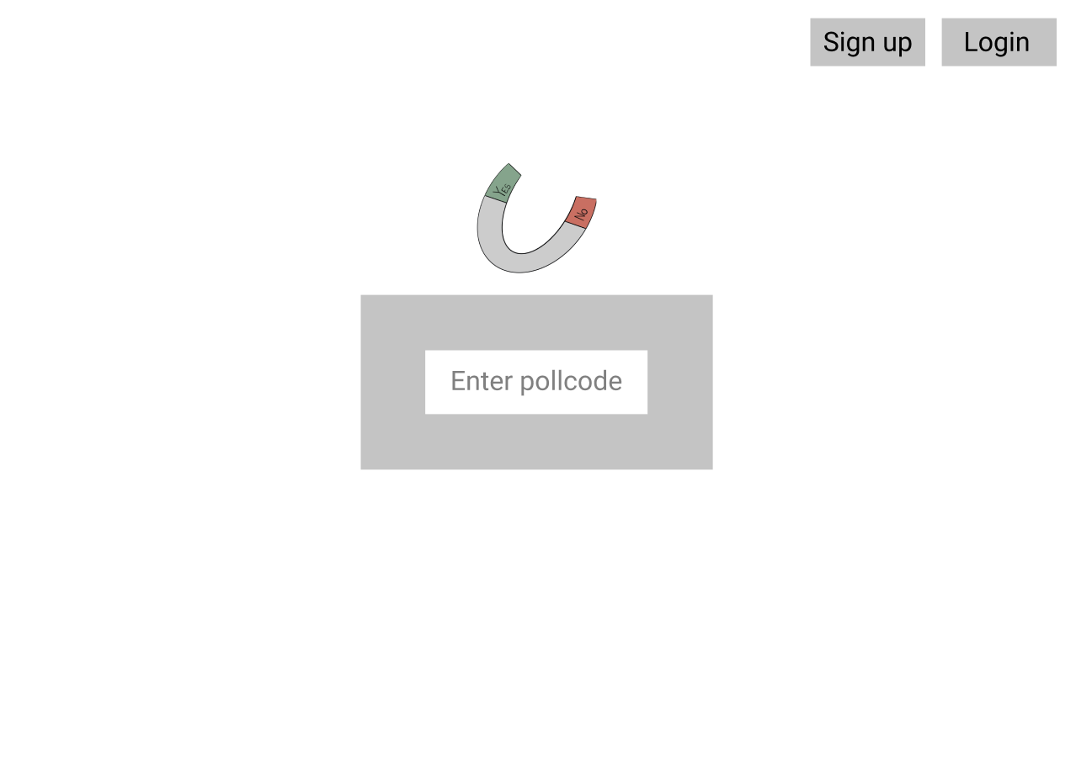
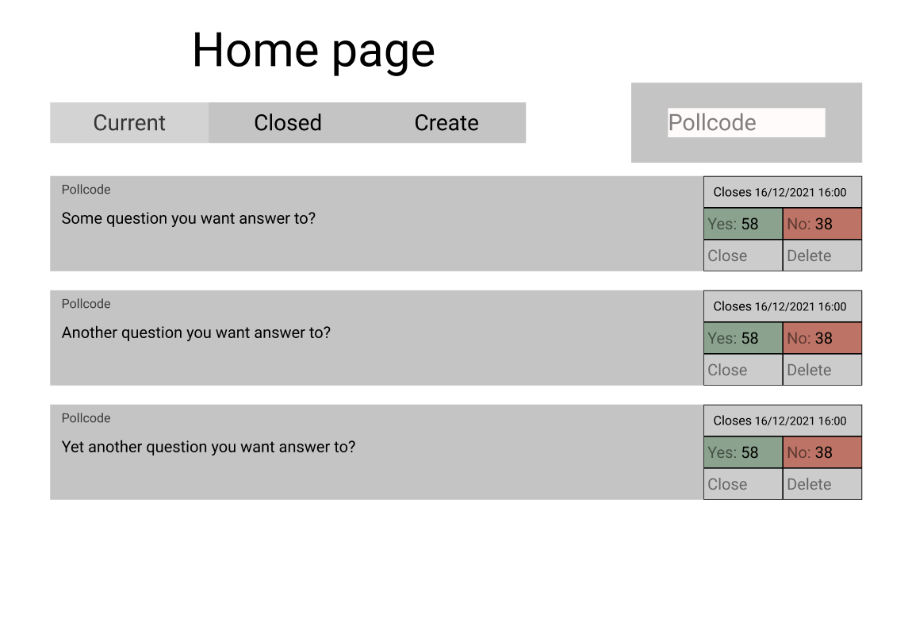
Mockups 1/2
Notes:
I’ll skip the sign in and sign up pages, you’ve all probably seen a million of those before. We’re thinking something along the lines of kahoot.it as a start screen.
As you see we’ve added the close, delete etc actions here into the poll overview. Might add a view button to jump to the live results if just clicking the poll works poorly.

Slide 6
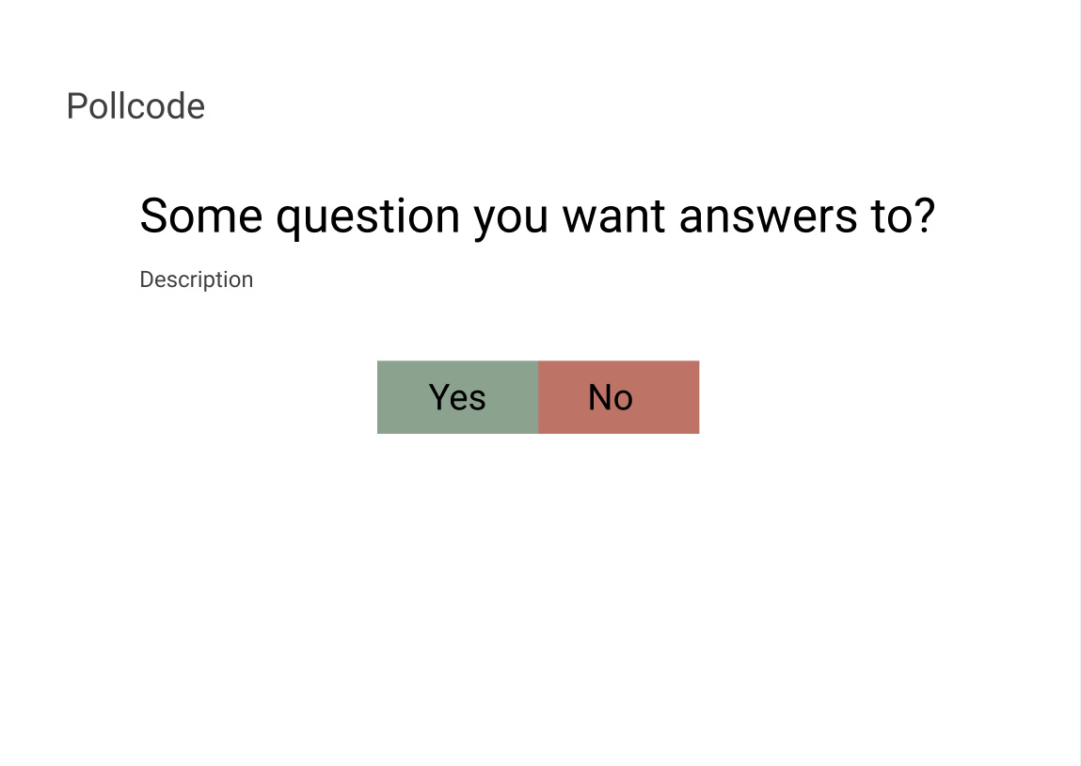
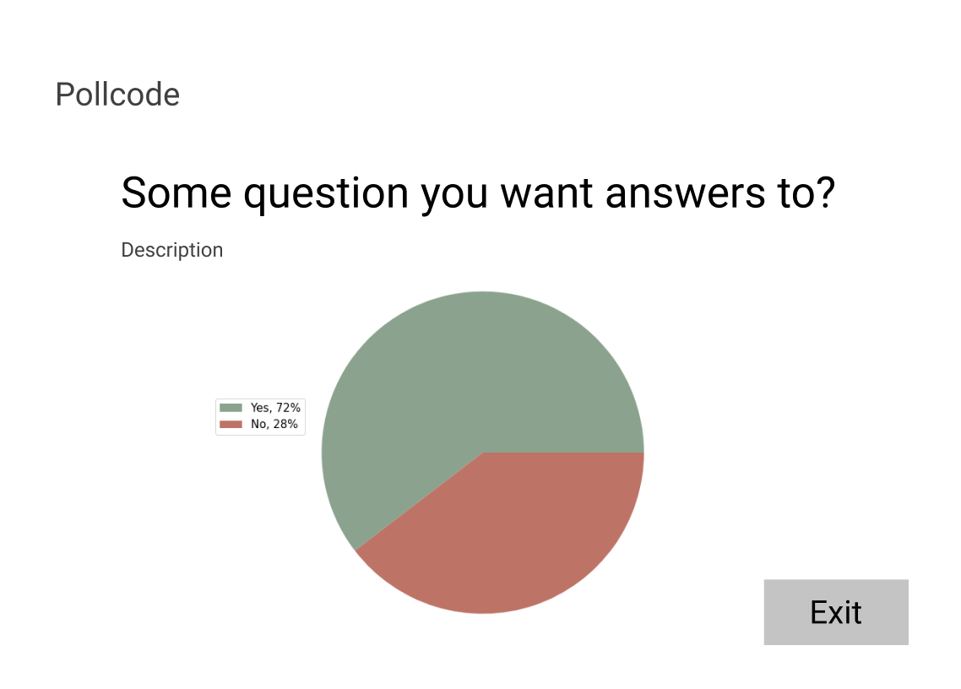
Mockups 2/2
Notes:
The poll creation or editing actions could look like the like the left page here, where you enter a topic and description seeing how it will look for others when they view it.
Also closing or deleting a poll could perhaps be done from the live results page on the right here instead of on the overview page. We’ll probably test out the different options and see what works best.

Slide 7
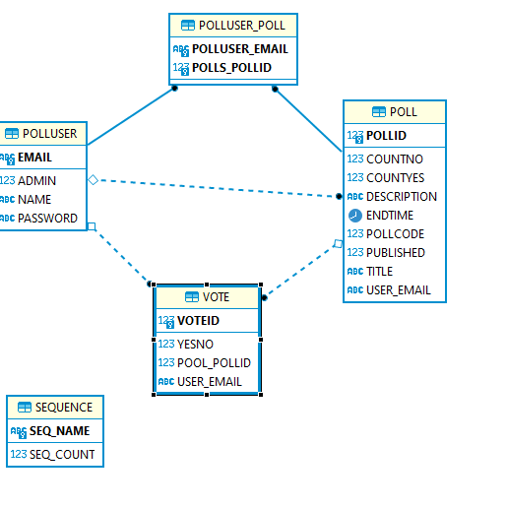
Domain model
Notes:
For our first JPA prototype we’ve gone with three entities. Polluser, Vote and Poll
Polluser keeps information about those registered as users of the system. An email is used as their ID, and is what they use with a password to login. A poll is something only a registered user is able to create, and they will then be the owner of the poll.
The owner is able to publish and decide when to close the poll. They also have the choice to restrict the poll to only registered users. Which is necessary since the system allows for non-registered voters.
This raises the question of how many times a person should be able to vote on one poll. We believe one vote per person seems fair, and our current solution for this is that you provide your email address when voting. It could be stored only in that poll, or hashed then stored.
There might be issues here, say if you vote and change your mind, does the vote update? If so could a different user write your email and overwrite your vote? Not to mention some privacy concerns, showing email addresses in a record together with voting on specific topics is far from ideal.
We’ve been thinking about using automatically generated IDs instead for users, which might avoid some privacy issues. We also considered using cookies to generate and store an ID for unregistered users. But we don’t want to make things too difficult for ourselves so we’ll probably start with the naïve email approach first. In any case it seems we’ll have to store some record of voting history to avoid endless voting on single polls.

